Slide 1
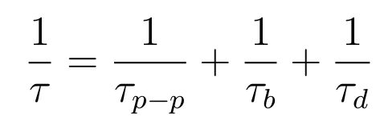
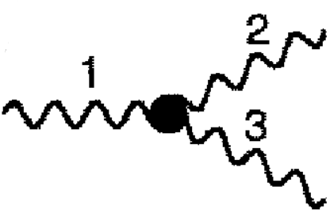

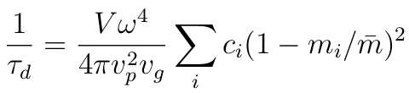
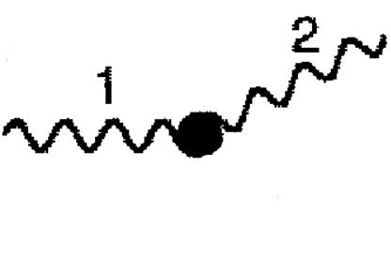
phonon scattering mechanisms
6
Matthiessen rule:
ALD + Debye->
[1] P. G. Klemens, ed. R. P. Tye, 1969, Vol. 1, Academic Press, London.
[2] Alan J. H. McGaughey and Ankit Jain, Applied Physics Letters, 100(6):061911, 2012.
[3] P. G. Klemens, Proc. Phys. Soc., London, Sect. A, 1955, 68, 1113.
[4] David G. Cahill, Fumiya Watanabe, Angus Rockett, and Cronin B. Vining, Phys. Rev. B, 71:235202, Jun 2005.

Slide 2
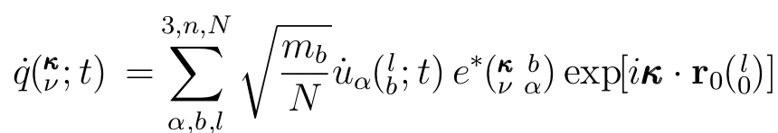
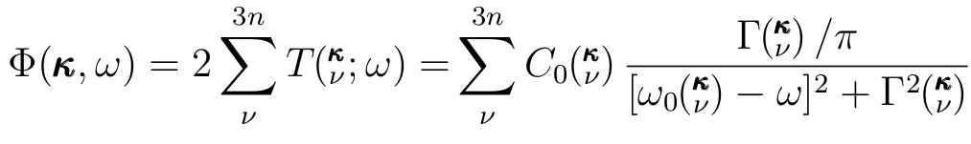
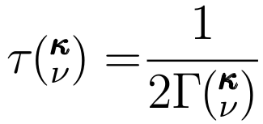
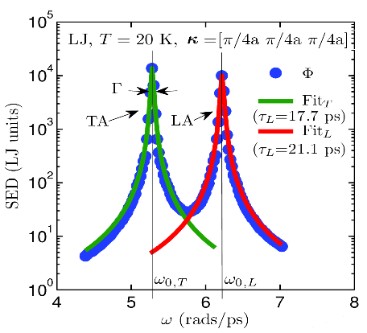
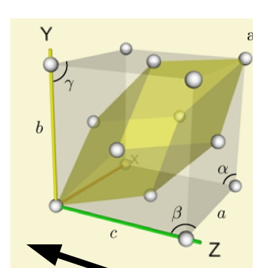
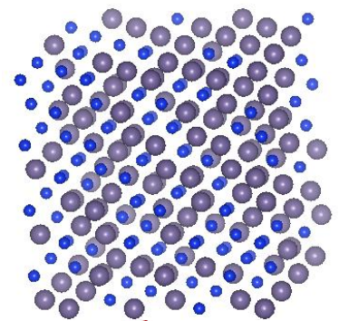
normal mode decomposition (nmd)
10
Phonon Normal Mode Coordinate:
MD (anharmonic)
Lattice Dynamics (harmonic)
vc vs
gamma
Unit cell?

Slide 3
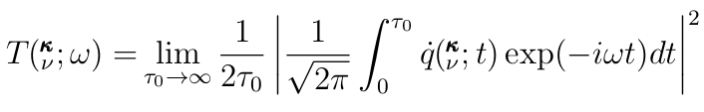
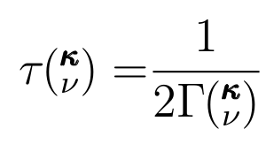
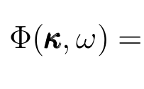
normal mode decomposition (NMD)
8
Phonon Normal Mode Coordinate:
VC
Gamma
vs
= 0

Slide 4
nmd vc vs ald lifetimes
15
SW:
ALD+taud agrees with VC-NMD.

Slide 5
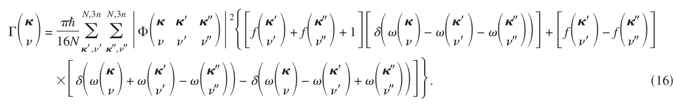
phonon scattering mechanisms
7
Matthiessen rule:
phonon-phonon scattering [1] (ald):
1/
f(freq_hld,eigvec_hld,fc_3)
freq_hld, eigvec_hld = easy
fc_3 = hard
Debye->

Slide 6


phonon scattering mechanisms
8
Defect scattering [3]:
f(freq_hld,eigvec_hld)
freq_hld, eigvec_hld = easy
Debye->

Slide 7
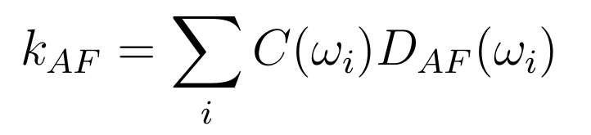
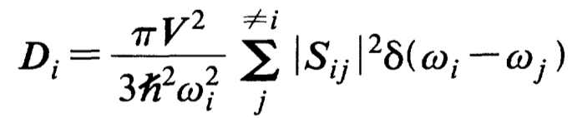
Diffuson Theory
14
Allen Feldman theory of diffusons [1]:
Conservation of energy:
Heat current operator:
Ingredients: harmonic Lattice Dynamics
[1] Philip B. Allen and Joseph L. Feldman. Thermal conductivity of disordered harmonic solids. Physical Review B, 48(17):12581–12588, Nov 1993.

Slide 8
char
14

