Slide 1
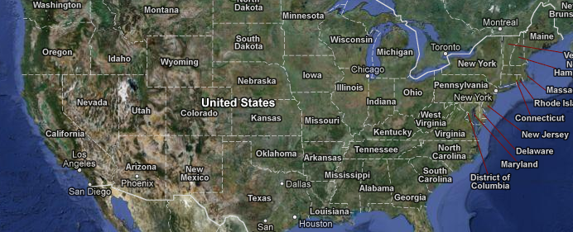
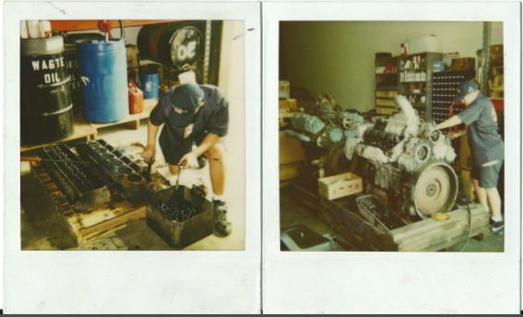
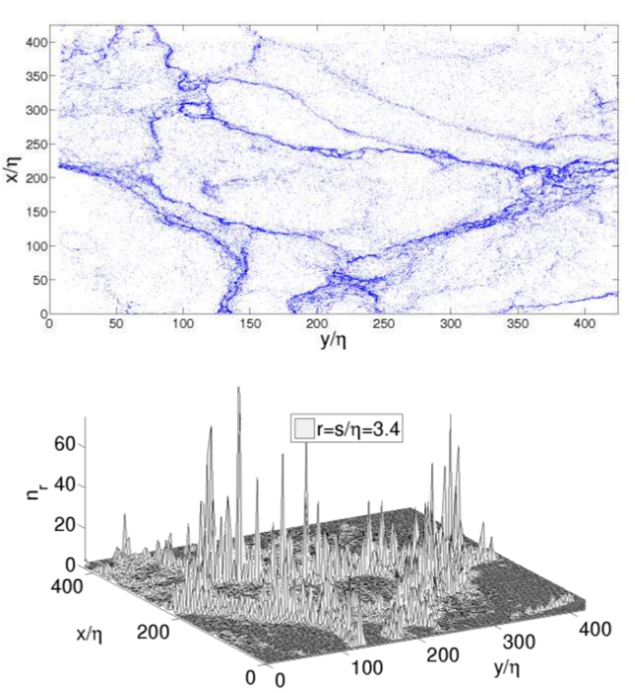

history
Born
6-13
13-now: University of Pitt., CMU

Slide 2
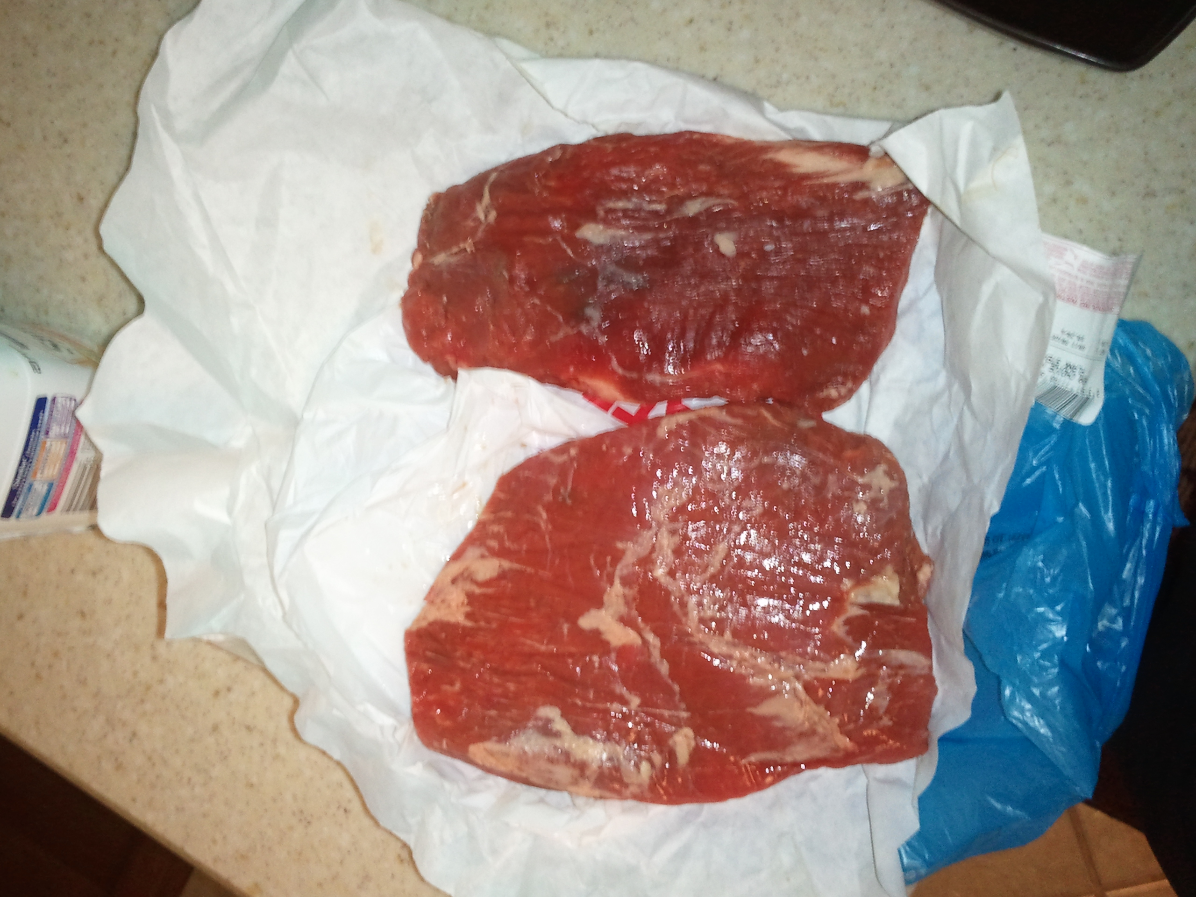
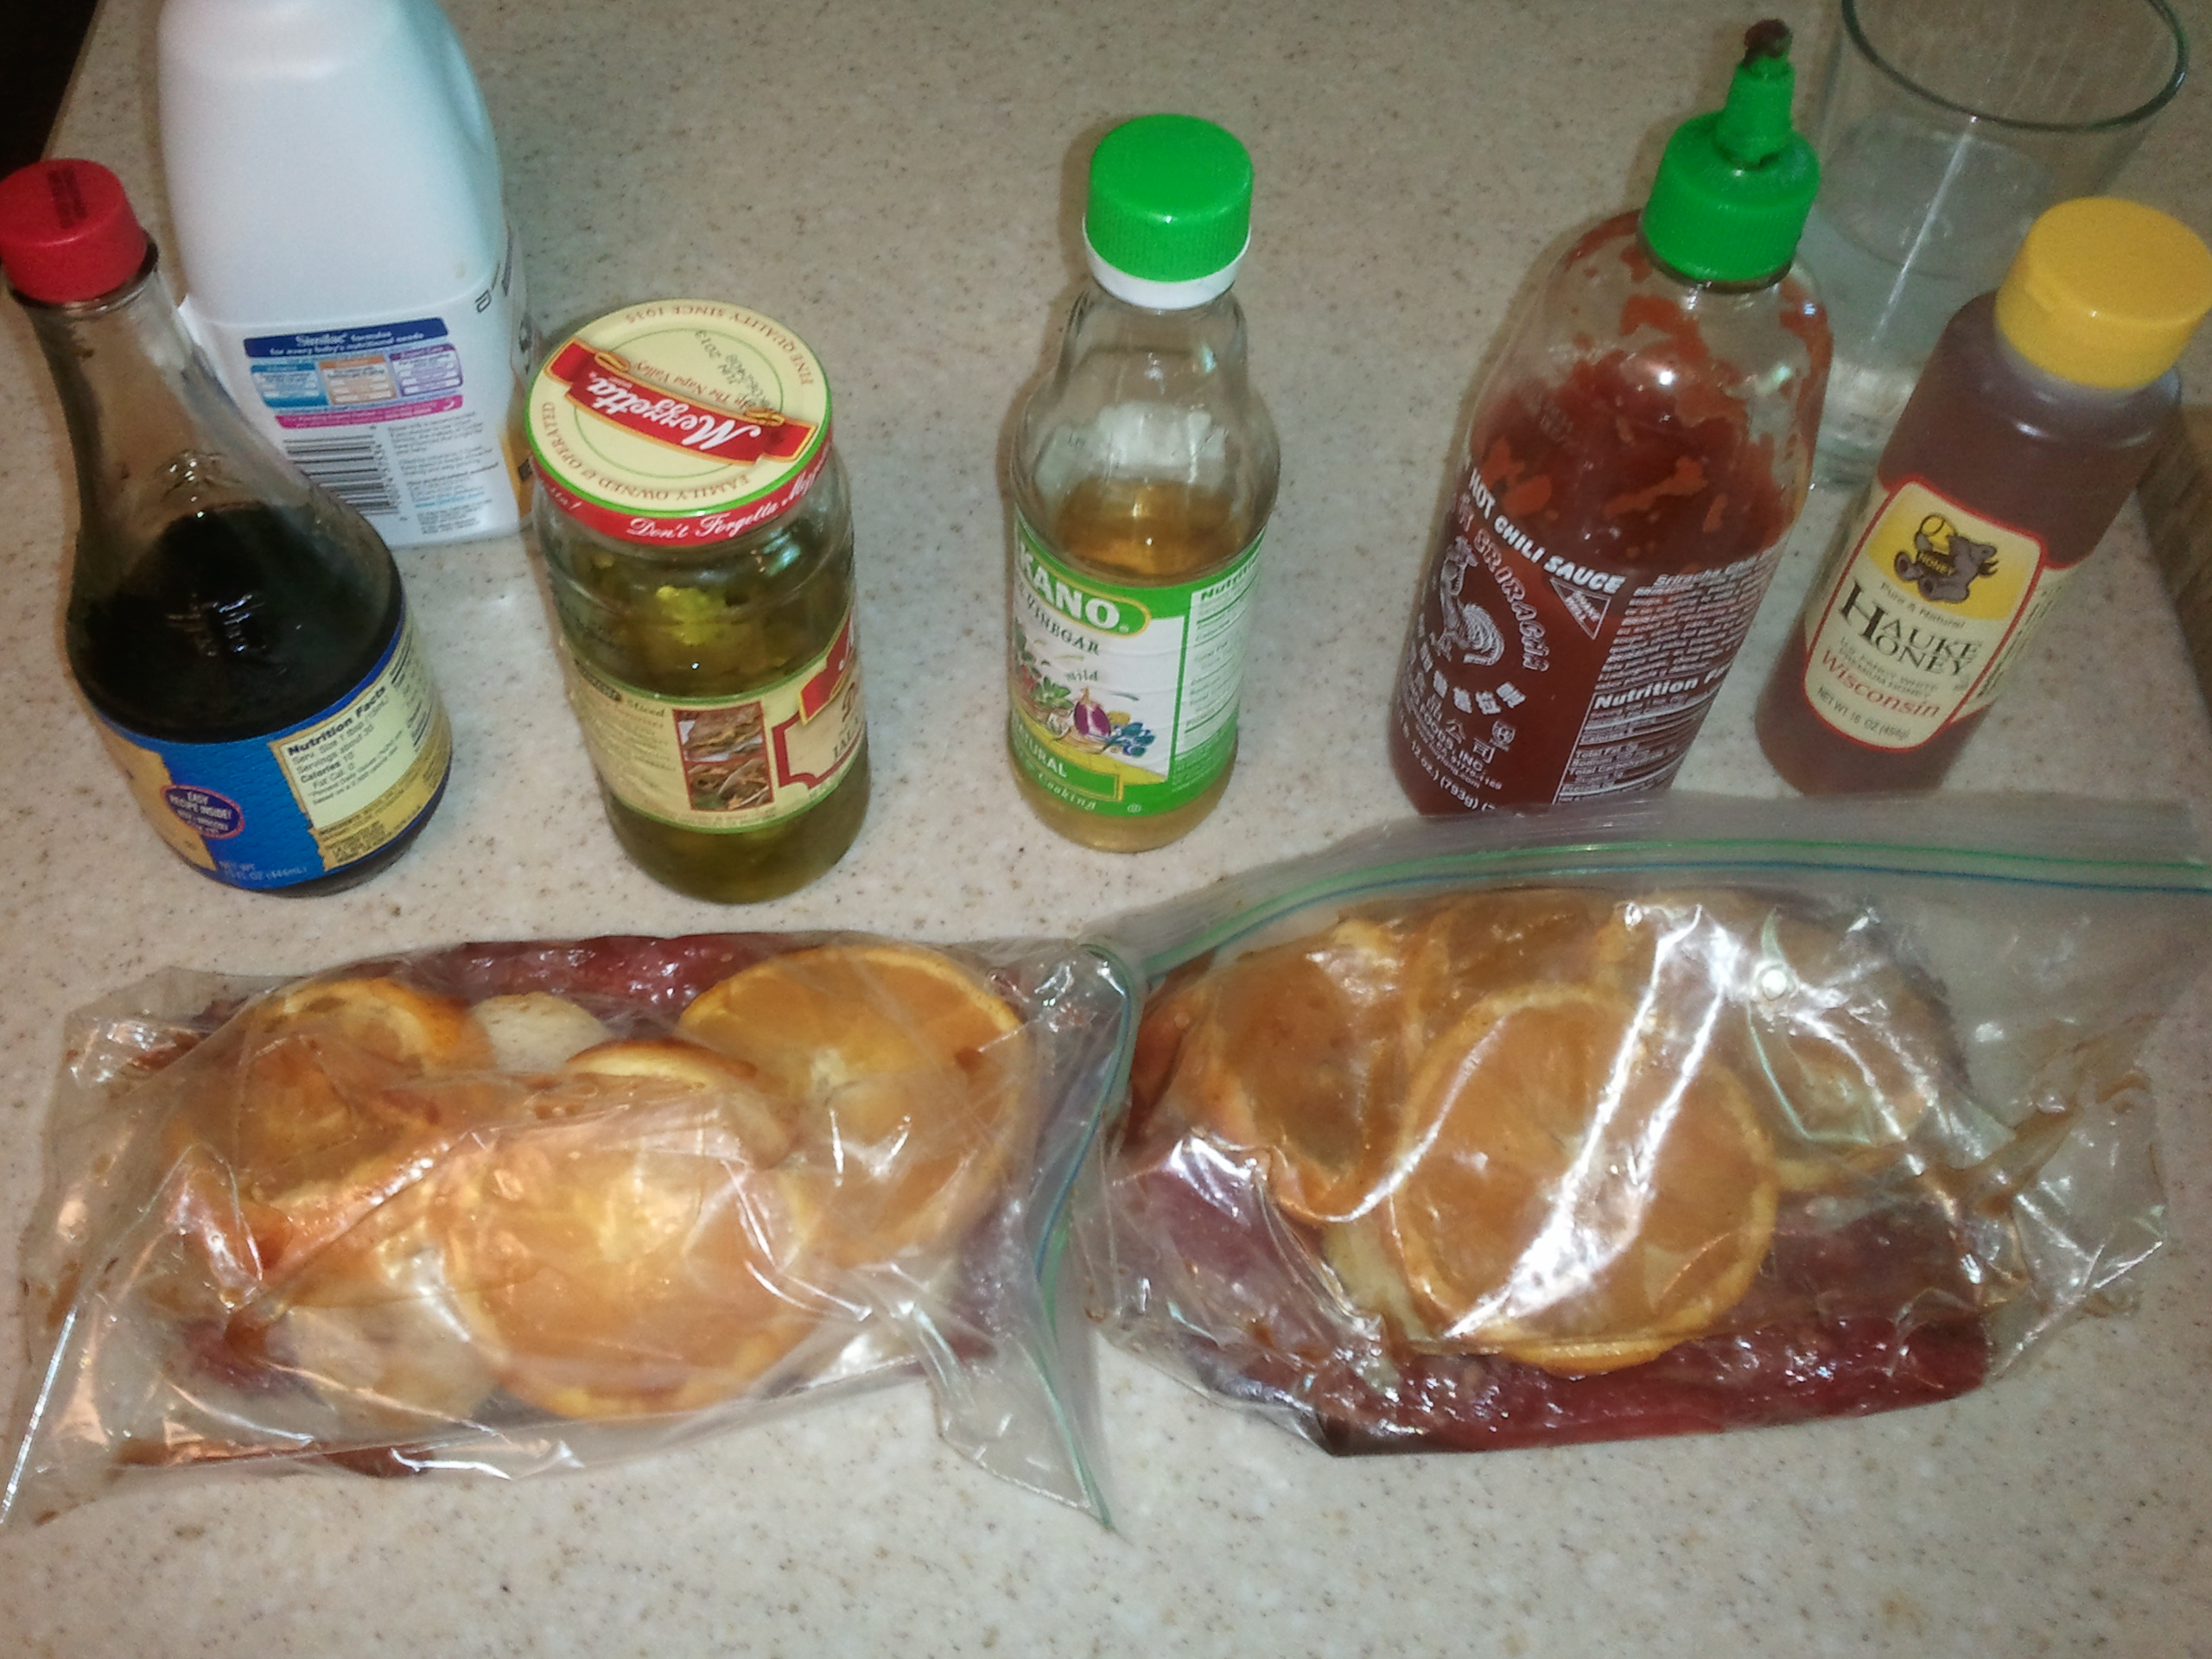
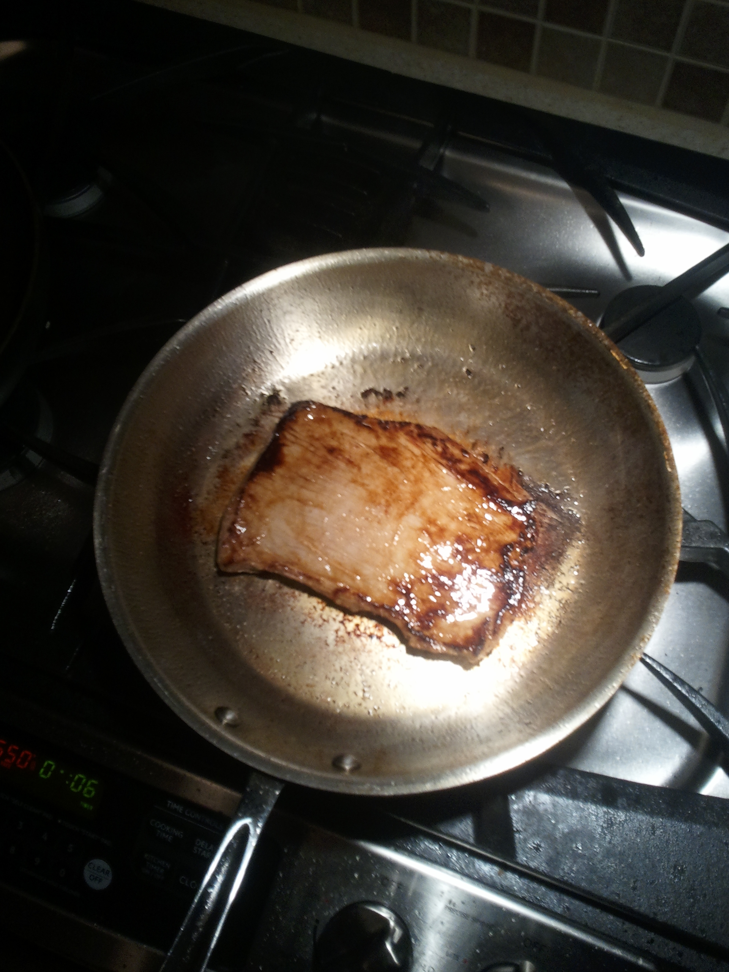
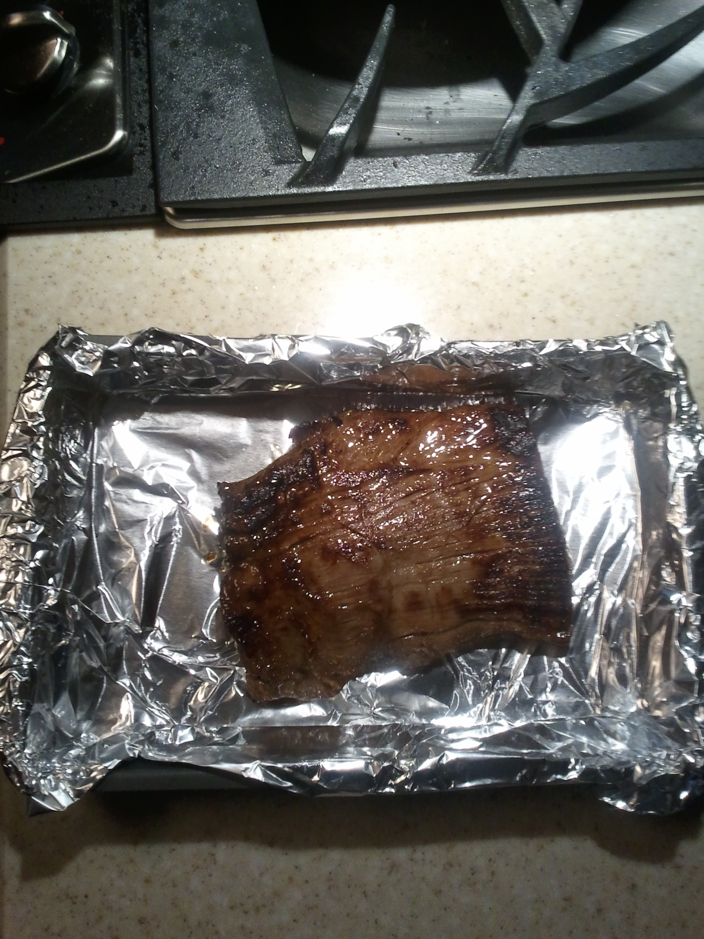
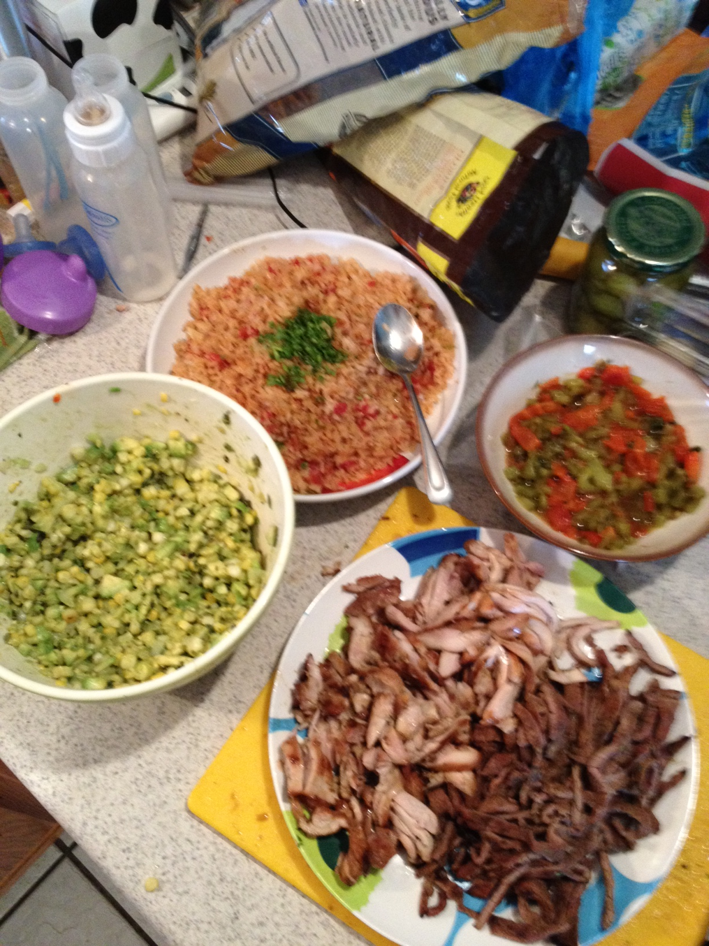
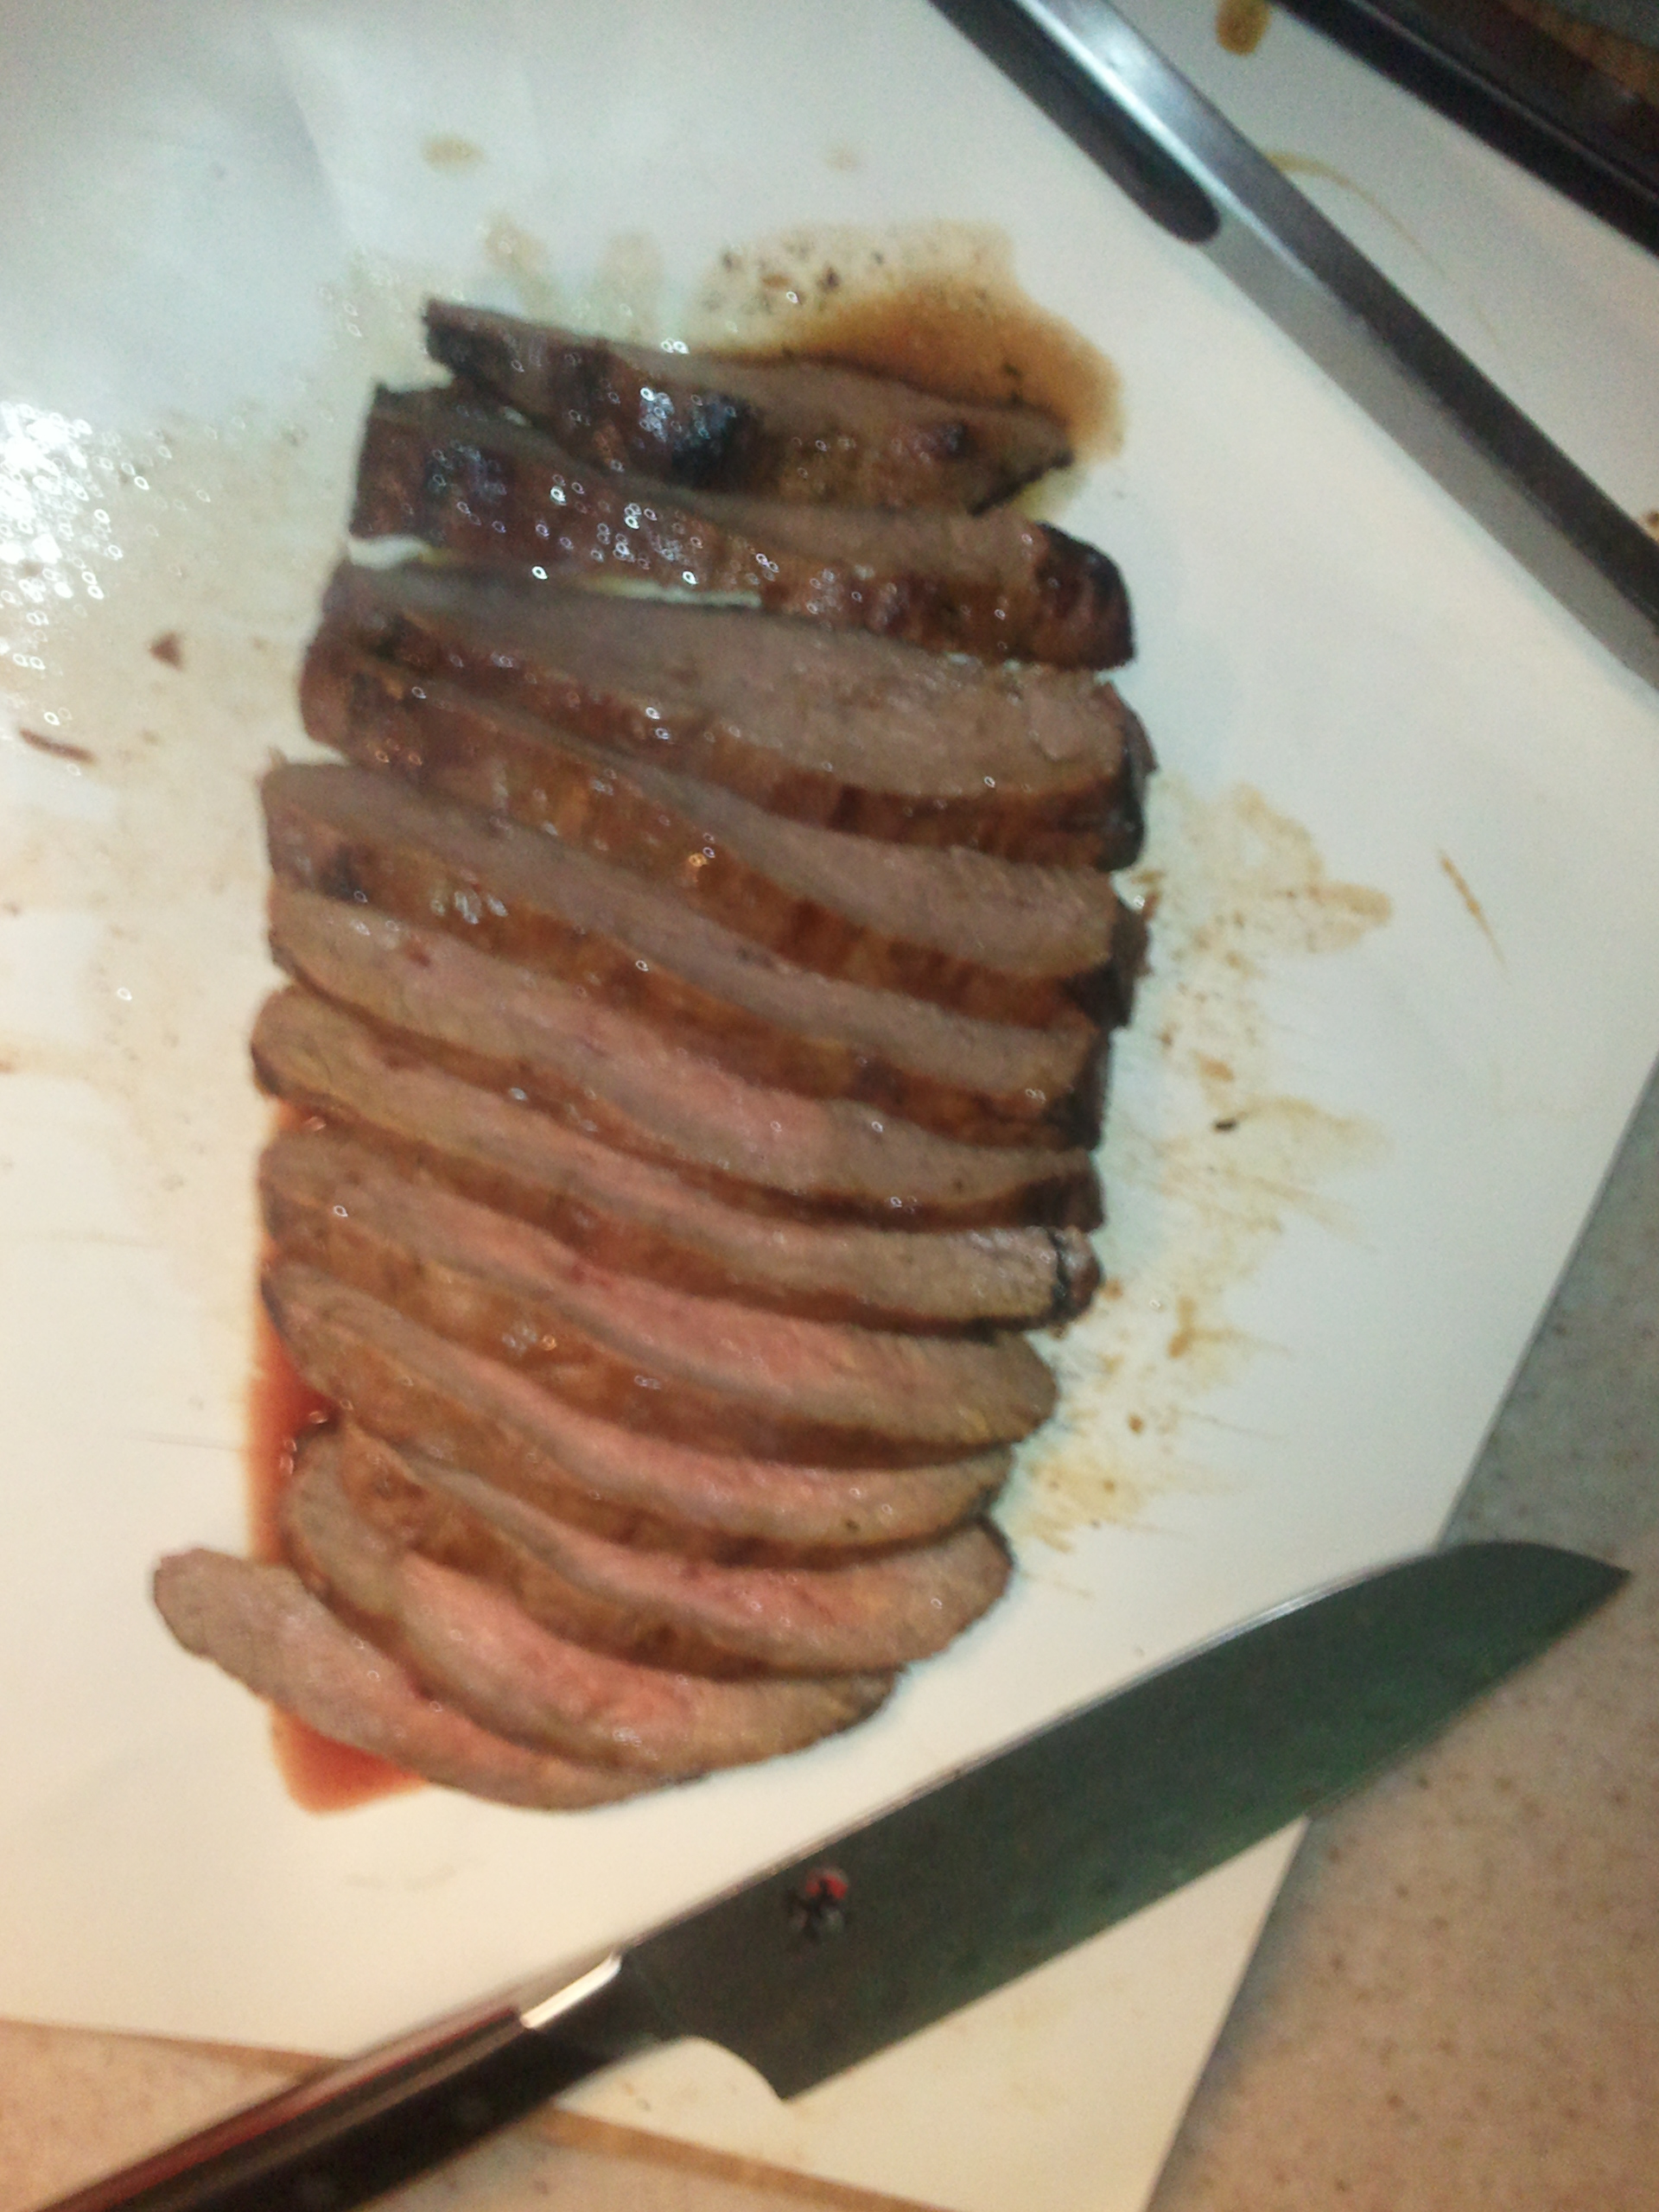
Food and heat txn
14

Slide 3
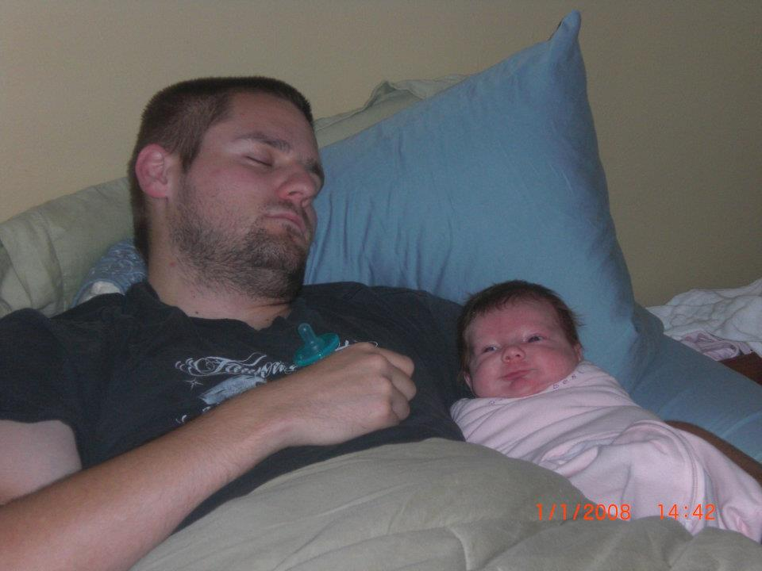

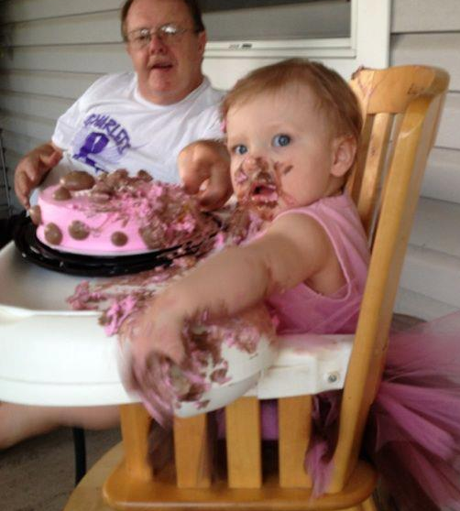
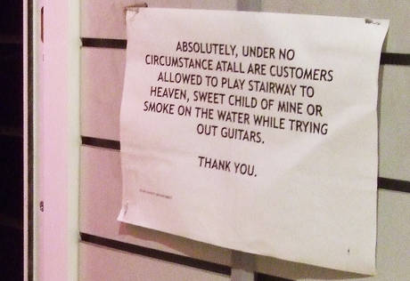
char
14
http://www.facebook.com/charlotte.larkin.144

Slide 4
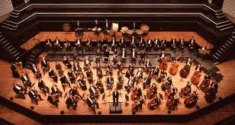
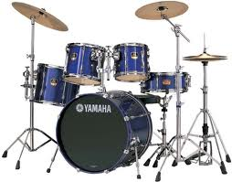
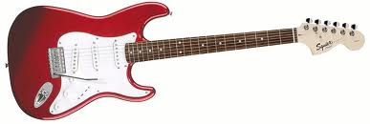
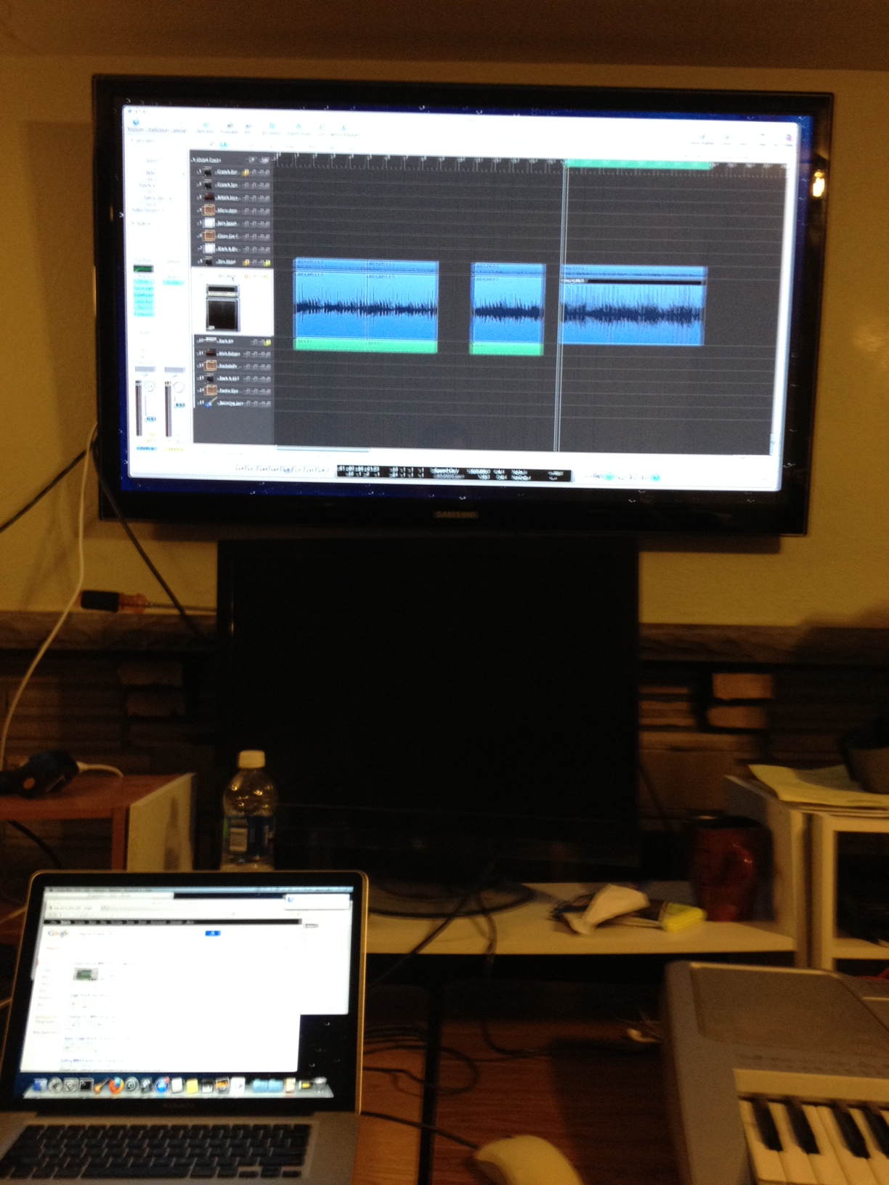

music
14

Slide 5
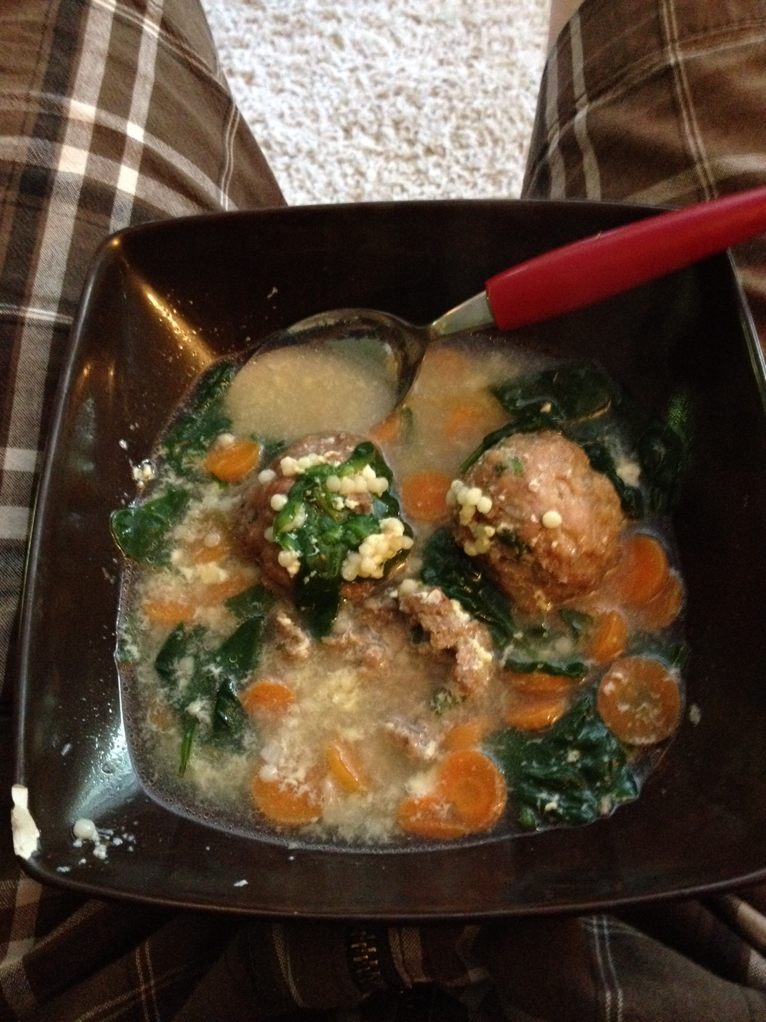
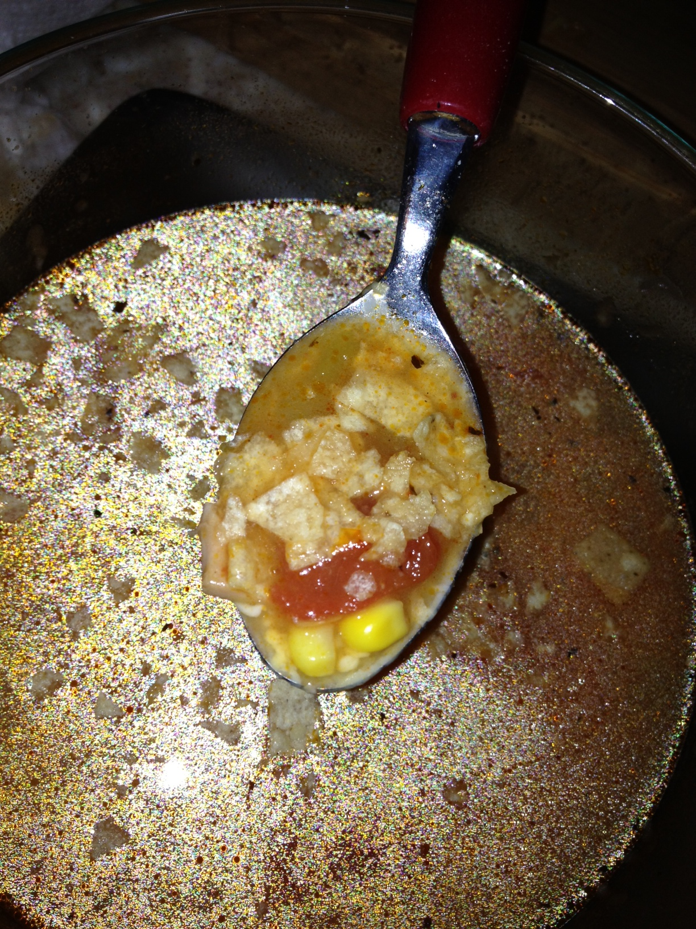
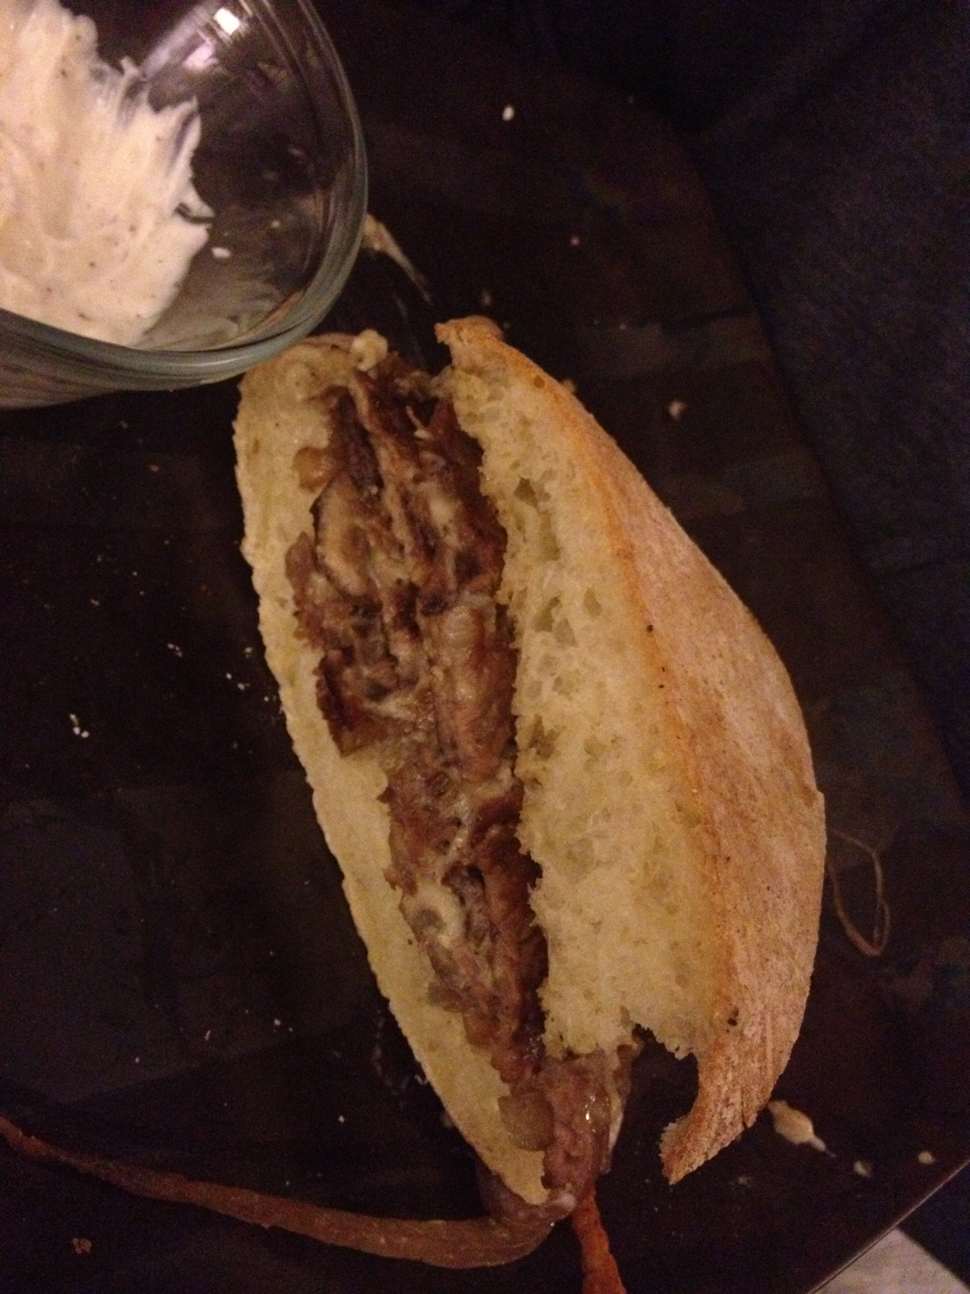
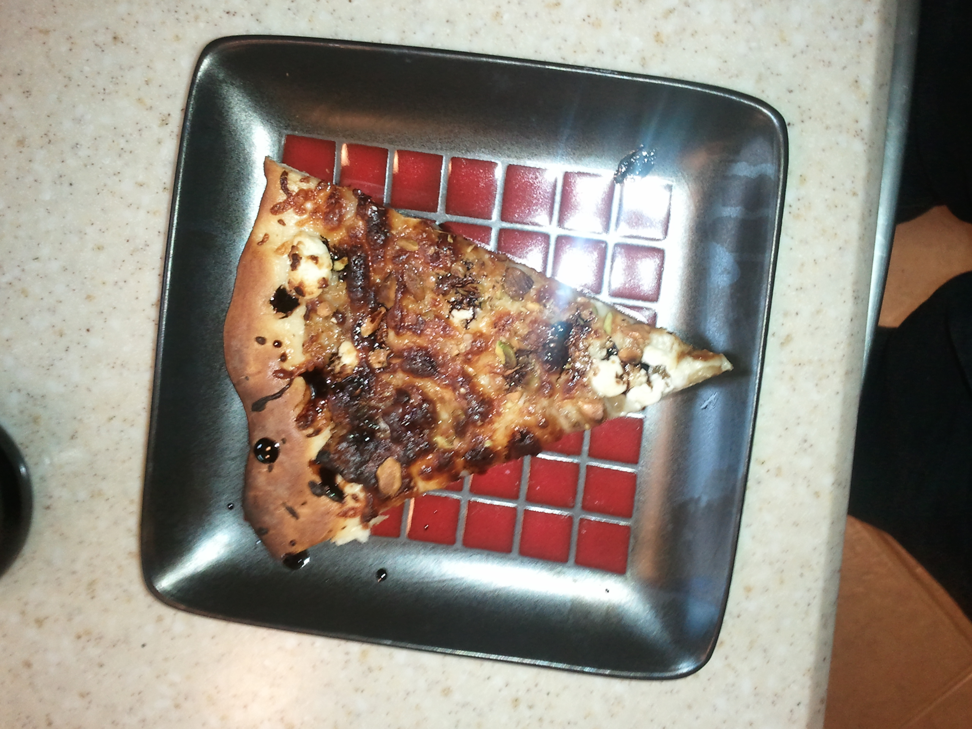
food
14
Wedding soup – beef/veal/pork meatball, ancini di pepe, spinach, carrot, parmesean/egg broth
Tortilla soup – rotiseree chicken (cooked with skin), corn, tomato, chickpea, green chile, tortilla chip
Steak sandwich – thin-sliced ribeye, white cheddar and horseradish sauce, roasted garlic mayo, carmelized onion and mushroom
Pizza – carmelized onion and garlic, mozzarella, goat cheese, pistachio, reduced basalmic

