Slide 1
Evaluation of the Virtual Crystal Approximation for Predicting Alloy Thermal Conductivity
Jason Larkin and Alan J. H. McGaughey
Department of Mechanical Engineering
Carnegie Mellon University
http://ntpl.me.cmu.edu/
04/04/13

Slide 2
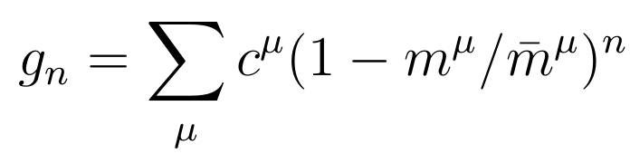

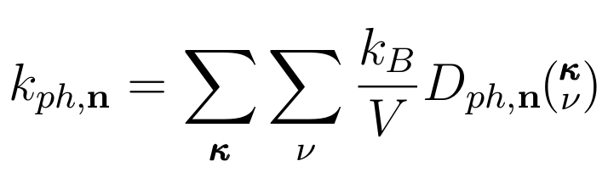
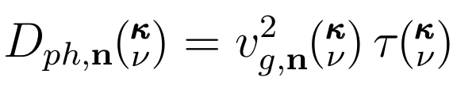
Virtual Crystal Approximation
Gamma
VC
Lennard-Jones Argon and Alloys
a
Abeles, Physical Review 131, 19061911 (1963)

Slide 3
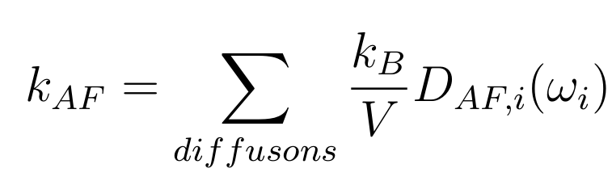
Virtual Crystal: Diffusivities
Gamma
VC
VC
Allen-Feldman (AF) Theory:
a
?
Allen-Feldman, PRB 48, 1258112588 (1993)

Slide 4
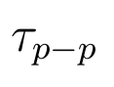

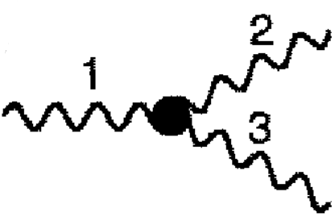
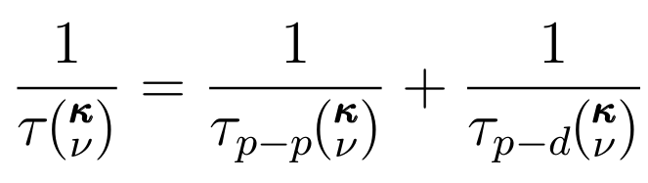

VC-ALD Diffusivities: Lifetimes
VC
ALD
Perturbation theory:
Anharmonic Lattice Dynamics (ALD)
1/
~
Tamura
Matthiessen's Rule:
1/
~

Slide 5
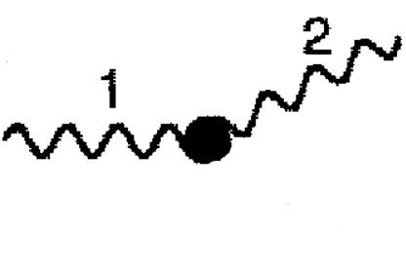
VC-ALD Diffusivities: Lifetimes
VC
ALD
Phonon-Defect
Perturbation theory:
Anharmonic Lattice Dynamics (ALD)
1
1/
~
Tamura
Matthiessen's Rule:
1/
~
1
Tamura, PRB 27, 858866 (1983)

Slide 6
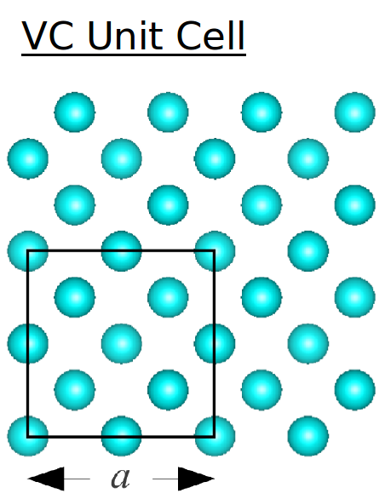
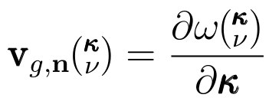

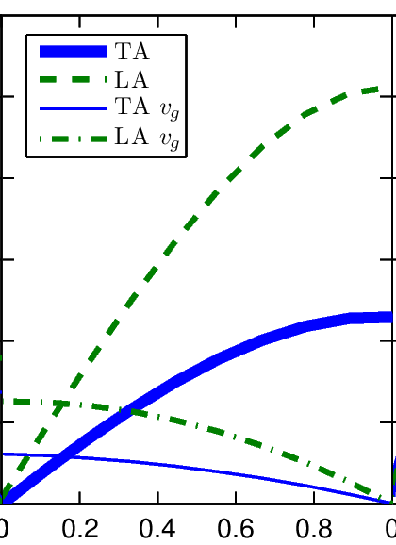

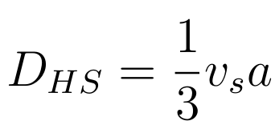
VC-ALD Diffusivities: Group Velocity
ALD
1/
~
Tamura
High-Scatter limit:
1
1/
~
1
Cahill, Ann. Rev. Phys. Chem. 39, 93121 (1988)

Slide 7
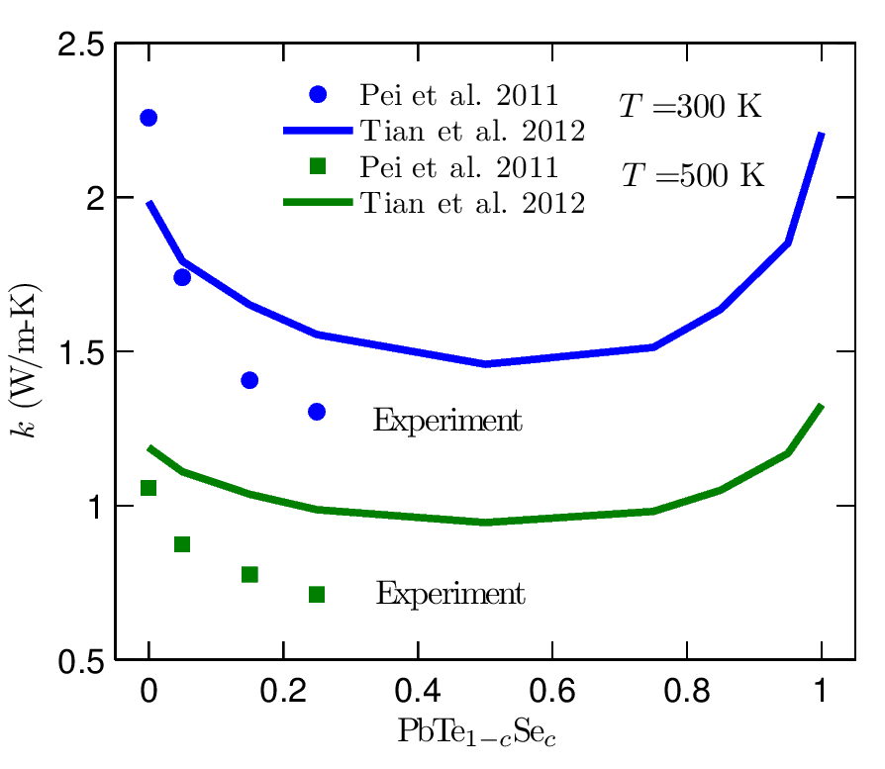
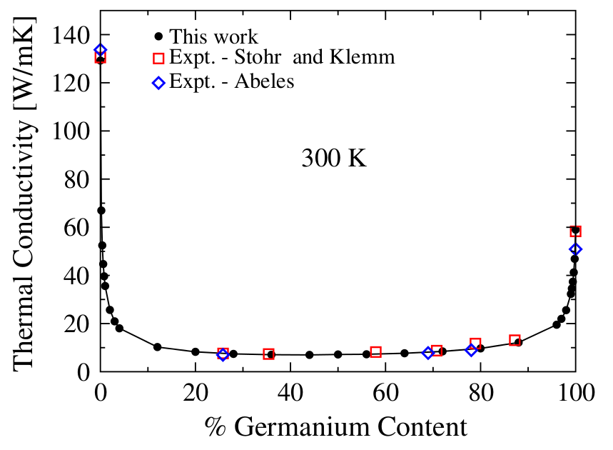
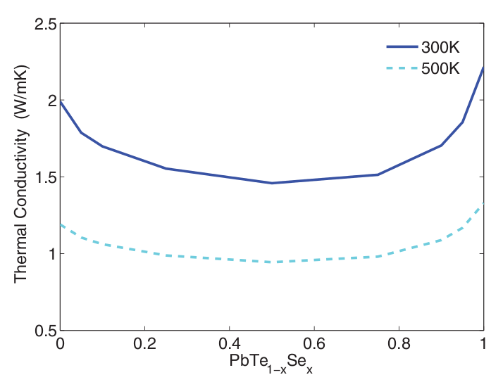
VC-ALD: experimental accuracy
Density Functional Theory (DFT) + (VC-ALD)
SiGe
PRL 106, 045901 (2011)
PRB 85, 184303 (2012)

Slide 8


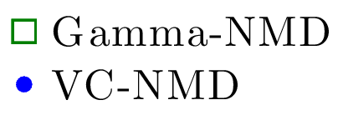

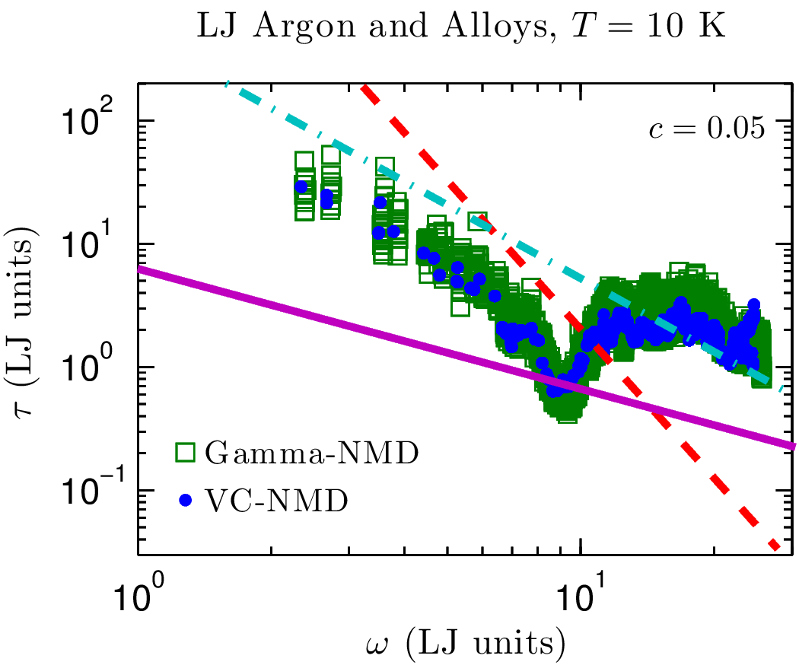



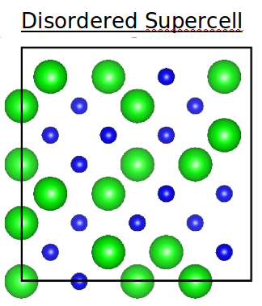

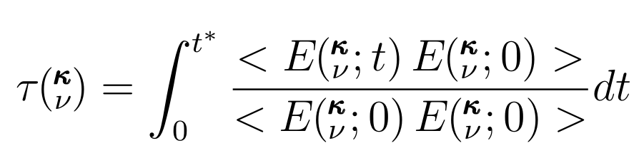
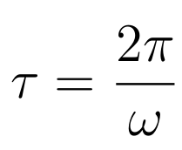


Explicit disorder: NMD
Disordered Supercell
Normal Mode Decomposition (NMD): Molecular Dynamics
Gamma

Slide 9
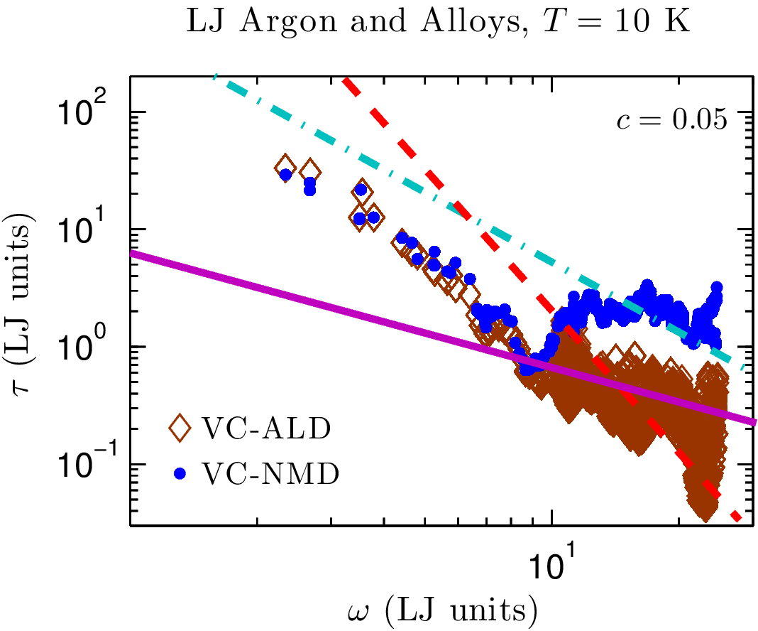
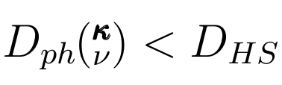
VC-NMD vs VC-ALD
VC
VC Unit Cell

Slide 10
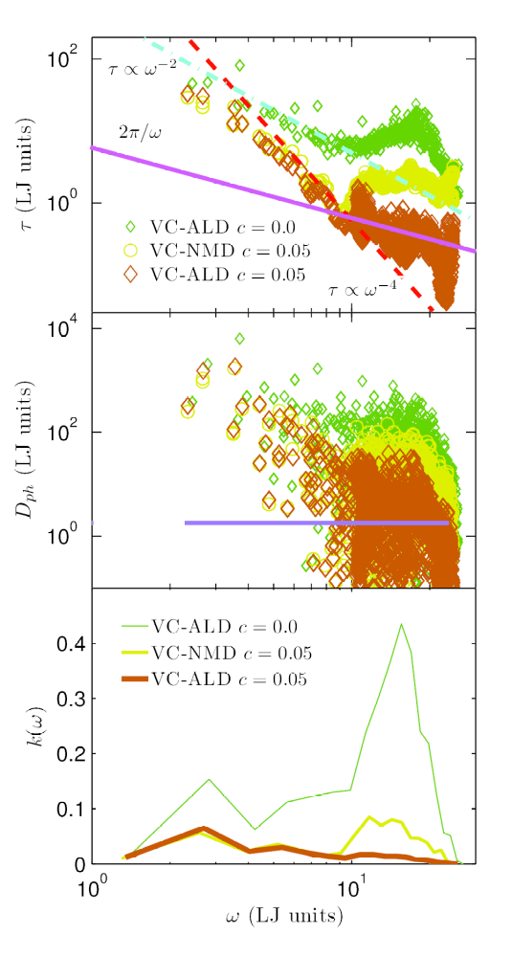
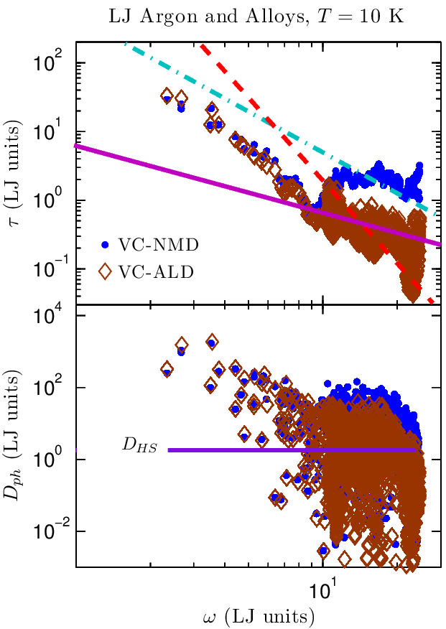
VC Diffusivities
VC Unit Cell

Slide 11
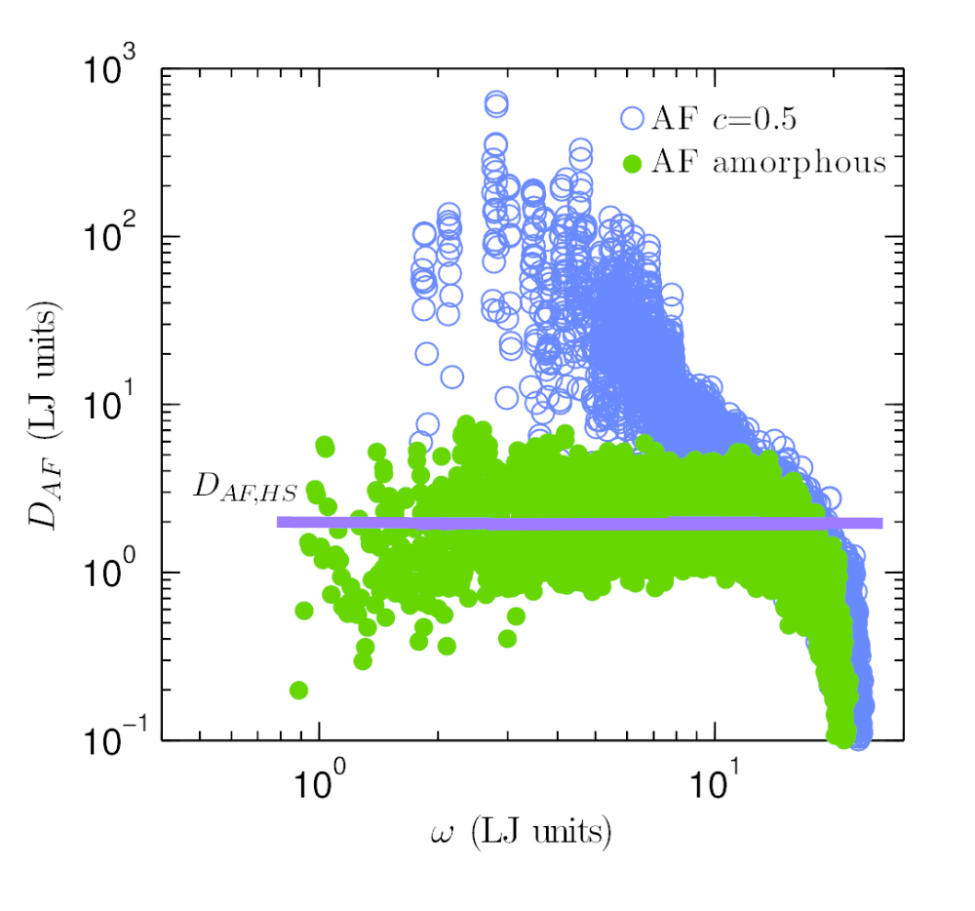
AF Diffusivities
Allen-Feldman (AF) Theory:
Allen-Feldman, PRB 48, 1258112588 (1993)

Slide 12
AF and VC Diffusivities
Allen-Feldman (AF) Theory:
Phonons
Diffusons
Allen-Feldman, PRB 48, 1258112588 (1993)

Slide 13
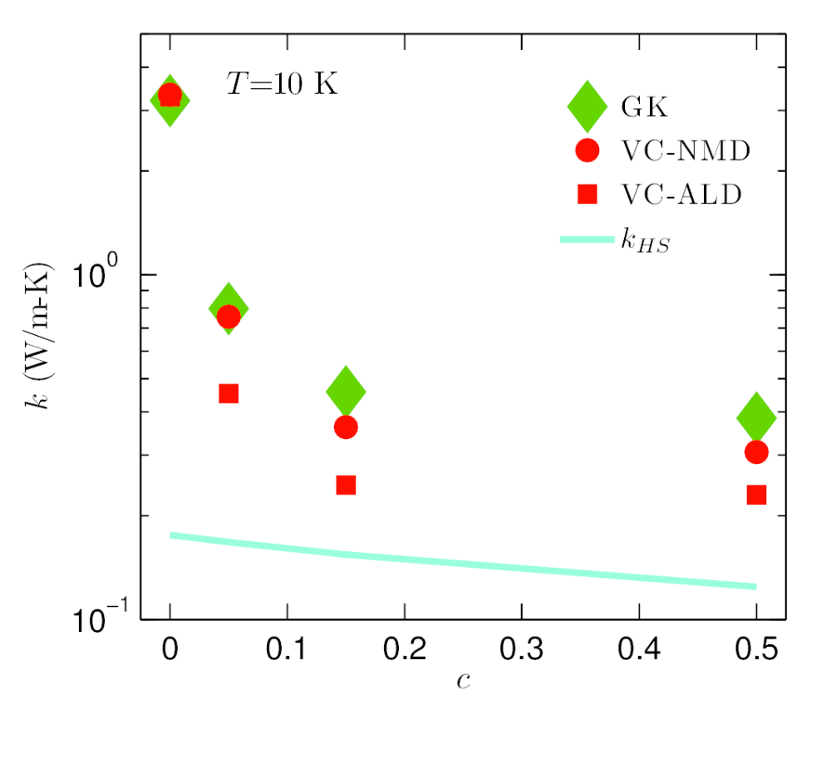
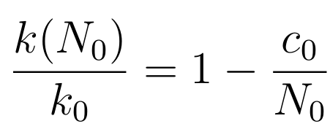
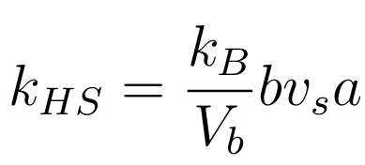
Thermal conductivity
Green-Kubo (GK): MD-based, no assumptions
MD-based Green-Kubo (GK)
GK Amorphous
High-scatter adjustment*:

Slide 14
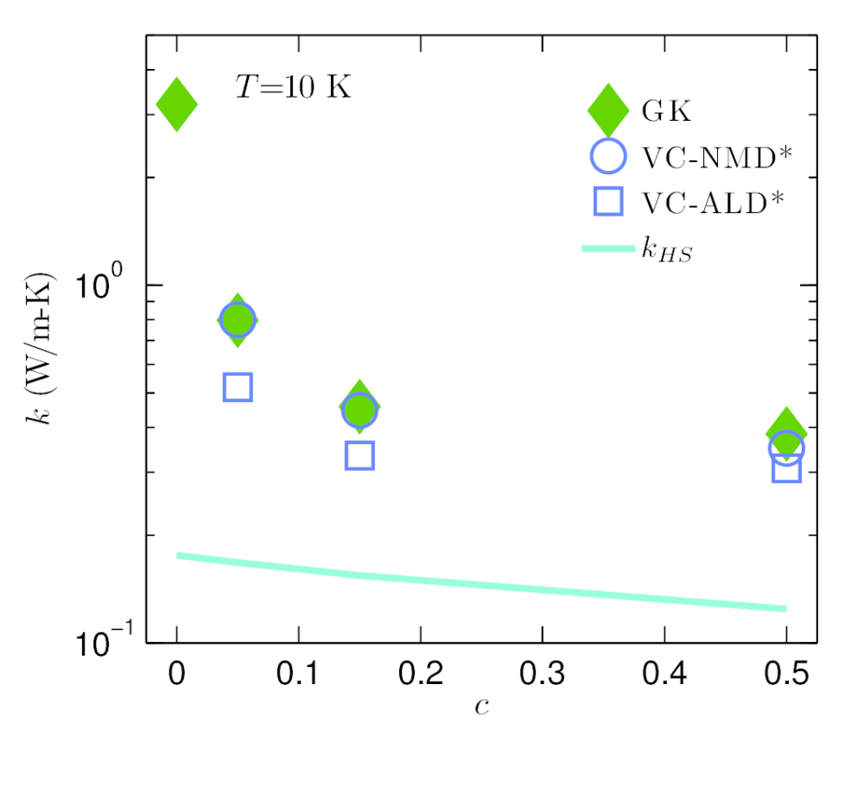
Thermal conductivity
MD-based Green-Kubo (GK)
MD-based Green-Kubo (GK)
GK Amorphous
High-scatter adjustment*:

Slide 15
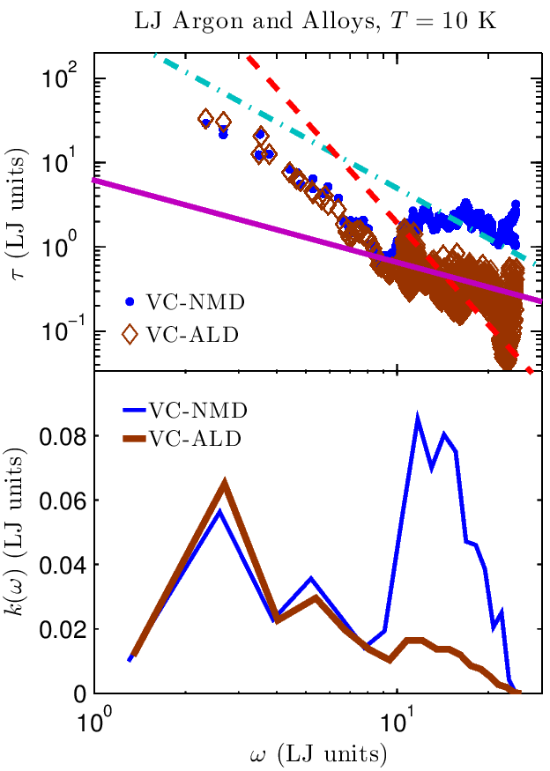
Thermal conductivity spectrum
GK Amorphous

Slide 16
Thermal conductivity spectrum
GK Amorphous
Phonon-Defect
1
1
Tamura, PRB 27, 858866 (1983)

Slide 17
Summary
GK Amorphous
SiGe
PRL 106, 045901 (2011)
GK Amorphous
This work was supported by AFOSR award FA95501010098 and by a grant of computer time from the DOD High Performance Computing Modernization Program at the US Army Engineer Research and Development Center.

Slide 18
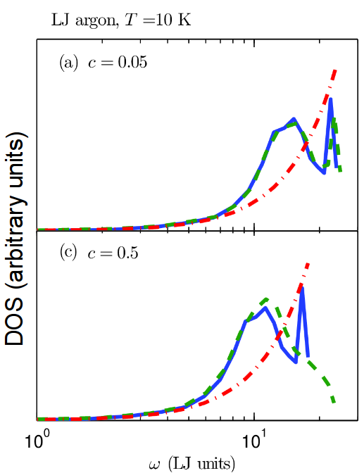
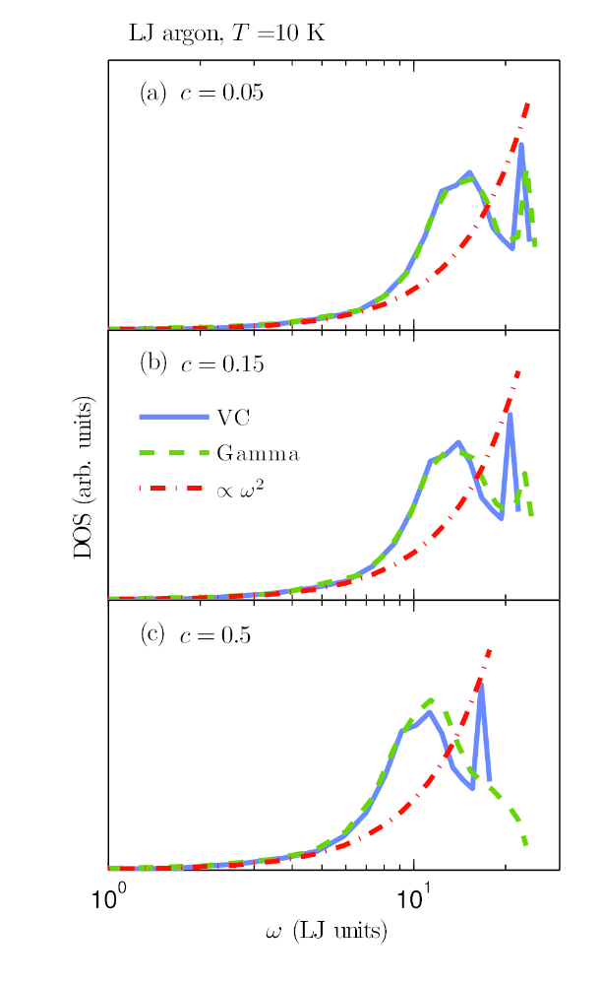
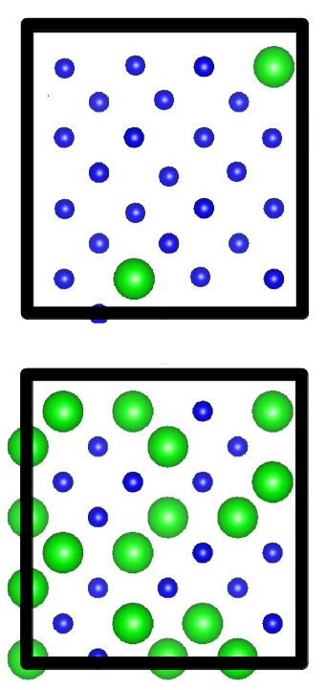
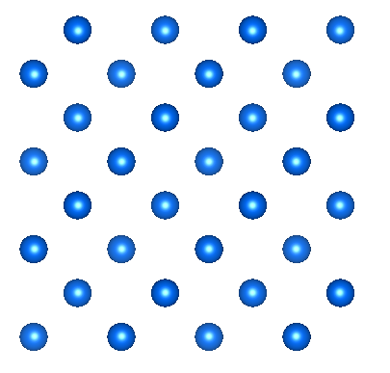
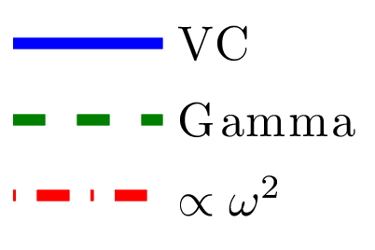
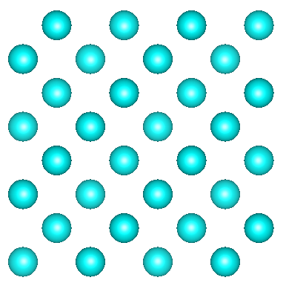
Explicit disorder: VC vs Gamma
Gamma
Gamma
VC
DOS (arbitrary units)

Slide 19
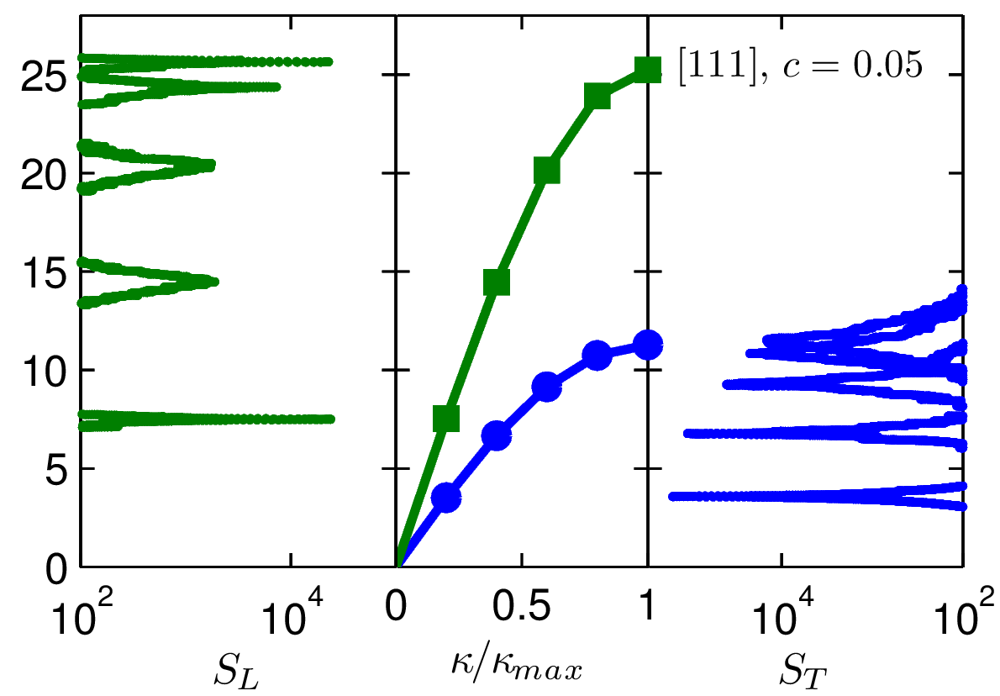
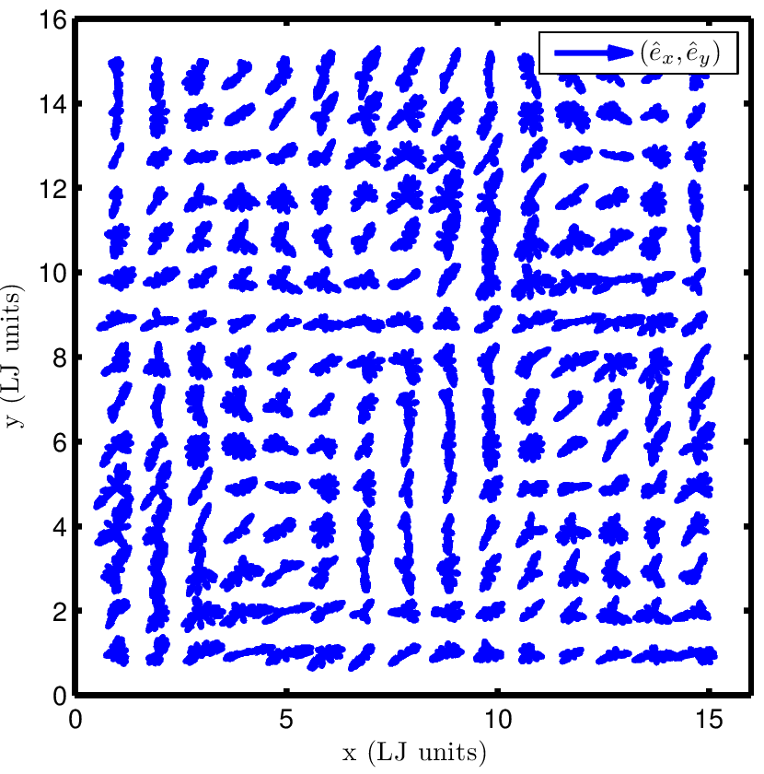

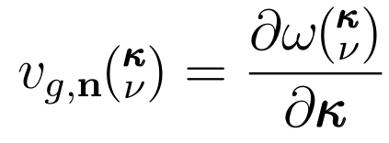
Explicit disorder: Structure Factor
Gamma
VC
Gamma
VC
Gamma
Phys. Rev. B 59, 35513559 (1999)

Slide 20

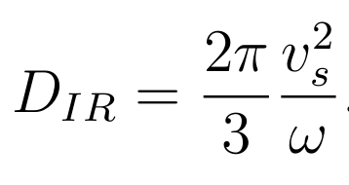
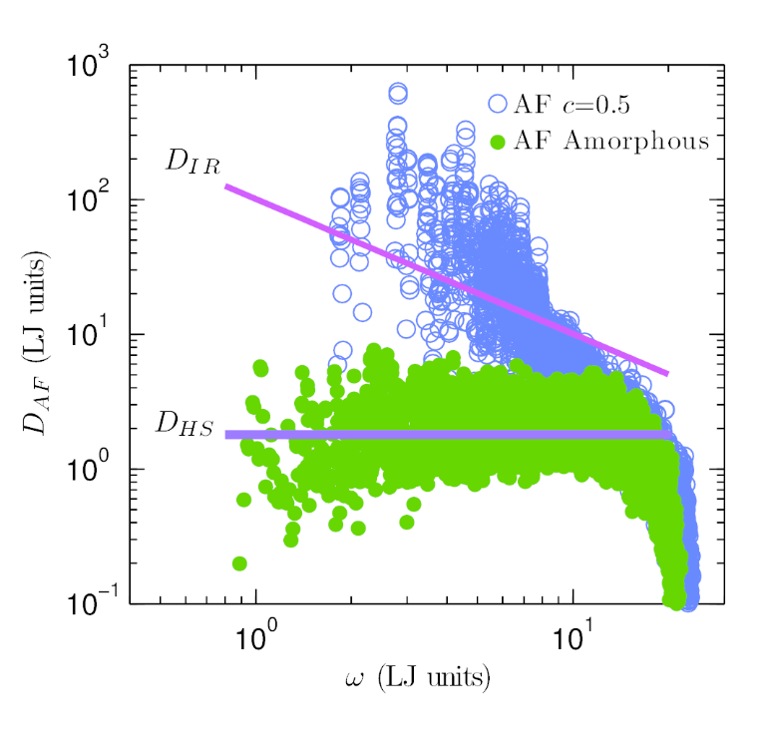
HS/IR Limit
P. Sheng and M. Zhou, Science 253, 539542 (1991)

Slide 21
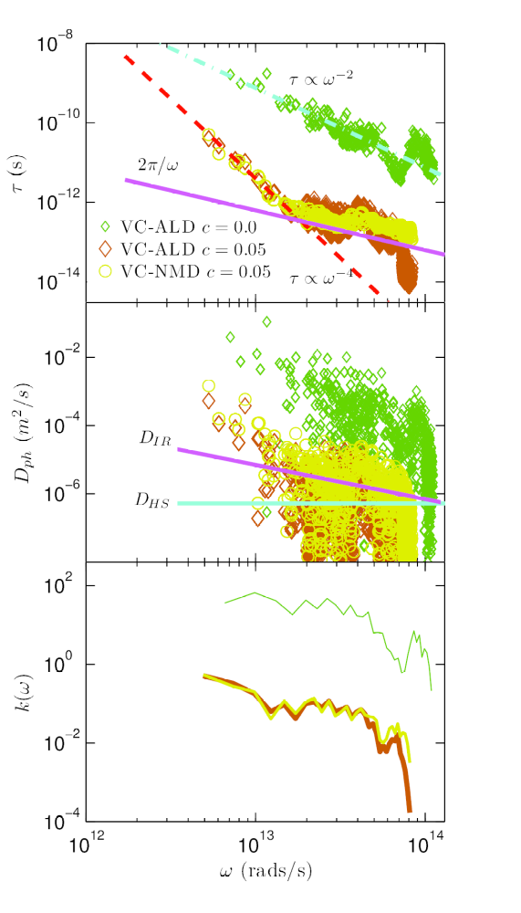
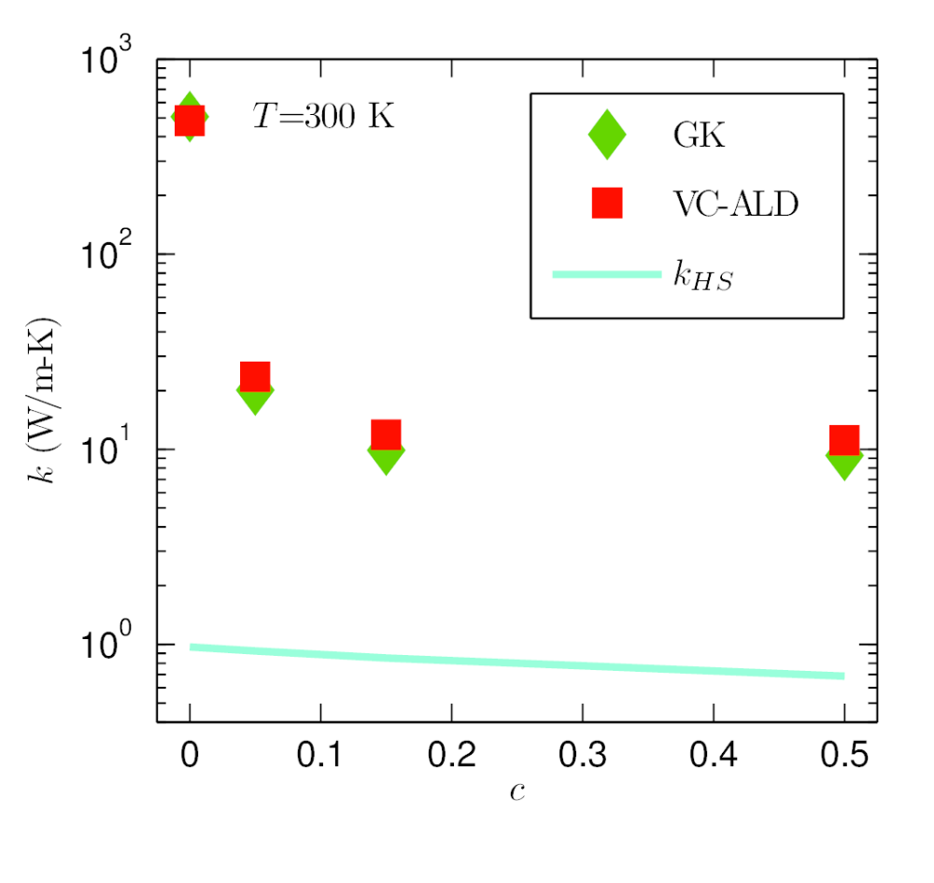
Thermal conductivity: SW silicon alloy
amor-Si

Slide 22
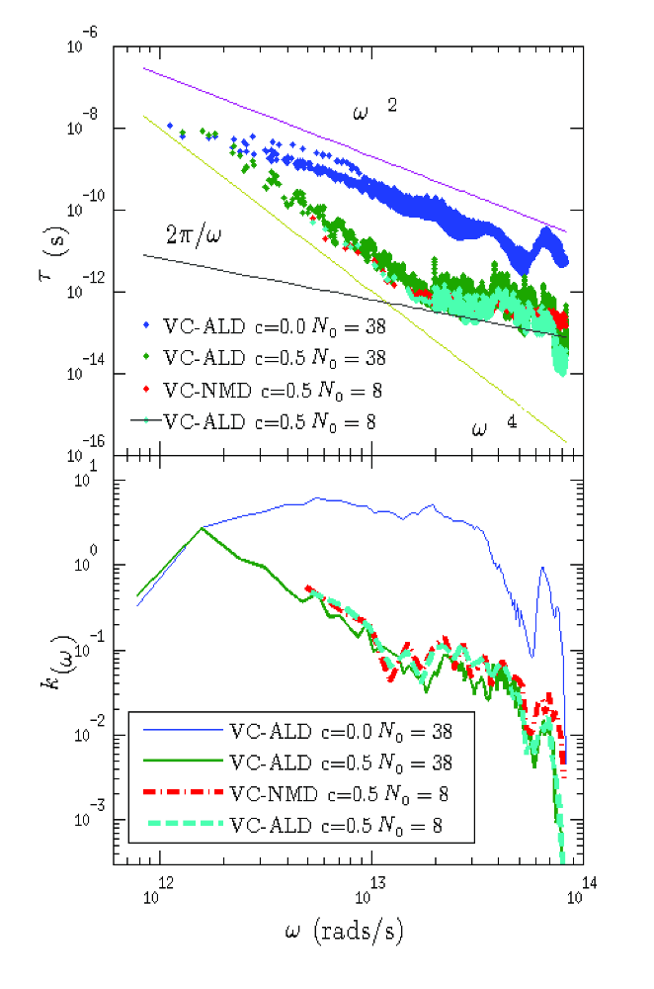
Phonon Spectrum: SW Si
MD-based:
1E4 modes
(7 days)*(100 cpu)
ALD:
1E6 modes
(7 days)*(12 cpu)

Slide 23
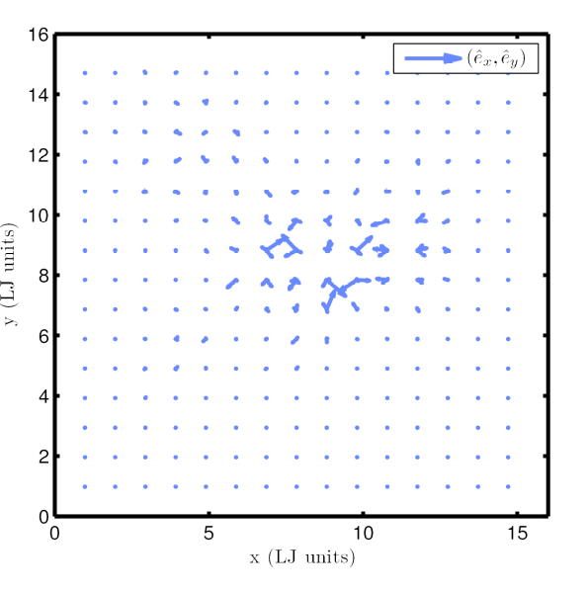
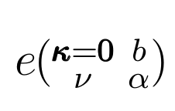
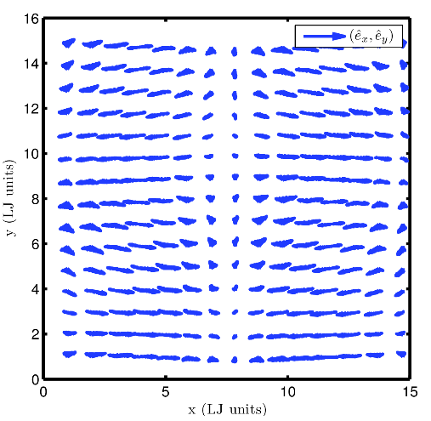
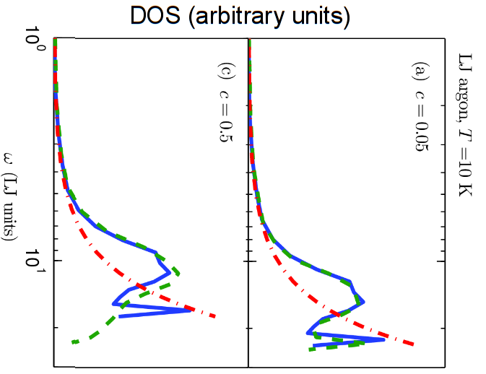
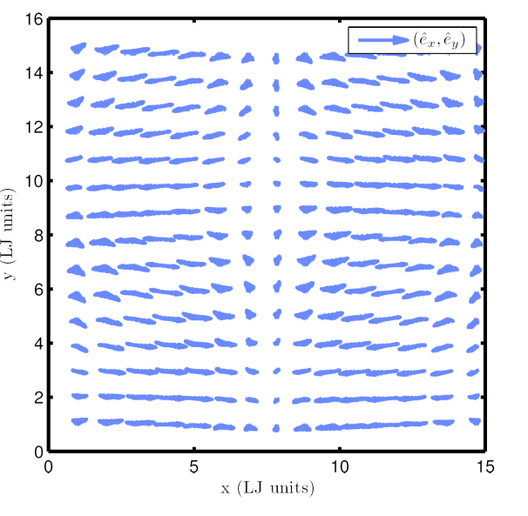
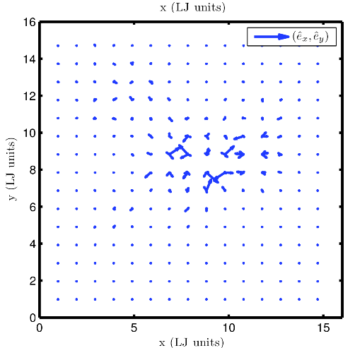
Gamma modes
DOS (arbitrary units)

Slide 24

NMD using VC modes

Slide 25



Conductivity Accumulation
SW Si
LJ Ar
PHYSICAL REVIEW B 85, 184303 (2012)

