Slide 1
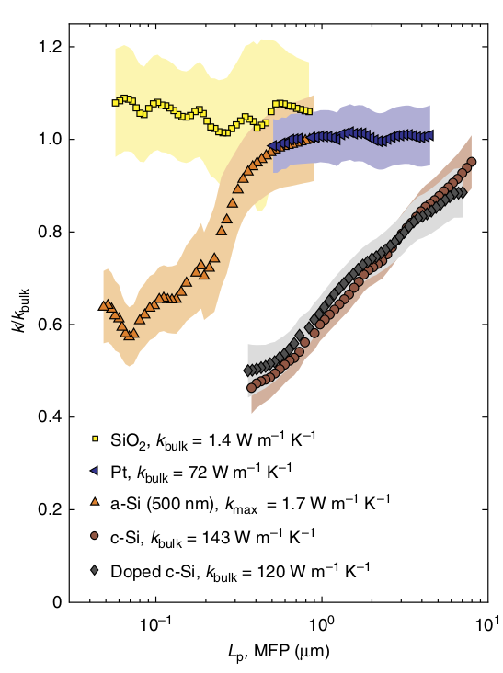
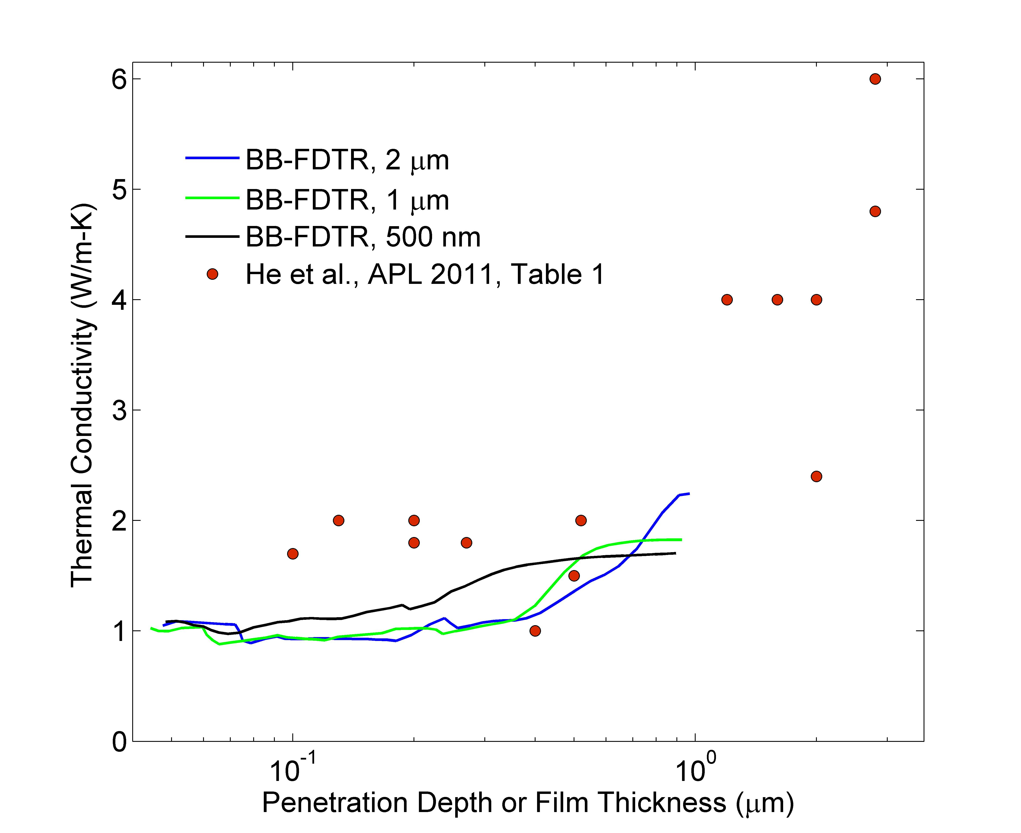
a-SiO2, a-Si: broadband experiments
1

Slide 2

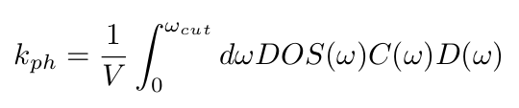




vibrational thermal conductivity

Slide 3
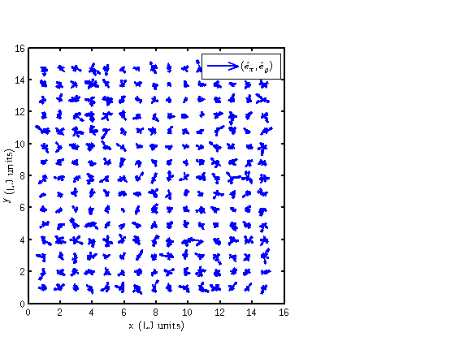
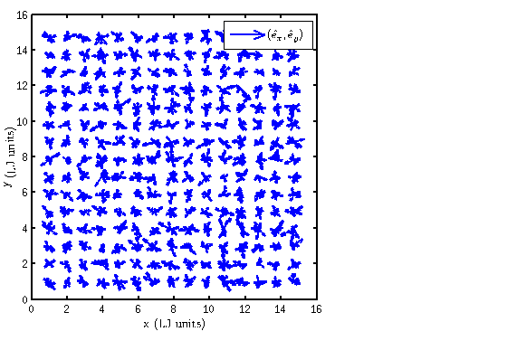
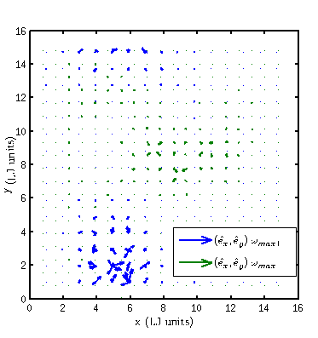
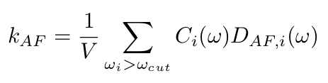
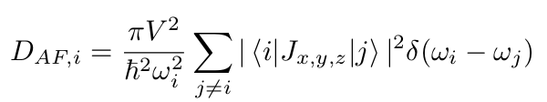
AF theory

Slide 4
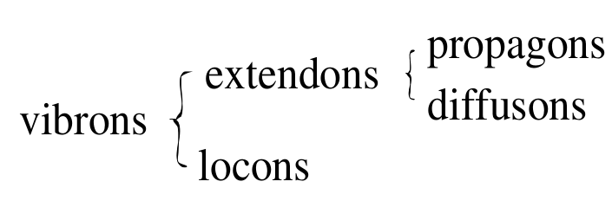
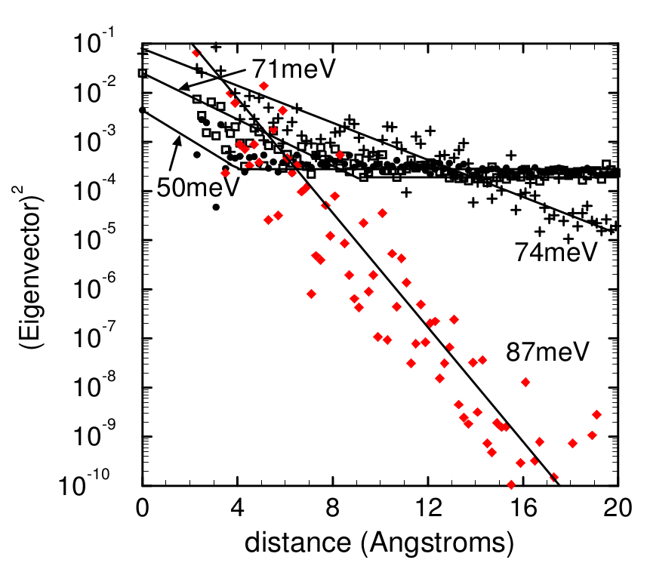
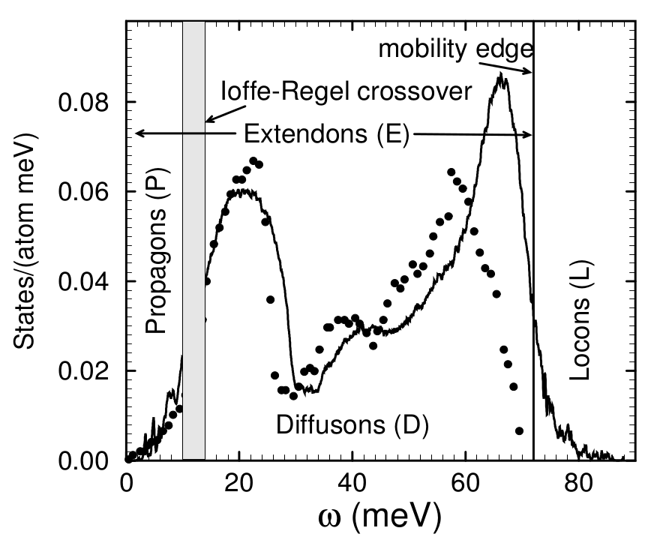
vibrons: propagons, diffusons, locons

Slide 5





thermal diffusivity limits

Slide 6
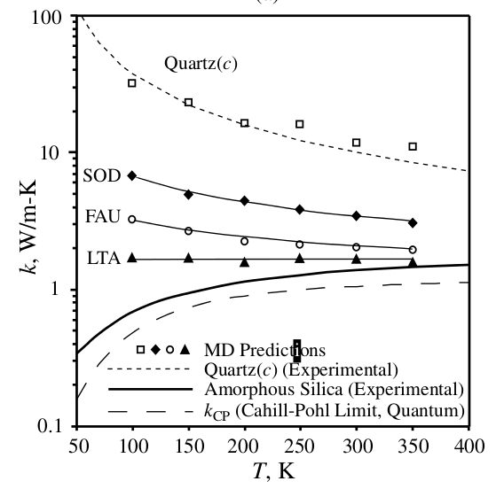
silica, silicon thermal conductivity
T=300K
a-Si

Slide 7
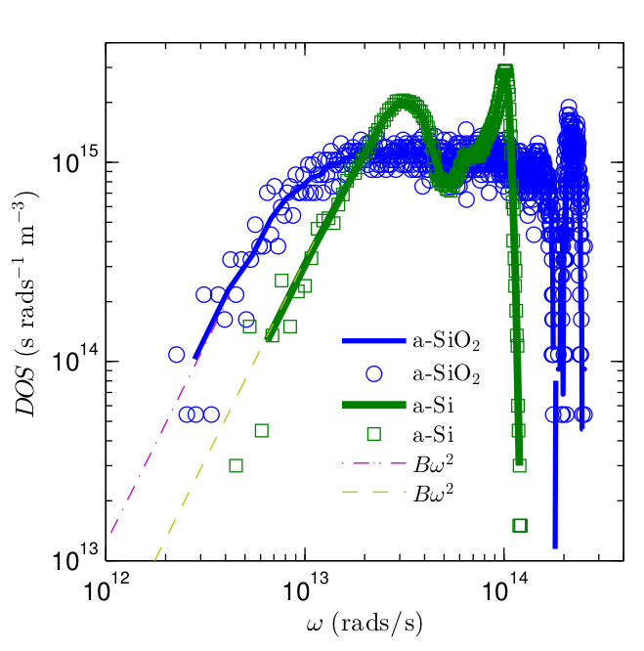

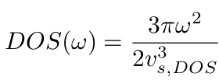


density of states

Slide 8
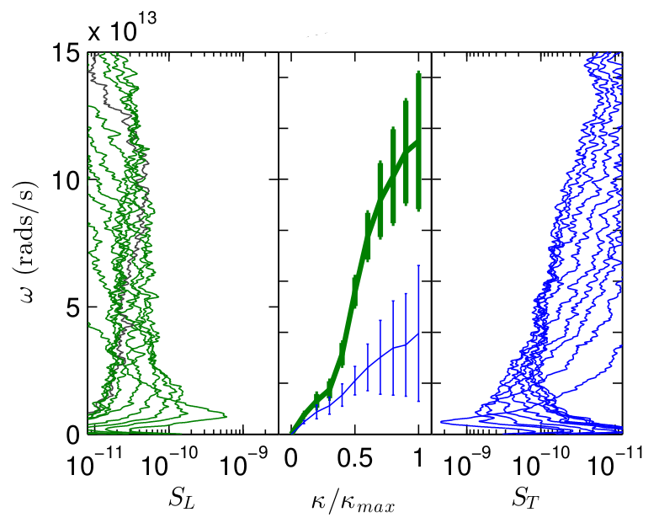
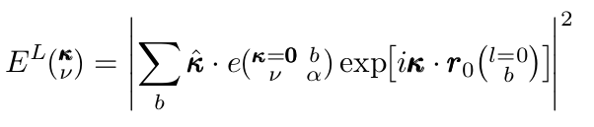
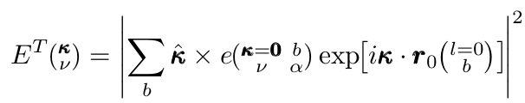
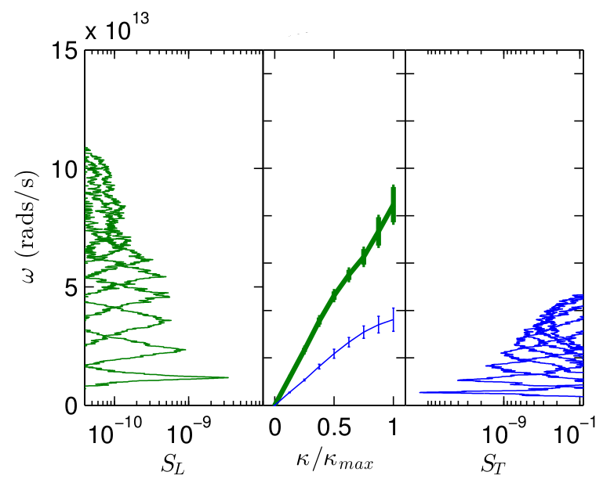


structure factor

Slide 9
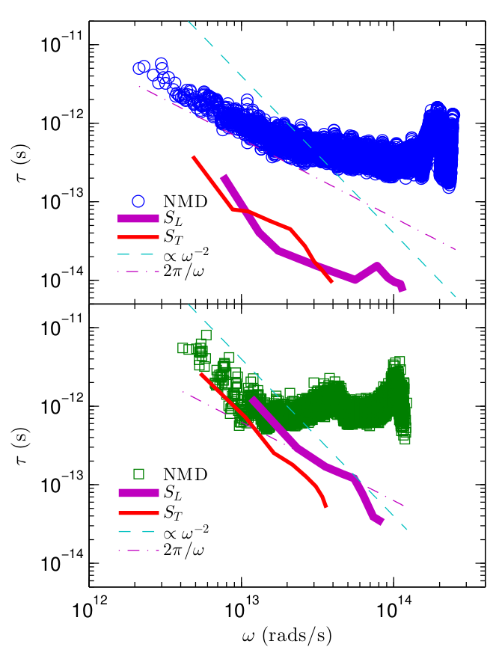
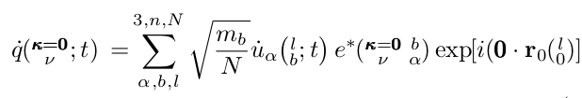

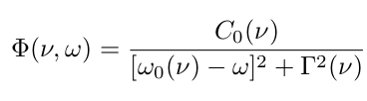

normal mode decomposition

Slide 10
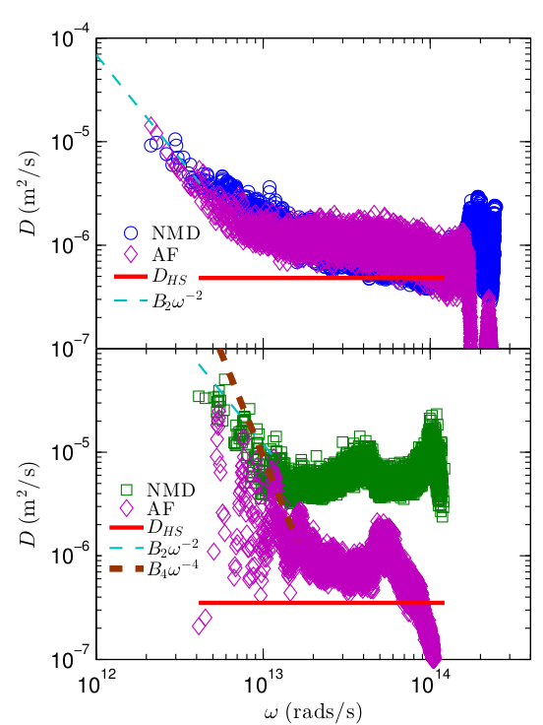
mode diffusivities

Slide 11
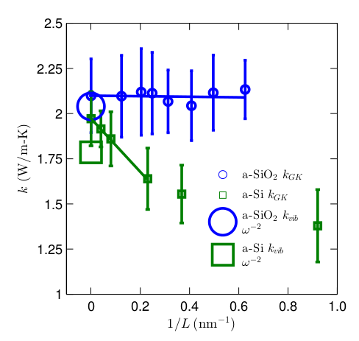

bulk thermal conductivity

Slide 12
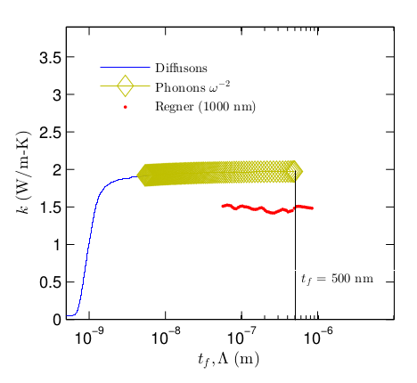

accumulated thermal conductivity: a-SiO2

Slide 13
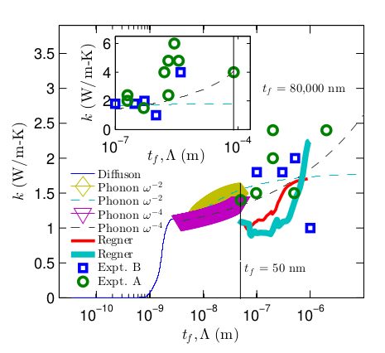
accumulated thermal conductivity: a-Si

Slide 14
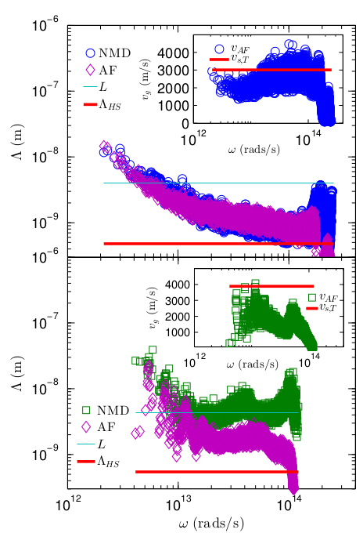



Slide 15
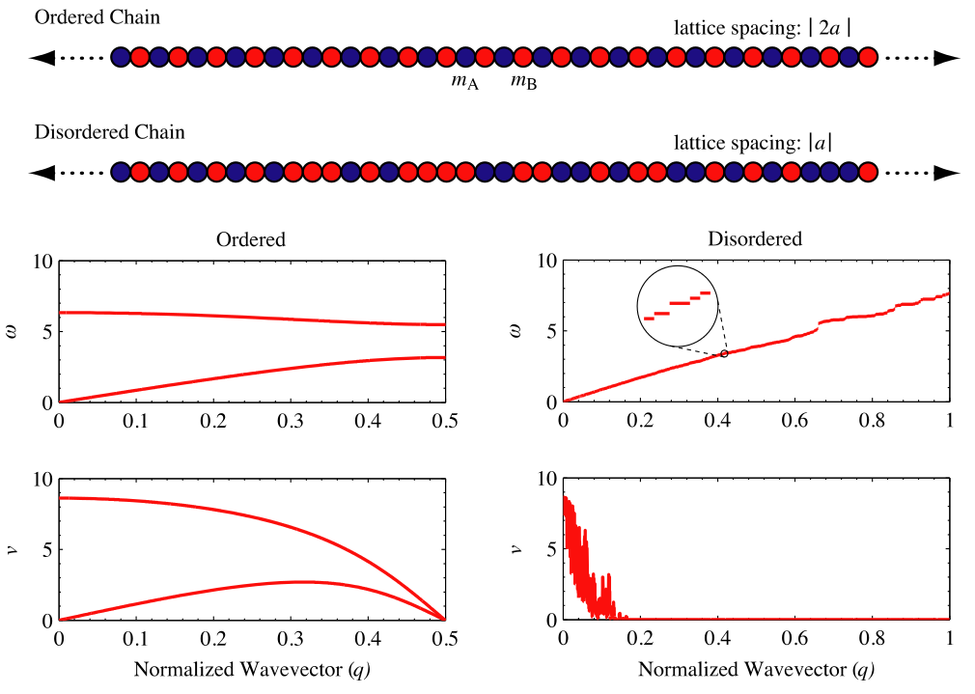
v_g from “zone-folding”:
http://iopscience.iop.org/0953-8984/23/20/205401
v_g from near [000]:
http://pubs.acs.org/doi/abs/10.1021/nn2003184
http://pubs.acs.org/doi/abs/10.1021/nl201359q

Slide 16
vibrons: propagons, diffusons, locons
Numerical studies of amorphous silicon show that the low-
est 4% of vibrational modes are plane-wave like (“propagons”)
and the highest 3% of modes are localized (“locons”). The
rest are neither plane-wave like nor localized. We call them
“diffusons.”
\cite{diffusons_allen_1999}

Slide 17
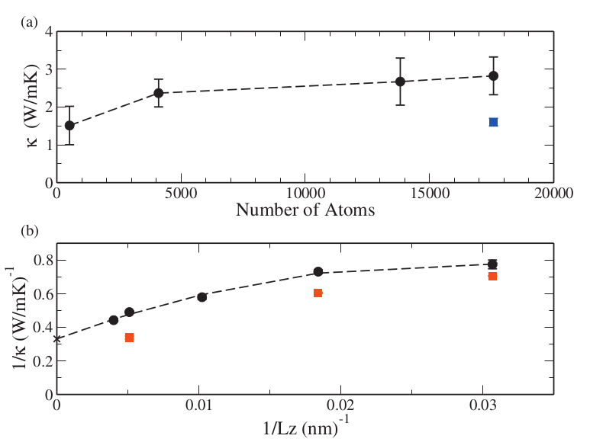
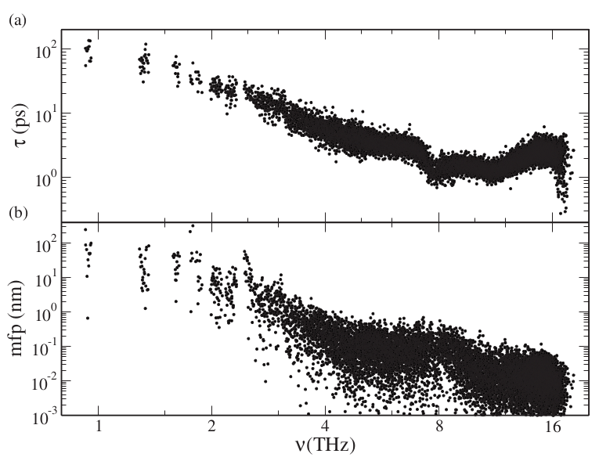
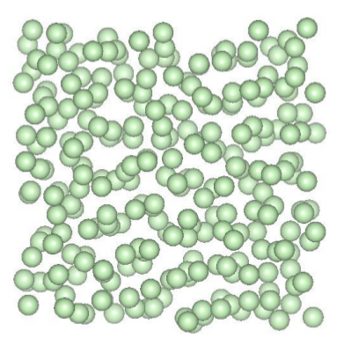
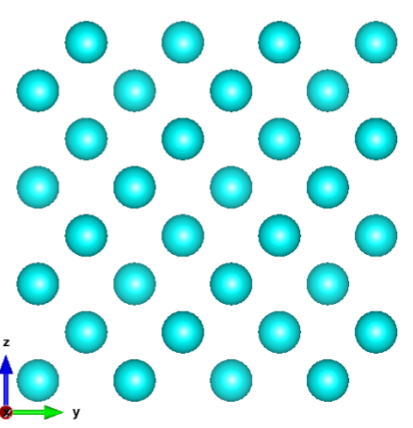
A-Si: Tersoff
MD-based: size of simulation cell=4.3 nm
Appl. Phys. Lett. 98, 144101 (2011)
http://apl.aip.org/resource/1/applab/v98/i14/p144101_s1

Slide 18
