Slide 1
Ultrascalable Fourier Transforms in Three Dimensions
Dmitry Pekurovsky
San Diego Supercomputer Center
UCSD

Slide 2
Introduction: Fast Fourier Transforms
Heavily used in many areas of computational science
Computationally demanding
  Not a cache-friendly algorithm
    Memory bandwidth is stressed
  Communication intense
    All-to-all exchange is an expensive operation, stressing bisection bandwidth of the host’s network
The goal: providing a scalable, portable, easy to use implementation of 3D FFT

Slide 3
Three-dimensional Fast Fourier Transform (3D FFT): the algorithm
1D FFT is applied three times (for X,Y and Z)
Use transpose approach:
  call FFT on local data only
  transpose where necessary so as to arrange the data locally for the direction of the transform
  It is more efficient to transpose the data once than to exchange the data multiple times during a distributed 1D FFT
At each stage, there are many 1D FFT to do
  Divide the work evenly

Slide 4
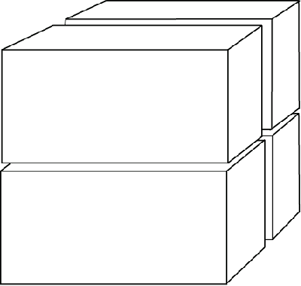
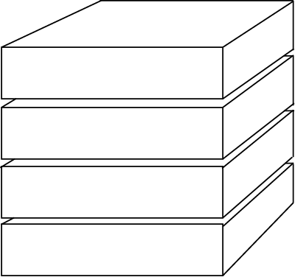
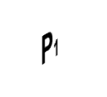
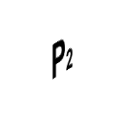
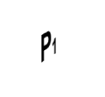
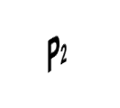
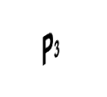
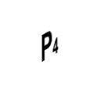
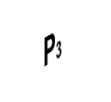
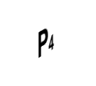
1D decomposition 2D decomposition
z
y
x

Slide 5
Algorithm scalability
1D decomposition: concurrency is limited to N (linear grid size).
  Not enough parallelism for O(10⁴)-O(10⁵) cores
  This is the approach of most libraries to date
  (FFTW 3.2, PESSL)
2D decomposition: concurrency is up to N²
  Scaling to ultra-large core counts is possible
  The answer to the petascale challenge

Slide 6
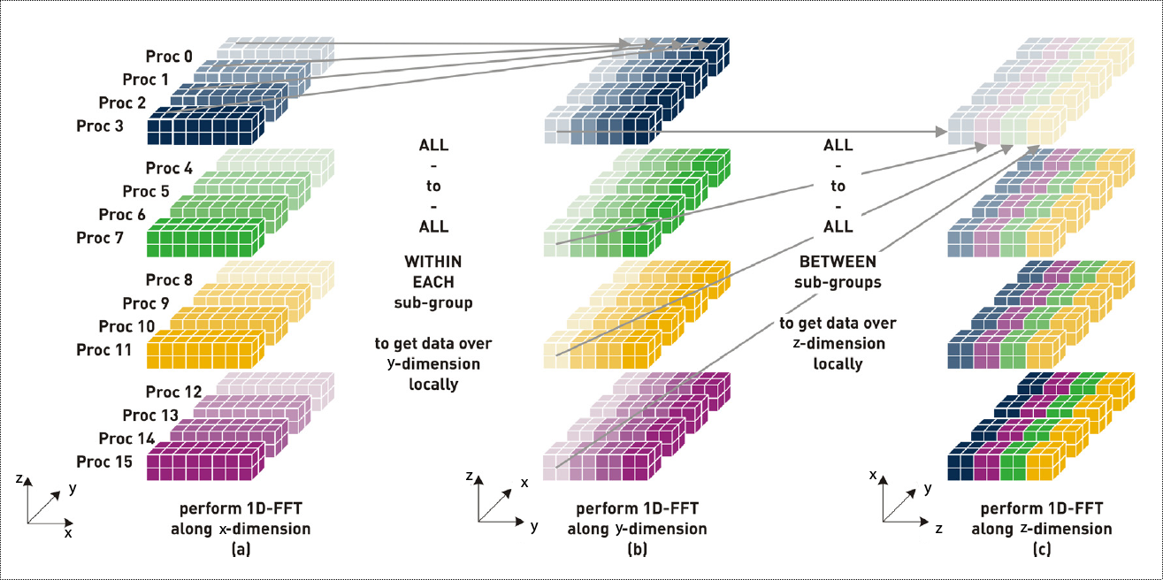
3D FFT algorithm with
2D decomposition
Image courtesy of H. Jagode (ORNL)

Slide 7
P3DFFT
Open source library for efficient, highly scalable 3D FFT on parallel platforms
Uses 2D decomposition
  Includes 1D option.
Available at http://code.google.com/p/p3dfft
Historically grew out of an Advanced User Support Project

Slide 8
P3DFFT: features
Implements real-to-complex (R2C) and complex-to-real (C2R) 3D transforms
Fortran and C interfaces
Performance-optimized
Single or double precision
Arbitrary dimensions
  Handles many uneven cases (N_{i} does not have to be a factor of M_{j)}
Can do either in-place or out-of-place transform
Includes example programs in Fortran and C

Slide 9
P3DFFT implementation
Baseline version implemented in Fortran90 with MPI
1D FFT: call FFTW or ESSL
Transpose implementation in 2D decomposition:
  Set up 2D cartesian subcommunicators, using MPI_COMM_SPLIT (rows and columns)
  Two transposes are needed: 1. in rows 2. in columns
  Baseline version: exchange data using MPI_Alltoall or MPI_Alltoallv

Slide 10
Communication performance
A large portion of total time (up to 80%) is all-to-all
Highly dependent on optimal implementation of MPI_Alltoall (varies with vendor)
Buffers for exchange are close in size
  Good load balance, predictable pattern
Performance can be sensitive to choice of (M₁,M₂)

Slide 11
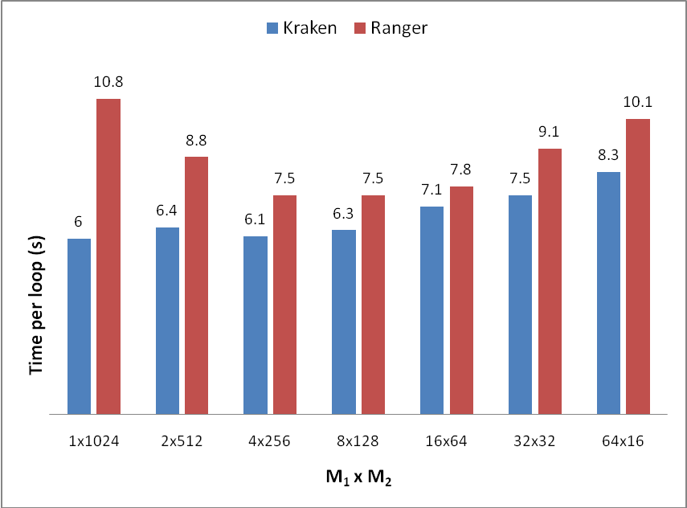
Performance dependance on processor grid shape M₁xM₂

Slide 12
Communication scaling and networks
All-to-all exchanges are directly affected by bisection bandwidth of the interconnect
Increasing P decreases buffer size
  Expect 1/P scaling on fat-trees and other networks with full bisection bandwidth (until buffer size gets below the latency threshold).
On torus topology (Cray XT) bisection bandwidth is scaling as P^{2/3}
  Expect P^{-2/3} scaling
Process mapping?
  No benefit so far

Slide 13
Computation performance
1D FFT, three times: 1. Stride-1
2. Small stride
3. Large stride (out of cache)
Strategy:
  Use an established library (ESSL, FFTW)
  An option to keep data in original layout, or transpose so that the stride is always 1
    The results are then laid out as (Z,Y,X) instead of (X,Y,Z)
    Use loop blocking to optimize cache use

Slide 14
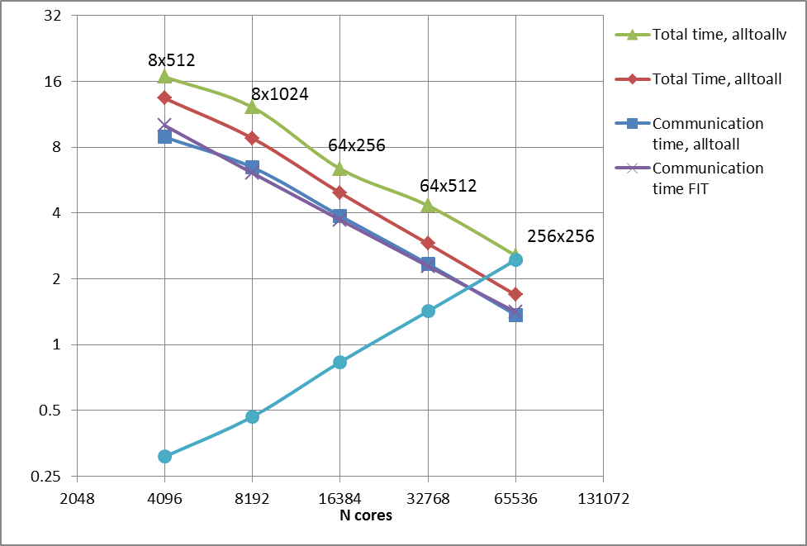
Strong scaling on Cray XT5 (Kraken) at NICS/ORNL
4096³ grid, double precision, best M₁/M₂ combination

Slide 15
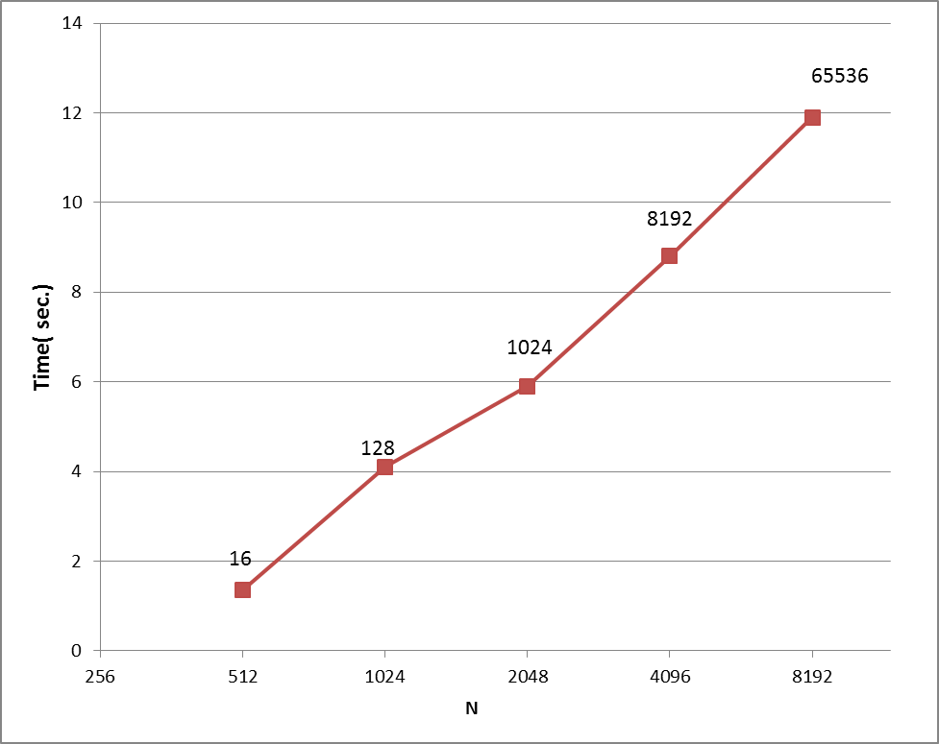
Weak Scaling (Kraken)
N³ grid, double precision

Slide 16
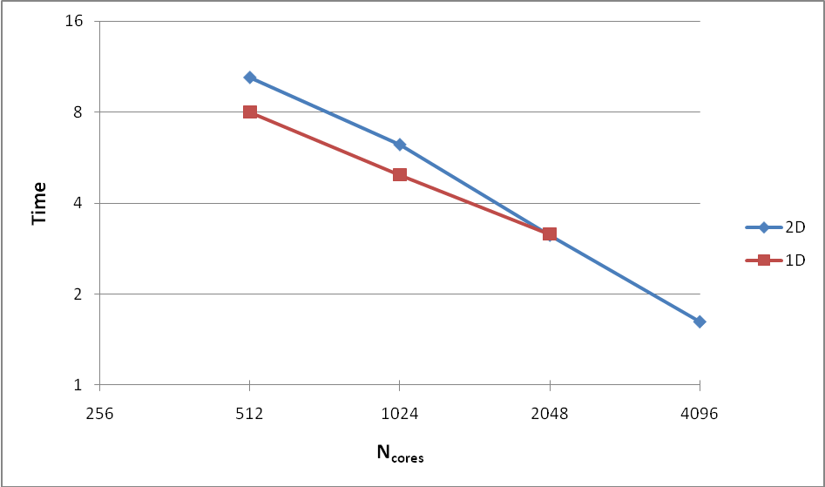
2D vs. 1D decomposition

Slide 17
Applications of P3DFFT
P3DFFT has already been applied in a number of codes, in science fields including the following:
Turbulence
Astrophysics
Oceanography
Other potential areas include
  Material Science
  Chemistry
  Aerospace engineering
  X-ray crystallography
  Medicine
  Atmospheric science

Slide 18
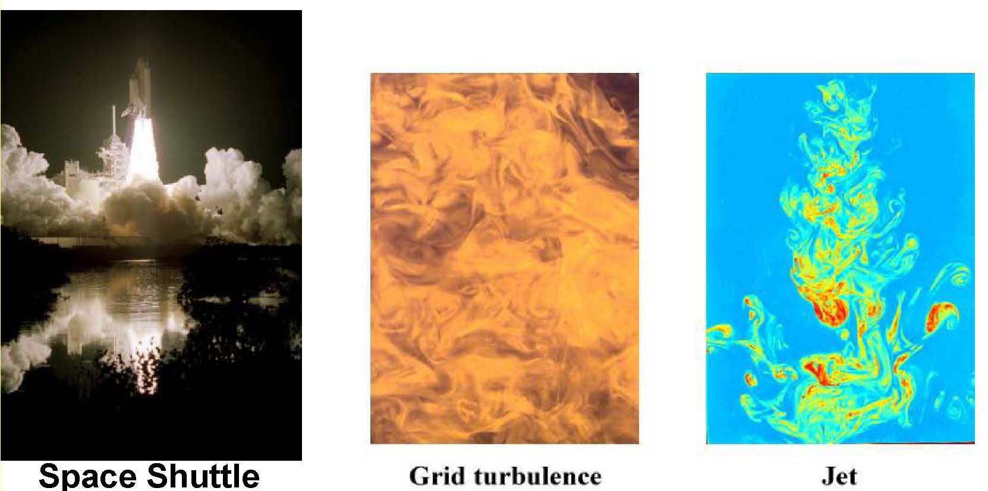
DNS turbulence
Direct Numerical Simulations (DNS) code from Georgia Tech (P.K.Yeung et al.) to simulate isotropic turbulence on a cubic periodic domain
  Characterized by disorderly, nonlinear fluctuations in 3D space and time that span a wide range of interacting scales
DNS is an important tool for first-principles understanding of turbulence in great detail
  Vital for new concepts and models as well as improved engineering devices
  Areas of application include aeronautics, environment, combustion, meteorology, oceanography
One of three Model Problems for NSF’s Track 1 solicitation

Slide 19
DNS algorithm
It is crucial to simulate grids with high resolution to minimize discretization effects, and study a wide
range of length scales.
Uses Runge-Kutta 2nd or 4th order for time-stepping
Uses pseudospectral method to solve Navier-Stokes eqs.
  3D FFT is the most time-consuming part
2D decomposition based on P3DFFT framework has been implemented.

Slide 20
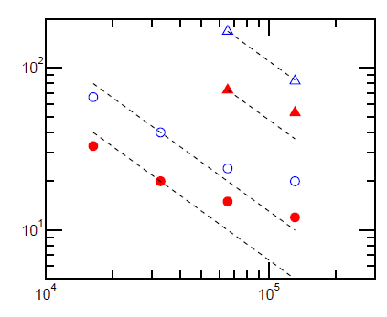
DNS performance (Cray XT5)
8192³
4096³
N_{cores}

Slide 21
P3DFFT - Ongoing work
Part 1: Interface and Flexibility
Expanding the memory layout options
Adding other types of transform (e.g. complex-to-complex, Chebyshev) - DONE
Adding ability to isolate transposes so the user can design their own transform
Adding ghost cell support/halo exchange

Slide 22
P3DFFT - Ongoing work
Part 2: Performance improvements
  One-sided communication
    MPI-2
    OpenSHMEM
    Co-Array Fortran
  Communication/computation overlap – requires RDMA
    Coarse-grain
    Fine-grain
  Hybrid MPI/OpenMP implementation

Slide 23
Coarse-grain overlap
Suitable for computing several FFTs at once
  Independent variables, e.g. velocity components
Overlap communication stage of one variable with computation stage of another variable
Advantage: uses large send buffers due to message aggregation
Uses pairwise exchange algorithm based on MPI-2 or SHMEM

Slide 24
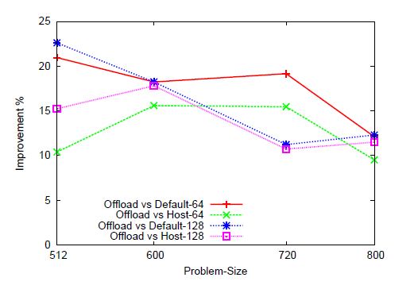
Coarse-grain overlap, results on Mellanox ConnectX-2 cluster (64 and 128 cores)
K.Kandalla, H.Subramoni, K.Tomko, D. Pekurovsky, S.Sur, D.Panda “High-Performance and Scalable Non-Blocking All-to-All with Collective Offload on InfiniBand Clusters: A Study with Parallel 3D FFT”, ISC’11, Germany. Computer Science – Research and Development, v. 26, i.3, 237-246 (2011)

Slide 25
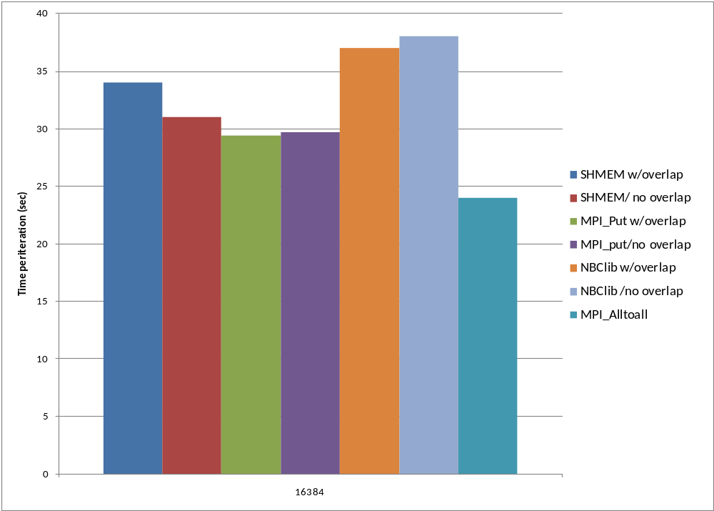
Coarse-grain overlap, preliminary results at large scale on Cray XE6 (Hopper), 16k cores

Slide 26
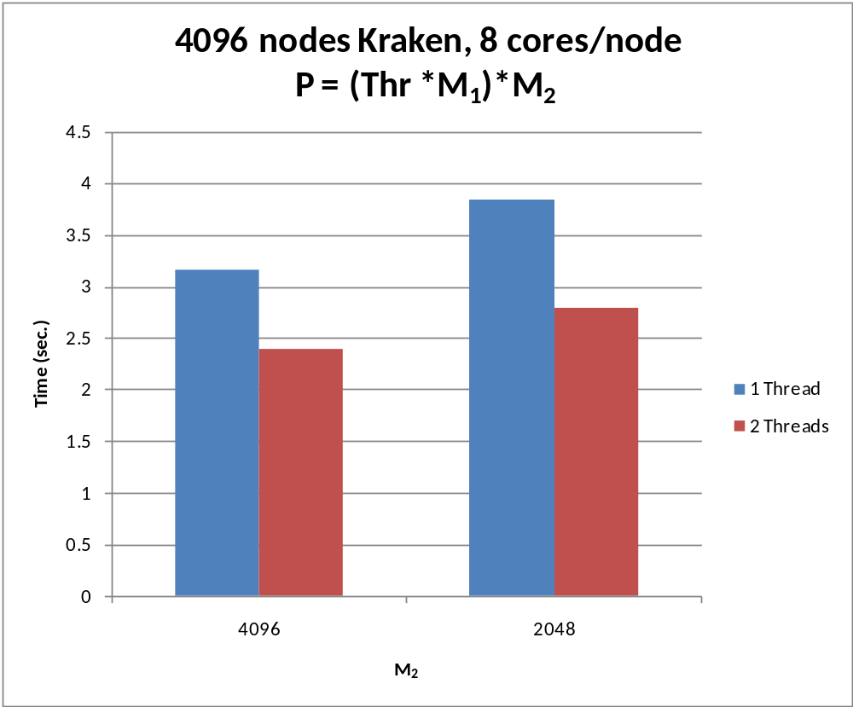
Hybrid MPI/OpenMP preliminary results (Kraken)

Slide 27
Conclusions
Efficient, scalable parallel 3D FFT library is available (open-source download available at http://code.google.com/p/p3dfft)
Strong performance is achieved on leading platforms
Great potential for enabling petascale science
An example of project that came out of a Teragrid Advanced User Support Collaboration, now benefiting a wider community
  Incorporated into a number of codes (13 citations as of today, hundreds of downloads)
  A future XSEDE community code
  Work under way to expand capability and improve ultra-scale performance even further
An excellent testing tool for future platforms’ capabilities
  Bisection bandwidth
  MPI implementation
  One-sided protocols implementation
  MPI/OpenMP hybrid performance

Slide 28
Acknowledgements
P.K.Yeung
D.A.Donzis
G. Chukkappalli
J. Goebbert
G. Brethouser
N. Prigozhina
K. Tomko
K. Kandalla
H. Subramoni
S. Sur
D. Panda
Work supported by Teragrid, NSF grants OCI-0850684 and CCF-0833155
Benchmarks run on Teragrid resources Ranger (TACC), Kraken (NICS), and DOE resources Jaguar (NCSS/ORNL), Hopper(NERSC)

