Slide 1
Three-dimensional Fast Fourier Transform (3D FFT): the algorithm
1D FFT is applied three times (for X,Y and Z)
Easily parallelized, load balanced
Use transpose approach:
  call FFT on local data only
  transpose where necessary so as to arrange the data locally for the direction of the transform
  It is more efficient to transpose the data once than exchanging data multiple times during a distributed 1D FFT
At each stage, there are many 1D FFT to do
  Divide the work evenly

Slide 2
Algorithm scalability
1D decomposition: concurrency is limited to N (linear grid size).
  Not enough parallelism for O(10⁴)-O(10⁵) cores
  This is the approach of most libraries to date
  (FFTW 3.2, PESSL)
2D decomposition: concurrency is up to N²
  Scaling to ultra-large core counts is possible, though not guaranteed
  The answer to the petascale challenge

Slide 3
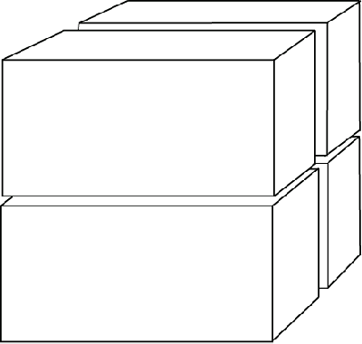
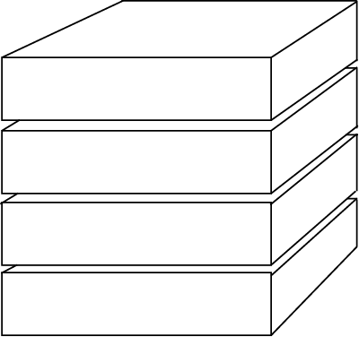
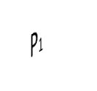
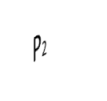
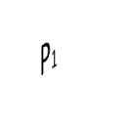
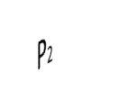
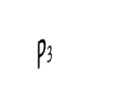
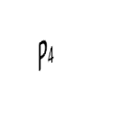
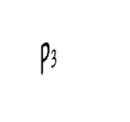
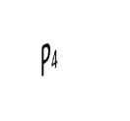
1D decomposition 2D decomposition
z
y
x

Slide 4
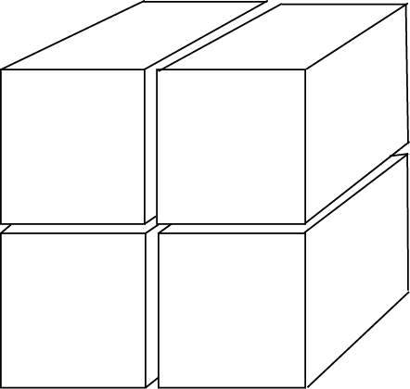
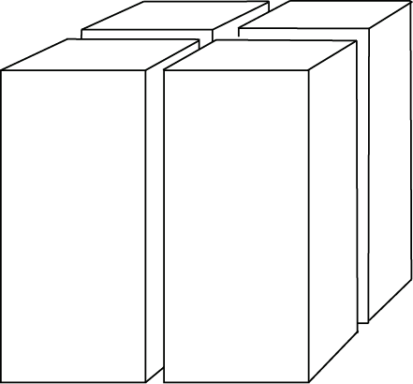
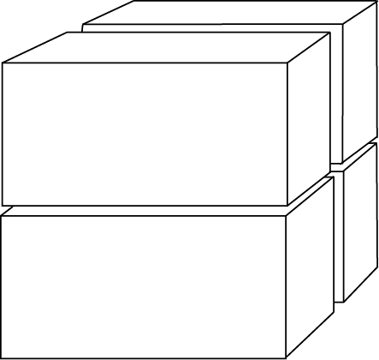
2D decomposition
Transpose in rows
P₂
P₁
P = P₁ x P₂
Transpose in columns

Slide 5
P3DFFT
Open source library for efficient, highly scalable 3D FFT on parallel platforms
Built on top of an optimized 1D FFT library
  Currently ESSL or FFTW
  In the future, more libraries
Uses 2D decomposition
  Includes 1D option.
Available at http://www.sdsc.edu/us/resources/p3dfft.php
Includes example programs in Fortran and C

Slide 6
P3DFFT: features
Implements real-to-complex (R2C) and complex-to-real (C2R) 3D transforms
Implemented as F90 module
Fortran and C interfaces
Performance-optimized
Single or double precision
Arbitrary dimensions
  Handles many uneven cases (N_{i} does not have to be a factor of P_{j)}
Can do either in-place or out-of-place transform

Slide 7
P3DFFT: Storage
R2C transform input:
  Global: (N_{x},N_{y},N_{z}) real array
  Local: (N_{x},N_{y}/P₁,N_{z}/P₂) real array
R2C output:
  Global: (N_{x}/2+1,N_{y},N_{z}) complex array
  Conjugate symmetry: F(N-i) = F*(i)
  F(N/2+2) through F(N) are redundant
  Local: ((N_{x}/2+1)/P₁),N_{y}/P₂,N_{z}) complex
C2R: input and output interchanged from R2C

Slide 8
Using P3DFFT
Fortran: ‘use p3dfft’
C: #include “p3dfft.h”
Initialization: p3dfft_setup(proc_dims,nx,ny,nz,overwrite)
  Integer proc_dims(2):
  Sets up the square 2D grid of MPI communicators in rows and columns
  Initializes local array dimensions
  For 1D decomposition, set P₁ = 1
  overwrite: logical (boolean) variable – is it OK to ovewrite the input array in btran?
Defines mytype –
4 or 8 byte reals

Slide 9
Using P3DFFT (2)
Local dimensions: get_dims(istart,iend,isize,Q)
  integer istart(3),iend(3),isize(3)
  Set Q=1 for R2C input, Q=2 for R2C output
Now allocate your arrays
When ready to call Fourier Transform:
  Forward transform exp(-ikx/N): p3dfft_ftran_r2c(IN,OUT)
  Backward (inverse) transform exp(ikx/N)
  p3dfft_btran_c2r(IN,OUT)

Slide 10
P3DFFT implementation
Implemented in Fortran90 with MPI
1D FFT: call FFTW or ESSL
Transpose implementation in 2D decomposition:
  Set up 2D cartesian subcommunicators, using MPI_COMM_SPLIT (rows and columns)
  Exchange data using MPI_Alltoall or MPI_Alltoallv
  Two transposes are needed: 1. within rows
    2. within columns
  MPI composite datatypes are not used
  Assemble data into/out of send/receive buffers manually

Slide 11
Communication performance
Big part of total time (~50%)
Message sizes are medium to large
  Mostly sensitive to network bandwidth, not latency
All-to-all exchanges are directly affected by bisection bandwidth of the interconnect
Buffers for exchange are close in size
  Good load balance
Performance can be sensitive to choice of P₁,P₂
  Often best when P₁ < #cores/node
  (In that case rows are contained inside a node, and only one of the two transposes goes out of the node)

Slide 12
Communication scaling and networks
Increasing P decreases buffer size
  Expect 1/P scaling on fat-trees and other networks with full bisection bandwidth (unless buffer size gets below the latency threshold).
On torus topology bisection bandwidth is scaling as P^{2/3}
  Some of it may be made up by very high link bandwidth (Cray XT3/4)

Slide 13
Communication scaling and networks (cont.)
Process mapping on BG/L did not make a difference up to 32K cores
  Routing within 2D communicators on a 3D torus is not trivial
MPI performance on Cray XT3/4:
  MPI_Alltoallv is significantly slower than MPI_Alltoall
  P3DFFT has an option to use MPI_Alltoall and pad the buffers to make them equal size

Slide 14
Computation performance
1D FFT, three times: 1. Stride-1
2. Small stride
Strategy: 3. Large stride (out of cache)
  Use an established library (ESSL, FFTW)
  It can help to reorder the data so that stride=1
    The results are then laid out as (Z,X,Y) instead of (X,Y,Z)
    Use loop blocking to optimize cache use
    Especially important with FFTW when doing
    out-of-place transform
    Not a significant improvement with ESSL or when doing
    in-place transforms

Slide 15
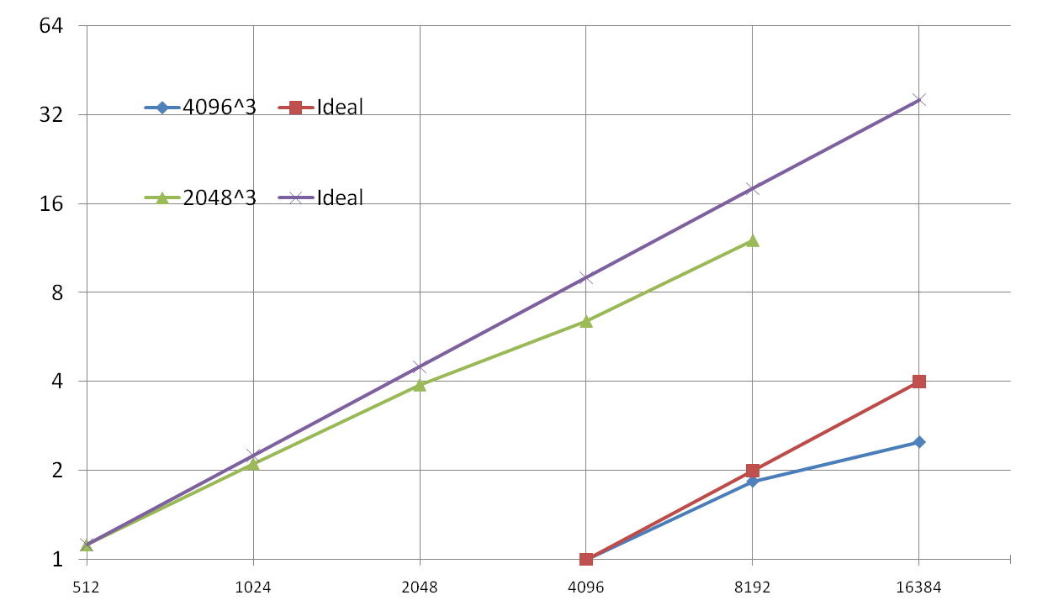
Performance on Cray XT4 (Kraken) at NICS/ORNL
speedup
# cores (P)

Slide 16
Applications of P3DFFT
P3DFFT has already been applied in a number of codes, in science fields including the following:
Turbulence
Astrophysics
Oceanography
Other potential areas include
  Molecular Dynamics
  X-ray crystallography
  Atmospheric science

Slide 17
DNS turbulence
Code from Georgia Tech (P.K.Yeung et al.) to simulate isotropic turbulence on a cubic periodic domain
Uses pseudospectral method to solve Navier-Stokes eqs.
3D FFT is the most time-consuming part
It is crucial to simulate grids with high resolution to minimize discretization effects and study a wide
range of length scales.
Therefore it is crucial to efficiently utilize
state-of-the-art compute resources, both for total memory and speed.
2D decomposition based on P3DFFT framework has been implemented.

Slide 18
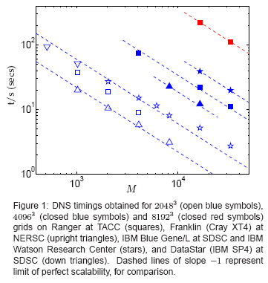
DNS performance
Plot adapted from D.A.Donzis et al., “Turbulence simulations on O(10^4) processors”, presented at Teragrid’08, June 2008

Slide 19
P3DFFT - Future work
Part 1: Interface and Flexibility
Add the option to break down 3D FFT into stages: three transforms and two transposes
Expand the memory layout options
  currently (X,Y,Z) on input, (X,Y,Z) or (Z,X,Y) on output
Expand decomposition options
  currently: 1D or 2D, with Y and Z divided on input
  in the future: more general processor layouts, incl. 3D
Add other types of transform: cosine, sine, etc.

Slide 20
P3DFFT - Future work
Part 2: Communication/computation overlap
  Approach 1: coarse-grain overlap.
    Stagger different stages of 3D FFT algorithm for different fields, overlap with all-to-all transposes
    Use either non-blocking MPI, or one-sided MPI-2, or ??
    Buffer sizes are still large (insensitive to latency)
  Approach 2: fine-grain overlap.
    Overlap FFT stages with transposes for parts of array (2D planes?) within each field
    Use either one-sided MPI-2, or CAF, or ??
    Buffer sizes are small, however if overlap is implemented efficiently latency may be hidden.
    Combine with threaded version?

Slide 21
Conclusions
Efficient, scalable parallel 3D FFT library is being developed (open-source download available at http://www.sdsc.edu/us/resources/p3dfft.php)
Good potential for enabling petascale science
Future work is planned for expanded flexibility of the interface and better ultra-scale performance
Questions or comments:
  dmitry@sdsc.edu

Slide 22
Acknowledgements
P.K.Yeung
D.A.Donzis
G. Chukkappalli
J. Goebbert
G. Brethouser
N. Prigozhina
Supported by NSF/OCI

