Slide 1
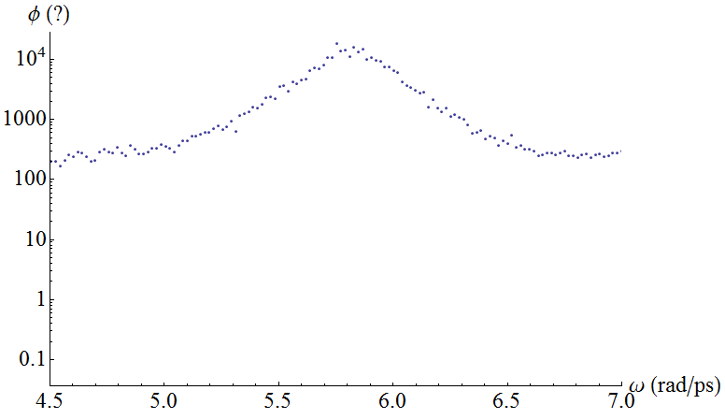
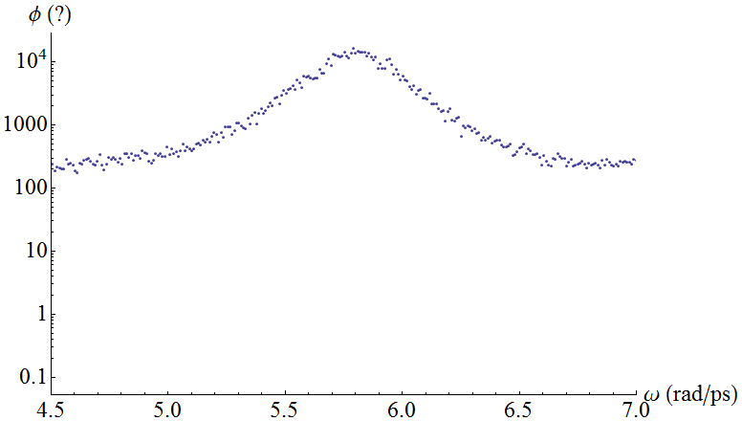
LJ argon case study (100) SED spectrum for various input parameters
N_{atoms} = 256
Δt = 5 ps
ω_{max} = 2π/(Δt*2⁶) rad/s
Zero pressure
T = 20K
ω_{step} = 2π/(Δt*2¹⁶) rad/s
t = Δt*2²⁰ s
T = 20K
ω_{step} = π/(Δt*2¹⁶) rad/s
t = Δt*2²⁰ s
ω_{o} = 5.81 rad/ps
τ = 3.37 ps
ω_{o} = 5.80 rad/ps
τ = 3.30 ps

Slide 2
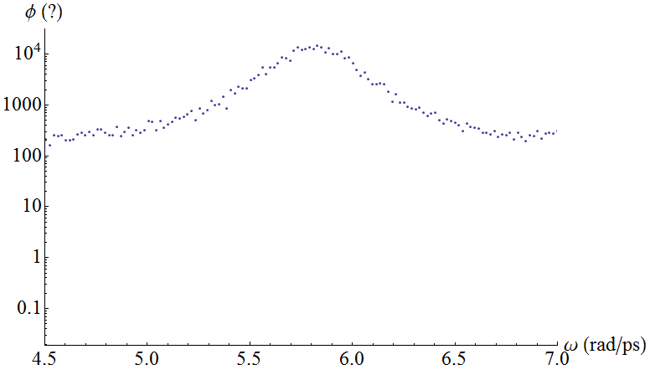
LJ argon case study (100) SED spectrum for various input parameters
N_{atoms} = 256
Δt = 5*10⁻¹⁵ s
ω_{max} = 2π/(Δt*2⁶) rad/s
Zero pressure
T = 20K
ω_{step} = 2π/(Δt*2¹⁶) rad/s
t = Δt*2²⁰ s
T = 20K
ω_{step} = 2π/(Δt*2¹⁶) rad/s
t = Δt*2²¹ s
ω_{o} = 5.81 rad/ps
τ = 3.37 ps
ω_{o} = 5.81 rad/ps
τ = 3.12 ps

Slide 3
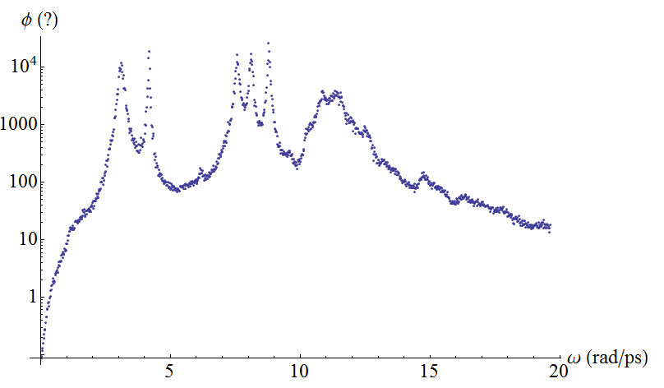
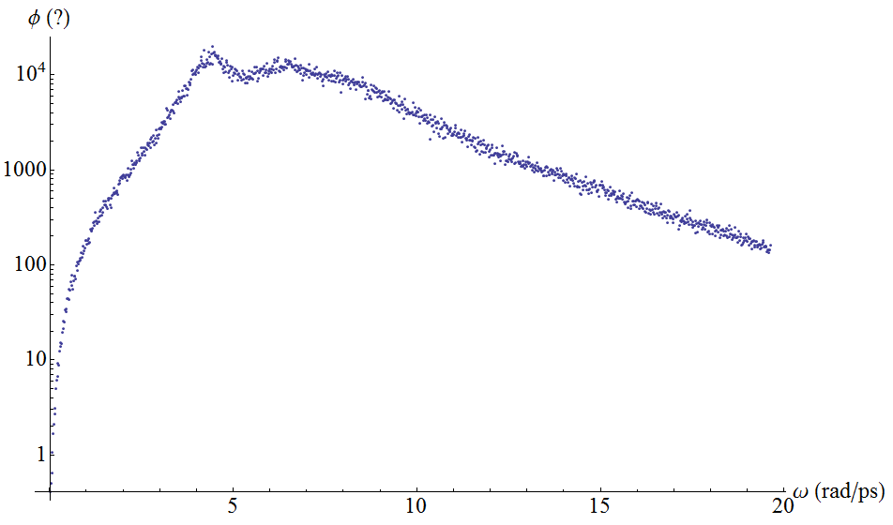
LJ argon case study (100) SED spectrum for various input parameters
N_{atoms} = 256
Δt = 5*10⁻¹⁵ s
ω_{max} = 2π/(Δt*2⁶) rad/s
Zero pressure
T = 20K
ω_{step} = 2π/(Δt*2¹⁶) rad/s
t = Δt*2²⁰ s
T = 80K
ω_{step} = 2π/(Δt*2¹⁶) rad/s
t = Δt*2²⁰ s

Slide 4
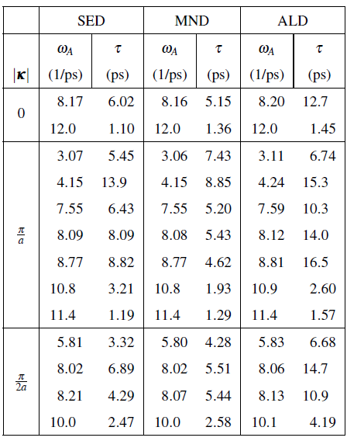
Joe
Alex
 | Runs 1-4 |  | Runs 5-8
|κ| | ω_{A} (rad/ps) | τ (ps) | ω_{A} (rad/ps) | τ (ps)
0 | 8.17 | 5.76 | 8.19 | 6.06
 | 12 | 1.11 | 12 | 1.14
π/a | 3.1 | 5.12 | 3.1 | 5.00
 | 4.18 | 20.2 | 4.17 | 20.8
 | 7.57 | 6.30 | 7.58 | 5.74
 | 8.11 | 7.22 | 8.1 | 7.18
 | 8.79 | 12.1 | 8.79 | 9.88
π/2a | 5.81 | 3.40 | 5.82 | 3.18
 | 8.05 | 5.72 | 8.05 | 6.98
 | 10 | 2.80 | 10 | 2.34

