Slide 1
AJTEC2011-44315:
Predicting Phonon Properties from
Molecular Dynamics Simulations
using the Spectral Energy Density
Joe Turney, John Thomas, and Alan McGaughey
Department of Mechanical Engineering
Carnegie Mellon University, Pittsburgh PA
Cristina Amon
Department of Mechanical & Industrial Engineering
University of Toronto, Toronto ON
AJTEC 2011, Honolulu HI, March16, 2011

Slide 2
Spectral Energy Density Method
Run MD simulation (classical)
  Empirical potentials
  DFT-MD (computational resources permitting…)
Output/track velocities of all atoms at all times
Project velocities onto traveling waves to
obtain spectral energy density
Extract phonon properties
Predict thermal conductivity
Any MD
Code

Slide 3
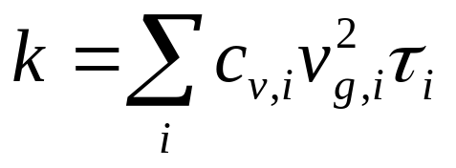
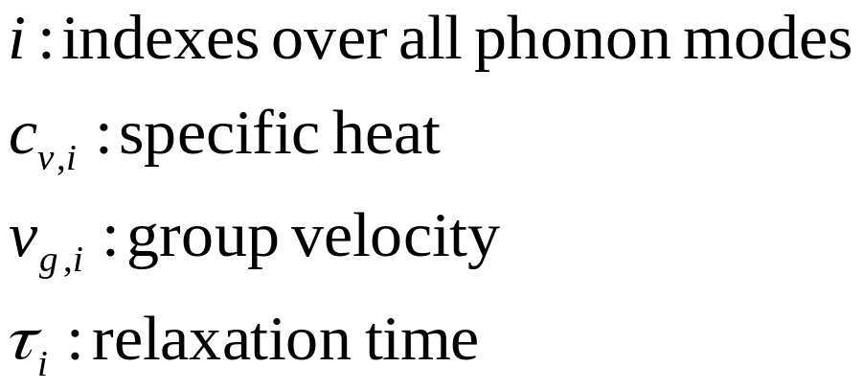
Spectral Formula for Thermal Conductivity
Boltzmann transport equation under
the relaxation time approximation
+ Fourier law

Slide 4
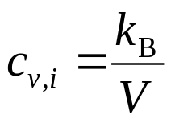
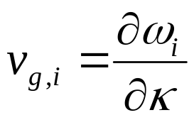
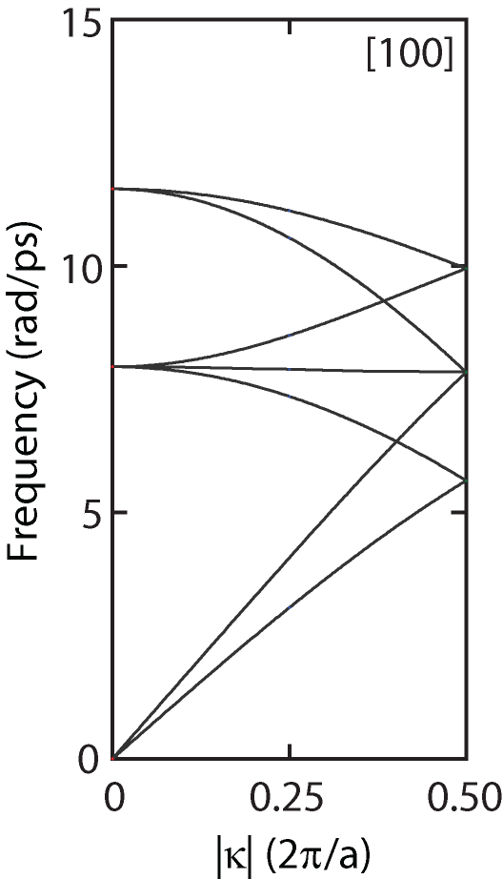
Predicting Phonon Properties
Harmonic lattice dynamics gives phonon frequencies, ω
Specific heat in classical (high-T) limit:
Group velocity from slope of dispersion curve:
LJ argon,
4-atom conventional unit cell

Slide 5
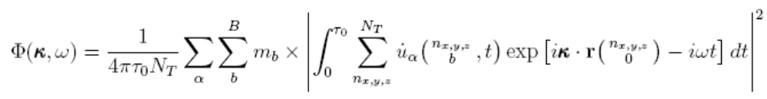
Spectral Energy Density
Formally derived from lattice dynamics theory.
Specify allowed wave vectors from system geometry
Frequency scan at each wave vector
Maruyama, Micro. Therm. Eng. 7 (2003) 41-50; Shiomi & Maruyama, PRB 73 (2006) 205420; de Koker, PRL 103 (2009) 125902; Thomas et al., PRB 81 (2010) 081411(R)

Slide 6
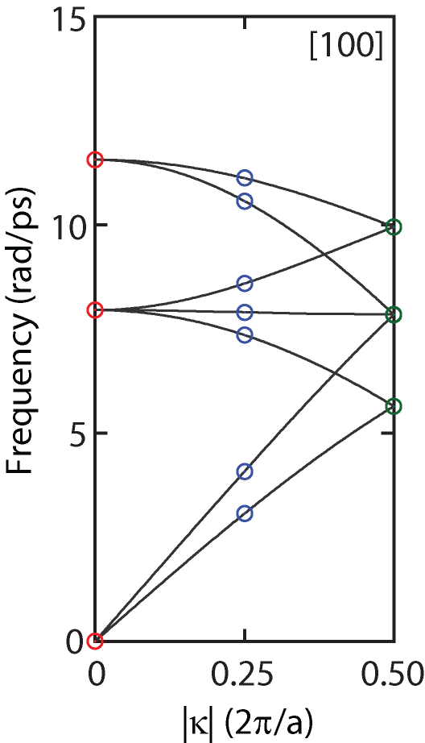
Case Study: LJ Argon
4x4x4 unit cells (256 atoms)
4-atom conventional unit cell
(simple cubic → Brillouin zone is also cubic)
T = 20 K (melting temperature ~ 85 K)
Five independent simulations of 2 million time steps (5 fs), average SED
Focus on [100] direction
With larger system, could also get dispersion curves and group velocities.

Slide 7
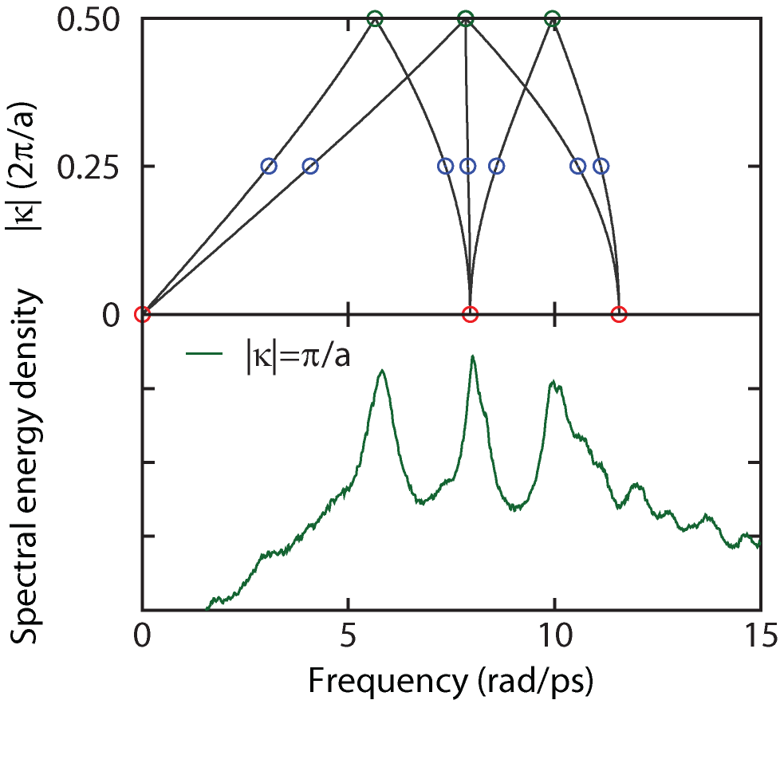
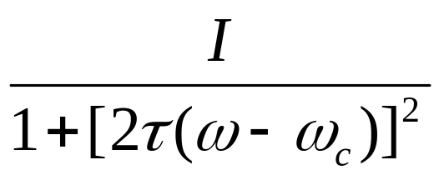
SED along κ = 0.5 (2π/a)
Peaks are Lorentzian:
Fit to get relaxation times
What about degeneracy?
(Log Scale)

Slide 8
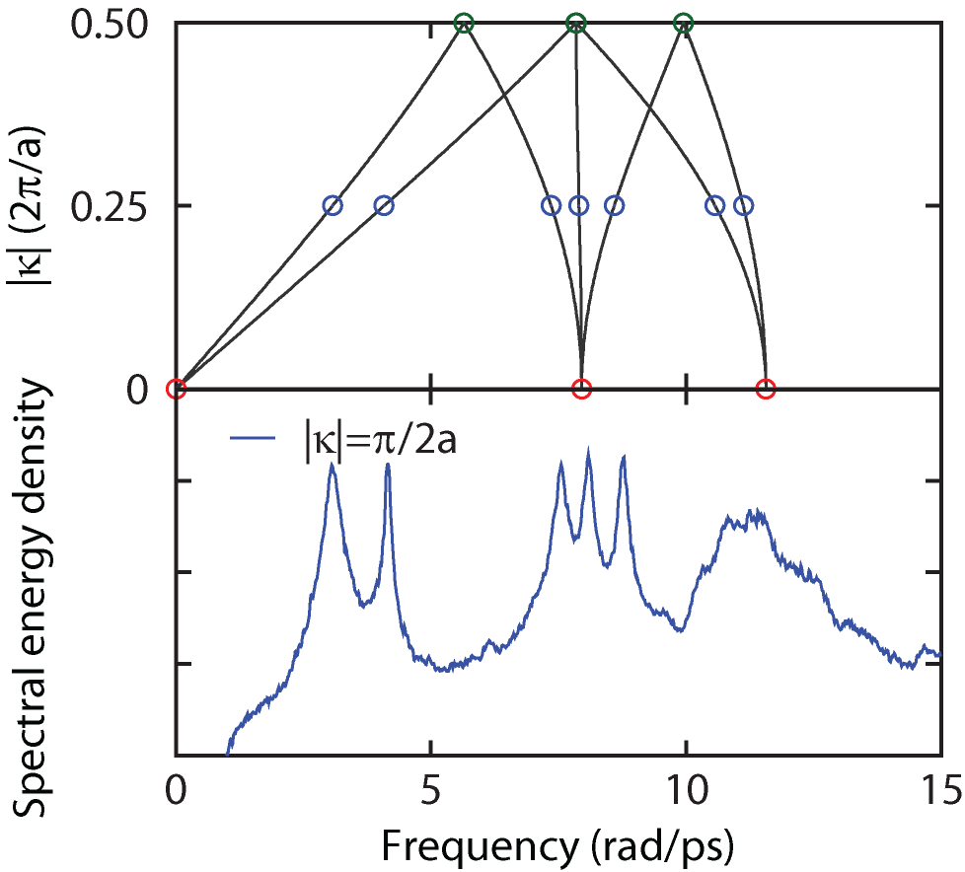
SED along κ = 0.25 (2π/a)
Not all peaks are well suited for fitting.
Hard to automate procedure
(Log Scale)

Slide 9
Other Techniques for Relaxation Times
Anharmonic lattice dynamics calculations
  Quantum effects naturally incorporated
  Force constants from an empirical potential or DFT
  Need frequencies and mode shapes from harmonic LD
  Capture up to three-phonon interactions (only good for low temperatures)
  Complicated theoretical framework and calculations
Normal mode decomposition (MD simulation)
  Captures full anharmonicity
  Need frequencies and mode shapes from harmonic LD
  MD simulation is classical (good for high temperatures)
  Cumbersome post-processing, hard to automate
  Turney et al., PRB 79, 064301 (2009)

Slide 10
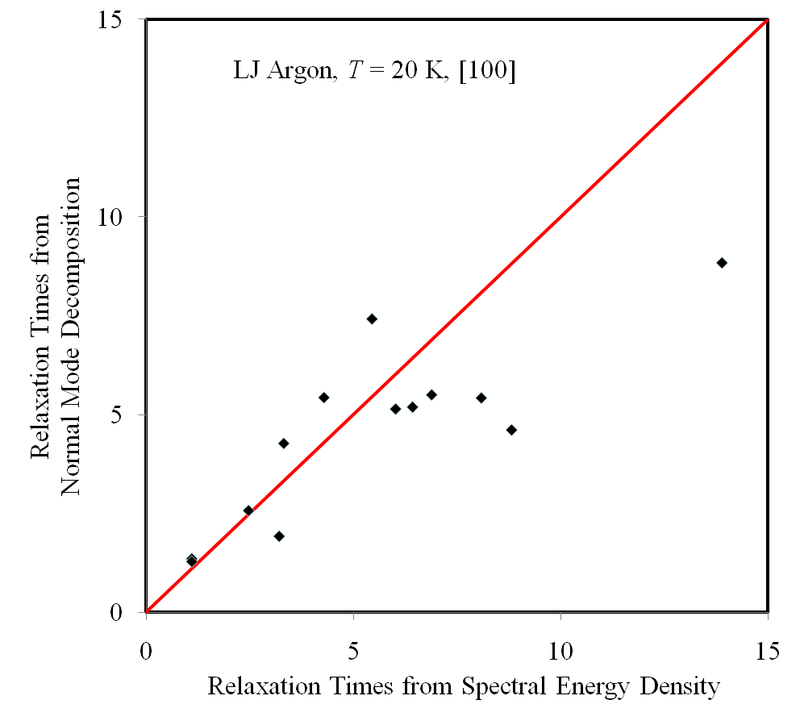
Relaxation Times

Slide 11
Pros/Cons of Spectral Energy Density
Do not need frequencies and mode shapes from harmonic LD
Captures full anharmonicity
Can study perturbations to periodicity
  Point defects, external fluid, …
MD simulation is classical (good for high temperatures)
Post-processing challenges

Slide 12
Summary
Use spectral energy density to predict phonon properties from an MD simulation
  Can model perfect and weakly-perturbed systems
Challenges:
  Need a lot of data
    Take advantage of Brillouin zone symmetry
  Degenerate modes
    Get help from lattice dynamics calculations
  Automating fitting procedure
  Quantifying uncertainty
Application to water-filled carbon nanotube:
  Thomas et al., Physical Review B 81 (2010) 081411(R).
Support: NSF Graduate Research Fellowship,
AFOSR FA95501010098

