Slide 1
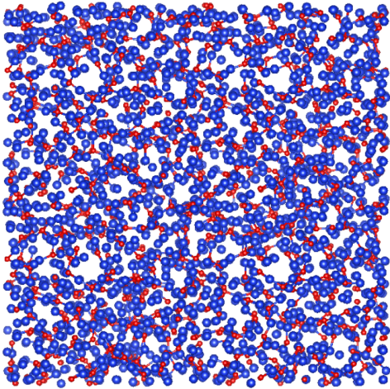
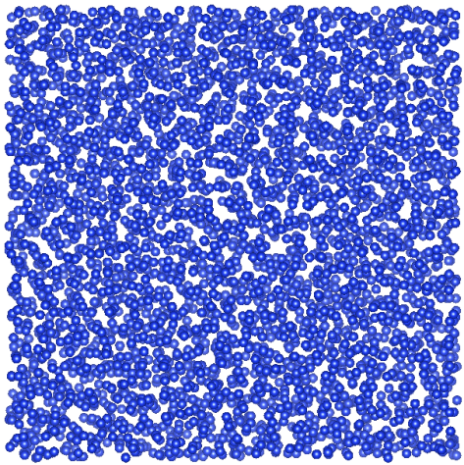
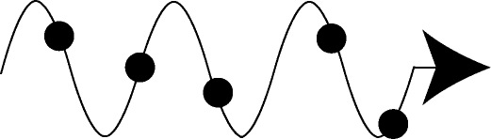
Predicting Vibrational Mean Free Paths in Disordered Systems
Jason Larkin and Alan McGaughey
Department of Mechanical Engineering
Carnegie Mellon University, Pittsburgh PA
Massoud Kaviany Symposium
2013 Summer Heat Transfer Conference
July 16, 2013
Support: AFOSR

Slide 2
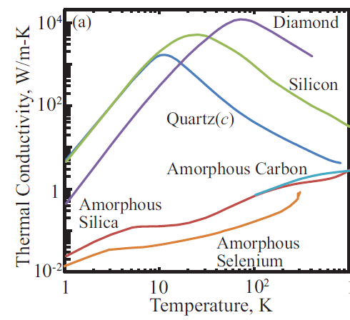
Amorphous Solids
Structural disorder
Composition disorder possible
Amorphous silicon (a-Si) and silica glass (a-SiO₂)
Experimental data from Touloukian, Thermophysical Properties of Matter.

Slide 3
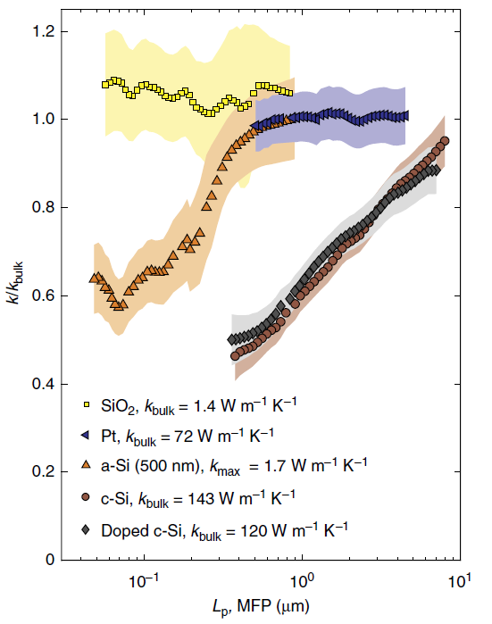
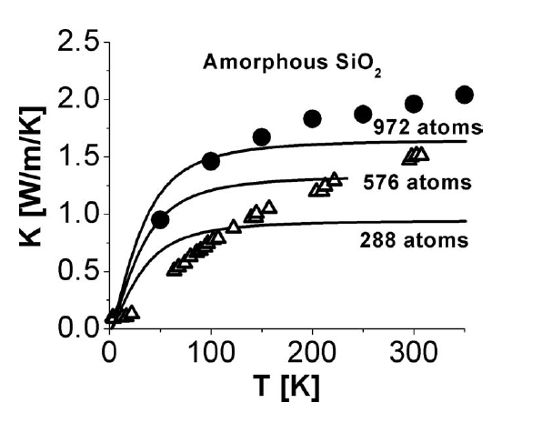
Mechanism?
FDTR Experiments (Malen):
But, from classical MD:
Shenogin et al., JAP 105 (2009) 034906.
Regner et al., Nat. Comm. 4, 1640 (2013).

Slide 4
Vibrational Modes in Disordered Systems
Extended modes
Propagon (phonon-like)
Diffuson (non-propagating, group velocity not well-defined)
Localized modes
Locons (not relevant to 3-D thermal transport)
Classify using eigenvectors, other methods …
All modes have a lifetime → decay of their energy.

Slide 5
Thermal Conductivity Prediction
PROPAGONS
DIFFUSONS
Allen and Feldman, PRB 48, 12581 (1993)

Slide 6
Amorphous Structures
Amorphous silica (a-SiO₂)
BKS potential
Melt-quench-anneal from quartz
4608 Atoms
Amorphous silicon (a-Si)
Stillinger-Weber potential
WWW structures + anneal
4096 Atoms
a-Si: Barkema and Mousseau, PRB 62, 4985 (2000).
a-SiO₂: McGaughey and Kaviany, IJHMT 47, 1799 (2004).

Slide 7
Computational Tools
Lattice dynamics theory
Harmonic (frequencies, Allen-Feldman diffusivities)
Molecular dynamics simulation
No assumptions about thermal transport (propagons vs. diffusons)
Classical statistics
Phonon lifetimes from normal mode decomposition
Thermal conductivity from Green-Kubo method

Slide 8
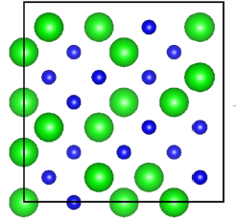
Treat Disorder Explicitly
Supercell = Unit Cell
N atoms
Lattice dynamics only at the Gamma-point.
1 wave vector × 3N polarizations = 3N modes
Cannot specify group velocity.
He et al., APL 98, 144101 (2011),
Hori et al., JAP 113, 203514 (2013)

Slide 9
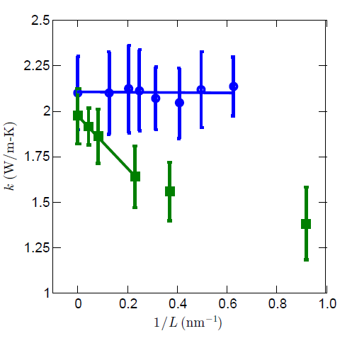
Green-Kubo Thermal Conductivity (Top-down)
a-SiO₂
a-Si

Slide 10
Bottom-Up Thermal Conductivity Prediction
Challenges:
Where is the transition between propagons and diffusons?
How to specify the propagon group velocity?
How to include low-frequency modes not in MD?

Slide 11
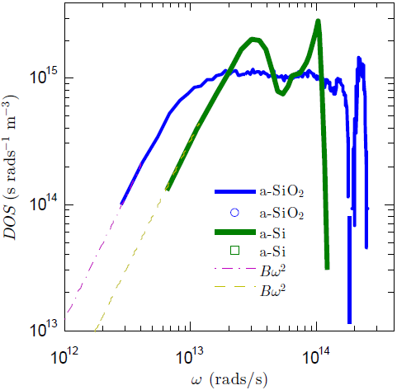
Density of States
Extract a single velocity scale from Debye region.
a-SiO₂
a-Si

Slide 12
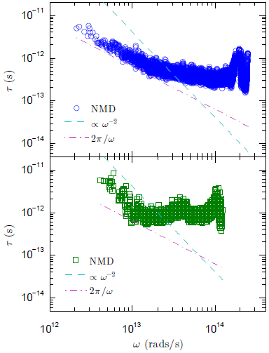
Lifetimes
a-SiO₂
Almost all diffusons.
a-Si
Clear propagon to diffuson transition.

Slide 13
Challenges Addressed
How to specify the propagon group velocity?
One velocity scale from DOS
Where is the transition between propagons and diffusons?
Transition in τ vs. ω plot
How to include low-frequency modes not in MD?
Summation → Integral

Slide 14
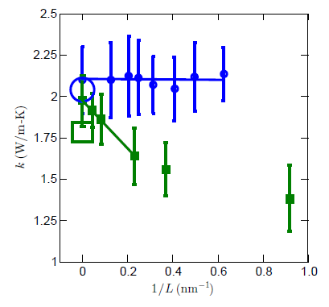
Thermal Conductivity
a-SiO₂
a-Si

Slide 15
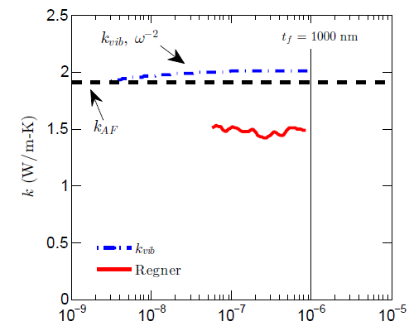
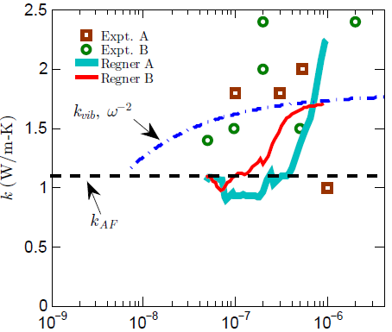
Thermal Conductivity Accumulation
a-SiO₂
a-Si
Mean Free Path, m
Mean Free Path, m
Regner et al., Nat. Comm. 4, 1640 (2013).

Slide 16
Summary
Not all amorphous materials are alike
In a-SiO2, majority of thermal conductivity from diffusons
In a-Si, contributions from propagons and diffusons
Challenges in interpreting a-Si data due to range of experiments

Slide 17
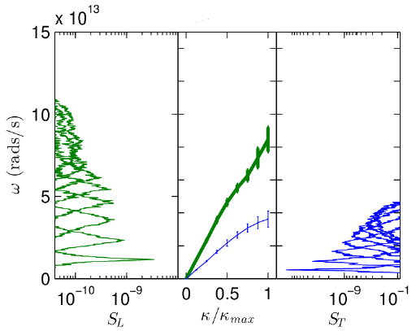



a-Si [100] Structure Factor and Dispersion

Slide 18
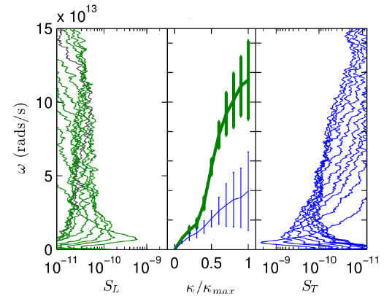
a-SiO₂ [100] Structure Factor and Dispersion

Slide 19





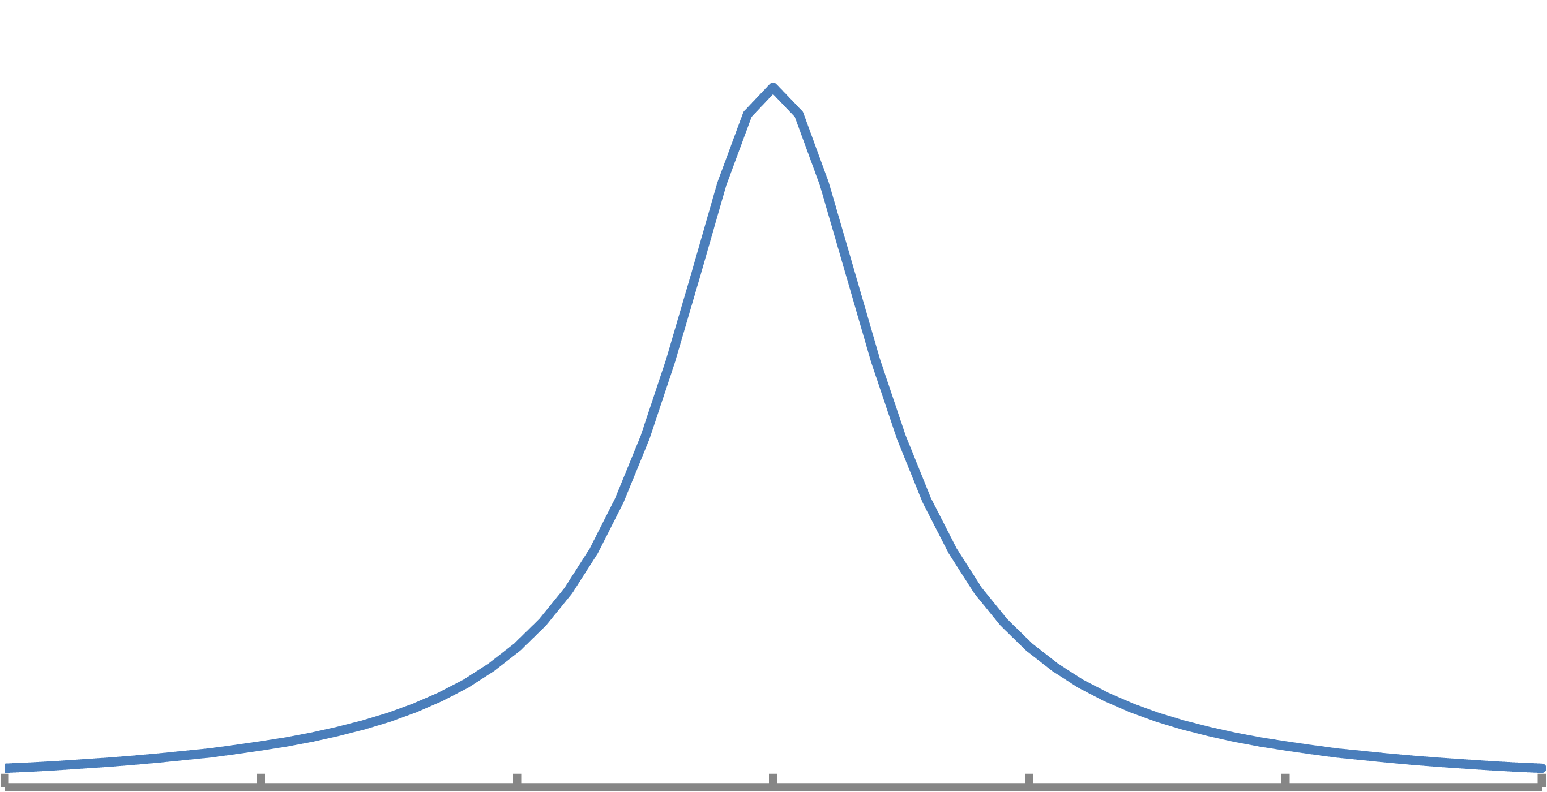
Normal Mode Decomposition
1. Equilibrium MD simulations provide atomic velocities.
2. Project velocities onto phonon modes from lattice dynamics calculations.
3. Auto-correlation and Fourier transform of phonon kinetic energy.
4. Extract phonon lifetime.
Ladd et al., PRB 34, 5068 (1986),
McGaughey and Kaviany, PRB 69, 094308 (2004).

Slide 20
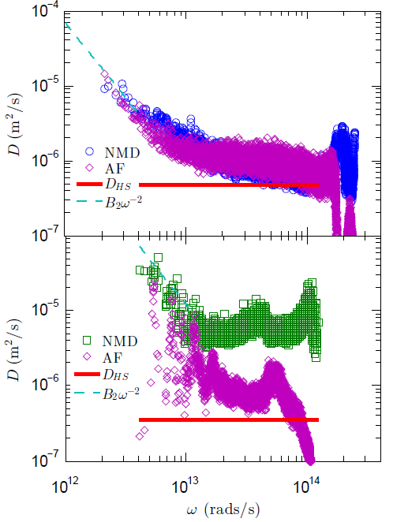
Diffusivities
a-SiO₂
a-Si

Slide 21
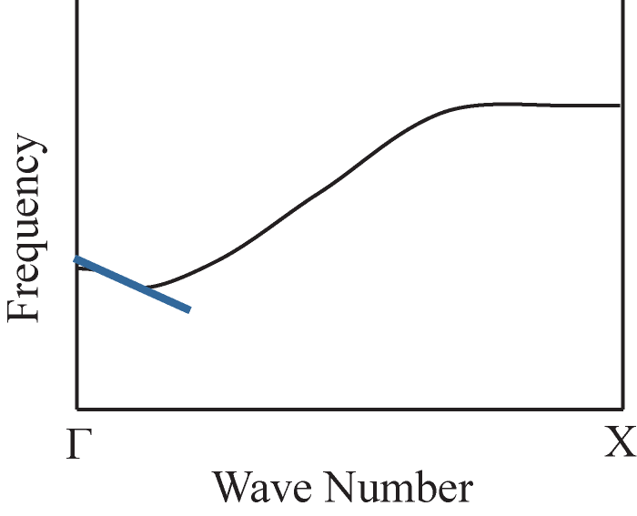
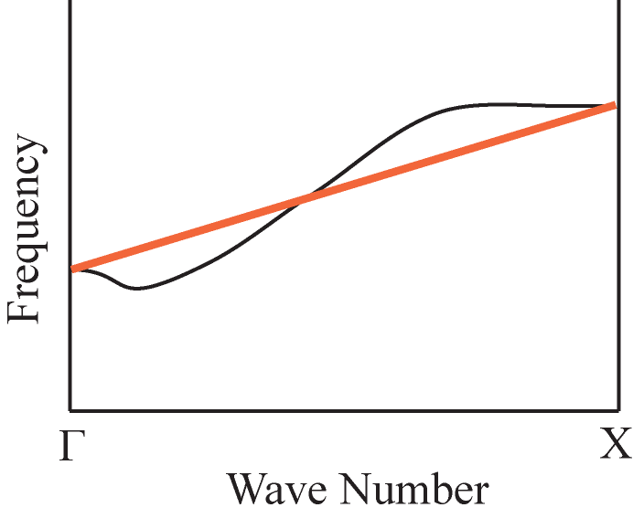
Group Velocity from Gamma Analysis?
All modes have zero group velocity
at the Gamma-point.
1. Linear fit near Gamma-point
2. Gamma-X linear fit
He et al., APL 98, 144101 (2011)
Hori et al., JAP 113, 203514 (2013)

