Slide 1
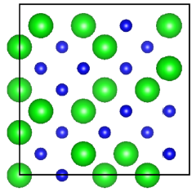
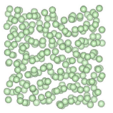
Predicting Vibrational Mode Properties in Disordered Systems
Jason Larkin and Alan McGaughey
Department of Mechanical Engineering
Carnegie Mellon University, Pittsburgh PA
Thermal Transport at the Nanoscale Workshop
Telluride Science Research Center
June 25, 2013
Collaboration: Jon Malen (CMU)
Support: AFOSR

Slide 2
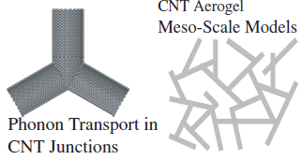
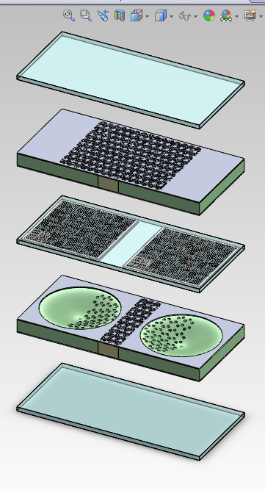
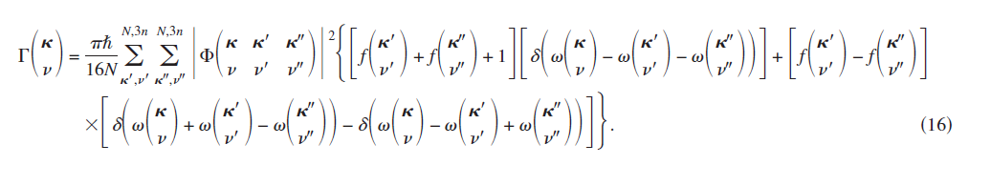
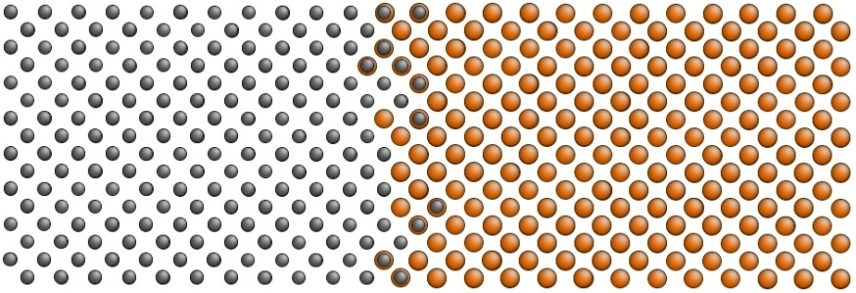
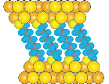
Research Projects
Carbon Nanotube Networks
(NSF; Anna, Islam, Malen, Pipe)
Active Micro Cooler
(DARPA; Fedder, Yao, ACT)
Methodology Development
Organic-Inorganic Hybrid Materials
(Malen)
Semiconductor Nanostructures
(AFOSR & NSF; Malen, PSC, Sandia)

Slide 3
Disordered Solids
Disordered lattice
Isotopic crystal, alloy
Compositional disorder
No structural disorder
Alloys for thermoelectric energy conversion (SiGe, PbTeSe)
Amorphous solid
Structural disorder
Composition disorder possible
Amorphous silicon in solar cells, silica glass

Slide 4
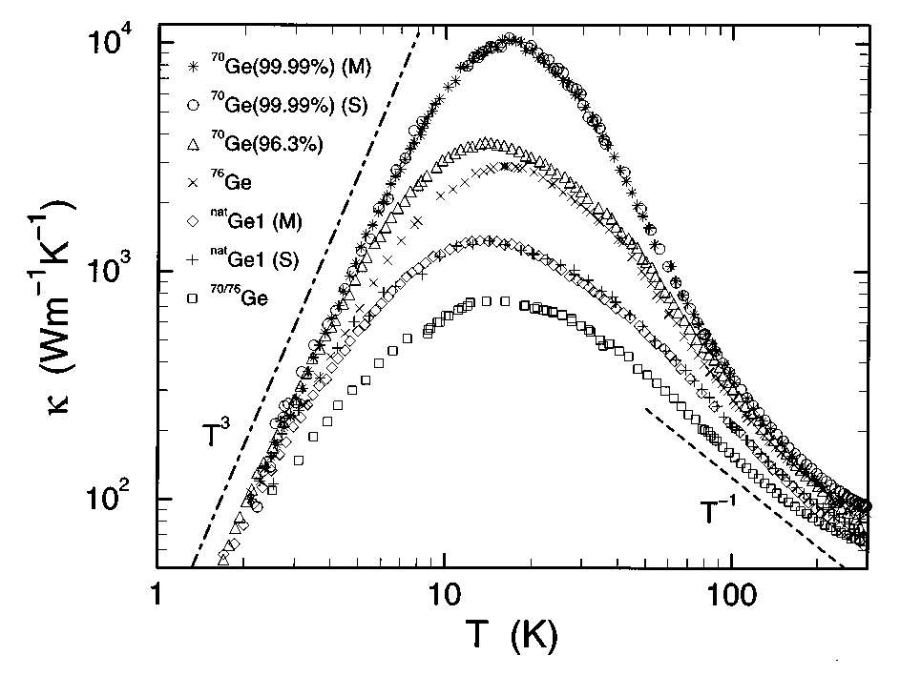
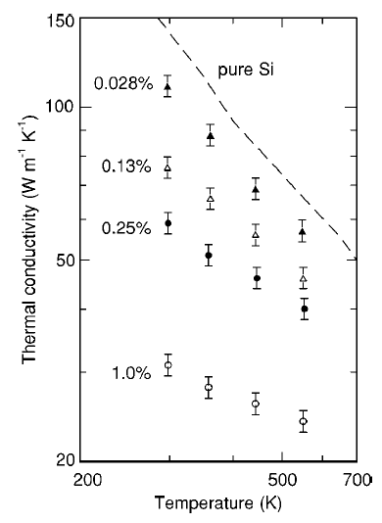
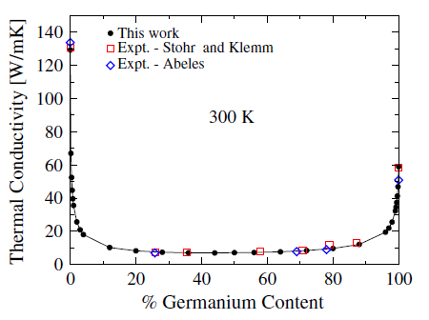
Disordered Lattice Thermal Conductivity
Asen-Palmer et al., PRB 56, 9431 (1997)
Garg et al.,
PRL 106, 045901 (2011)
Cahill et al., PRB 71, 235202 (2005)

Slide 5
Vibrational Modes in Disordered Systems
Extended modes
Propagon (phonon-like)
Diffuson (non-propagating, group velocity not well-defined)
Localized modes
Locons (not relevant to 3-D thermal transport)
Classify using eigenvectors, other methods …
All modes have a lifetime → decay of their energy.

Slide 6
Thermal Conductivity Prediction
PHONONS
DIFFUSONS
Allen and Feldman, PRB 48, 12581 (1993)

Slide 7
Objectives
Understand thermal transport in disordered lattices
Lennard-Jones mass alloy
Assess commonly-used tools and assumptions
Virtual crystal approximation
Tamura theory for mass-point defect scattering

Slide 8
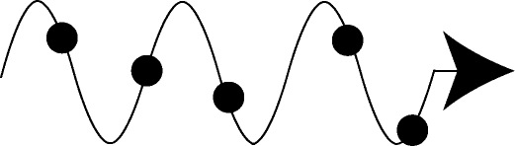
Outline
Introduction
Tools, Treating Disorder
LJ Mass Alloy

Slide 9
Computational Tools
Lattice dynamics theory
Harmonic (frequencies, phonon-defect lifetimes, Allen-Feldman diffusivities)
Anharmonic (phonon-phonon lifetimes)
Force constants from DFT or empirical potentials
Quantum or classical statistics
Scales as (atoms in unit cell)⁴
Molecular dynamics simulation
No assumptions about thermal transport
Classical statistics
Empirical potentials → large length and time scales
Phonon lifetimes from normal mode decomposition
Thermal conductivity from Green-Kubo method
Scales as total number of atoms

Slide 10
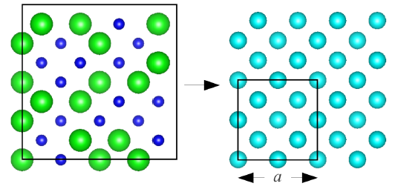
1. Disorder as a Perturbation
Virtual Crystal (VC) Approximation
N atoms
n atoms
Perform lattice-dynamics calculations on the VC unit cell.
N/n wave vectors × 3n polarizations = 3N modes
Perturbative disorder with Tamura theory.
Abeles, PR 131, 1906 (1963),
Tamura, PRB 27, 858 (1983), Garg et al., PRL 106, 045901 (2011)

Slide 11
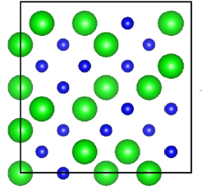
2. Disorder Explicitly
Supercell = Unit Cell
N atoms
Lattice dynamics only at the Gamma-point.
1 wave vector × 3N polarizations = 3N modes
How to define group velocity?
He et al., APL 98, 144101 (2011),
Hori et al., JAP 113, 203514 (2013)

Slide 12
Outline
Introduction
Tools, Treating Disorder
LJ Mass Alloy

Slide 13
Alloy System
Lennard-Jones potential, T = 10 K, N ≤ 6,092
m₁=1, m₂=3 alloy (no strain)
Concentrations c = 0, 0.05, 0.15, 0.5
Data from:
Virtual crystal unit cell (VC)
Supercell as unit cell (Gamma)

Slide 14
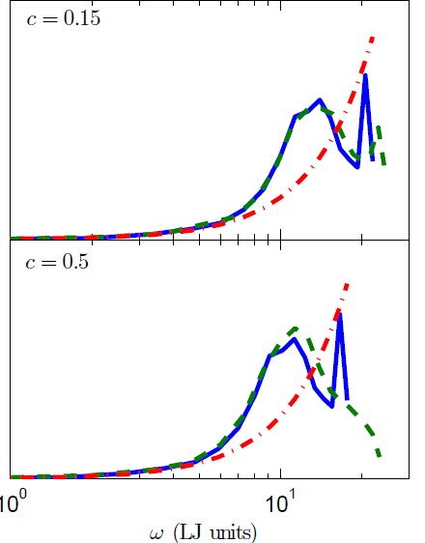
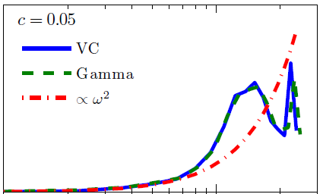

Density of States
Larkin and McGaughey, to appear in JAP.

Slide 15
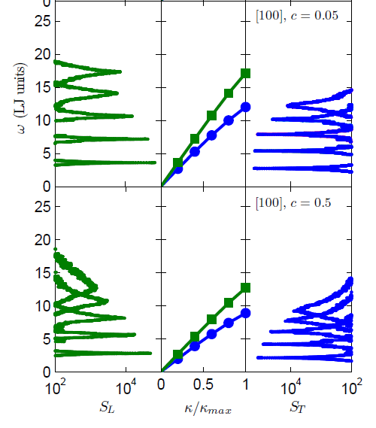
Structure Factor and Dispersion
The majority of alloy vibrational modes are phonon-like.
Use VC group velocities in thermal conductivity prediction.
Larkin and McGaughey, to appear in JAP.

Slide 16
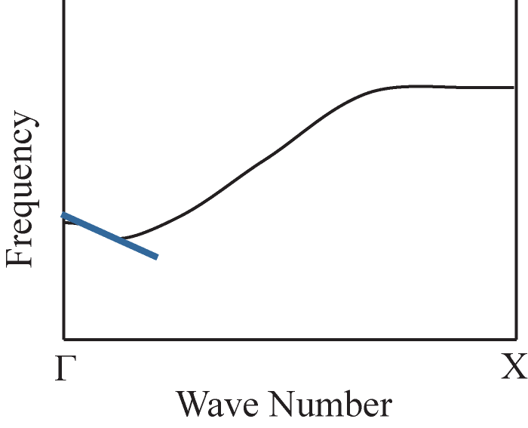
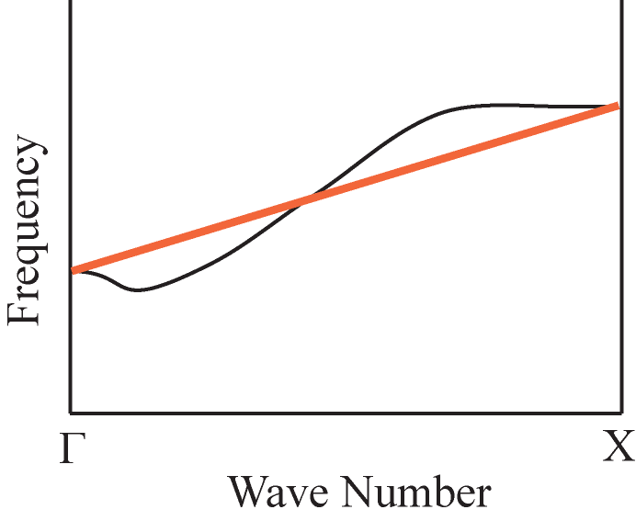
Group Velocity from Gamma Analysis?
All modes have zero group velocity
at the Gamma-point.
1. Linear fit near Gamma-point
2. Gamma-X linear fit
He et al., APL 98, 144101 (2011)
Hori et al., JAP 113, 203514 (2013)

Slide 17





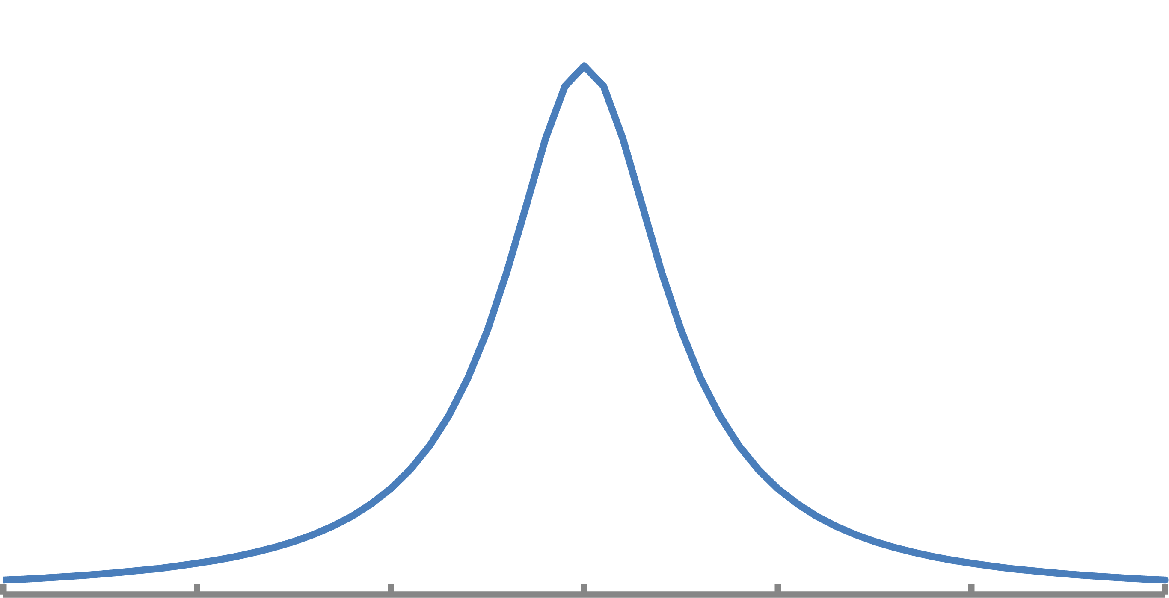
Normal Mode Decomposition
1. Equilibrium MD simulations provide atomic velocities.
2. Project velocities onto phonon modes from lattice dynamics calculations.
3. Auto-correlation and Fourier transform of phonon kinetic energy.
4. Extract phonon lifetime.
Ladd et al., PRB 34, 5068 (1986),
McGaughey and Kaviany, PRB 69, 094308 (2004).

Slide 18
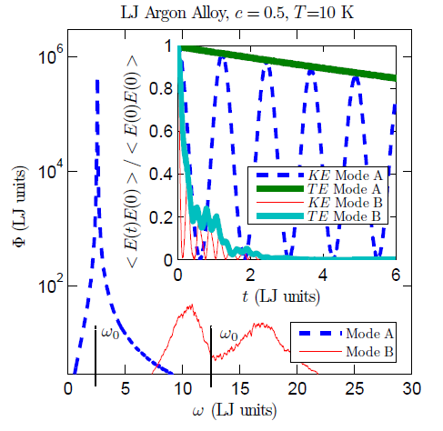
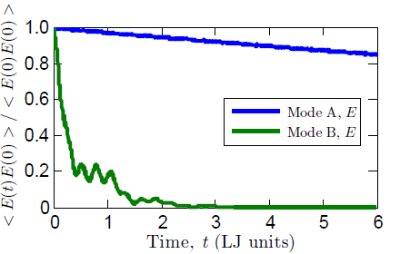
VC Normal Mode Decomposition on Alloys
Larkin and McGaughey, to appear in JAP.

Slide 19
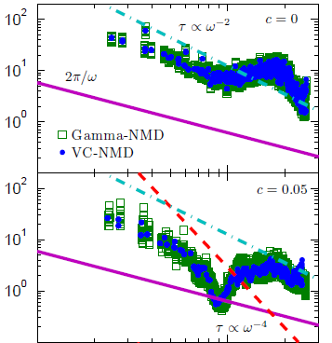
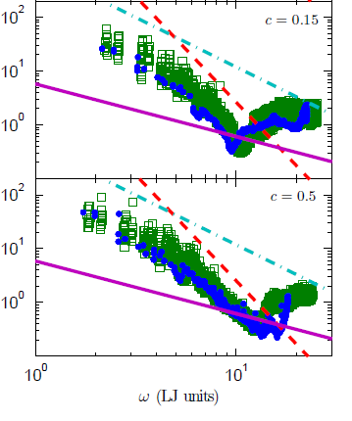



NMD Lifetimes: Gamma vs. VC
Larkin and McGaughey, to appear in JAP.

Slide 20
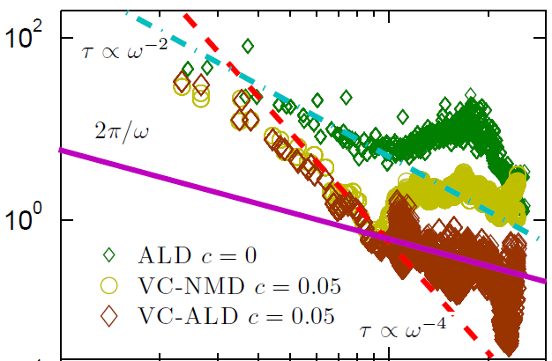


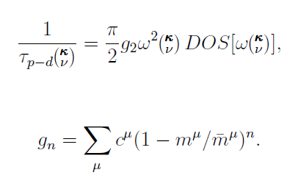
VC-ALD Lifetimes
Larkin and McGaughey, to appear in JAP.

Slide 21
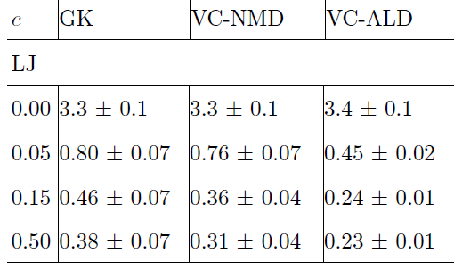
Thermal Conductivity (W/m-K)
Larkin and McGaughey, to appear in JAP.

Slide 22
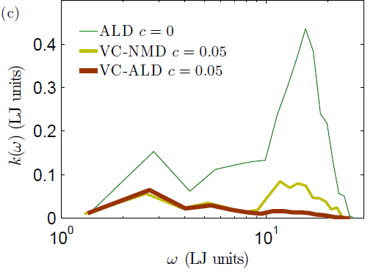
Thermal Conductivity Contribution

Slide 23
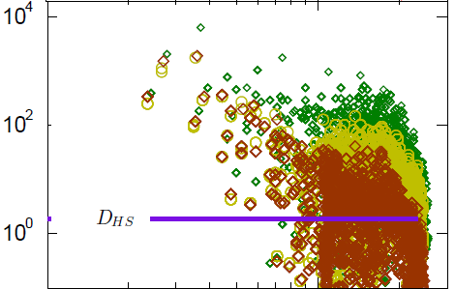



What is Happening?
Larkin and McGaughey, to appear in JAP.

Slide 24
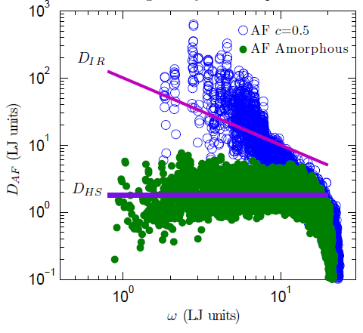
Diffusivity Correction
D_{min,ph}=0
but
D_{min,diff} =D_{HS}
If D < D_{HS},
set D = D_{HS}

Slide 25
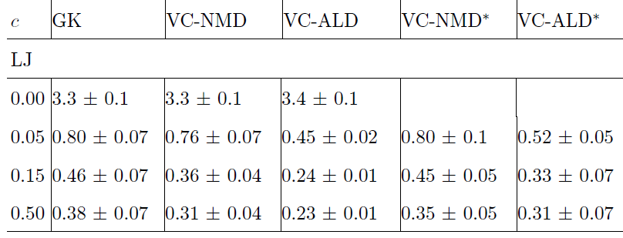
Corrected Thermal Conductivity
Larkin and McGaughey, to appear in JAP.

Slide 26
Summary
In LJ alloy, high-frequency modes contribute to thermal conductivity
Virtual crystal approximation underpredicts thermal conductivity
Low group velocity → correction proposed
Neglect of higher order terms in Tamura theory?
No issue for SW silicon, where low-frequency modes dominate thermal conductivity.

Slide 27
Outline
Introduction
Tools, Treating Disorder
LJ Mass Alloy
Amorphous Silica and Amorphous Silicon

Slide 28
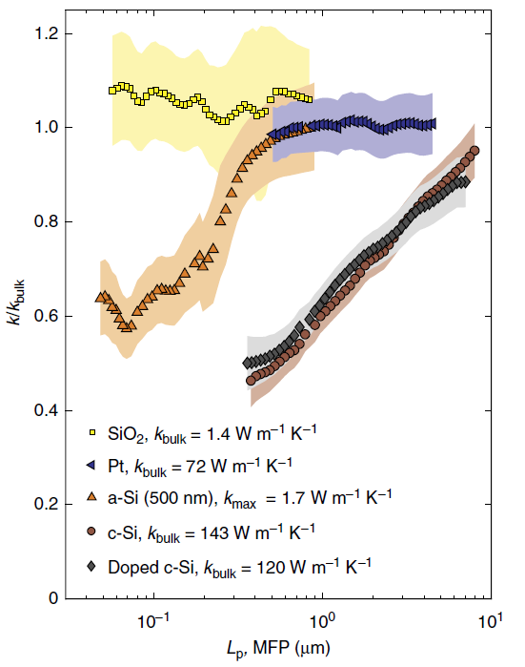
More Motivation: Thermal Conductivity Accumulation from Malen Group
Regner et al., Nat. Comm. 4, 1640 (2013).

Slide 29
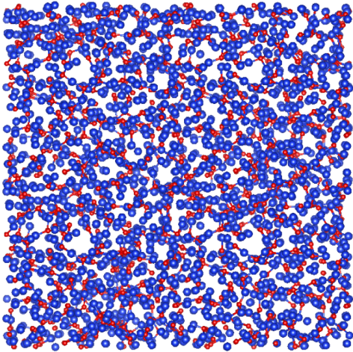
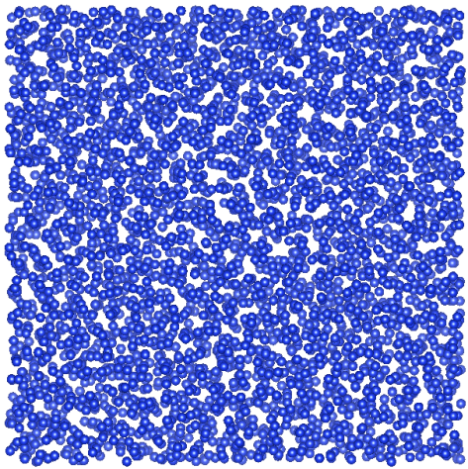
Amorphous Structures
Amorphous silica (a-SiO₂)
BKS potential, melt-quench-anneal from quartz, 4608 Atoms
Amorphous silicon (a-Si)
Stillinger-Weber potential, WWW structures + anneal, 4096 Atoms
Data from supercell as unit cell (Gamma)
Lifetimes from Gamma-NMD, Diffusivities from Allen-Feldman
WWW: Ladd et al., PRB 34, 5068 (1986),
McGaughey and Kaviany, IJHMT 47, 1799 (2004).

Slide 30
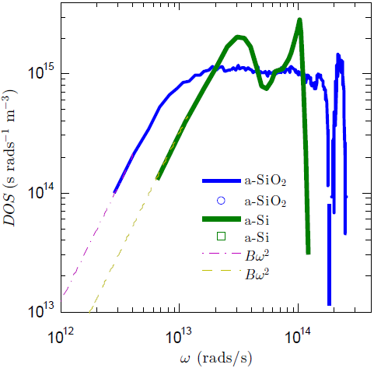
Amorphous Density of States

Slide 31
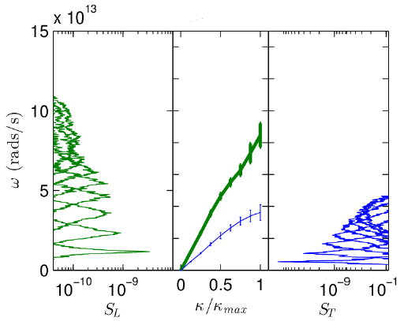
a-Si [100] Structure Factor and Dispersion

Slide 32
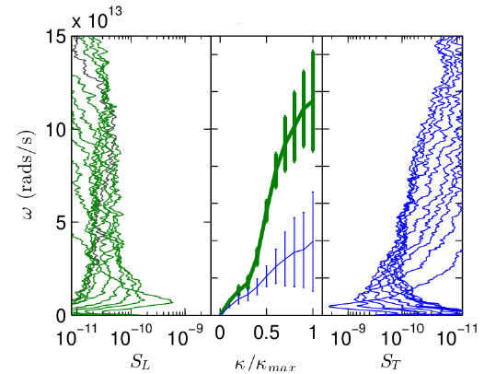
a-SiO₂ [100] Structure Factor and Dispersion

Slide 33
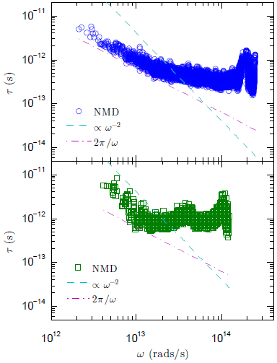
Amorphous Lifetimes
a-SiO₂
a-Si

Slide 34
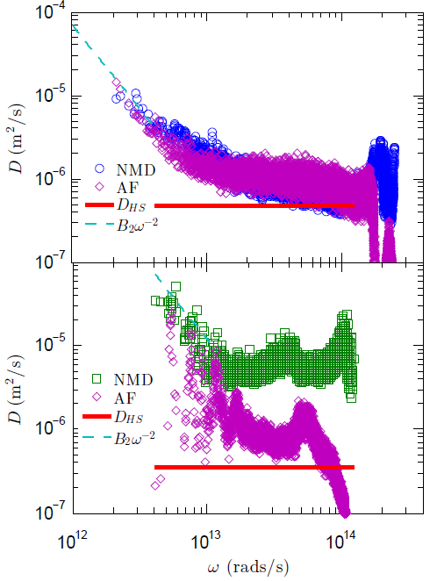
Amorphous Diffusivities
a-SiO₂
a-Si

Slide 35
Amorphous Summary and Looking Forward
Only Gamma analysis is possible
a-SiO₂ and a-Si show very different behaviors
Consistent with previous modeling and experiments
Group velocity must be specified to predict thermal conductivity
Working on making this decision
Phonon-diffuson transition
Predict thermal conductivity accumulation

Slide 36
Tamura Theory
Tamura, PRB 27, 858 (1983).

Slide 37
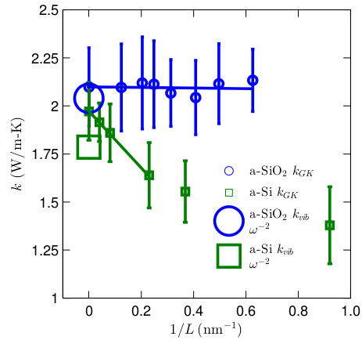
Amorphous Thermal Conductivity

Slide 38
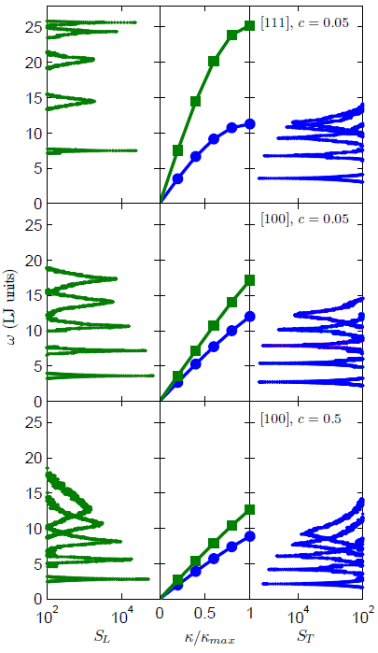



Structure Factor Equations
The majority of alloy vibrational modes are phonon-like.
Larkin and McGaughey, to appear in JAP.

