Slide 1
Thermal Transport in Disordered Materials
Jason Larkin
Nanoscale Transport Phenomena Laboratory
Carnegie Mellon Department of Mechanical Engineering http://ntpl.me.cmu.edu/
03/07/2012
1

Slide 2
Method vs. System Size

Slide 3
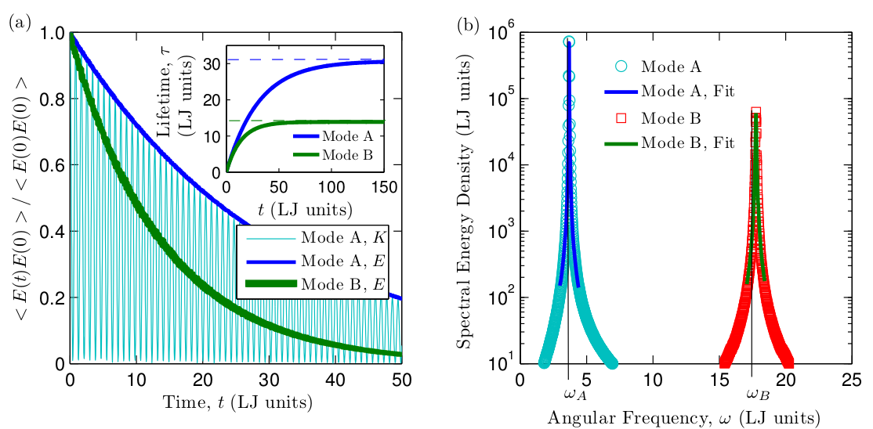

Slide 4
Comparison of Spectral Energy Methods for Predicting
Jason Larkin and Alan J. H. McGaughey
Department of Mechanical Engineering
Carnegie Mellon University
http://ntpl.me.cmu.edu/
04/04/13

Slide 5
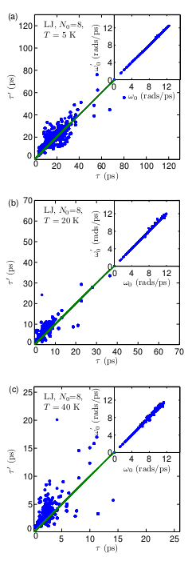

Slide 6
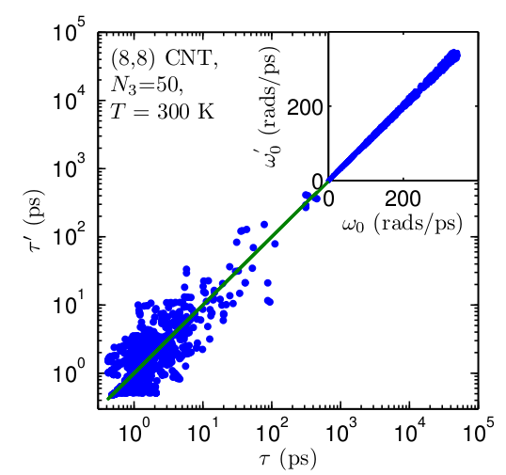
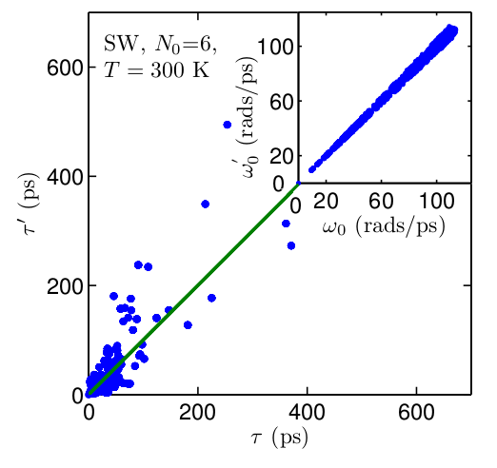

Slide 7
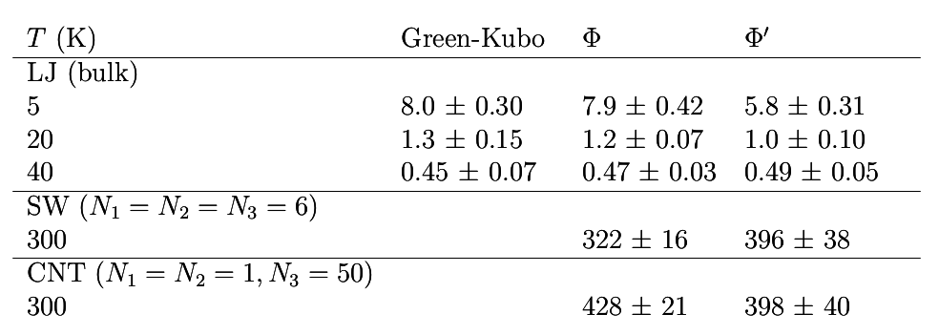

Slide 8
Evaluation of the Virtual Crystal Approximation for Predicting Thermal Conductivity
Jason Larkin and Alan J. H. McGaughey
Department of Mechanical Engineering
Carnegie Mellon University
http://ntpl.me.cmu.edu/
04/04/13

Slide 9
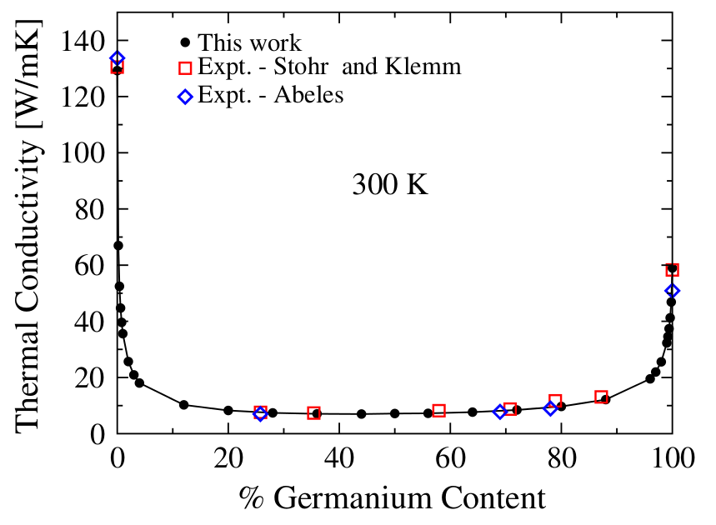
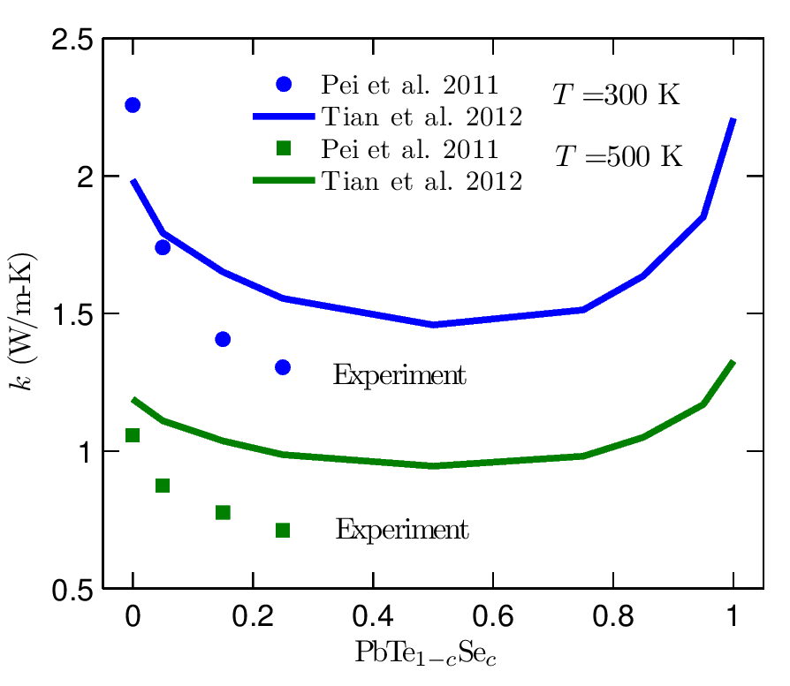
Motivation: experimental accuracy
Expensive Density Functional Theory (DFT) calculations
+
Virtual Crystal (VC) approximation &
Anharmonic Lattice Dynamics (ALD) (VC-ALD)
Alloys: isotopic effects, thermoelectric materials
PRL 106, 045901 (2011)
PRB 85, 184303 (2012)
SiGe

Slide 10
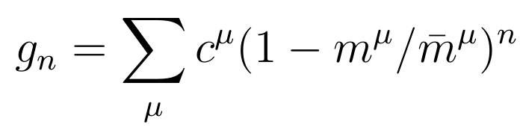

Virtual Crystal Approximation
a
,

Slide 11
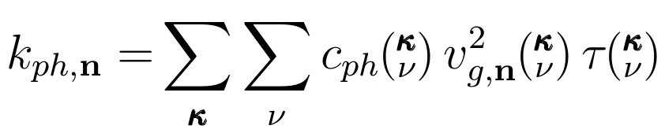
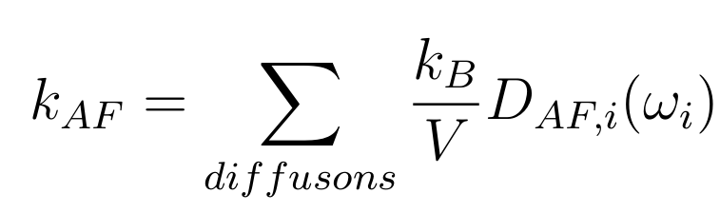
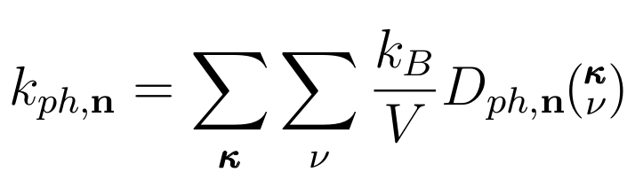
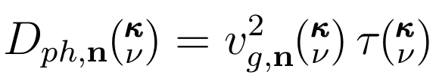
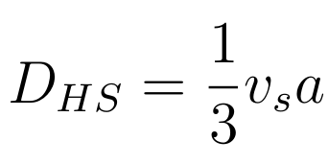
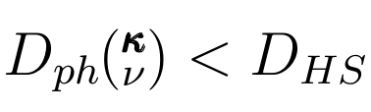
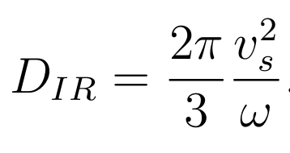
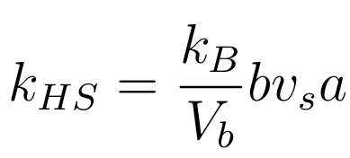
Kinetic Theory for Crystal
Thermal conductivity
Thermal diffusivity

Slide 12
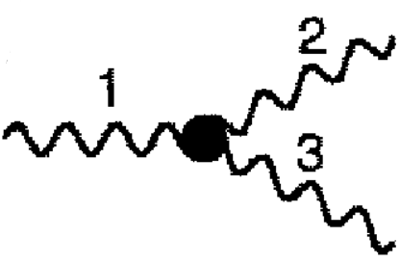
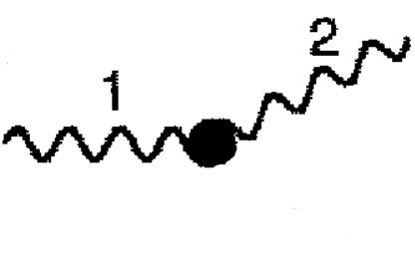


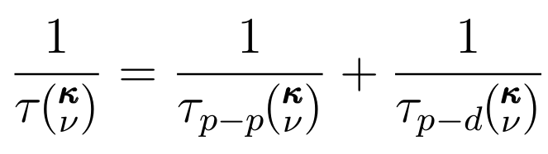

VC-ALD: Lifetimes
ALD
Tamura
~
1/
~
1/
Matthiessen's Rule

Slide 13
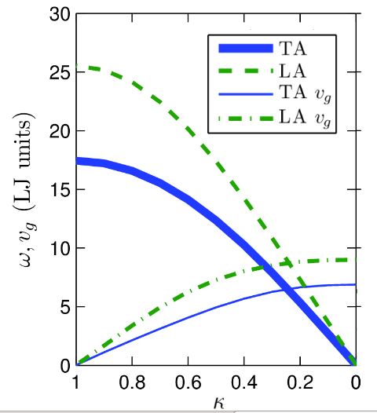
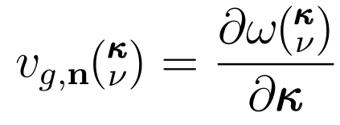

VC-ALD: Group Velocity

Slide 14
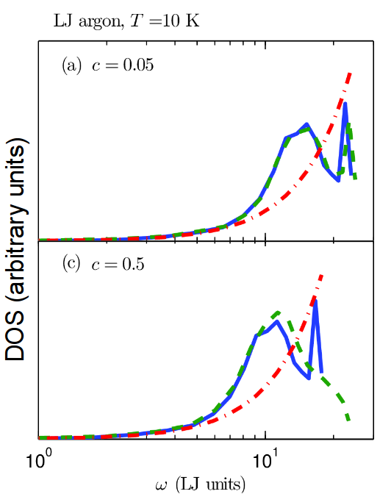
Explicit disorder: VC vs Gamma
Gamma
Computationally-inexpensive empirical potential:
Lennard-Jones argon

Slide 15
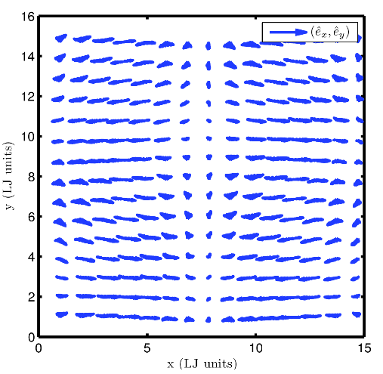
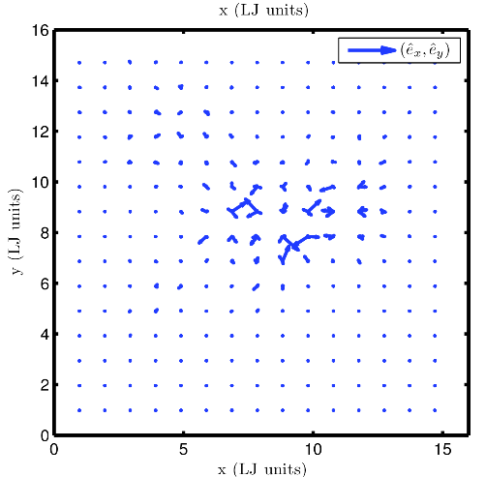
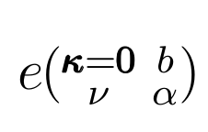
Gamma modes
DOS (arbitrary units)

Slide 16
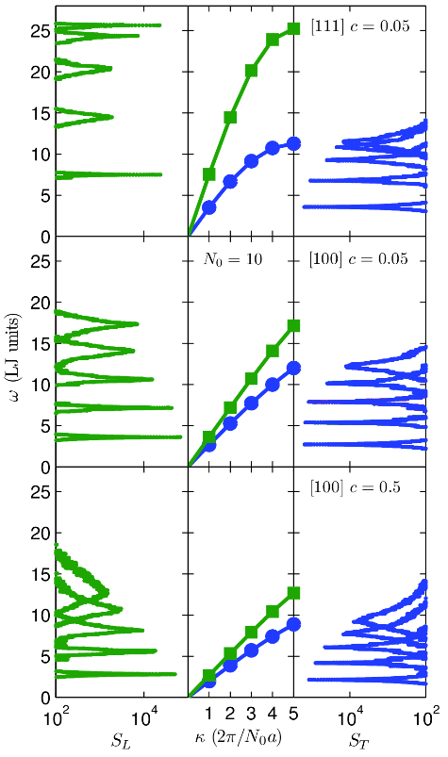
Gamma modes Structure Factor
Gamma
VC
Gamma

Slide 17


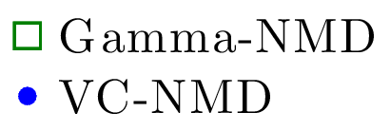

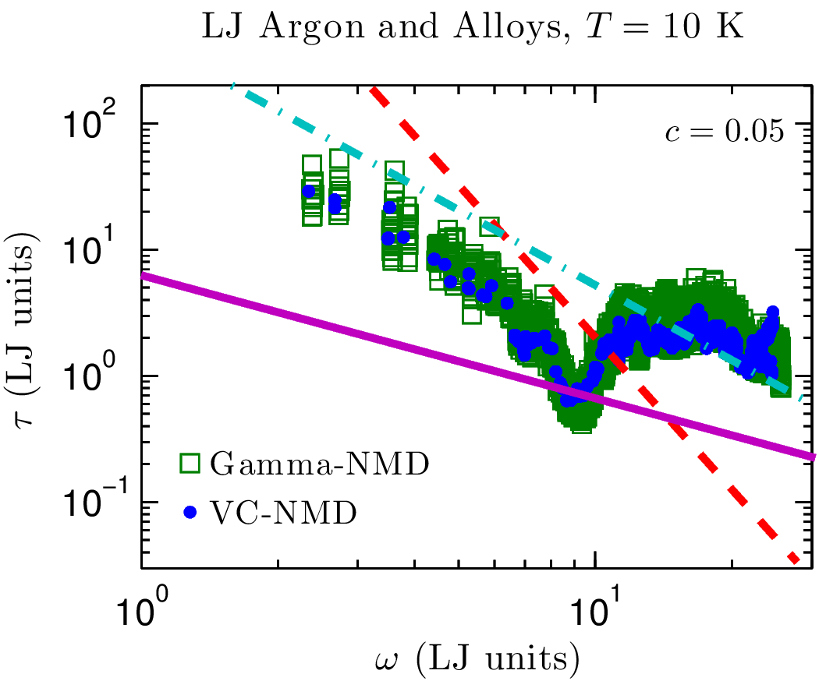



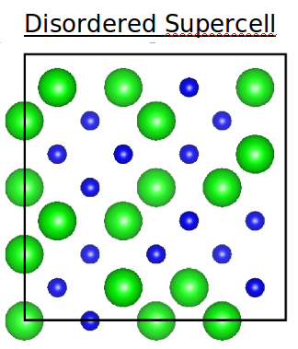

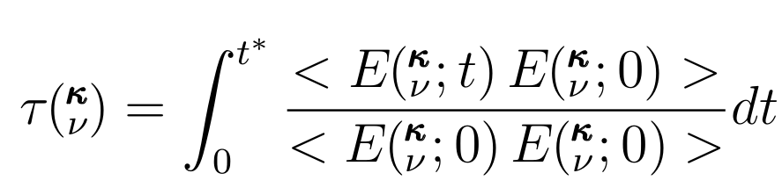
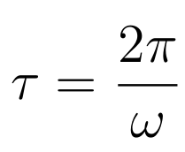


Explicit disorder: NMD
Disordered Supercell
Normal Mode Decomposition (NMD): Molecular Dynamics
Gamma

Slide 18
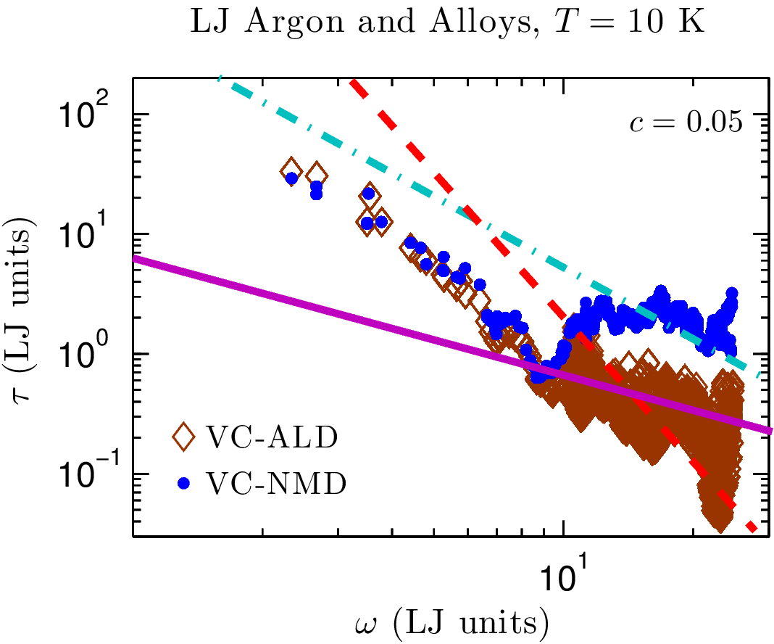
VC-NMD vs VC-ALD
VC
VC Unit Cell

Slide 19
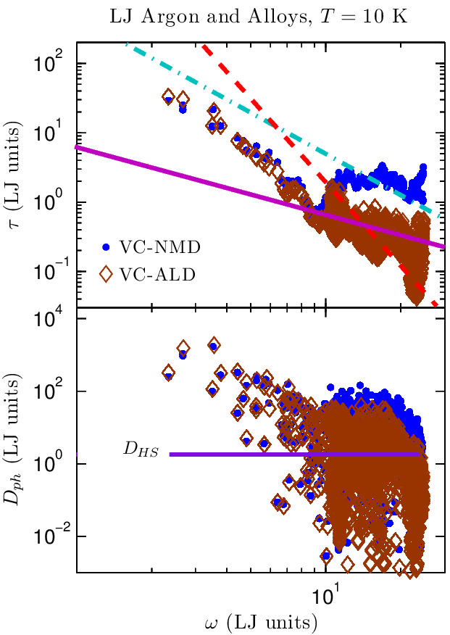
VC Diffusivities
VC Unit Cell

Slide 20
AF Diffusivities
Allen-Feldman (AF) Theory:
Allen-Feldman, PRB 48, 1258112588 (1993)

Slide 21
AF and VC Diffusivities
Allen-Feldman (AF) Theory:
Phonons
Diffusons
Allen-Feldman, PRB 48, 1258112588 (1993)

Slide 22
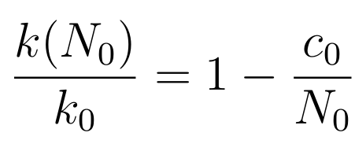
Thermal conductivity
Green-Kubo (GK): MD-based, no assumptions
MD-based Green-Kubo (GK)
GK Amorphous
High-scatter adjustment*:

Slide 23
Thermal conductivity
MD-based Green-Kubo (GK)
MD-based Green-Kubo (GK)
GK Amorphous
High-scatter adjustment*:

Slide 24
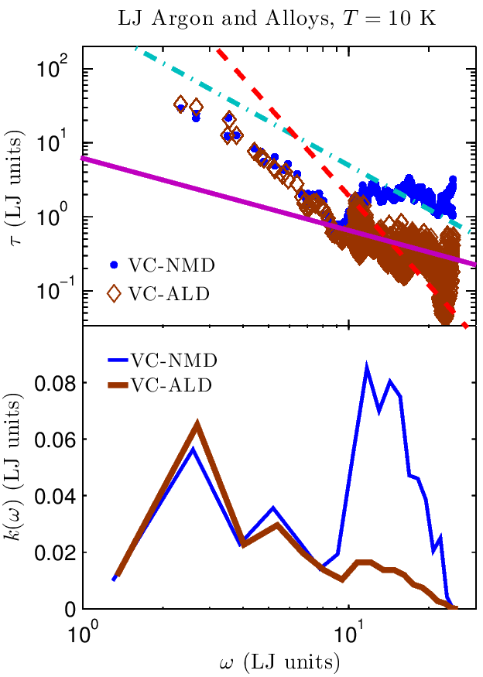
Thermal conductivity spectrum
GK Amorphous

Slide 25
Thermal conductivity spectrum
GK Amorphous
Phonon-Defect
1
1
Tamura, PRB 27, 858866 (1983)

Slide 26
Summary
GK Amorphous
SiGe
PRL 106, 045901 (2011)
GK Amorphous
This work was supported by AFOSR award FA95501010098 and by a grant of computer time from the DOD High Performance Computing Modernization Program at the US Army Engineer Research and Development Center.

Slide 27
Thermal Conductivity Accumulation in Amorphous Materials
Jason Larkin and Alan J. H. McGaughey
Department of Mechanical Engineering
Carnegie Mellon University
http://ntpl.me.cmu.edu/
04/04/13

Slide 28
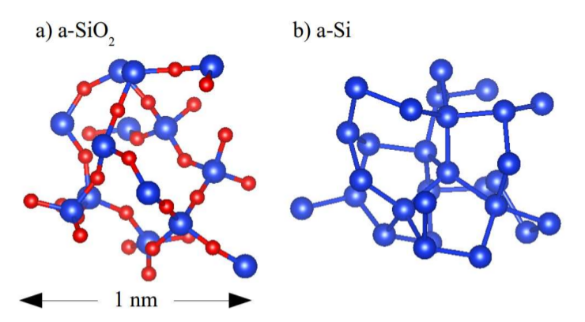

Slide 29
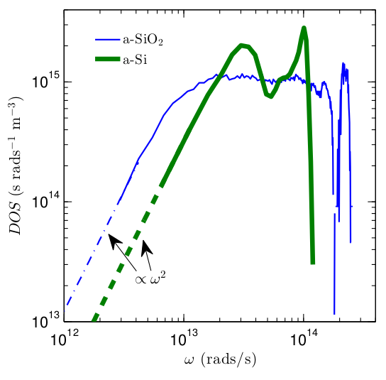

Slide 30
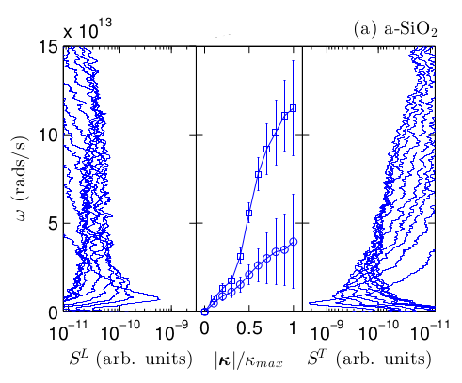
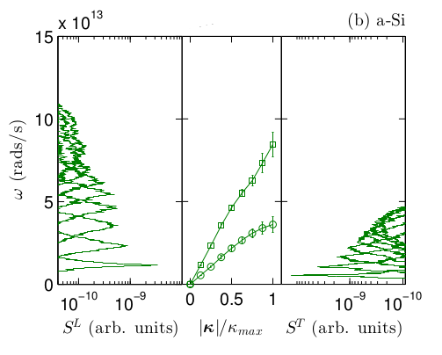

Slide 31
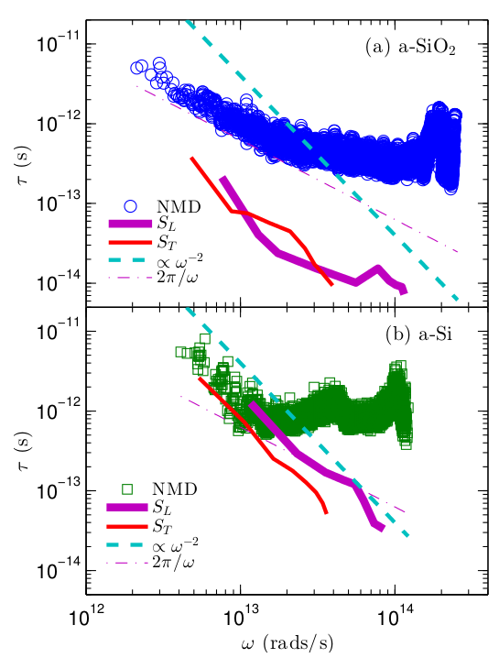

Slide 32
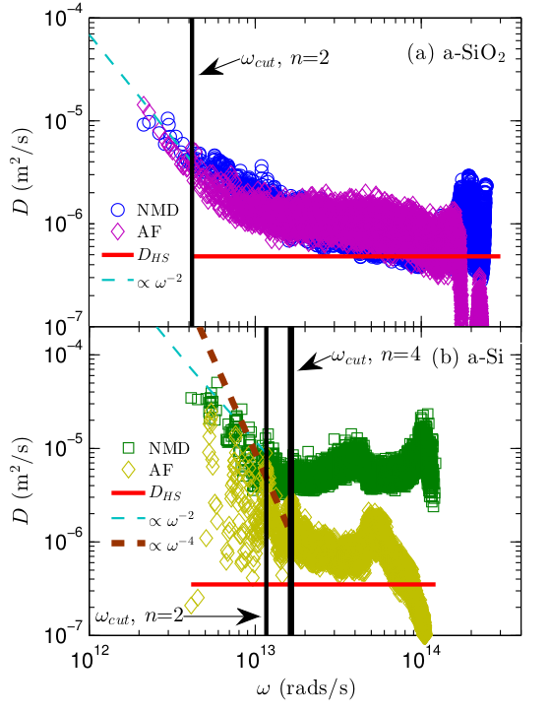

Slide 33
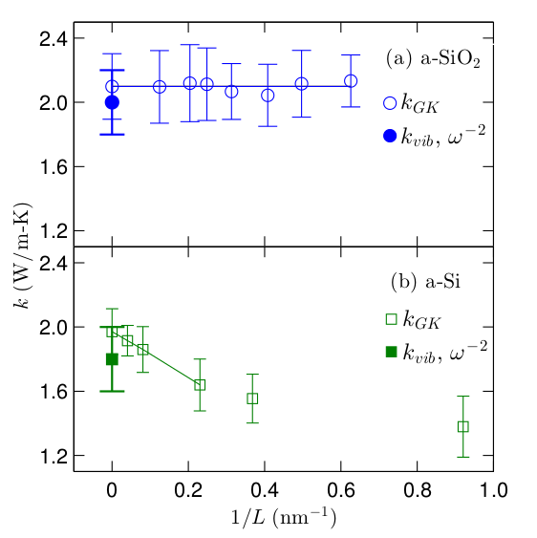

Slide 34
