Slide 2
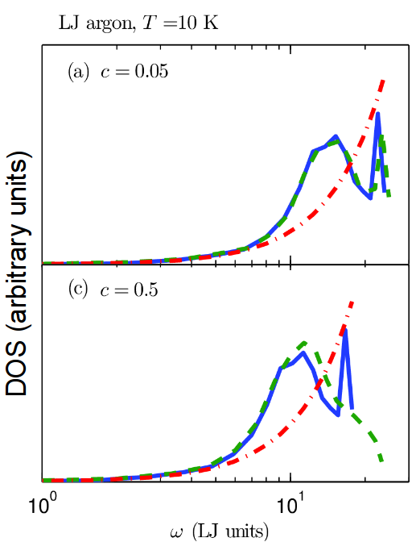

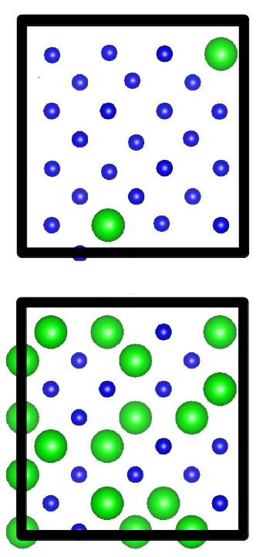
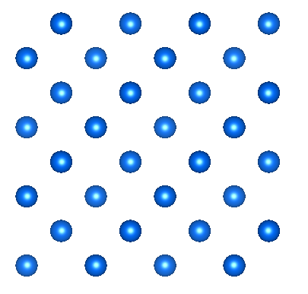
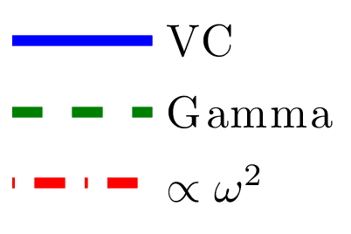
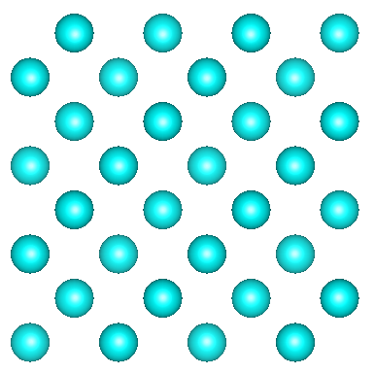
Explicit disorder: VC vs Gamma
Gamma
Gamma
VC
DOS (arbitrary units)

Slide 3
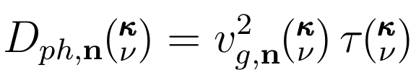
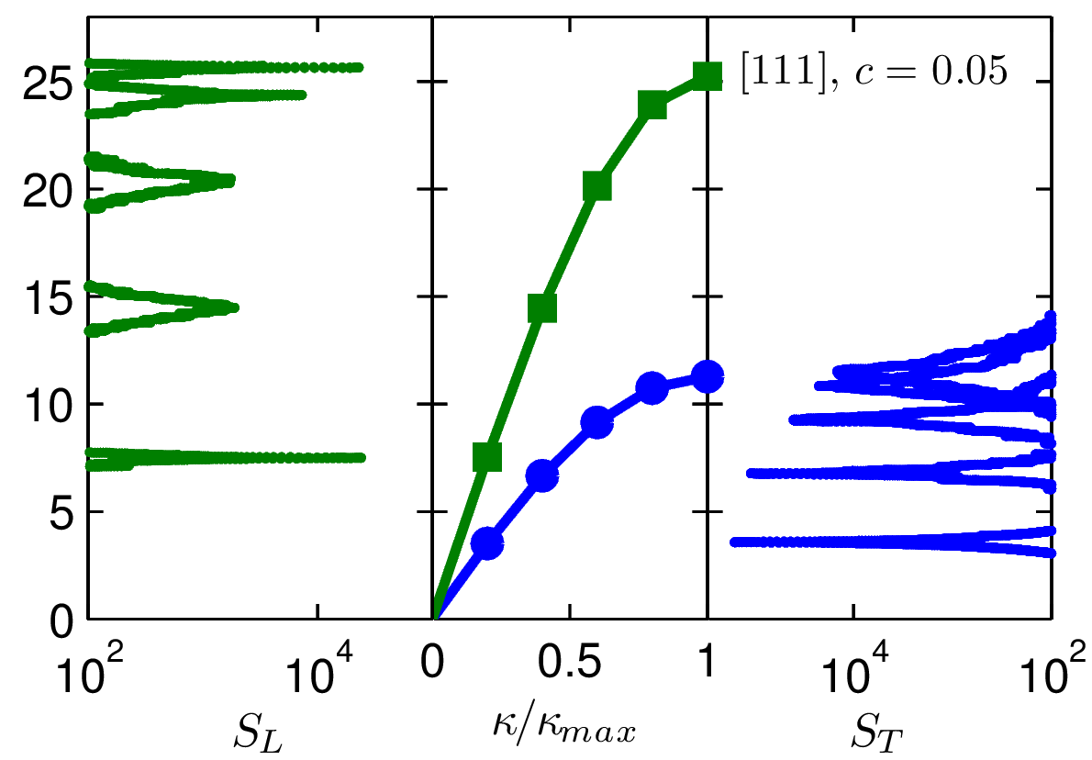
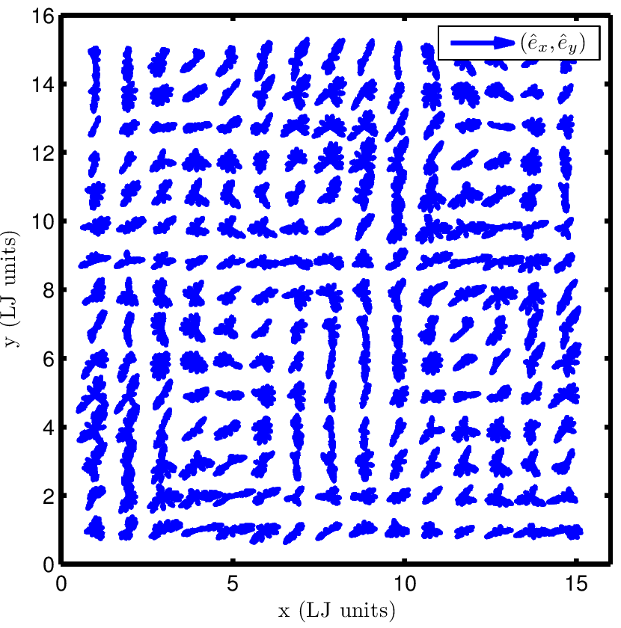

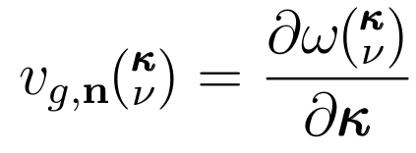
Explicit disorder: Structure Factor
Gamma
VC
Gamma
VC
Gamma
Phys. Rev. B 59, 35513559 (1999)

Slide 4
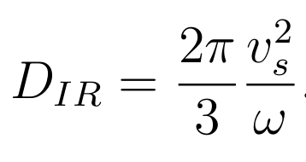
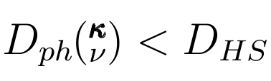
HS/IR Limit
P. Sheng and M. Zhou, Science 253, 539542 (1991)

Slide 5
Thermal conductivity: SW silicon alloy
amor-Si

Slide 6
Phonon Spectrum: SW Si
MD-based:
1E4 modes
(7 days)*(100 cpu)
ALD:
1E6 modes
(7 days)*(12 cpu)

Slide 7
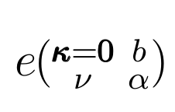
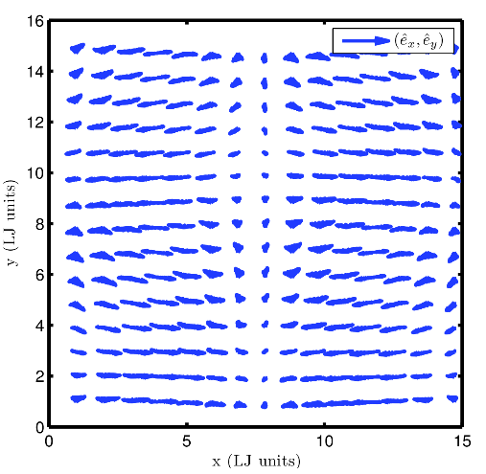
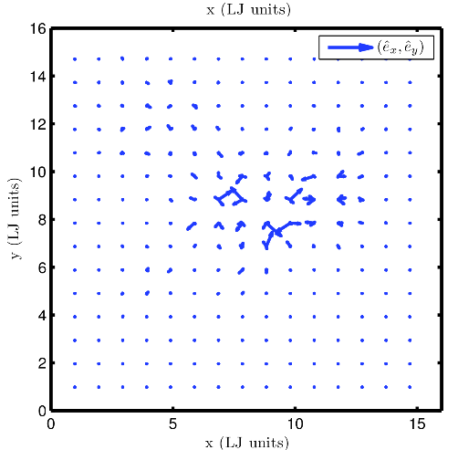
Gamma modes
DOS (arbitrary units)

Slide 8
NMD using VC modes

Slide 9
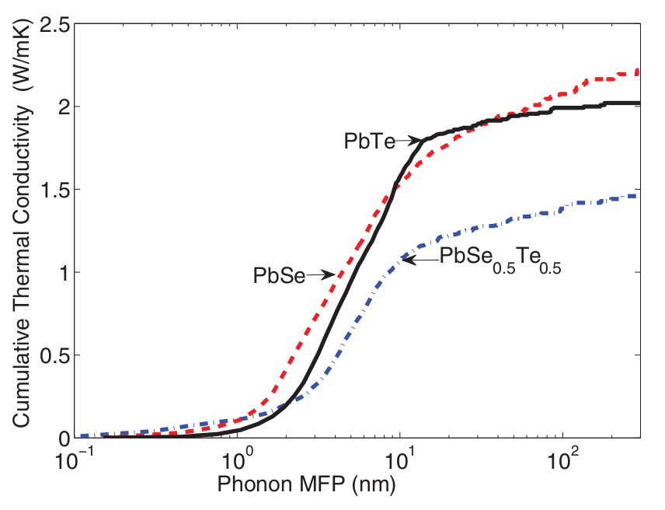
Conductivity Accumulation
SW Si
LJ Ar
PHYSICAL REVIEW B 85, 184303 (2012)

