Slide 1
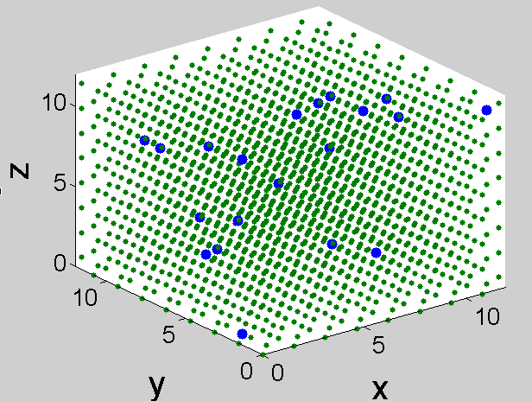
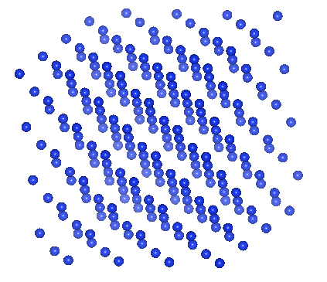
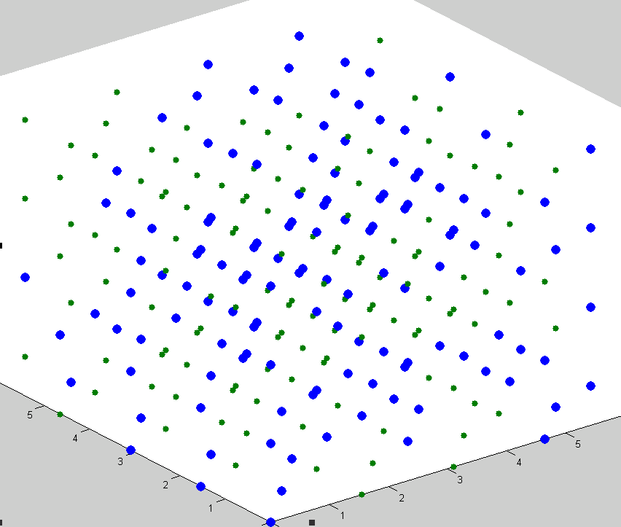
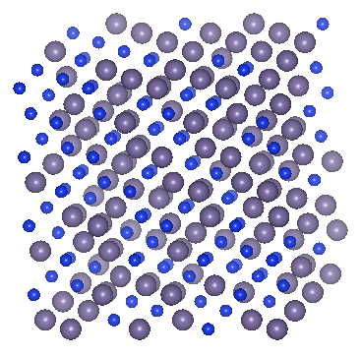
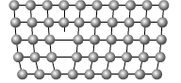
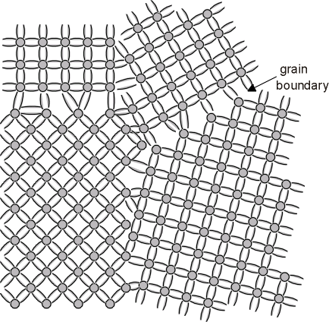
Alloys
Disorder = non-periodic
Blue => mass=1.0
Purple => mass=3.0
Phonon picture still valid?

Slide 2
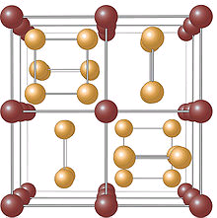
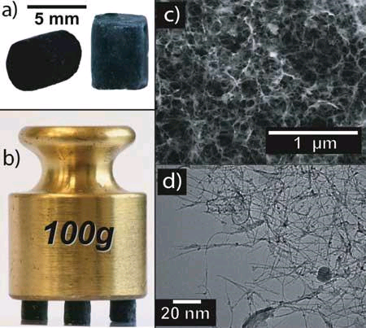
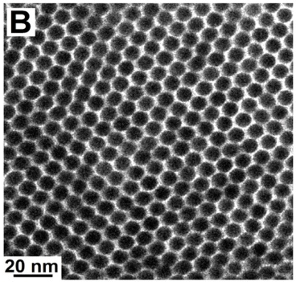
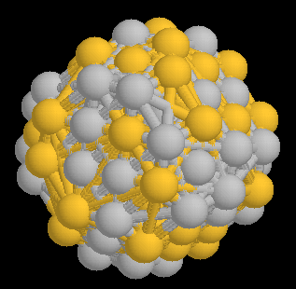
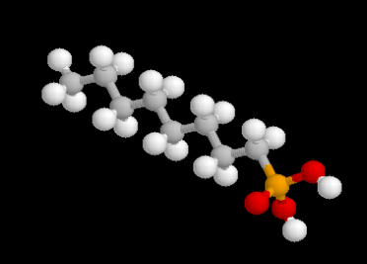
New Disordered Materials
Large Unit Cell Crystals
Aerogels
Organic Crystals

Slide 3
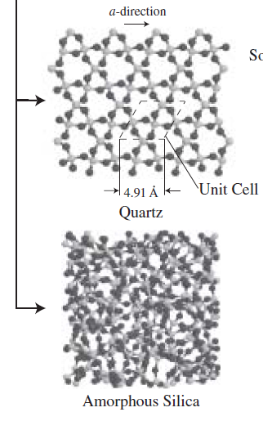
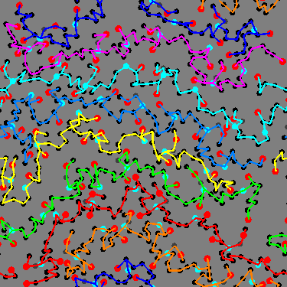
Amorphous
Thermal conductivity w/o anharmonic term
Thermal conductivity w/ anharmonic term
Amorphous with many interfaces
Thermal conductivity w/o anharmonic term
Thermal conductivity w/ anharmonic term
How does anharmonic term effect on thermal conductivity change for like volume fraction, or a system with many interfaces? The condensed solid

Slide 4
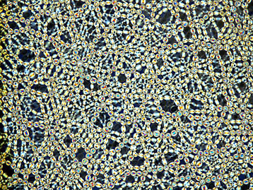
Jammed System under Stress
Cahill expt., conductivity should most certainly go up with T
k~f(T)? Like an amorphous system?
A way to tune the thermal conductivity of amorphous systems.
Amorphous material as
stress

