Slide 1
Role of Disorder in Thermal Transport
Jason Larkin
Nanoscale Transport Phenomena Laboratory
Carnegie Mellon Department of Mechanical Engineering http://ntpl.me.cmu.edu/
03/07/2012
1

Slide 2
Outline
2
Introduction/Motivation
Preliminary Work
Proposed Work
Schedule

Slide 3
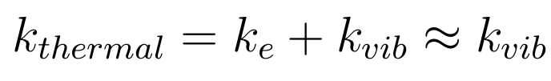
Range of Thermal Conductivity
3
Large Unit Cell Materials
Conductivity in LUC ~ amorphous

Slide 4
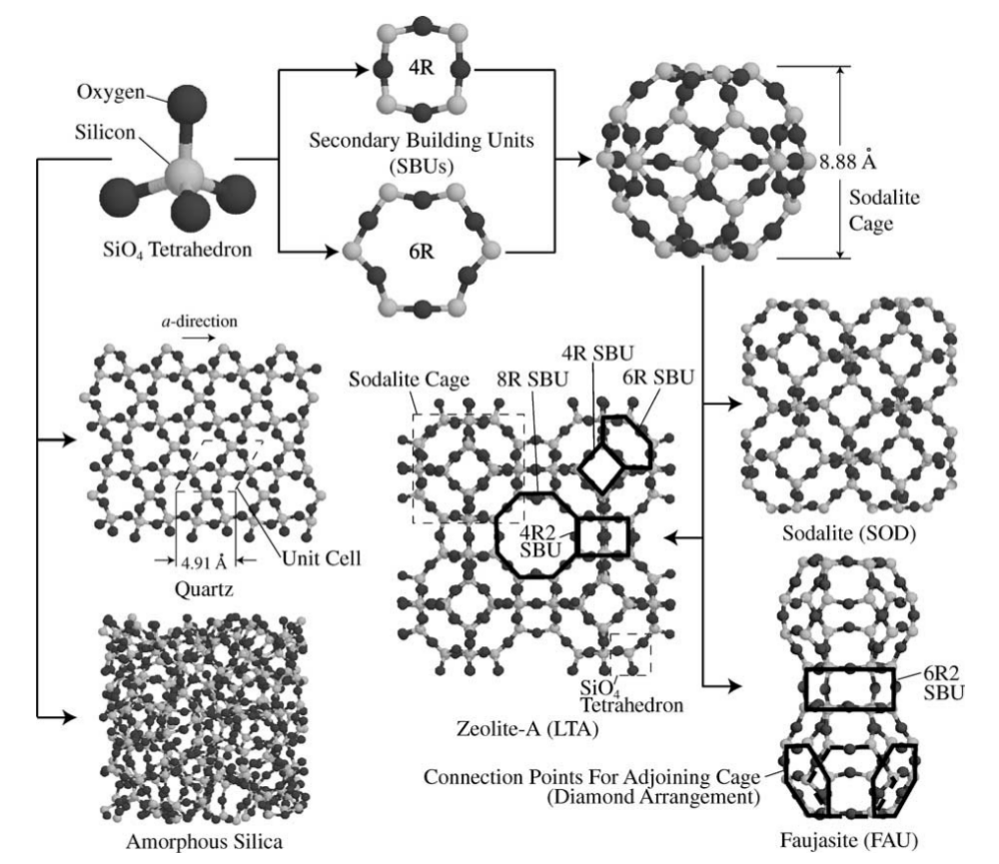
Large Unit Cell (LUC) Materials
4
Effectively disordered.
Thermal transport from both phonons and diffusons.
What are sub-unit cell effects?

Slide 5
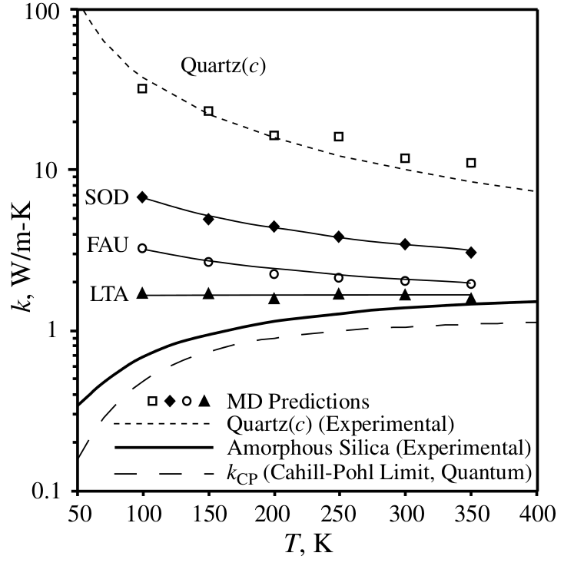
Zeolite Range of Conductivity
5
Green-Kubo
Quartz shows crystalline (ordered) behavior.
Other allotropes more disordered/amorphous.
A. J. H. McGaughey and M. Kaviany, International Journal of Heat and Mass Transfer, 47:1799–1816, 2004.

Slide 6
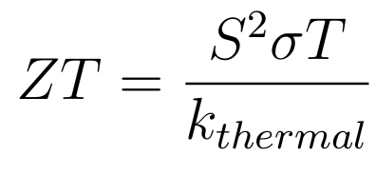
LUC Materials for Thermoelectric Energy Conversion
6
Lower thermal conductivity for improved thermoelectric efficiency:
Skutterudites: “electron-crystal, phonon-glass”
What is responsible for low thermal conductivity?
Phonon picture, sub-unit cell effects...

Slide 7

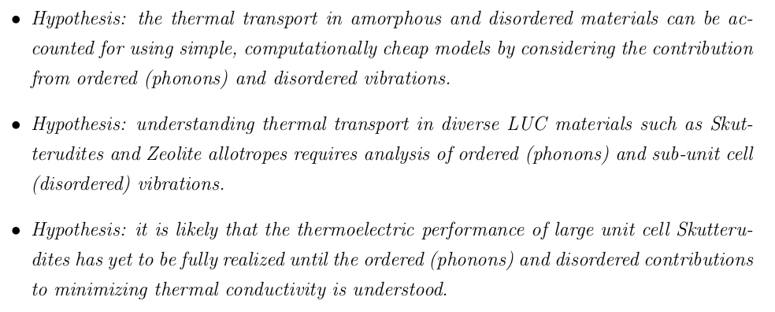
Objectives
7
(disorder)
(order)

Slide 8
Outline
8
Introduction/Motivation
Background
Preliminary Work
Proposed Work
Schedule

Slide 9
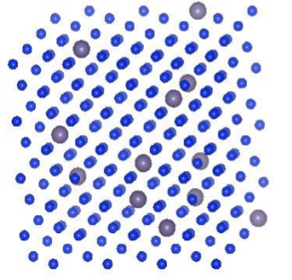
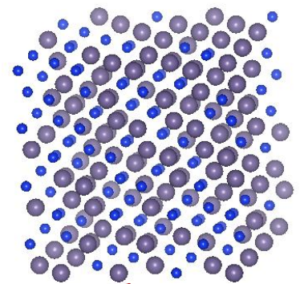
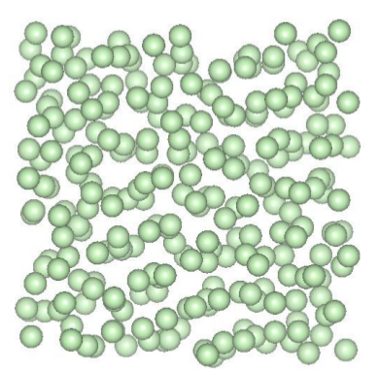
Thermal Transport in Disordered Materials
9
Phonon picture valid with perturbations.
- Phonon picture only valid for very long wavelengths.
- Localized vibrations (diffusons) become important.

Slide 10
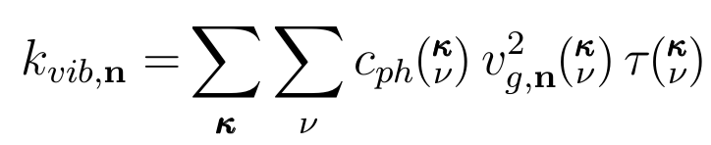

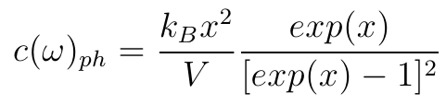
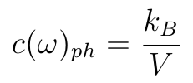
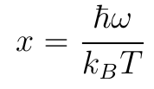
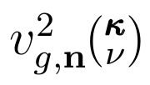



Thermal Conductivity in Ordered Systems
10
Conductivity in ordered (crystalline) system sum over phonon modes:
Mode-specific properties:
Property | Model
,
=
Depends on Scattering Mechanisms

Slide 11
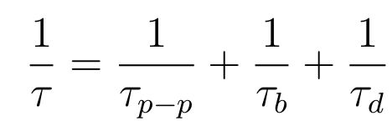
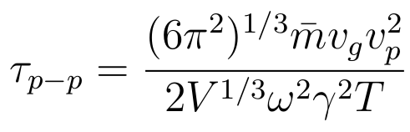

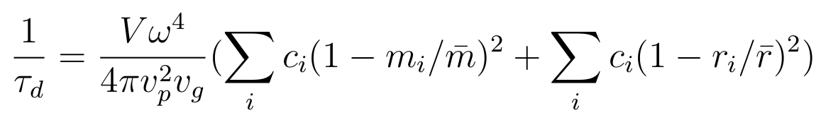
Phonon Scattering Mechanisms
11
Matthiessen rule:
Phonon-phonon scattering [1]:
[1] P. G. Klemens, ed. R. P. Tye, 1969, Vol. 1, Academic Press, London.
[2] Alan J. H. McGaughey and Ankit Jain, Applied Physics Letters, 100(6):061911, 2012.
[3] P. G. Klemens, Proc. Phys. Soc., London, Sect. A, 1955, 68, 1113.
[4] David G. Cahill, Fumiya Watanabe, Angus Rockett, and Cronin B. Vining, Phys. Rev. B, 71:235202, Jun 2005.
Boundary scattering [2]:
Defect scattering [3]:
These model phonon scattering accurately [2,4].

Slide 12
Thermal Conductivity in Ordered Systems
12
Conductivity in ordered (crystalline) system sum over phonon modes:
Mode-specific properties:
Property | Model
,
=
Depends on Scattering Mechanisms

Slide 13
Outline
13
Introduction/Motivation
Background
Preliminary Work
Proposed Work
Schedule

Slide 14
Thermal Conductivity from MD Simulation
14
Molecular Dynamics (MD) simulation and Green-Kubo method.
No vibrational properties are predicted:
Green-Kubo
modes
Predictions show Green-Kubo can capture all effects.
MD simulations are classical, no quantum effects.

Slide 15
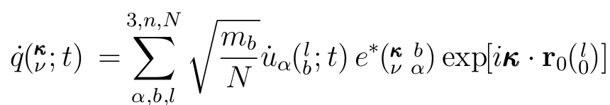
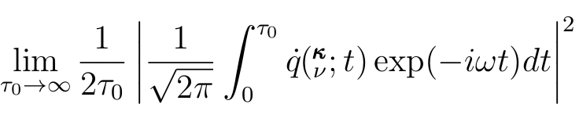
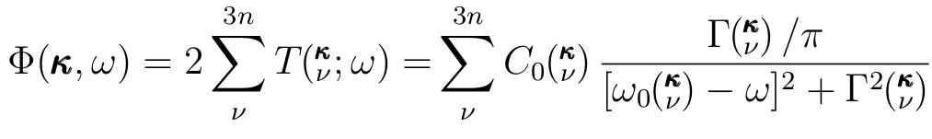
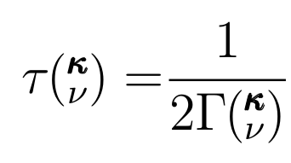
Predicting Phonon Properties
15
Phonon Normal Mode Coordinate:
Molecular Dynamics (anharmonic)
Lattice Dynamics (harmonic)
Normal Mode Decomposition: Lattice Dynamics + Molecular Dynamics
Predicts the Phonon frequency and lifetime:

Slide 16
Predicting Phonon Properties
16
Predicts the Phonon frequency and lifetime:
Have used NMD on a variety of systems [1].
[1] J. M. Larkin, J. E. Turney, A. D. Massicotte, A. J. H. McGaughey, C. H. Amon, Comparison and evaluation of spectral energy methods for predicting phonon properties, in submission, 2012.

Slide 17
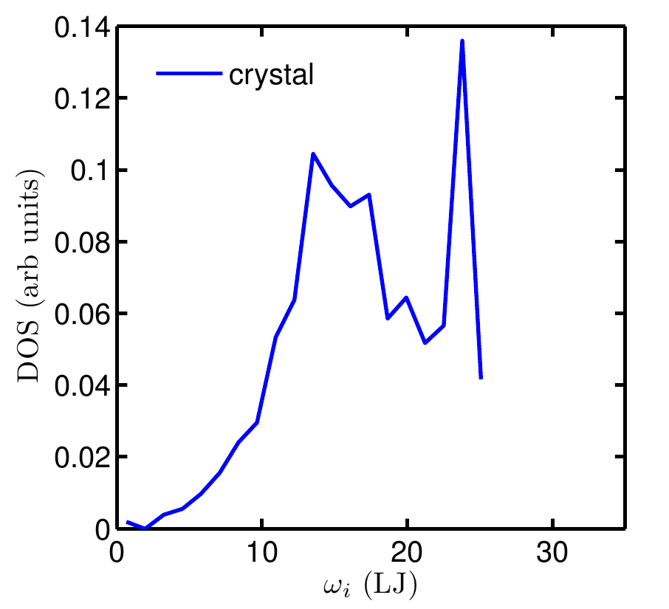
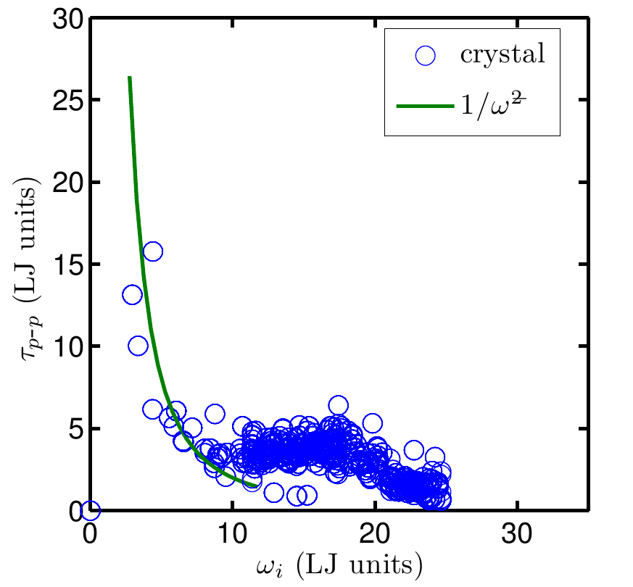
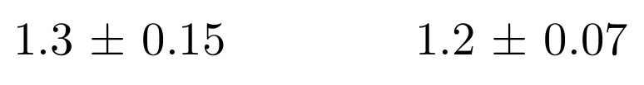
Predicted Phonon Properties
17
Model Lennard-Jones system:
NMD
Lattice Dynamics
Green-Kubo
(W/m-K)
NMD (W/m-K)
Lattice Dynamics
+
Molecular Dynamics

Slide 18



Thermal Conductivity Integral
18
Would like to write as an integral with simple property scalings :
Debye model:
Umklapp phonon-phonon scattering [1]:
[1] P. G. Klemens, Theory of Thermal Conductivity in Solids, in Thermal Conductivity, ed. R. P. Tye, 1969, Vol. 1, Academic Press, London.

Slide 19
Predicted Phonon Properties
19
50%
50%
DOS/lifetimes follows Debye/Umklapp scaling only at low frequencies.
Significant contributions come from “non-Debye” type modes.

Slide 20
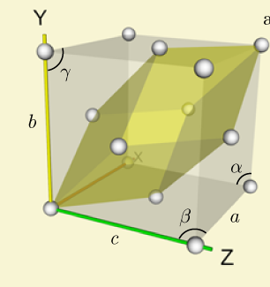

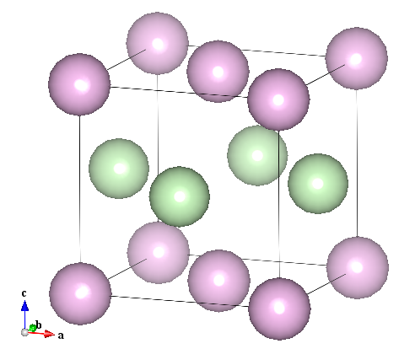
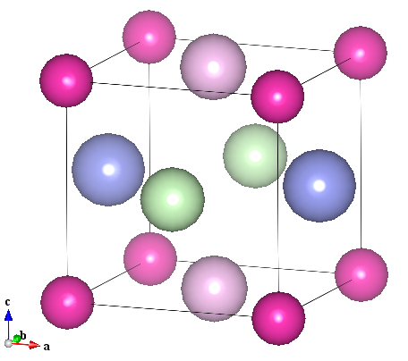
Dispersion in Multi-Species Systems
20
=
a
LJ model dispersion using Lattice Dynamics
Breakdown of Debye Model

Slide 21
Effect of Dispersion on Thermal Conductivity
21
Debye
Breakdown of Debye Model for dispersion [1]:
=
[1] Eric S. Toberer, Alex Zevalkink, and G. Jeffrey Snyder. Phonon engineering through crystal chemistry. J. Mater. Chem., 21, 2011.

Slide 22




Thermal Conductivity of LJ Alloys
22
Breakdown of phonon picture

Slide 23
Dispersion in Amorphous System
23
Treat 256 atom amorphous LJ as a LUC
L=4a

Slide 24
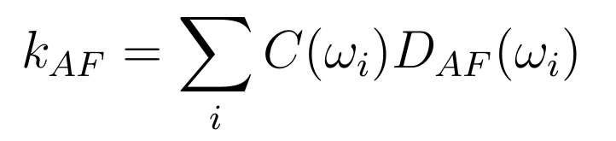
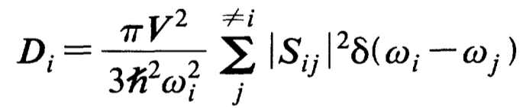
Diffuson Theory
24
Allen Feldman theory of diffusons [1]:
Conservation of energy:
Heat current operator:
Ingredients: harmonic Lattice Dynamics
[1] Philip B. Allen and Joseph L. Feldman. Thermal conductivity of disordered harmonic solids. Physical Review B, 48(17):12581–12588, Nov 1993.

Slide 25


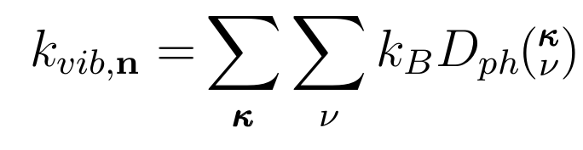
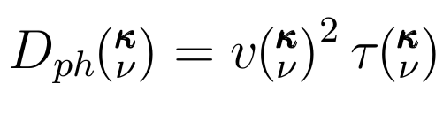

Thermal Diffusivity
25
Classical harmonic limit:
Phonon mode diffusivity:

Slide 26




Phonons in Amorphous System
26
Green-Kubo prediction (includes all modes):
Green-Kubo
AF prediction (diffusons):
Phonon contribution?:
Atomistic prediction for amorphous silicon [1]:
[1] Yuping He, et al.. Heat transport in amorphous silicon: Interplay between morphologyand disorder. Applied Physics Letters, 98:144101, 2011.

Slide 27


Toolbox
27
Method | Type of Analysis | Classical | Ab-initio
Green-Kubo | Top-level: Phonons + Diffusons Anharmonic
Normal Mode Decomposition | Bottom-level: Phonons + (Diffusons?) Anharmonic
Lattice Dynamics (AF) | Bottom-level: Diffusons Harmonic
Importance of anharmonicity:
- Can we capture thermal transport properties using (quasi)-harmonic analysis?
Ab-initio calculations:
- Physically accurate
- Computationally expensive

Slide 28
Outline
28
Introduction/Motivation
Background
Preliminary Work
Proposed Work
Schedule

Slide 29
Ordered and Disordered Contributions to Thermal Transport
29
LJ models of crystal, alloy, and amorphous phases using MD, Green-Kubo, NMD, and AF

Slide 30
Role of Anharmonicity
30
Debye-type model?
From LJ study:
Lattice Dynamics (harmonic)
What is role of anharmonicity?
- Use Lattice Dynamics (harmonic) and MD-NMD (anharmonic) to investigate.
- Results will inform ab-initio calculations for amorphous silicon.
- Would like a simple model for phonon contribution, all parameters calculated using Lattice Dynamics (harmonic):

Slide 31
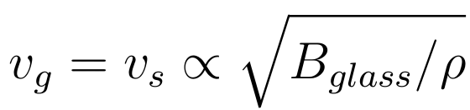
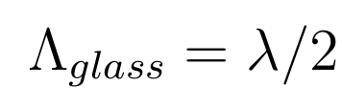
Validity of Theoretical Models
31
Cahill-Pohl model [1]: physically meaningful?
All modes in a glass are “phonons” with sound speed group velocity:
“Phonon” mode mean free paths equal to half the “wavelength”:
[1] David G. Cahill, et al.. Lower limit to the thermal conductivity
of disordered crystals. Phys. Rev. B, 46:6131–6140, Sep 1992.

Slide 32
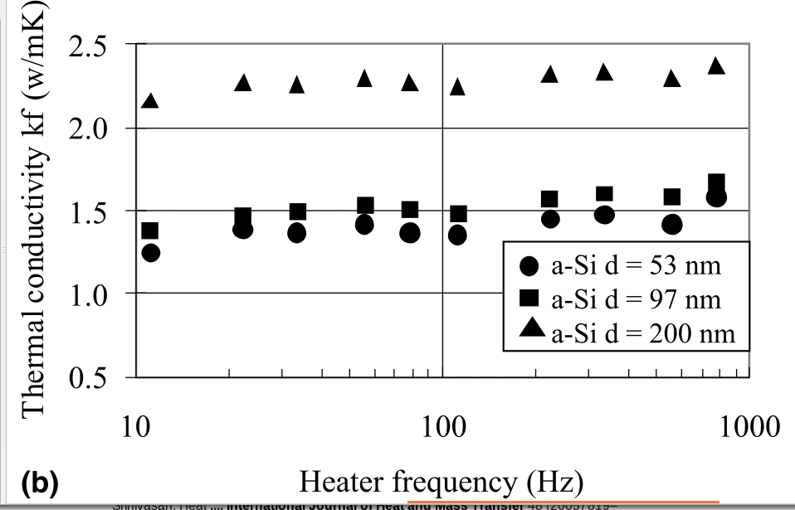
Thermal Transport in Amorphous Silicon using Ab Initio Calculations
32
Classical atomistic prediction for amorphous silicon [2]:
Design ab-initio calculations based on LJ results.
Will inform calculations for LUC.
S Moon, International Journal of Heat and Mass Transfer, 45(12):2439–2447, 2002.
[2] Yuping He, et al.. Heat transport in amorphous silicon: Interplay between morphologyand disorder. Applied Physics Letters, 98:144101, 2011.

Slide 33
Large Unit Cell (LUC) Materials
33
- Use silica structures as model LUC materials
- Top-down (Green-Kubo) measurements exist [1]
- Phonon and diffuson contributions:
What are sub-unit cell effects?
- Coordination
- Adsorbed molecules
[1] A. J. H. McGaughey and M. Kaviany, International Journal of Heat and Mass Transfer, 47:1799–1816, 2004.

Slide 34
LUC Materials for Thermoelectrics
34
Debye
Debye models not sufficient:
- Two scalings with b indicate phonon picture qualitatively right [1]
What are sub-unit cell effects?
- “Rattler” atoms effect on phonon dispersion, scattering?
[1] Eric S. Toberer, Alex Zevalkink, and G. Jeffrey Snyder. Phonon engineering through crystal chemistry. J. Mater. Chem., 21, 2011.

Slide 35
Outline
35
Introduction/Motivation
Background
Preliminary Work
Proposed Work
Schedule

Slide 36
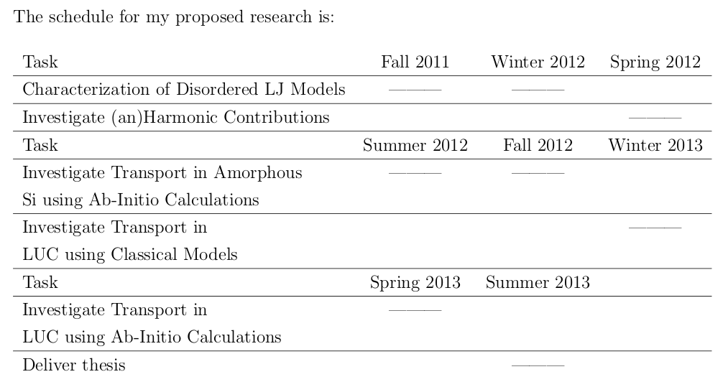
Schedule
36

Slide 37
Questions
37

Slide 38
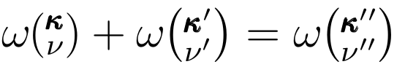

Open Questions
21
How do phonons and diffusons interact?
Conservation of energy
Conservation of crystal momentum

Slide 39
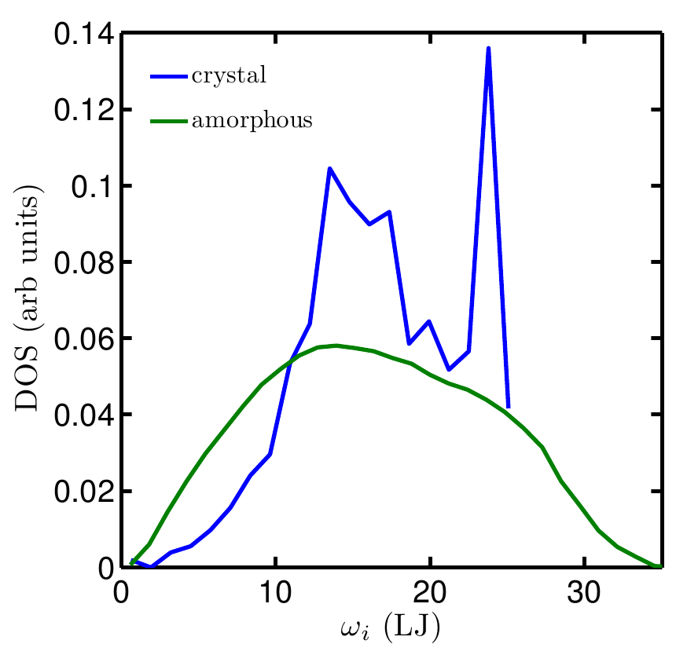

Slide 42
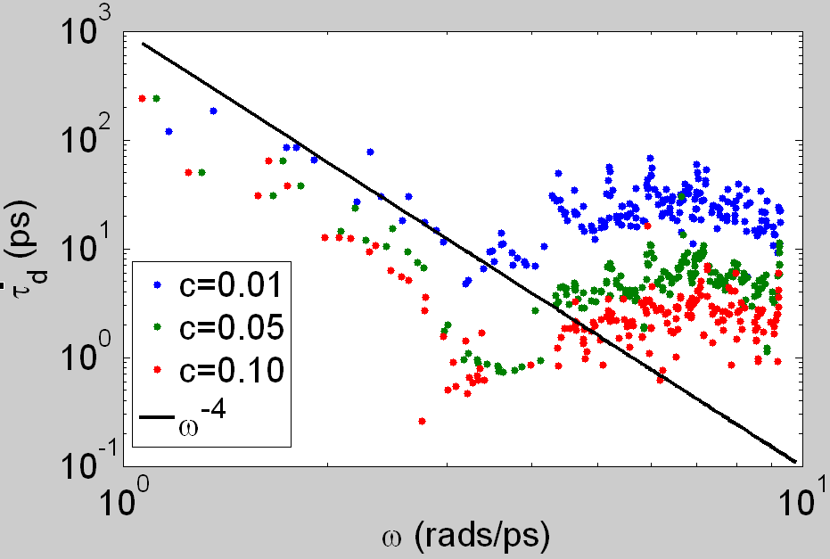
Defect Scattering
16
Matthiesen Rule:
Rayleigh scattering:

Slide 43


