Slide 1
Role of Disorder in Thermal Transport
Jason Larkin
Nanoscale Transport Phenomena Laboratory
Carnegie Mellon Department of Mechanical Engineering http://ntpl.me.cmu.edu/
03/07/2012
1

Slide 2
Outline
2
Introduction/Motivation
Background
Preliminary Work
Proposed Work
Schedule

Slide 3
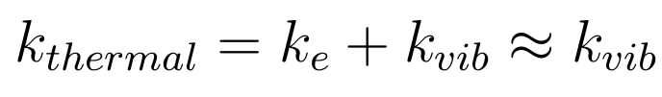
Range of Thermal Conductivity
3
Large Unit Cell Materials
Conductivity in LUC ~ amorphous

Slide 4
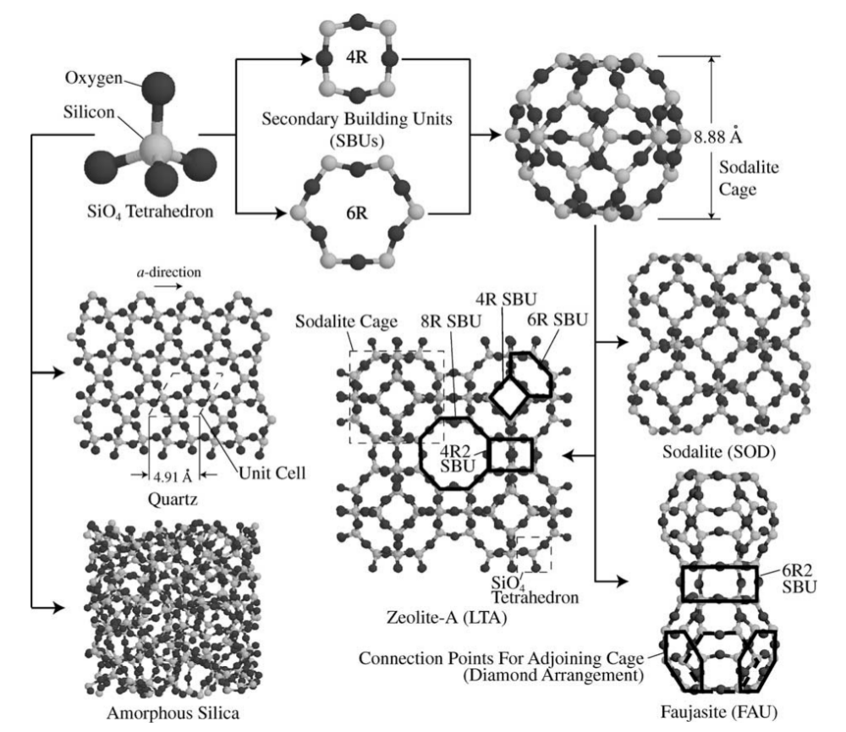
Large Unit Cell (LUC) Materials
4
Effectively disordered.
Thermal transport from both phonons and diffusons.
What are sub-unit cell effects?

Slide 5
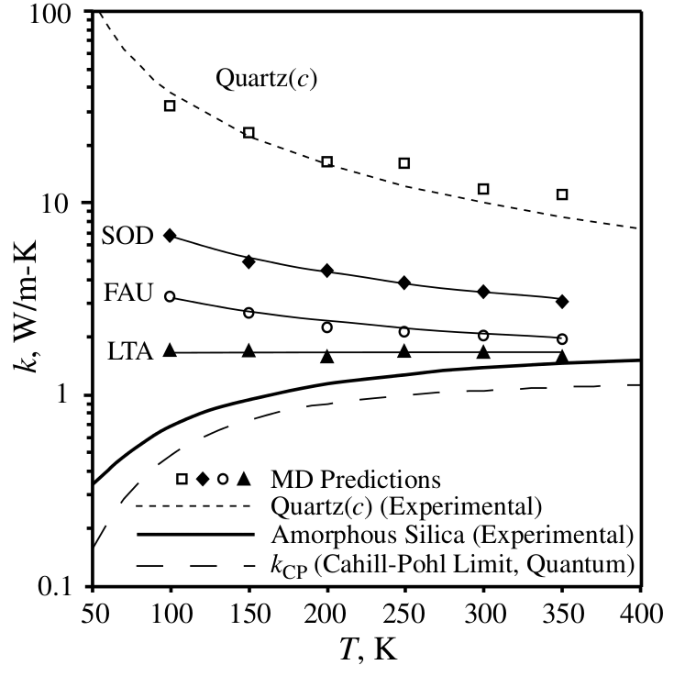
Zeolite Range of Conductivity
5
Green-Kubo
Quartz shows crystalline (ordered) behavior.
Other allotropes more disordered/amorphous.
A. J. H. McGaughey and M. Kaviany, International Journal of Heat and Mass Transfer, 47:1799–1816, 2004.

Slide 6
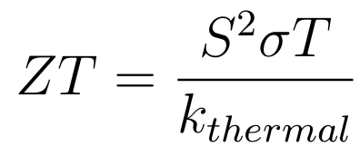
LUC Materials for Thermoelectric Energy Conversion
6
Lower thermal conductivity for improved thermoelectric efficiency:
Skutterudites: “electron-crystal, phonon-glass”
What is responsible for low thermal conductivity?
Phonon picture, sub-unit cell effects...

Slide 7
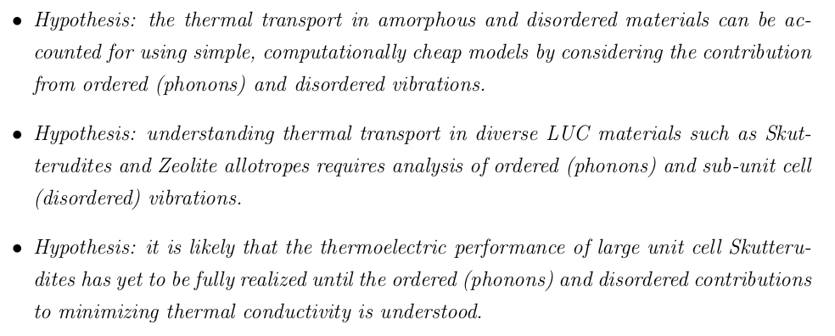

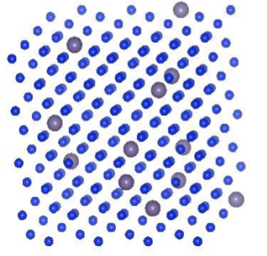
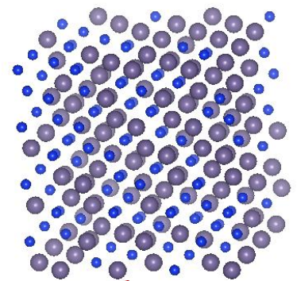
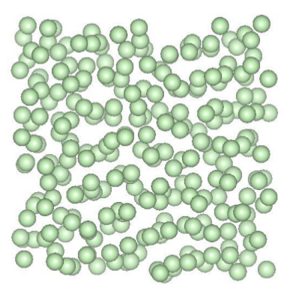
Objectives
7
(disorder)
(order)

Slide 8
Objectives
8
(disorder)
(order)

Slide 9
Objectives
9
(disorder)
(order)

Slide 10
Outline
10
Introduction/Motivation
Background
Preliminary Work
Proposed Work
Schedule

Slide 11
Thermal Transport in Disordered Materials
11
Phonon picture valid with perturbations.
- Phonon picture only valid for very long wavelengths.
- Localized vibrations (diffusons) become important.

Slide 12
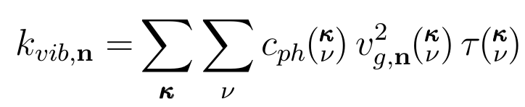

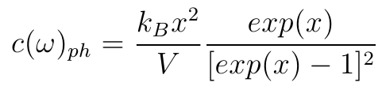
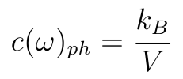
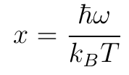
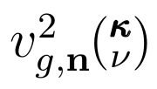



Thermal Conductivity in Ordered Systems
12
Conductivity in ordered (crystalline) system sum over phonon modes:
Mode-specific properties:
Property | Model
,
=
Depends on Scattering Mechanisms

Slide 13
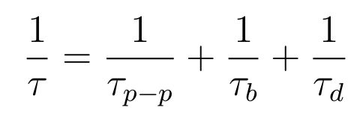
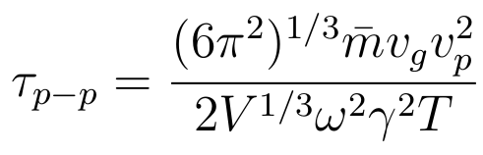

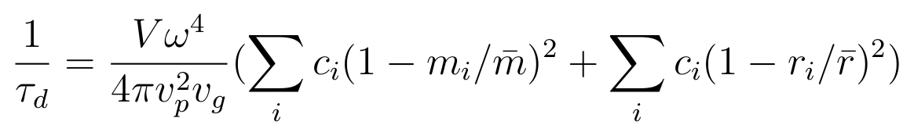
Phonon Scattering Mechanisms
13
Matthiessen rule:
Phonon-phonon scattering [1]:
[1] P. G. Klemens, ed. R. P. Tye, 1969, Vol. 1, Academic Press, London.
[2] Alan J. H. McGaughey and Ankit Jain, Applied Physics Letters, 100(6):061911, 2012.
[3] P. G. Klemens, Proc. Phys. Soc., London, Sect. A, 1955, 68, 1113.
[4] David G. Cahill, Fumiya Watanabe, Angus Rockett, and Cronin B. Vining, Phys. Rev. B, 71:235202, Jun 2005.
Boundary scattering [2]:
Defect scattering [3]:
These expressions can account for phonon scattering accurately [2,4].

Slide 14
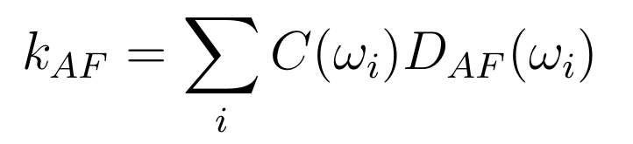
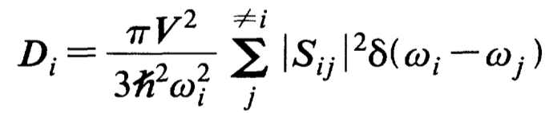
Diffuson Theory
14
Allen Feldman theory of diffusons [1]:
Conservation of energy:
Heat current operator:
Ingredients: harmonic Lattice Dynamics
[1] Philip B. Allen and Joseph L. Feldman. Thermal conductivity of disordered harmonic solids. Physical Review B, 48(17):12581–12588, Nov 1993.

Slide 15
Outline
15
Introduction/Motivation
Background
Preliminary Work
Proposed Work
Schedule

Slide 16
Thermal Conductivity from MD Simulation
16
Model Lennard-Jones system:
Molecular Dynamics (MD) simulation and Green-Kubo method.
No vibrational properties are predicted:
Green-Kubo
modes
Predictions show Green-Kubo can capture all effects.
MD simulations are classical, no quantum effects.

Slide 17
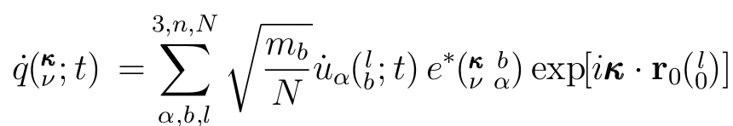
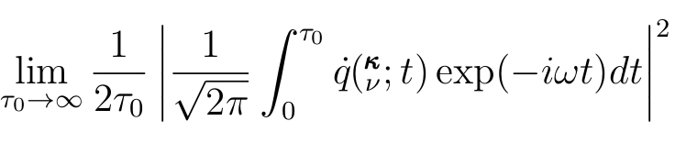
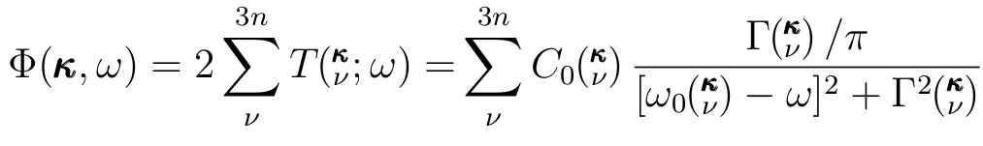
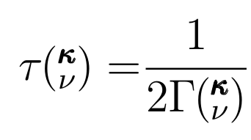
Predicting Phonon Properties
17
Phonon Normal Mode Coordinate:
Molecular Dynamics (anharmonic)
Lattice Dynamics (harmonic)
Normal Mode Decomposition: Lattice Dynamics + Molecular Dynamics
Predicts the Phonon frequency and lifetime:

Slide 18
Predicting Phonon Properties
18
Predicts the Phonon frequency and lifetime:
Have used NMD on a variety of systems [1].
[1] J. M. Larkin, J. E. Turney, A. D. Massicotte, A. J. H. McGaughey, C. H. Amon, Comparison and evaluation of spectral energy methods for predicting phonon properties, in submission, 2012.

Slide 19
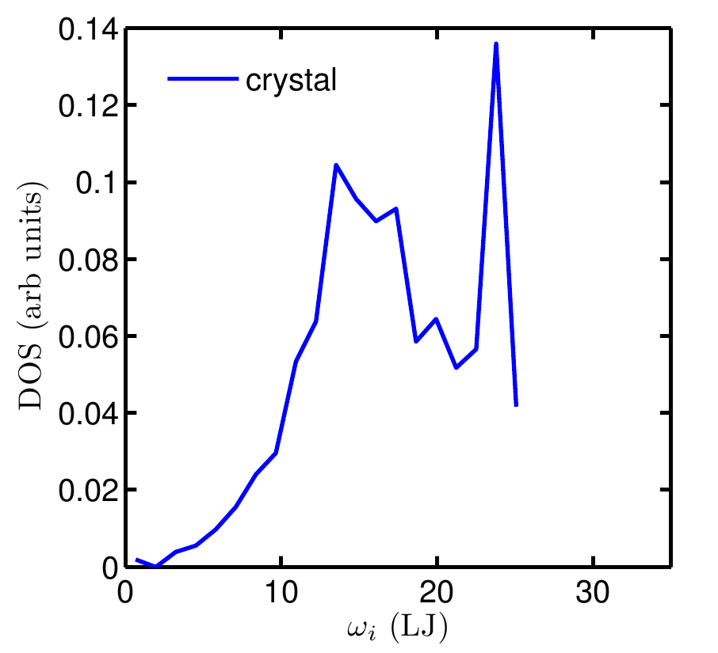
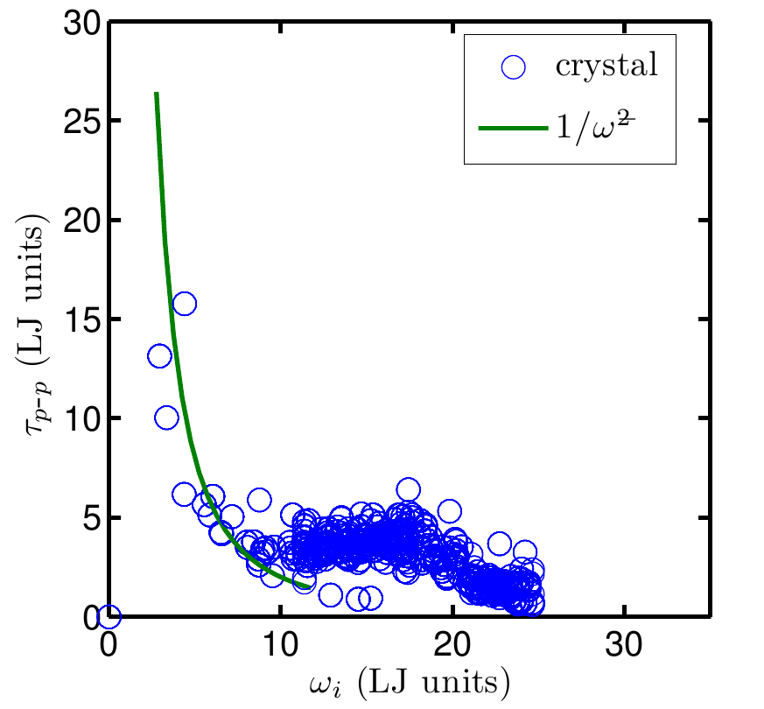

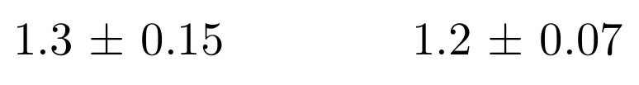
Predicted Phonon Properties
19
Model Lennard-Jones system:
NMD
Lattice Dynamics
Green-Kubo
(W/m-K)
NMD (W/m-K)
Lattice Dynamics
+
Molecular Dynamics

Slide 20



Thermal Conductivity Integral
20
Would like to write as an integral with simple property scalings :
Debye model:
Umklapp phonon-phonon scattering [1]:
[1] P. G. Klemens, Theory of Thermal Conductivity in Solids, in Thermal Conductivity, ed. R. P. Tye, 1969, Vol. 1, Academic Press, London.

Slide 21
Predicted Phonon Properties
21
50%
50%
DOS/lifetimes follows Debye/Umklapp scaling only at low frequencies.
Significant contributions come from “non-Debye” type modes.

Slide 22
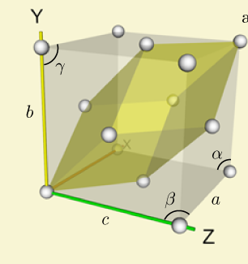

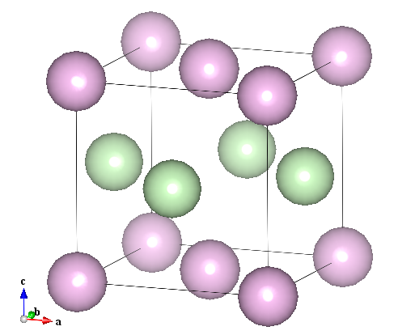
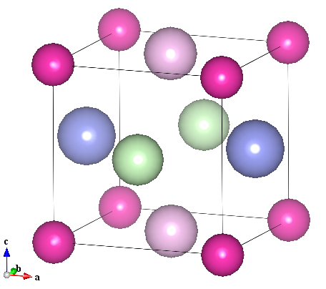
Dispersion in Multi-Species Systems
22
=
a
LJ model dispersion using Lattice Dynamics
Breakdown of Debye Model

Slide 23
Effect of Dispersion on Thermal Conductivity
23
Debye
Breakdown of Debye Model for dispersion [1]:
=
[1] Eric S. Toberer, Alex Zevalkink, and G. Jeffrey Snyder. Phonon engineering through crystal chemistry. J. Mater. Chem., 21, 2011.

Slide 24



Thermal Conductivity of LJ Alloys
24
Green-Kubo
Breakdown of phonon picture

Slide 25
Dispersion in Amorphous System
25
Use MD to melt-quench LJ crystal to produce amorphous structure.
Treat 256 atom amorphous LJ as a LUC
L=4a

Slide 26
Diffuson Theory
26
Allen Feldman theory of diffusons [1]:
Conservation of energy:
Heat current operator:
Ingredients: harmonic Lattice Dynamics
[1] Philip B. Allen and Joseph L. Feldman. Thermal conductivity of disordered harmonic solids. Physical Review B, 48(17):12581–12588, Nov 1993.

Slide 27


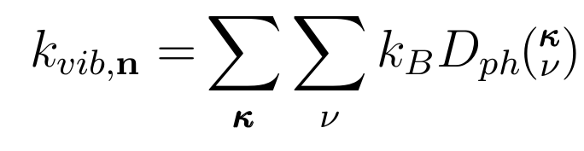
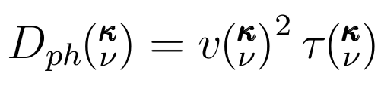

Thermal Diffusivity
27
NMD
Classical harmonic limit:
Phonon mode diffusivity:

Slide 28




Phonons in Amorphous System
28
Green-Kubo prediction (includes all modes):
Green-Kubo
AF prediction (diffusons):
Phonon contribution?:
Atomistic prediction for amorphous silicon [1]:
[1] Yuping He, et al.. Heat transport in amorphous silicon: Interplay between morphologyand disorder. Applied Physics Letters, 98:144101, 2011.

Slide 29


Toolbox
29
Method | Type of Analysis | Information | Classical | Ab-initio
Green-Kubo | Anharmonic | Top-down: Phonons + Diffusons
Normal Mode Decomposition | Anharmonic | Bottom-up: Phonons + (Diffusons?)
Lattice Dynamics (AF) | Harmonic | Bottom-up: Diffusons
Importance of anharmonicity:
- Can we capture thermal transport properties using (quasi)-harmonic analysis?
Ab-initio calculations:
- Physically accurate
- Computationally expensive

Slide 30
Outline
30
Introduction/Motivation
Background
Preliminary Work
Proposed Work
Schedule

Slide 31
Ordered and Disordered Contributions to Thermal Transport
31
LJ models of crystal, alloy, and amorphous phases using MD, Green-Kubo, NMD, and AF

Slide 32
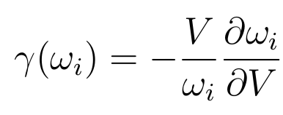
Role of Anharmonicity
32
Debye-type model?
From LJ study:
Lattice Dynamics (harmonic)
What is role of anharmonicity?
- Use Lattice Dynamics (harmonic) and MD-NMD (anharmonic) to investigate.
- Results will inform ab-initio calculations for amorphous silicon.
- Would like a simple model for phonon contribution, all parameters calculated using Lattice Dynamics (harmonic):

Slide 33
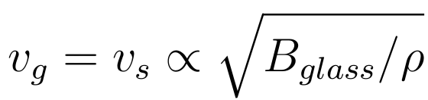
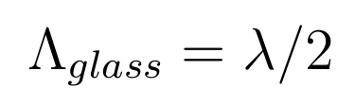
Validity of Theoretical Models
33
Cahill-Pohl model [1]: physically meaningful?
All modes in a glass are “phonons” with sound speed group velocity:
“Phonon” mode mean free paths equal to half the “wavelength”:
[1] David G. Cahill, et al.. Lower limit to the thermal conductivity
of disordered crystals. Phys. Rev. B, 46:6131–6140, Sep 1992.

Slide 34
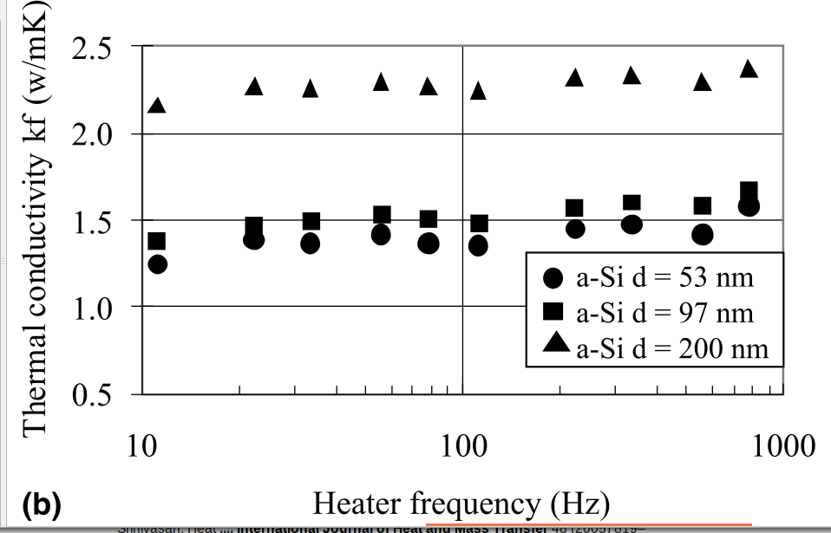
Thermal Transport in Amorphous Silicon using Ab Initio Calculations
34
Classical atomistic prediction for amorphous silicon [2]:
Design ab-initio calculations based on LJ results.
Will inform calculations for LUC.
S Moon, International Journal of Heat and Mass Transfer, 45(12):2439–2447, 2002.
[2] Yuping He, et al.. Heat transport in amorphous silicon: Interplay between morphologyand disorder. Applied Physics Letters, 98:144101, 2011.

Slide 35
Large Unit Cell (LUC) Materials
35
- Use silica structures as model LUC materials
- Top-down (Green-Kubo) predictions exist [1]
- Phonon and diffuson contributions:
What are sub-unit cell effects?
- Coordination
- Adsorbed molecules
[1] A. J. H. McGaughey and M. Kaviany, International Journal of Heat and Mass Transfer, 47:1799–1816, 2004.

Slide 36
LUC Materials for Thermoelectrics
36
Debye
Debye models not sufficient:
- Two scalings with b indicate phonon picture qualitatively right [1]
What are sub-unit cell effects?
- “Rattler” atoms effect on phonon dispersion, scattering?
[1] Eric S. Toberer, Alex Zevalkink, and G. Jeffrey Snyder. Phonon engineering through crystal chemistry. J. Mater. Chem., 21, 2011.

Slide 37
Outline
37
Introduction/Motivation
Background
Preliminary Work
Proposed Work
Schedule

Slide 38
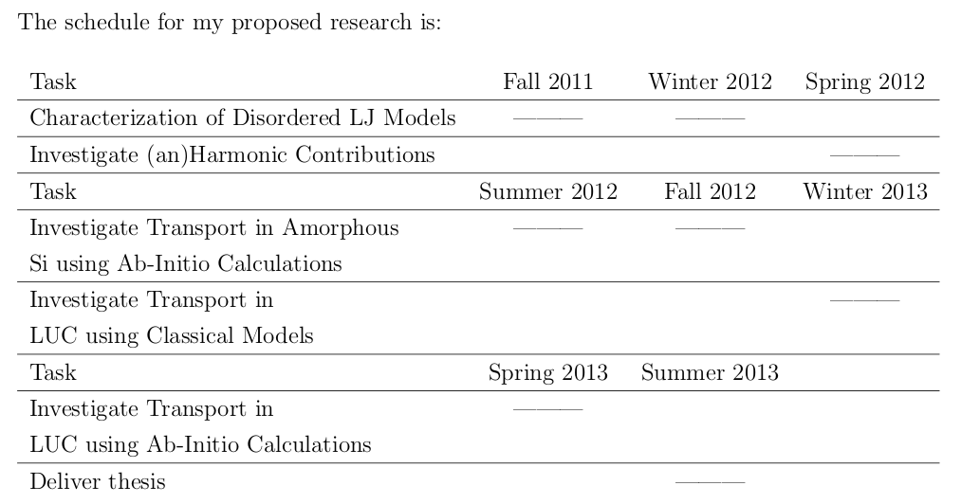
Schedule
38

Slide 39
Questions
39

Slide 40
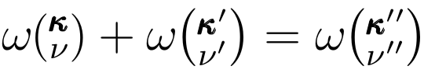

Open Questions
How do phonons and diffusons interact?
Conservation of energy
Conservation of crystal momentum

Slide 41
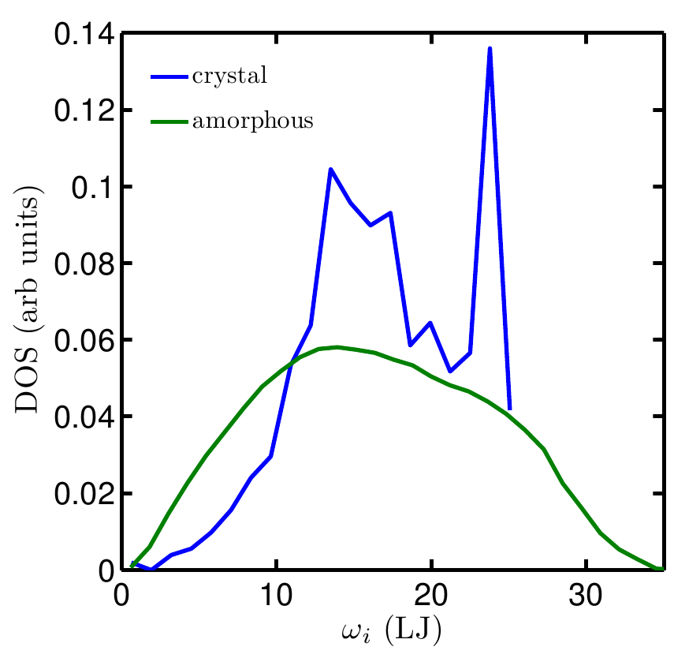

Slide 44
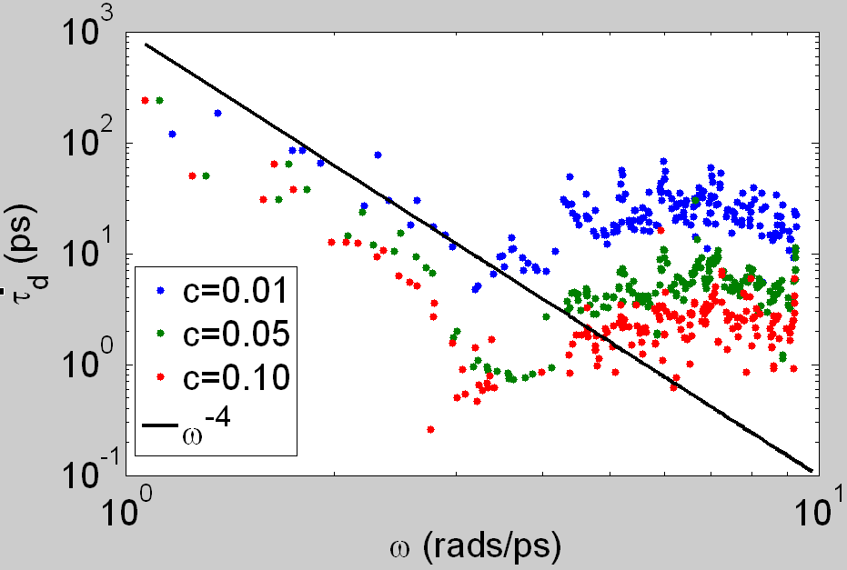
Defect Scattering
16
Matthiesen Rule:
Rayleigh scattering:

Slide 45


