Slide 1
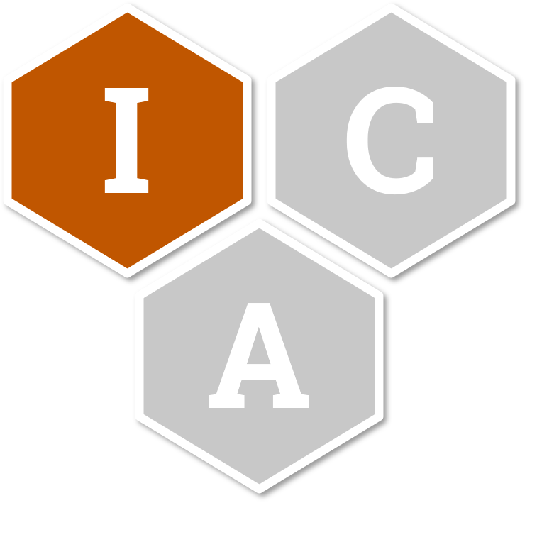
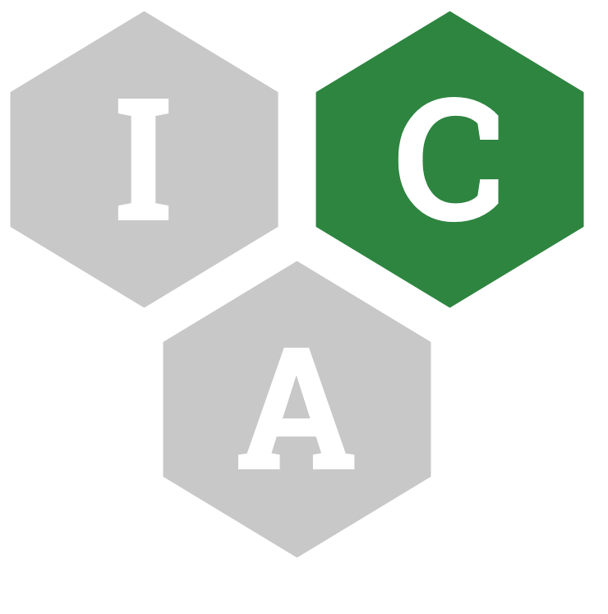





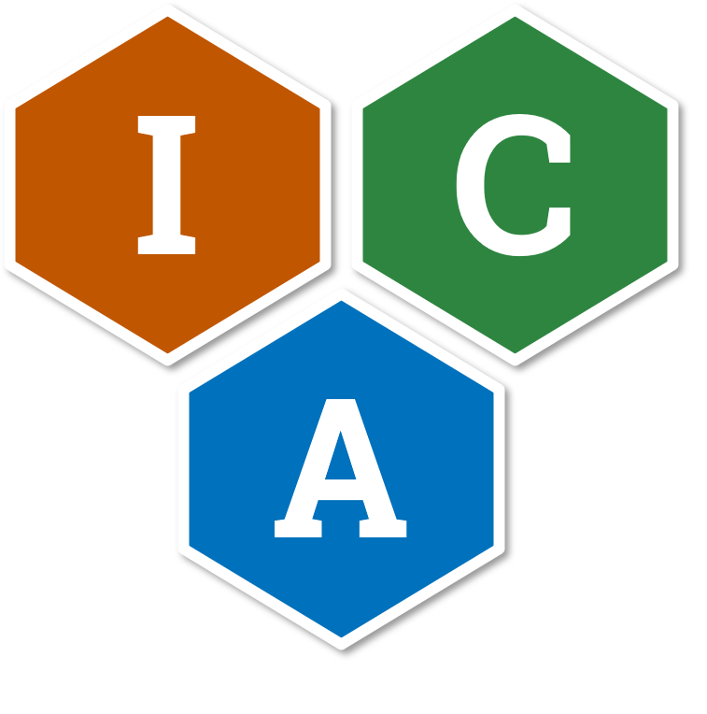




Identity, Credential, and Access Management (ICAM)
The set of tools, policies, and systems that an agency uses to enable the right individual to access the right resource, at the right time, for the right reason in support of federal business objectives.
Identity Management
Credential Management
✓
How an agency collects, verifies, and manages attributes to establish and maintain enterprise identities for employees and contractors.
How an agency issues, manages, and revokes credentials bound to enterprise identities.
Access Management
Federation
Governance
The technology, policies, standards, and processes that allow an agency to accept digital identities, attributes, and credentials managed by other agencies.
The set of practices and systems that guides ICAM functions, activities, and outcomes.
✓
How an agency authenticates enterprise identities and authorizes appropriate access to protected services.

