Slide 1









Identity Management
Federation
Credential Management
Governance
Access Management

Slide 2




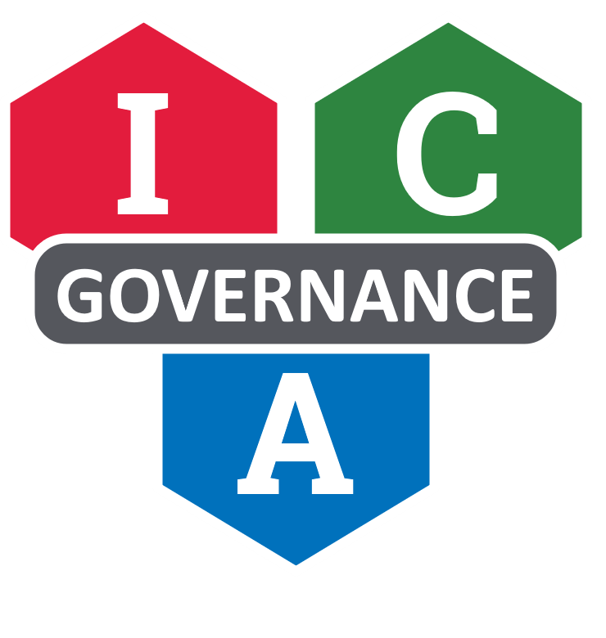
Identity Management
Credential Management
Access Management
Federation
Governance

Slide 3
Identity Management
Credential Management
Access Management
Federation
Governance

