Slide 1
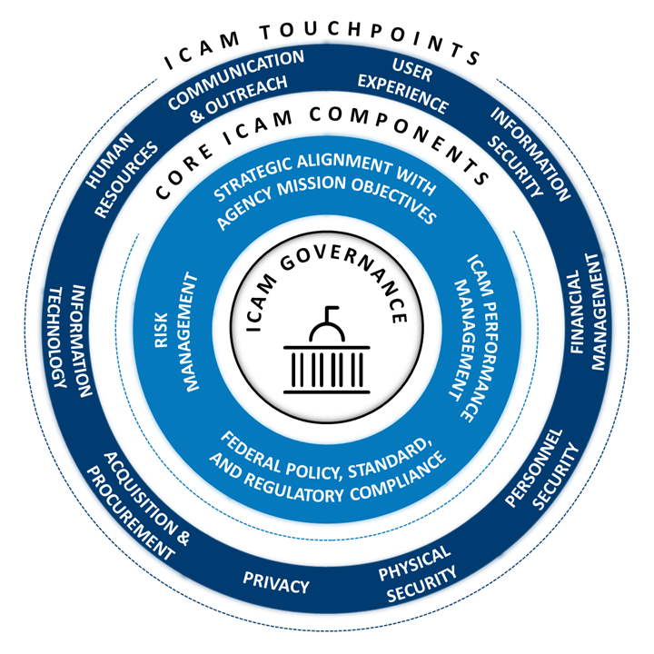
ICAM Placemat Template
Identity Credential and Access Management Governance
Enable the right individual to access the right resource, at the right time, for the right reason in support of federal business objectives and effective agency mission delivery
Benefits and Outcomes of ICAM Governance
Core Components of ICAM Governance
Activities for ICAM Governance Stakeholders
Strategic Alignment: Incorporating ICAM into agency strategic missions, and cybersecurity goals and objectives.
ICAM Performance Management: Tracking, managing, monitoring and reporting on overall ICAM activity performance and metrics to measure resource contributions to specific missions, goals and objectives.
Enterprise Risk Management: The identification of policies and practices, and the analysis, monitoring and mitigation of threats to the success of ICAM operations and mission delivery
Federal Policy, Standard, and Regulatory Compliance: Ensure agency-wide adoption of ICAM services through internal policies and practices with strong executive buy-in and support, alignment with the agency’s business needs and mission, and compliance with applicable laws, regulations and policies.
Drive Missions
Increases overall awareness of importance of ICAM at Executive Leadership level
Reduces risk for agency systems and services that would stem from inadequate auditing and monitoring
Empower Customers
Provides consistent, timely, and seamless identity creation, provisioning, and authorization to systems
Increases workforce productivity through streamlined tasks, allowing agencies to focus on mission-critical activities
Establish and maintain Advisory Councils and Working Groups to facilitate communication and feedback conveying ICAM capabilities to business areas.
Evaluate current and outdated internal policies and make recommendations for changes.
Communicate the benefits of ICAM to stakeholders and executive leadership at an enterprise level.
Educate and inform agency staff on the importance of ICAM to the mission delivery.
Proactively communicate proposed changes to enterprise wide ICAM solutions and services, and their corresponding implementation benefits.
Establish agency ICAM best practices to facilitate efficiency and effectiveness to enhance security and the overall customer experience.
Enhance Security
Implements Multi-Factor Authentication as a staple of cybersecurity
Reduces delays in issuance and removal of credentials and access to authorized systems and services
Improve Business and Cost Efficiencies
Reduces resource expenditures for cost savings that can be shared among agencies
Improves continual management to authorized services
Achieve Mission
Enhance Security
Improve customer experience
Improve customer service scores
Improve workforce onboarding experience
Increase transparency and visibility across enterprise
Set foundation for Zero Trust through access control policies/rules
Enable compliance and auditing by providing oversight and clear milestones
Provide ability to implement enterprise capabilities through governance processes
Notes:
Core components on the left side of the slide
Activities for ICAM Governance Stakeholders on the right side of the slide
Center - have the ICAM Governance Core Components and Touchpoints Diagram
Surrounding the diagram are example benefits and outcomes of ICAM Governance

Slide 2
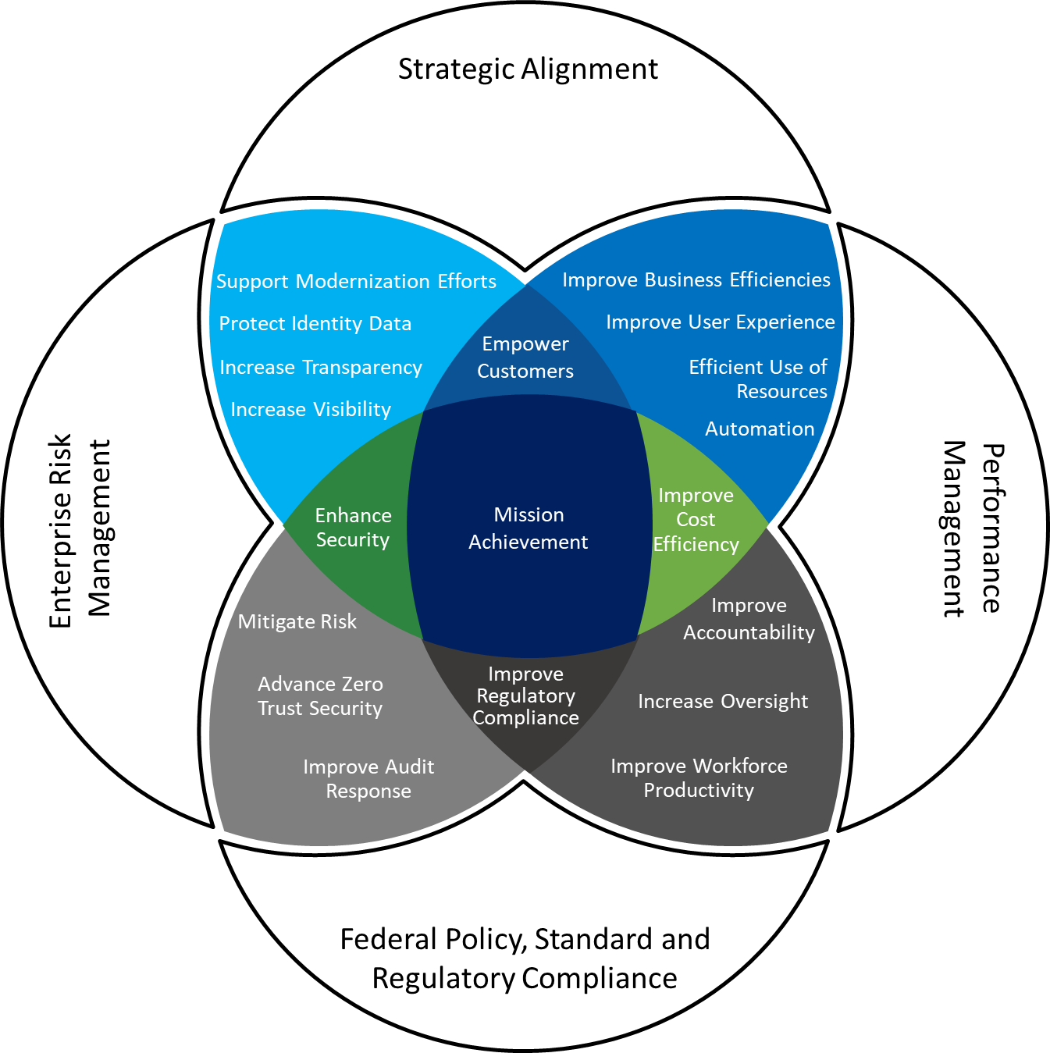
Venn Diagram Template

Slide 3
ICAM Touchpoints Template
ICAM Touchpoints
COMMUNICATION
& OUTREACH
USER
EXPERIENCE
Core ICAM components
HUMAN
RESOURCES
INFORMATION
SECURITY
STRATEGIC ALIGNMENT WITH
AGENCY MISSION OBJECTIVES
Information
Technology
Acquisition &
procurement
FINANCIAL
MANAGEMENT
ICAM GOVERNANCE
RISK
MANAGEMENT
ICAM PERFORMANCE
MANAGEMENT
FEDERAL POLICY, STANDARD,
AND REGULATORY COMPLIANCE
PERSONNEL
SECURITY
PHYSICAL
SECURITY
PRIVACY

Slide 4
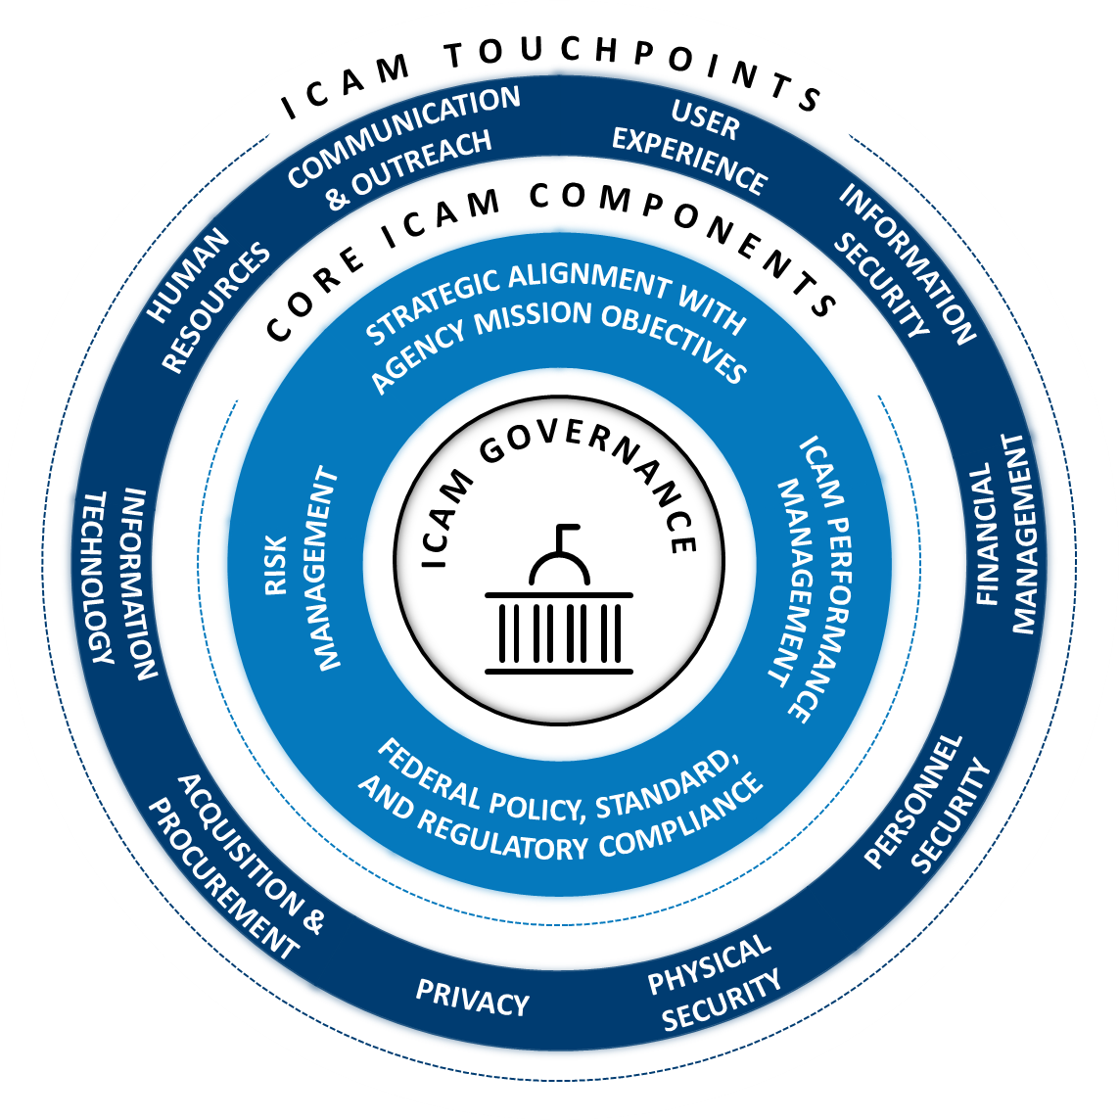
ICAM Touchpoints Static Image

Slide 5

Basic Journey Map
Template: Agency Journey Map
Select & Implement
Current State of ICAM Capability
Key drivers
Build foundational blocks
Define Future Vision
Assess & Analyze
Cyclical approach to stabilize, enhance and optimize processes & controls to account for updated federal regulations and/or business enablement requirements
Socialize approach across Agency
Draft Policies & Procedures that facilitate adoption
Setup Reporting, Dashboard & KPI metrics
Create High Level Technical Roadmap - Agile
Plan & Design
Notes:
High level journey map to help tell the ICAM capability story you want to convey and the steps needed to obtain the ICAM capability.

Slide 6

Example: Agency Digital Identity Journey Map
Understand business and technical requirements as well as a detailed awareness of the options available within the market
Review agency understanding of the processes in use today and
Categorize and identify opportunities for consolidation and automation.
Build the “Case” - outline internal or external factors causing issues, identifying specific behaviors that must change, clarifying the impacts of not changing, and outlining a roadmap with measurable success criteria.
Review authoritative source integration for enhancement opportunities while developing an implementation strategy
Confirm and document agency’s understanding of current processes and the tools used to support them,
Identify overlaps between program needs to avoid duplication of efforts.
Identify key stakeholders who could be affected by the selection and implementation of an enterprise-wide identity service. Standing up working group / committee to meet regularly and share progress
Select deployment options - Full service or componentized
Select & Implement
Review of existing architecture and infrastructure supporting targeted agency applications – including identity proofing, authentication, federation, and identity management technologies.
Set up governance structure to ensure organizational change and enterprise solution; Development requires well defined governance, cross-program involvement and multi-team collaboration to be successful
Review current policies and draft updates to the policies for the new digital identity approach
Define success metrics and milestones to track progress towards project success.
Formalize policies throughout enterprise and engage in change management to increase adoption
Current State of Digital Identity
Key drivers
Build foundational blocks
Define Future Vision
Assess & Analyze
Cyclical approach to stabilize, enhance and optimize processes & controls to account for updated federal regulations and/or business enablement requirements
Socialize approach across Agency
Draft Policies & Procedures that facilitate adoption
Setup Reporting, Dashboard & KPI metrics
Securing User data – protect Customer and Workforce users from fraud and identity theft in an environment of evolving threats and attack vectors.
Review of existing tools and technologies used to support identity proofing, authentication and authorization of users along with federation capabilities.
Interim: This will focus on an “interim state” where agency will leverage current technologies – potential products that can be easily integrated with currently owned technology – and acknowledge potential regulatory changes that may be required to support integration of processes.
Understand Key Performance Indicators (KPIs) and how to track them
Create High Level Technical Roadmap - Agile
Plan & Design
Empowering Users & moving to Digital – Digital Identity solution will allow users to further protect sensitive data and ensure compliance with electronic authentication guidelines.
Design path forward and future vision of Digital Identity approach
Create Reports to monitor progress and development of digital identity strategy
Plan working group requirements gathering sessions to capture technical and functional requirements
Define deployment options of the digital identity strategy
End state: The “end state” implementation will look beyond current constraints and include recommendations for improvements to both technology and processes while focusing on innovation and scalable and feasible solutions for offering a shared service.
Assess working group current state assessment and future vision
Produce periodic reports/metrics for stakeholders to make strategic decisions
Complying with Federal Guidelines - Review of associated policies and regulations for their impact on future business entity identity assurance and validation processes.
Technical roadmap will include customizability to allow for future agile updates
Analyze a path forward on current state assessment and future vision. Embed activities associated with stabilize, enhance and optimize in the future vision.
Design initial solution recommendations including strategic, business, and technical outputs
Technical roadmap will integrate the current state and future intended digital identity state
Detailed Journey Map
Assess and analyze the fundamental drivers of project success, defining interventions to successfully manage stakeholders, and ultimately enabling the highest levels of end-user adoption
Agency will identify necessary resources to be procured to achieve the intended digital identity state
Technical roadmap will incorporate user experience & transparency to ensure a seamless transition for end users
Notes:
This slide includes the same high-level stages from the prior slide, but offers a detailed example of a completed Digital Identity Journey Map
Agencies can tailor the precise steps needed as they see fit to advance from the Current State to the desired End State according to the ICAM capability they’d like to implement or build upon.

Slide 7
Word Cloud Option 1
Improve Digital Services
Improve Regulatory Compliance
Mitigate Risk
ICAM GOVERNANCE
Empower Customers
Increase Transparency and Visibility
Improve Business Efficiencies
Strategic Alignment
Protect Identity Data
Advance Zero Trust Security
Enterprise Risk Management
Improve Accountability
Improve Workforce Productivity
BENEFITS
Mission Achievement
Performance Management
Improve Audit Response
Increase Automation
Support Modernization Efforts
Federal Policy, Standard, and Regulatory Compliance
Enhance Security
Efficient Use of Resources
Improve User Experience
Reduce Operating Costs
Improve Cost Efficiency
Increase Oversight

Slide 8
Word Cloud Option 2
Increase consumer confidence in agency services
ICAM GOVERNANCE
Improve audit responses
Improve customer service scores
Increase transparency and visibility across enterprise
Strategic Alignment
Improve cross-agency collaboration
Enterprise Risk Management
Improve workforce onboarding experience
BENEFITS
Enhance mission delivery
Efficient use of resources
Performance Management
Improve workforce productivity
Support modernization efforts
Federal Policy, Standard, and Regulatory Compliance
Improve cost efficiency
Lower help desk costs
Improve personnel security
Improve offboarding processes
Improve physical security
Improve regulatory compliance
Improve public consumer experience

Slide 9
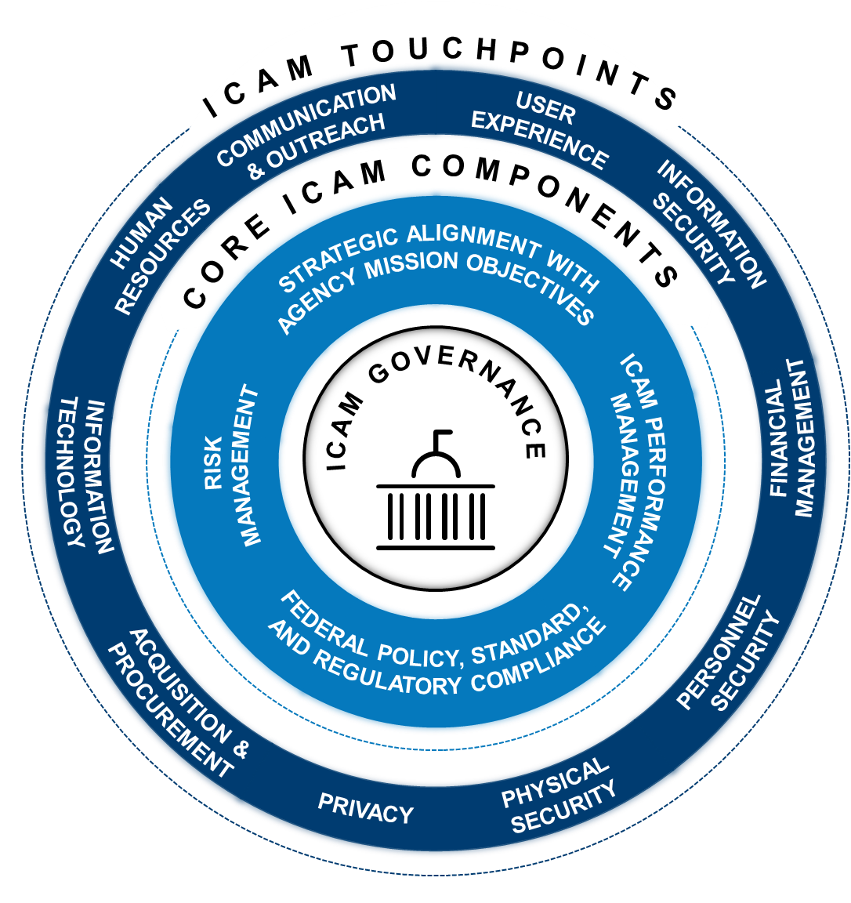
Communication and Outreach
User Experience
Strategic Alignment
ICAM Program Management Playbook
Example Performance Metrics
Elevator Pitches | Placemats
Word Clouds
Budget “talking points”
Journey Maps
Value Propositions
Elevator Pitches | Placemats
Journey Maps
Word Clouds
ICAM Program Management Playbook
Business Case/Return on Investment
Program Charter
Example Performance Metrics
ICAM Strategy
Internal ICAM Policies
ICAM Vision Statement
Human Resources
Performance Management
Example onboarding processes
Journey Maps
Word Clouds
Elevator Pitches | Placemats
ICAM Primer / 101
ICAM Program Management Playbook
Example Performance Metrics
Service Level Agreements (SLAs)
Enterprise Risk Management
Information Security, Financial Management, Physical Security, Personnel Security, Privacy
ICAM Strategy / Policy
IT Strategic Plan
Risk Register
Elevator Pitches | Placemats
Word Clouds
Journey Maps
ICAM Primer / 101
Information Technology
Elevator Pitches | Placemats
Word Clouds
Journey Maps
ICAM Primer / 101
Acquisition & Procurement
Federal Policy, Standard and Regulatory Compliance
ICAM Acquisition Guidance
FITARA Review triggers
ICAM Primer / 101
ICAM Policy/Strategy
Example Performance Metrics
Gap Analysis Template
ICAM Governance Tool

