Slide 1
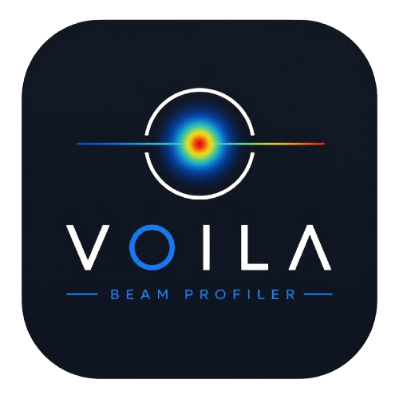
User Guide & Tutorial
Live camera-based laser beam profiling — acquisition, measurement, and propagation analysis
Version v4.7 • VOILA Lab

Slide 2
01
Introduction
What this app does, and what to keep in mind before you start

Slide 3
INTRODUCTION
What is VOILALab Beam?
Live beam view — real-time camera image with X/Y intensity profiles
Size & position metrics — FWHM, 1/e², Gaussian fit, D4σ, centroid, peak
Pointing stability — tracks centroid drift over time
Data output — CSV logging, TIFF / NumPy / JSON capture files
Propagation analysis — multi-position beam-caustic and provisional M² fitting
VOILALab Beam — User Guide
2

Slide 4
INTRODUCTION
Before You Start: Safety & Measurement Scope
Laser safety first — this software is not a substitute for your institution's laser-safety controls and attenuation practices
Not automatically ISO 11146-compliant — the app can perform ISO-style D4σ and caustic math, but compliance also needs calibration, correct background handling, unsaturated images, known pixel pitch/wavelength, and points on both sides of the waist
Read the warnings — truncated, saturated, or low-SNR results are flagged — don't override them without understanding why
VOILALab Beam — User Guide
3

Slide 5
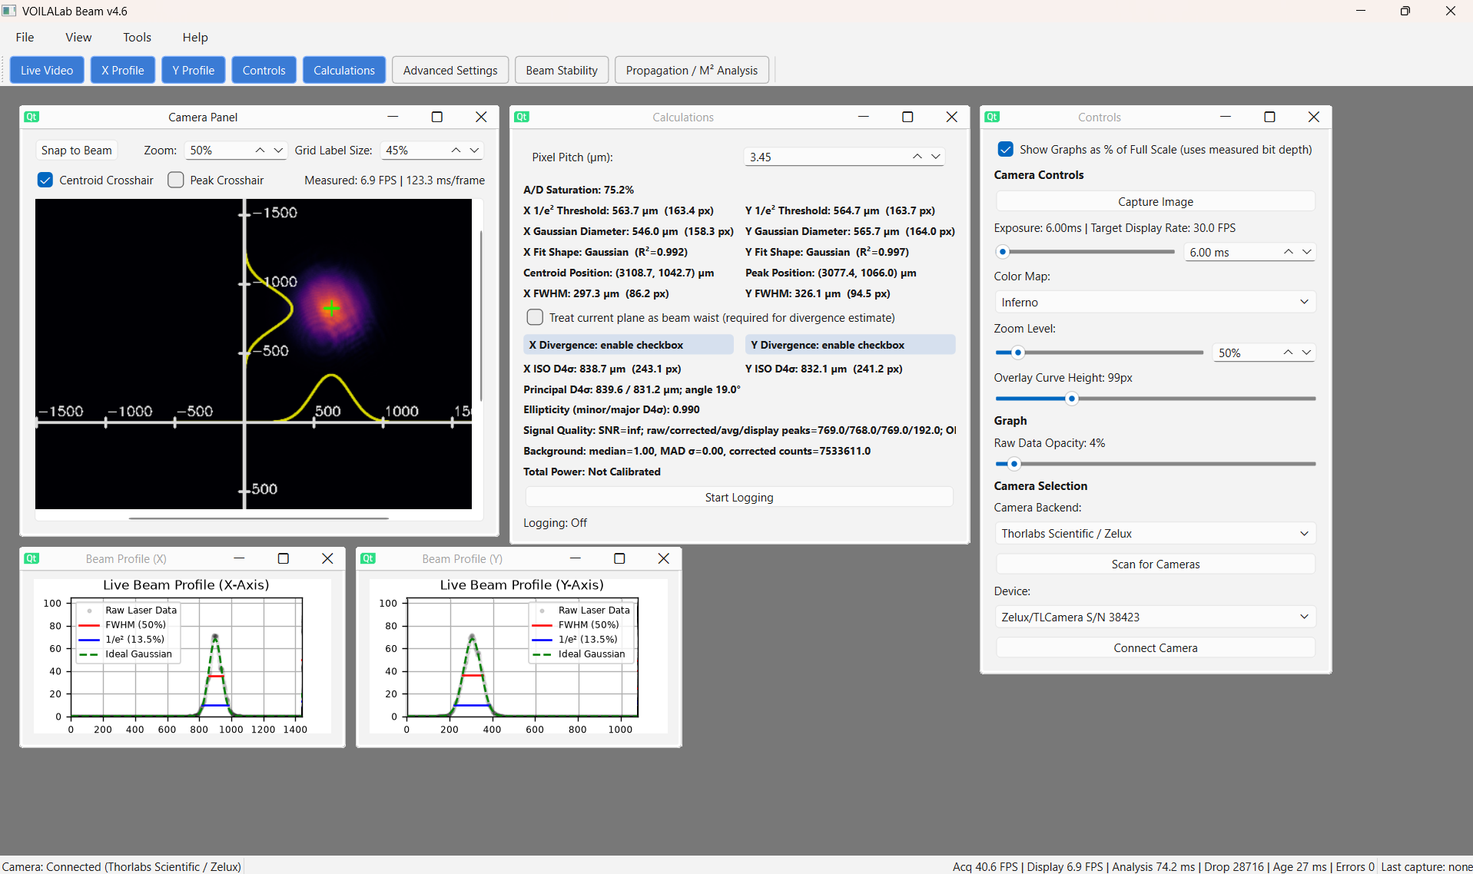
INTRODUCTION
Main Window Overview
Movable, resizable subwindows — arrange panels however suits your workflow
Show / hide, don't destroy — closing a panel just hides it — reopen anytime from the toolbar or View menu
Two themes — light and dark, switchable from the View menu
Seven panels total — Camera, X/Y Profile, Controls, Calculations, Advanced Settings, Beam Stability, Propagation / M²
VOILALab Beam — User Guide
4

Slide 6
02
Menu Bar & Toolbar
Where every panel and action lives

Slide 7
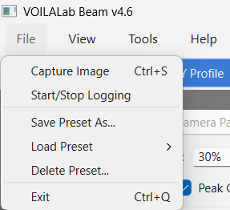
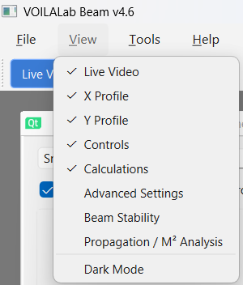
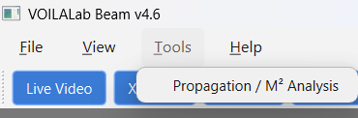
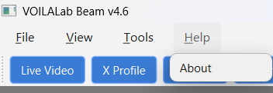
MENU BAR & TOOLBAR
Menu Bar at a Glance
File — capture, logging, presets, exit
View — show/hide any panel, switch light/dark theme
Tools — open Propagation / M² Analysis (Also accessible via Toolbar)
Help — About — application info
VOILALab Beam — User Guide
6

Slide 8
MENU BAR & TOOLBAR
File Menu
Capture Image (Ctrl+S) — saves the latest displayed frame + measurement metadata
Start / Stop Logging — begins or ends CSV measurement recording
Save Preset As… — stores current settings under a chosen name
Load Preset — applies a previously saved preset
Delete Preset… — removes a saved preset
Exit (Ctrl+Q) — closes the app and safely stops the camera worker
VOILALab Beam — User Guide
7

Slide 9
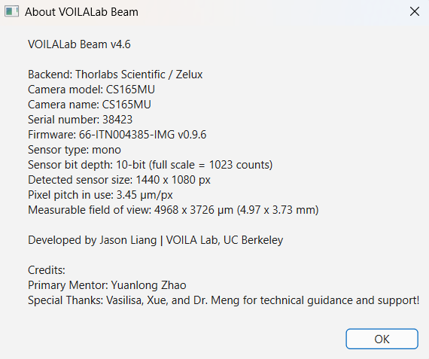
MENU BAR & TOOLBAR
Help Menu
About — Shows detected camera information, app version, and credits
VOILALab Beam — User Guide
8

Slide 10
MENU BAR & TOOLBAR
View Menu
Panel toggles — Live Video, X Profile, Y Profile, Controls, Calculations, Advanced Settings, Beam Stability, Propagation / M²
Dark Mode — switches the interface and plots between light and dark themes
VOILALab Beam — User Guide
9

Slide 11
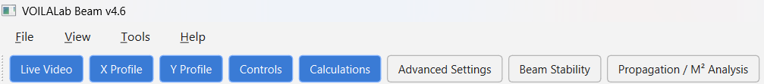
MENU BAR & TOOLBAR
Toolbar & Status Bar
Toolbar — one-click show/hide for every major panel
Analysis health — analysis time, dropped frames, frame age, worker errors
Highlighted button — means that panel is currently visible
Recent activity — shows the most recent capture
Camera & performance — connection status, acquisition/display FPS
VOILALab Beam — User Guide
10

Slide 12
03
Getting Started
Launch the app and get a usable beam image

Slide 13
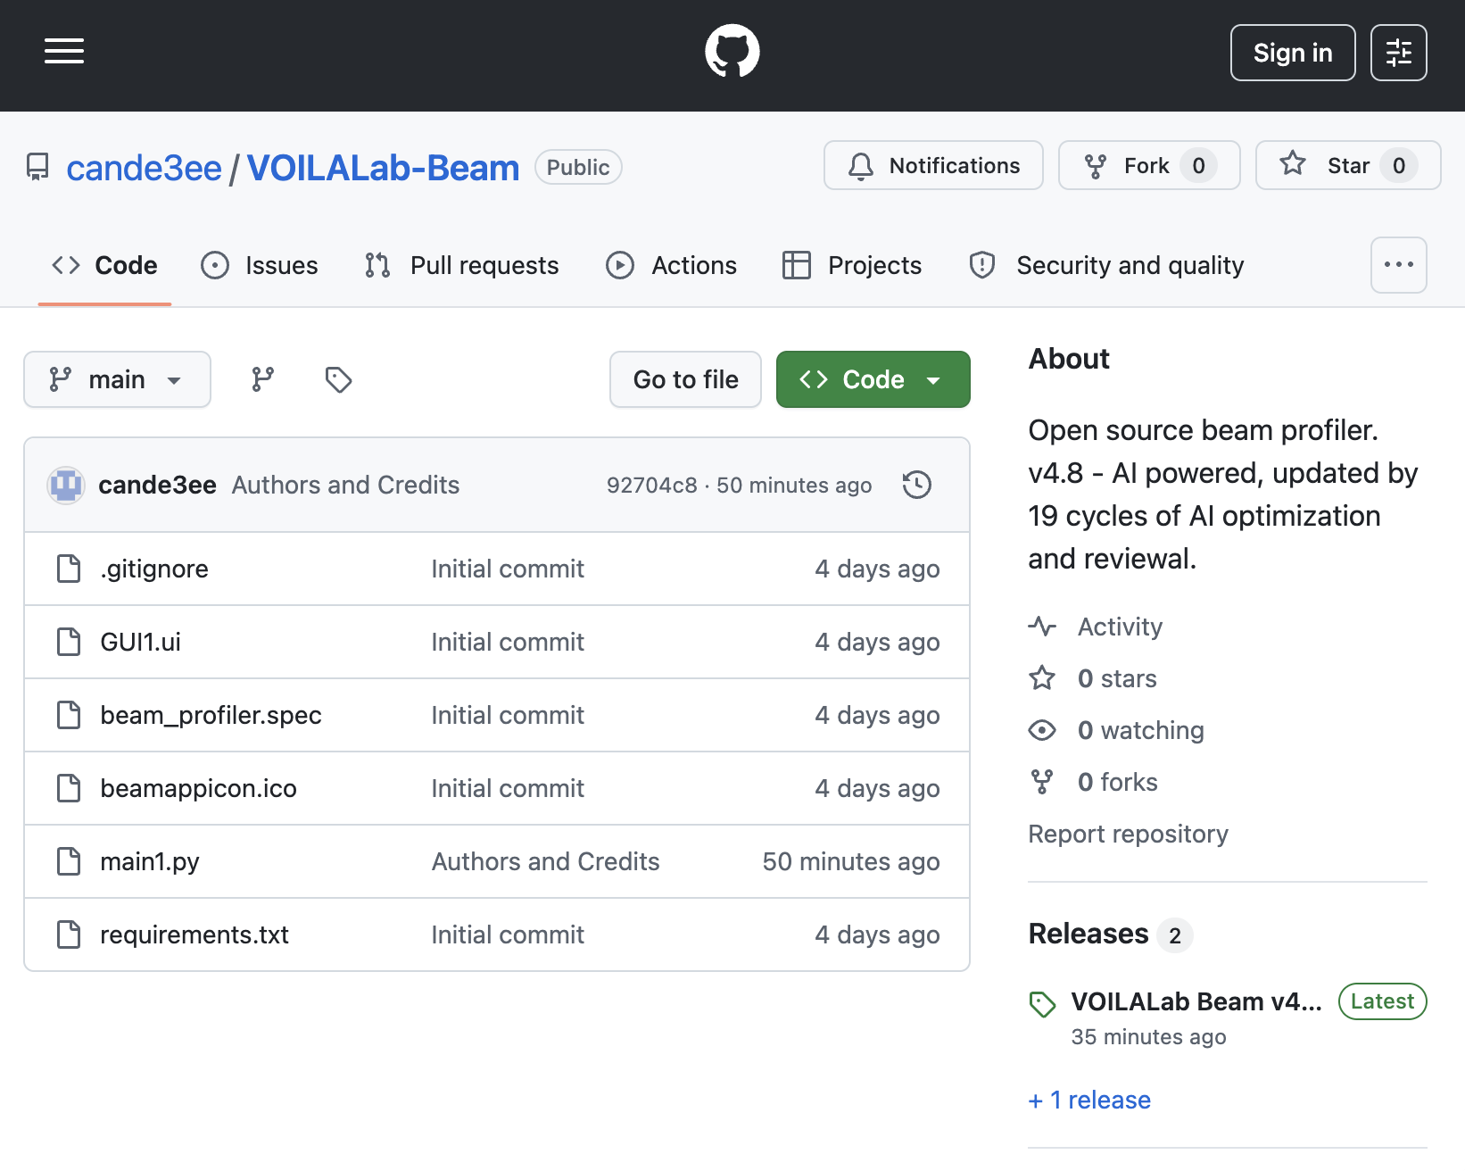
GETTING STARTED
How to Download the App
1
Download the .zip file in the releases section
Github: https://github.com/cande3ee/VOILALab-Beam
2
Extract all from the zip file
3
Open VOILALabBeam.exe
VOILALab Beam — User Guide
12

Slide 14
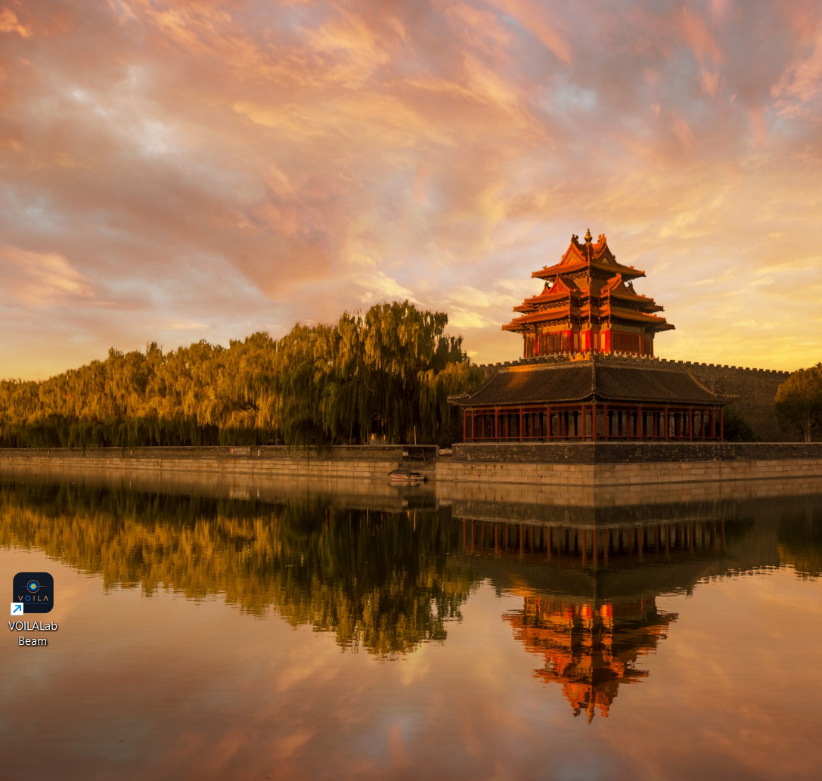
GETTING STARTED
How to Start the App
1
Launch the executable or run the script
double-click the .exe, or run python v47_packaging_ready.py
2
Confirm the main window opens
with its default panel layout
3
Open Controls
this is where you'll select a camera backend next
VOILALab Beam — User Guide
13

Slide 15
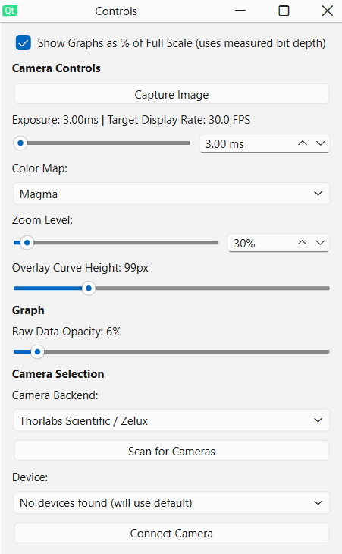
GETTING STARTED
Connecting a Camera
1
Open the Controls panel
and select the appropriate camera backend (OpenCV, Thorlabs, or UC480)
2
Click Scan for Cameras
lists available devices for that backend
3
Select your device
from the list
4
Click Connect Camera
5
Verify pixel pitch
check it in the Calculations panel — auto-filled where supported, but confirm against the spec sheet
VOILALab Beam — User Guide
14

Slide 16

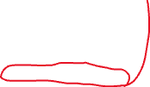


GETTING STARTED
Getting Started
3
Adjust to appropriate pixel pitch
Software cannot detect hardware pixel pitch
5
Adjust exposure
In Controls panel
4
Watch the A/D Saturation readout
in the Calculations panel as you go
1
Center the beam
Zoom out, find the
Beam first, and
Center it.
2
Snap to Beam
You can zoom in and
Press Snap to Beam
To automatically center the beam on the panel.
VOILALab Beam — User Guide
15

Slide 17
04
Panel Tour
Every panel, what it shows, and how to use it

Slide 18
PANEL TOUR
The Seven Panels, at a Glance
1. Camera Panel
2. X / Y Profile Panels
Live beam image, crosshairs, zoom, grid overlay
1D intensity slices through the centroid
3. Controls Panel
4. Calculations Panel
Exposure, color map, camera selection
Widths, centroid/peak, D4σ, power, logging
5. Advanced Settings Panel
6. Beam Stability Panel
Dark frame, SNR, performance, calibration
Centroid drift over time
7. Propagation / M² Panel
Multi-position beam-caustic fitting
VOILALab Beam — User Guide
17

Slide 19
PANEL TOUR — 1. CAMERA PANEL
Camera Panel
Snap to Beam — centers the view on the latest measured centroid — handy when zoomed in
Zoom — changes only the displayed size; never affects resolution or measurements
Grid Label Size — adjusts the sensor-axis gridlines and µm labels
Centroid / Peak Crosshairs — show or hide each independently
Measured FPS — achieved frame rate and time per frame
VOILALab Beam — User Guide
18

Slide 20
PANEL TOUR — 2. X/Y PROFILE PANELS
X Profile and Y Profile Panels
Raw Laser Data — the measured profile samples
FWHM — region above 50% of peak-above-background
1/e² width — region above ~13.5% of peak-above-background
Ideal Gaussian — fitted curve, shown only when it passes the R² quality threshold
Counts vs. % scale — toggle raw camera counts or % of sensor full-scale in the top of the Controls panel
VOILALab Beam — User Guide
19

Slide 21
PANEL TOUR — 3. CONTROLS PANEL
Controls Panel
% of Full Scale — toggle for the profile graph scale
Capture Image — saves the exact latest analyzed frame (.tif, .npy, .json)
Camera Exposure — slider for speed, spin box for precise ms entry
Color Map — Inferno / Jet / Hot / Magma — display only
Zoom Level — mirrors the Camera Panel zoom
Overlay Curve Height / Raw Data Opacity — tune the on-image profile overlay
Camera Selection — backend → Scan → select → Connect
VOILALab Beam — User Guide
20

Slide 22
PANEL TOUR — 4. CALCULATIONS PANEL
Calculations Panel — Core Measurements
Pixel Pitch — physical size of one pixel (µm) — verify against the camera spec
A/D Saturation — brightest pixel as % of full-scale
1/e² Threshold Widths — direct measurement, no Gaussian assumption required. 13.5% Threshold
Gaussian Diameters — diameter of the fitted Gaussian distribution.
Fit Shape / R² — how closely the profile follows a Gaussian curve
VOILALab Beam — User Guide
21

Slide 23
PANEL TOUR — 4. CALCULATIONS PANEL
Calculations Panel — Position & D4σ
Centroid position — intensity-weighted beam center
Peak position — location of the single brightest pixel
FWHM — full width at half maximum 50% threshold beam width
D4σ diameters — camera-axis X/Y, plus major/minor axis, orientation, ellipticity
Truncation & validity — D4σ is highly sensitive to background, edges, and stray light — treat a truncated/invalid flag as unreliable
Treat as Waist — enables a local divergence estimate — only if the camera is actually at the waist
VOILALab Beam — User Guide
22

Slide 24
PANEL TOUR — 4. CALCULATIONS PANEL
Calculations Panel — Power & Logging
Signal quality — SNR (Signal to noise ratio), peak intensities (bit-depth dependent)
Power readout — µW / mW / dBm — requires a calibration factor entered in Advanced Settings
Wavelength alone ≈ no calibration — entering it does not calibrate camera responsivity
Start Logging — creates a timestamped CSV and records measurements periodically
Stop before closing — stop logging before closing/moving the file so it finalizes correctly
VOILALab Beam — User Guide
23

Slide 25
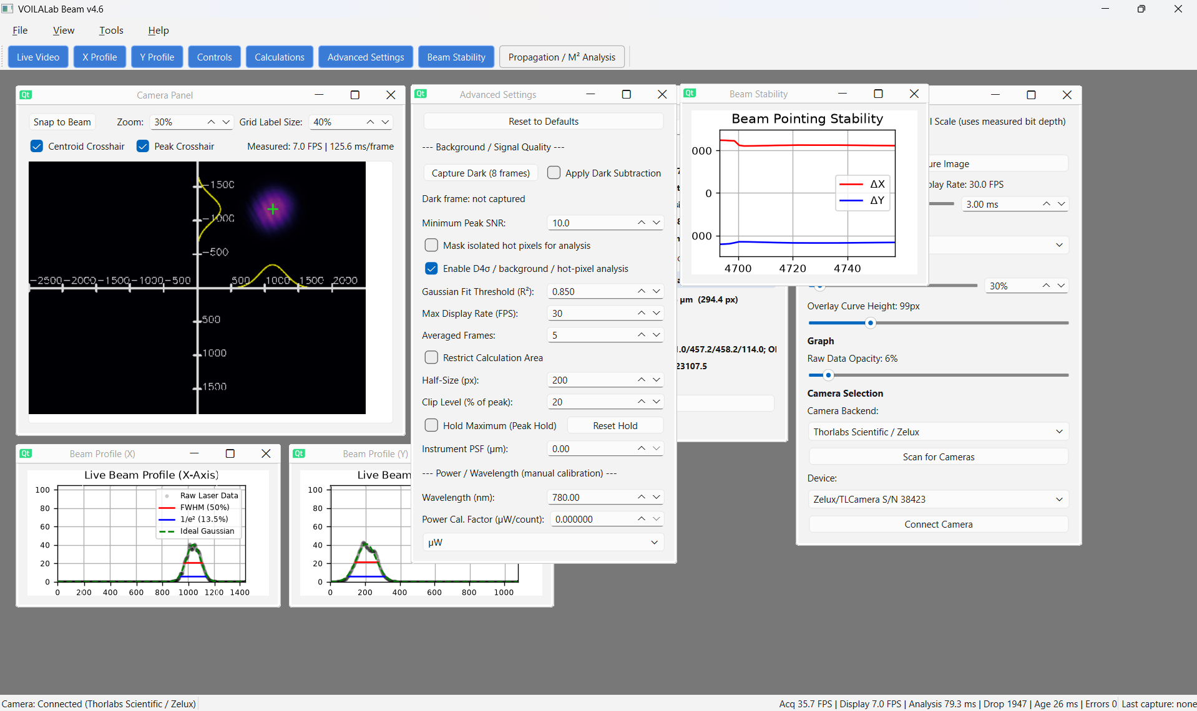
PANEL TOUR — 5. ADVANCED SETTINGS PANEL
Advanced Settings Panel — Dark Frame Workflow
Capture Dark (8 frames) — block all light, keep settings unchanged, then capture
Apply Dark Subtraction — subtracts the stored dark frame before analysis
Automatic rejection — a mismatched dark frame (changed exposure/gain/resolution/camera) is flagged invalid
Recapture after changes — any time exposure, gain, pixel format, resolution, or camera changes
VOILALab Beam — User Guide
24

Slide 26
PANEL TOUR — 5. ADVANCED SETTINGS PANEL
Advanced Settings — Performance & Analysis
Minimum Peak SNR — signal-quality acceptance threshold
Restrict Calculation Area — must stay large enough for the full beam + tails
Mask isolated hot pixels — excludes defective pixels from analysis
Clip Level — % of peak used to build the centroid mask
Enable D4σ / bg / hot-pixel analysis — toggle the heavier diagnostics for speed
Hold Maximum — running per-pixel max — good for brief pulses
Gaussian Fit Threshold (R²) — minimum quality before a Gaussian result is trusted
Max Display Rate / Averaged Frames — refresh cap; 1–20 frame averaging
Instrument PSF / Wavelength / Power Cal — optional corrections — leave at zero/uncalibrated unless independently characterized
VOILALab Beam — User Guide
25

Slide 27
PANEL TOUR — 6. BEAM STABILITY PANEL
Beam Stability Panel
Plots centroid movement — X/Y offset from sensor center, in µm, over time
Use it to spot — pointing drift, vibration, warm-up behavior, sudden movement, long-term alignment issues
Live diagnostic only — use CSV logging when you need to keep the data
VOILALab Beam — User Guide
26

Slide 28
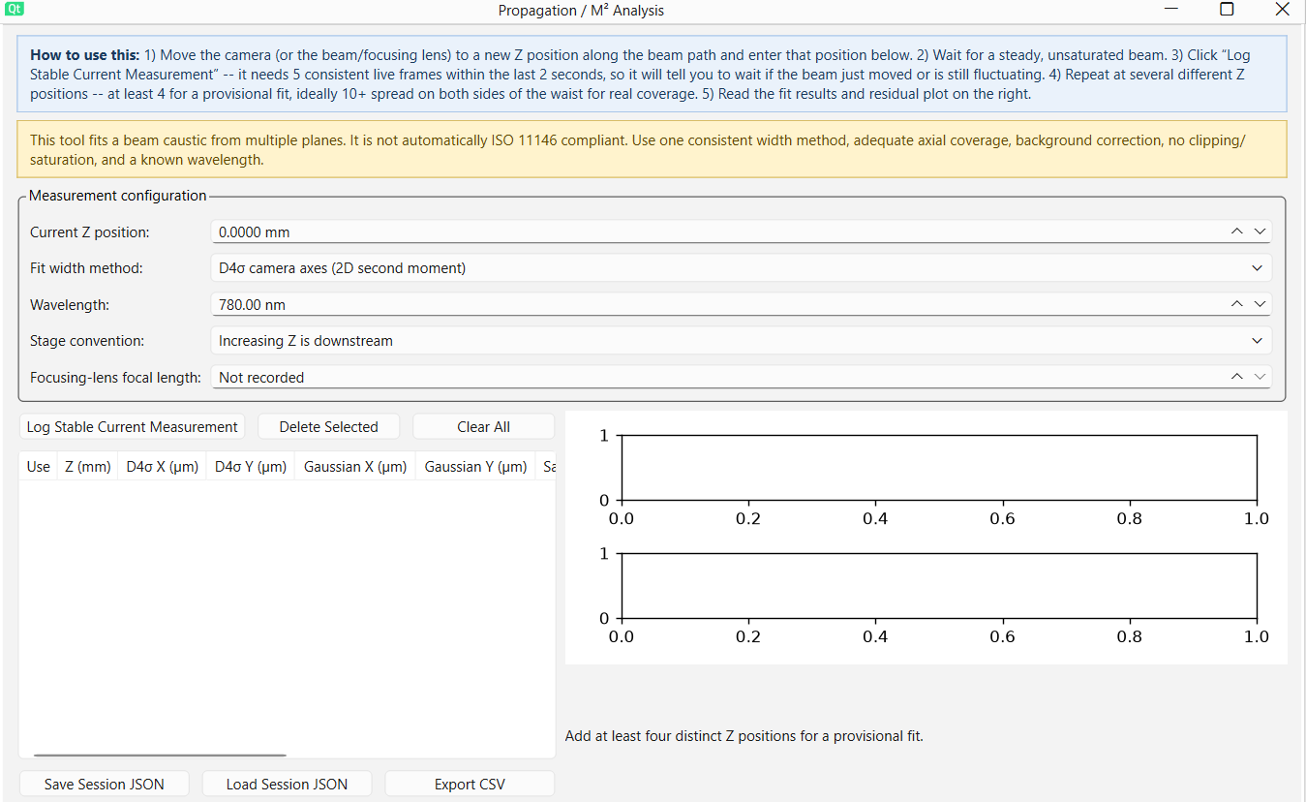
PANEL TOUR — 7. PROPAGATION / M² PANEL
Propagation / M² Panel — Overview
Fits a beam caustic — from measurements at several axial (Z) positions
D4σ camera axes — preferred, ISO-style second-moment method
Gaussian-fit 1/e² diameters — non-ISO comparison method — valid only for sufficiently Gaussian beams
Minimum data — 4 distinct Z positions for a provisional fit; 10+ well-distributed positions preferred
VOILALab Beam — User Guide
27

Slide 29
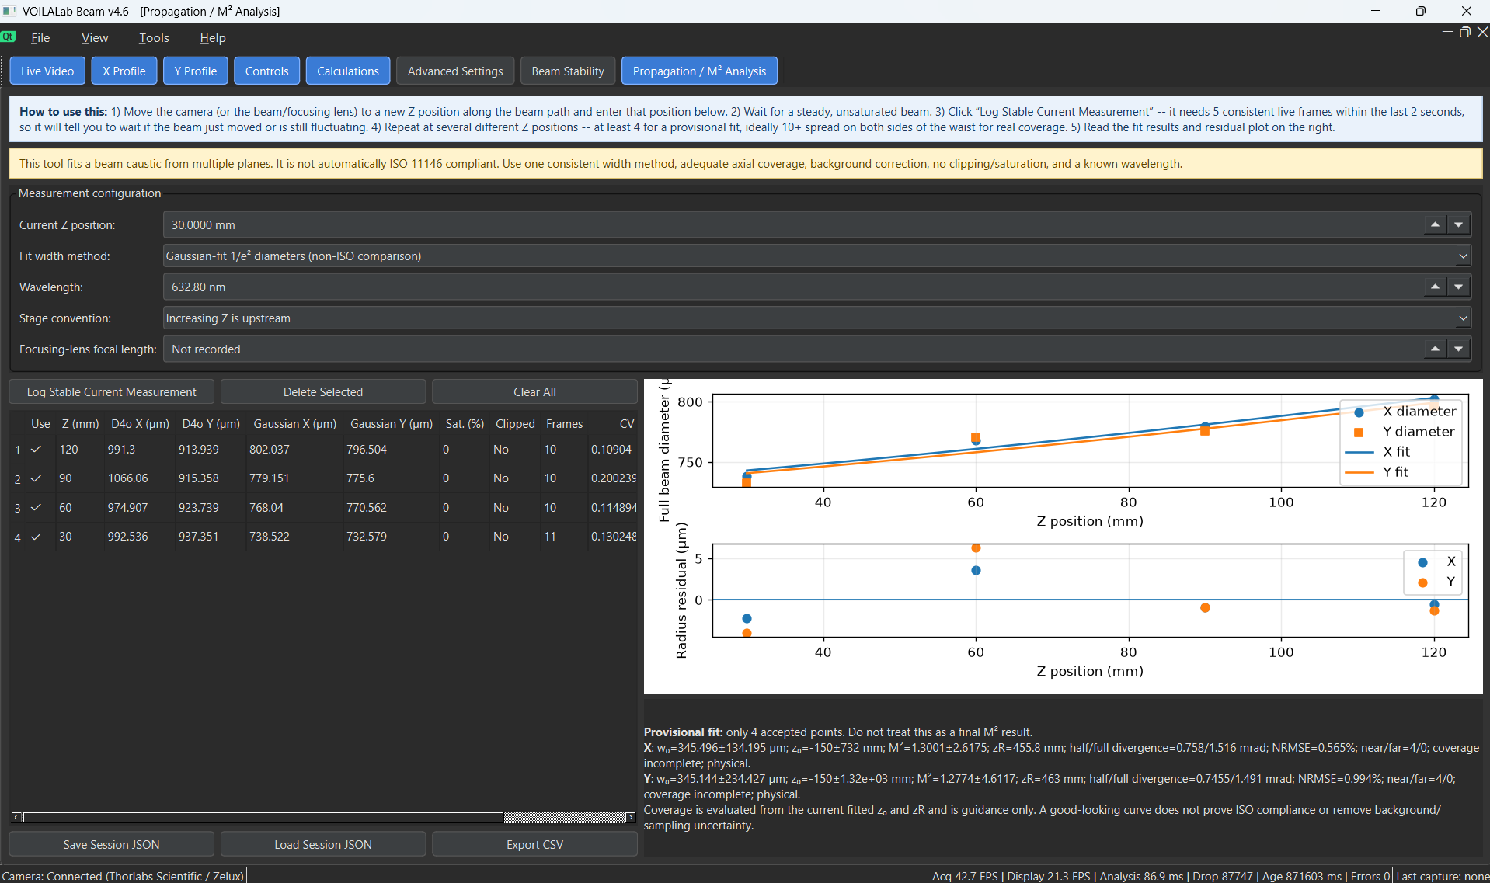
PANEL TOUR — 7. PROPAGATION / M² PANEL
Propagation / M² Workflow
1
Enter the beam wavelength
and select the width method
2
Move to a known Z position
camera, beam, or focusing optic — then enter that coordinate
3
Wait for a stable, unsaturated beam
4
Click Log Stable Current Measurement
5
Repeat on both sides of the waist
at multiple positions
6
Inspect fitted curves, residuals, warnings, and parameters
10 measurements highly recommended: half within one Rayleigh range of the waist (to lock in the bottom of the curve), and half beyond two Rayleigh ranges (to lock in the angle of the diverging tails). Without these measurements, you may have a very high error margin, as shown in the above screenshot.
VOILALab Beam — User Guide
28

Slide 30
05
Output & Troubleshooting
Where your data goes, and what to do when something looks wrong

Slide 31
OUTPUT & TROUBLESHOOTING
Saved Capture Files
Raw TIFF (.tif)
NumPy array (.npy)
Raw grayscale camera values, full available bit depth
Exact image array + dtype, for later Python analysis
JSON metadata (.json)
Display TIFF (_display16.tif)
Settings + measurements: exposure, pixel pitch, centroid, Gaussian fit, signal quality, dark correction, profiles, second-moment data
16-bit, display-range-shifted copy for easy viewing — not for quantitative use
VOILALab Beam — User Guide
30

Slide 32
OUTPUT & TROUBLESHOOTING
Presets & Persistent Settings
Presets file — beam_profiler_presets.json — save/load/delete named configurations
Qt settings — also remember applicable interface/operating choices between sessions
A preset is a starting point, not a calibration — re-verify exposure, pixel pitch, dark frame, wavelength, and power calibration after changing cameras or optics
VOILALab Beam — User Guide
31

Slide 33
OUTPUT & TROUBLESHOOTING
Troubleshooting Quick Reference
No cameras found
Image is black
Image is saturated
Check power/connection, correct backend, driver/SDK installed, camera not in use elsewhere
Raise exposure, confirm beam reaches sensor, check dark-frame validity, confirm device selection
Reduce exposure/gain/power; add attenuation before trusting any width/power reading
D4σ invalid/truncated
Gaussian diameter missing
Frame rate is low
Enlarge calc area, remove stray light/reflections, apply a valid dark frame, mask hot pixels
Profile didn't meet the R² threshold — may correctly mean a non-Gaussian beam. Lower the gaussian threshold in advanced settings
Reduce exposure/averaging/resolution, raise display-rate cap, disable heavy diagnostics if unneeded
VOILALab Beam — User Guide
32

Slide 34
Questions & Support
Developed by the VOILA Lab
Contact: Jason Liang, jason.liang2@howardcc.edu • Project: https://github.com/cande3ee/VOILALab-Beam
See the full README for installation details, file formats, and complete troubleshooting steps.

