Slide 1



Hidden layer
(can have more than one hidden layer)
Input layer
bias
Output layer
bias
10 prediction values
784 Features
.
.
.
.
.
.
.
.
.
X⁽¹⁾
w$1$
X⁽²⁾
w$2$
$$\hat{y}$$

Slide 2






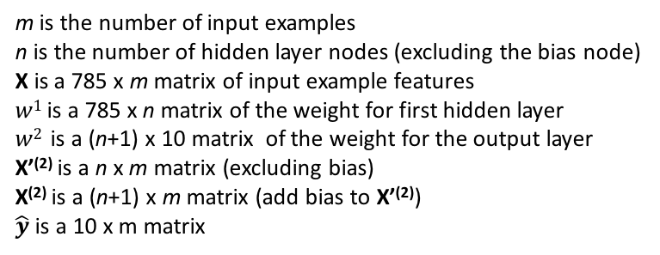




$${w1 }^{T}$$
Input layer X⁽¹⁾
hidden layer X’⁽²⁾
$$\left[\begin{matrix} & ⋯ & \\ ⋮ & ⋱ & ⋮ \\ & ⋯ & \end{matrix}\right]$$
$$\left[\begin{matrix} & ⋯ & \\ ⋮ & ⋱ & ⋮ \\ & ⋯ & \end{matrix}\right]$$
$$\left[\begin{matrix} & ⋯ & \\ ⋮ & ⋱ & ⋮ \\ & ⋯ & \end{matrix}\right]$$
$$×$$
$$=$$
n x 785
785 x m
n x m
$${w2 }^{T}$$
hidden layer X⁽²⁾
output layer $\hat{y}$
$$\left[\begin{matrix} & ⋯ & \\ ⋮ & ⋱ & ⋮ \\ & ⋯ & \end{matrix}\right]$$
$$\left[\begin{matrix} & ⋯ & \\ ⋮ & ⋱ & ⋮ \\ & ⋯ & \end{matrix}\right]$$
$$\left[\begin{matrix} & ⋯ & \\ ⋮ & ⋱ & ⋮ \\ & ⋯ & \end{matrix}\right]$$
$$×$$
$$=$$
10 x (n+1)
(n+1) x m
n x m
m is the number of input examples
n is the number of hidden layer nodes (excluding the bias node)
X is a 785 x m matrix of input example features
$w1$ is a 785 x n matrix of the weight for first hidden layer
$w2$ is a (n+1) x 10 matrix of the weight for the output layer
X’⁽²⁾ is a n x m matrix (excluding bias)
X⁽²⁾ is a (n+1) x m matrix (add bias to X’⁽²⁾)
$\hat{y}$ is a 10 x m matrix

Slide 3
