Slide 1
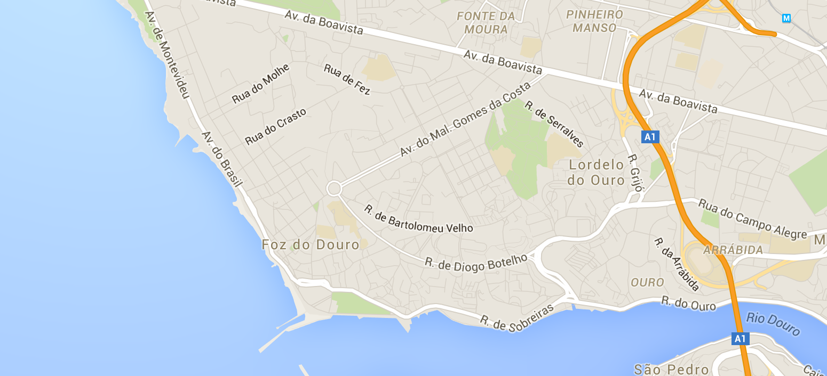

Taxi Trajectory Prediction
?
Machine Learning: Data to Model
Final Project Proposal
Qun Gao, Li-Yi Lin

Slide 2
Problem Description
Major Shifts of taxi dispatch systems:
adoption of electronic dispatch systems
switch from broadcast-based radio messages for service dispatching to unicast-based messages
To improve the efficiency of electronic taxi dispatch systems it is important to be able to predict the final destination of a taxi while it is in service.
Goal: Predict the destination of taxi trips based on initial partial trajectories and other metadata (pick up time, date...)

Slide 3
Key Variables
Partial trajectory —— A list of GPS coordinates, each with value of longitude and latitude.
Call type —— the way to request a taxi, including
A: call to the taxi center
B: call at a specific taxi stand
C: call on a random street
Origin call: ID for each phone number which is used for the demand.
Taxi stand: ID of the taxi stand.
Time: the pick up time of a ride.
Day type: the day type of a trip’s start time, including three types:
A: If this trip started on a holiday or any other special day (i.e. extending holidays, floating holidays, etc.);
B: If the trip started on a day before a type-A day;
C: Otherwise (i.e. a normal day, workday or weekend).

Slide 4




Model: Multilayer Perceptron
Partial
Trajectory
Input layer
Hidden layer
Output layer:
cluster center
bias
bias
y₁
...
$$a_{1}^{(2)}$$
G
y₂
P
$$a_{2}^{(2)}$$
Predicted
destination
(the center of the
predicted cluster)
C
y₃
$$a_{3}^{(2)}$$
S
T
...
...
R
y_{k}
D
$$a_{s2}^{(2)}$$
P: phone call
S: taxi stand
R: random street
C: call type
G: trajectory GPS
T: pick up time
D: day type

Slide 5
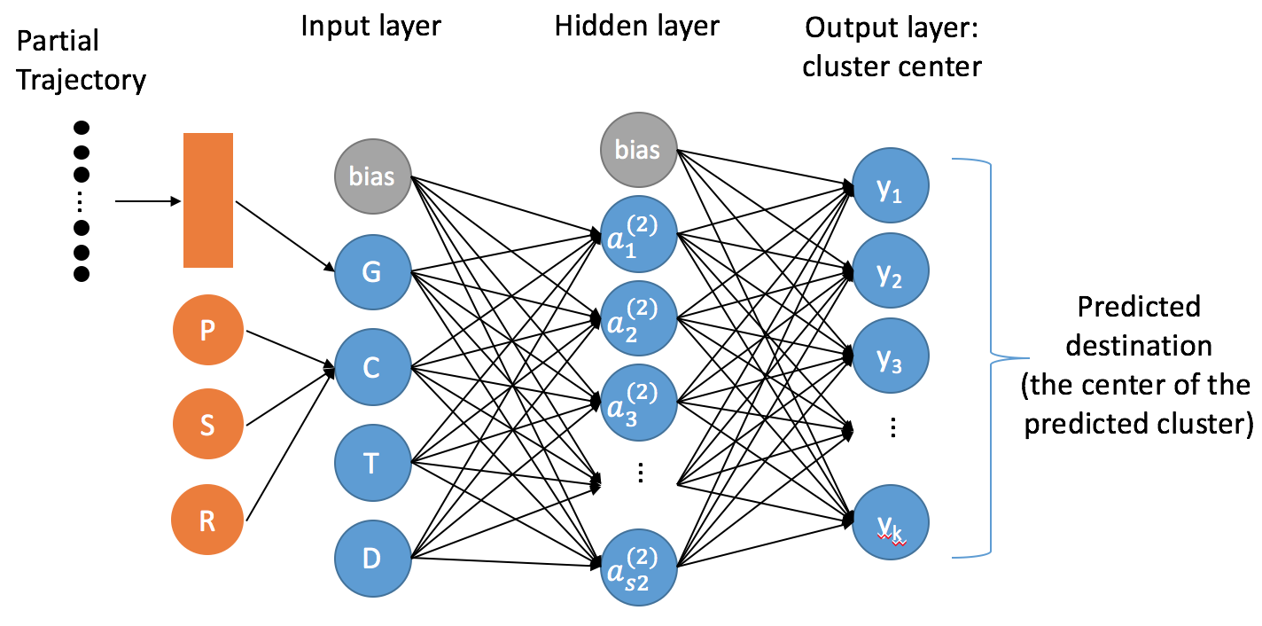
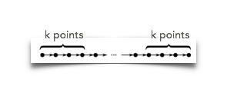
Preprocess
Partial trajectory: Take the first k and last k points of input to form a fixed size.
Prior information of destination: Clustering the destination points of the training set and use the cluster centers as the candidate destinations for the model.
Call type: Merge the information of origin call, taxi stand and other cases into the variable call type.
Time: convert into discrete value.

Slide 6
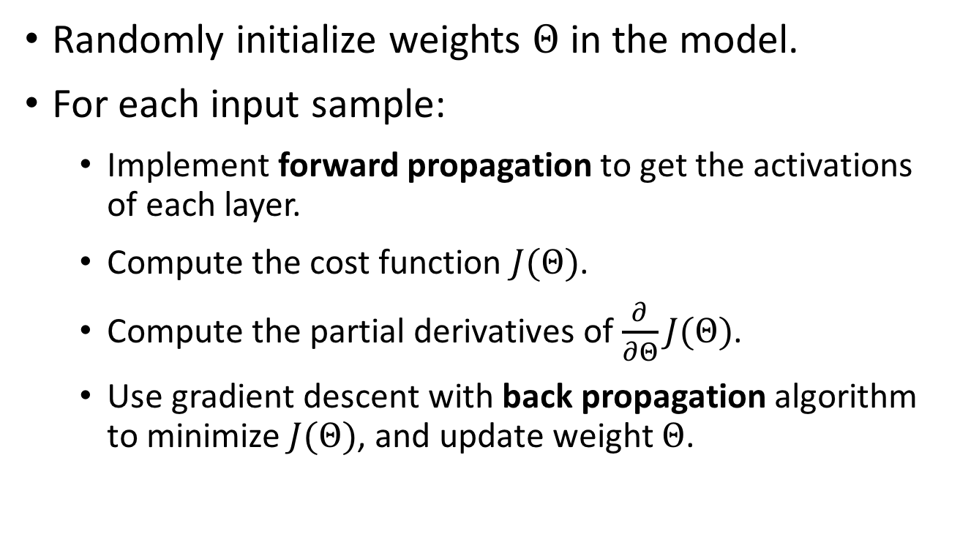
Training algorithm
Randomly initialize weights $Θ$ in the model.
For each input sample:
Implement forward propagation to get the activations of each layer.
Compute the cost function $J(Θ)$.
Compute the partial derivatives of $\frac{∂}{∂Θ}J(Θ)$.
Use gradient descent with back propagation algorithm to minimize$J(Θ)$, and update weight $Θ$.

Slide 7
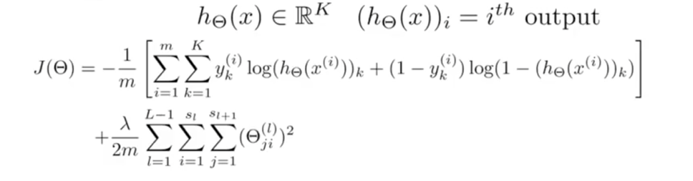
Forward Propagation
forward propagation
Sigmoid activation function:
Activations:
hidden layer
output layer
Cost function:

Slide 8
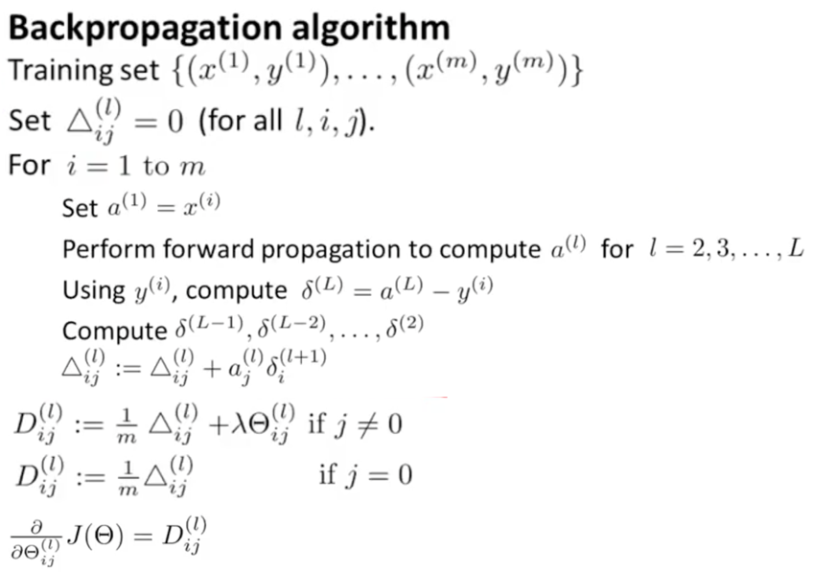
Back propagation
back propagation
Weight update
weights between hidden layer and output layer:
weights between input layer and hidden layer:

Slide 9
Evaluation
Data source: Kaggle website
https://www.kaggle.com/c/pkdd-15-predict-taxi-service-trajectory-i/data
Accuracy of the destination prediction:
the proportion of correctly predicted destination clusters
Alternation evaluation (by distance)
Use the centroid of the output cluster as the prediction destination.
Evaluate the test performance by using Mean Haversine Distance.

Slide 10
References
ECML/PKDD 15: Taxi Trajectory Prediction (I)
https://www.kaggle.com/c/pkdd-15-predict-taxi-service-trajectory-i/data
“Artificial Neural Networks Applied to Taxi Destination Prediction”
http://arxiv.org/abs/1508.00021
Making a Bayesian Model to Infer Uber Rider Destinations.
https://newsroom.uber.com/inferring-uber-rider-destinations
Machine Learning by Andrew Ng., Coursera course.

Slide 11
Thank You!

