Slide 1
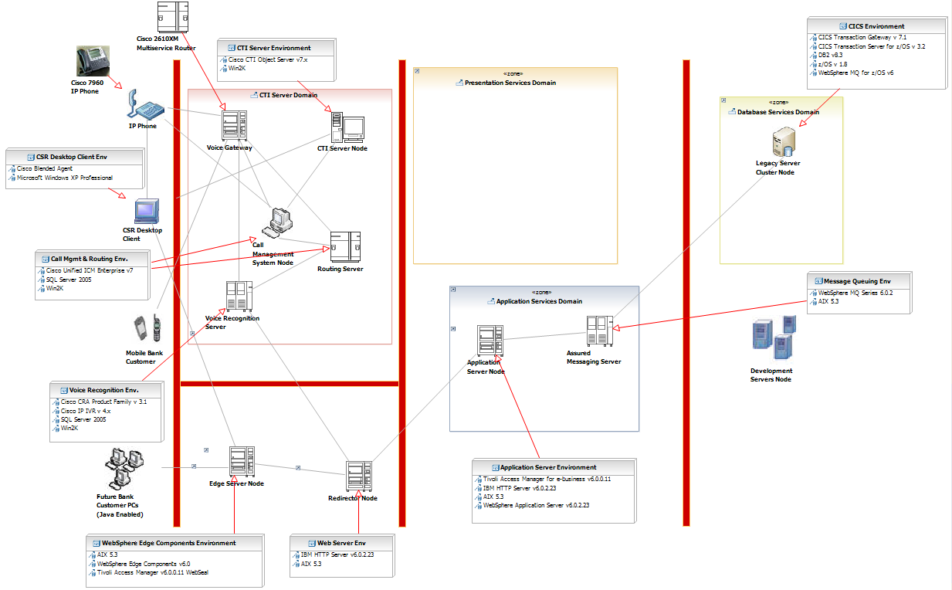
My Bank Current IT Infrastructure
Sample

