Slide 1
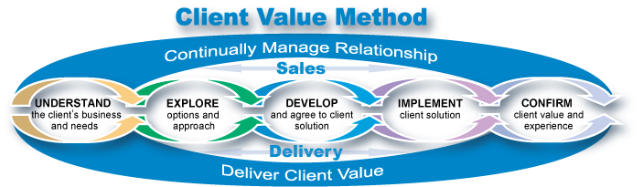
April 2009
Sherrye Goss/Chattanooga/IBM

Slide 2
Findings show a fundamental shift in our clients’ expectations of value, which demands a change to the way we respond to clients
Our clients expect more from us
We must change our client response
The dialog should be, “how are you, how’s your business, we’re very interested in making you more successful - let me understand your company.”
“. . . create value for me.”
“Don’t let your internal issues get in the way of customer service."
“IBM is world's best in solutions and service business and we as a customer need that.” However, "IBM is hard to piece together...IBM needs to make it easier for me."
We need to show up as one team—“In my mind, they [sales, delivery, all brands] need to be one and the same.”
Emphasize the agenda of the client, not ours.
Deliver on our promises, not just the sale.
Work together seamlessly as a team across ALL of IBM
Align to the unique needs of different clients and markets.
Move away from inspection and list management and personally add value to our teams and clients
Learn to trust!
“When we make the client's agenda our first priority - asking, ‘how can we create value for you?’ - and integrate our efforts to support the clients' success, it directly leads to our long-term success."
Frank Kern , Senior Vice President
Global Sales & Distribution
CLIENT VALUE METHOD is a framework to begin our change

Slide 3
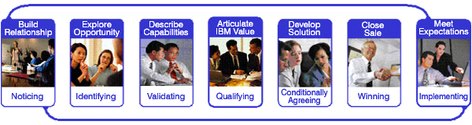
The Client Value Method increases focus on creating value for clients and leads to greater value for IBM— internal version
Signature Selling Method
RECOMMENDATIONS
Transform Signature Sales Method (SSM) into an end to end client value methodology focused on sales through delivery/fulfillment
Embed and align key value drivers for each Buying Behavior and strengthen value proposition focus
1
2
3
4
5
6
7
CVM
End to end method
Integration of Sales AND Delivery/Fulfillment
Stronger role for Delivery in crafting solutions, minimizing the impact of missed expectations
Emphasis on Team collaboration and decisions “tuned” to client expectations and value drivers
+
Buying Behaviors
Value driver patterns defined for Value for Money, Trusted Supplier, Innovation Player
Guidance for response based on unique value drivers and client expectations
Siebel enabled tracking and analysis by Buying Behavior
+
Value Creation
Increased focus on value proposition alignment with clients needs
Value drivers specific guidance for value proposition development by Buying Behavior
Measurement of value delivered at transaction and relationship level (Client Value Assessments)
Direct alignment to client’s expectations and priorities
One face of IBM with improved execution
Responsive solutions and quantifiable value realized
Enhanced end to end client experience
CLIENT VALUE

Slide 4
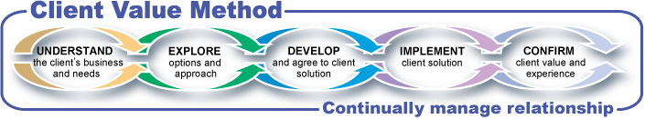
The Client Value Method increases focus on value creation and leads to greater value for IBM
Signature Selling Method
RECOMMENDATIONS
Transform Signature Sales Method (SSM) into an end to end client value methodology focused on sales through delivery/fulfillment
Embed and align key value drivers for each Buying Behavior and strengthen value proposition focus
1
2
3
4
5
6
7
End to end method
Buying Behaviors
Value Creation
=
CLIENT
VALUE
+
+
Direct alignment to client’s expectations and priorities
One face of IBM with improved execution
Responsive solutions and quantifiable value realized
Enhanced end to end client experience
CLIENT VALUE

Slide 5






The Client Value Method (CVM) simplifies the 7 step Signature Sales Method (SSM) method into 5 phases
SSM
Build Relationship | Explore Opportunity | Describe Capabilities | Articulate IBM Value | Develop Solution | Close Sale | Meet Expectations
Noticed
Identified
Conditionally
Agreed
Won &
Implementing
Validated
Qualified
Won
Won &
Complete
New CVM
Siebel stages still used but not signaling the end of a phase
Siebel Stage Indicators signaling end of a phase in the new CVM
Notes:
This chart shows the alignment of the new CVM with existing Opportunity Management sales stages of the CRM/Siebel tool. As you will see, all current CRM/Siebel stages are available to teams for their use based on their business practices. The definitions of when/how to use each opportunity management stage remains the same. The only difference is that with only 5 phases, opportunities exit each of the first four phases of CVM as Validated, Qualified, Won, and Completed, respectively. There is no Opportunity Management stage for the end of Phase CONFIRM. No changes in pipeline reporting are required for CVM at this time.

Slide 6

The 5 phases cover the end-to-end client engagement life cycle
Confirm the client’s Compelling Reason to Act | Develop the client perception of IBM Unique Value | Confirm the client’s expected solution benefit and value proposition | Confirm that the client’s delivery expectations are being met | Confirm the use of the solution as intended by the client
Understand client’s business & IT issues Prioritize issues to address Business need Value criteria | Clarify IT need Create value proposition Explore IBM unique value Select best option and make pursuit decision | Design solution Validate solution alignment, doability & risks Refine value proposition Present value proposal Negotiate contract | Implement solution Manage delivery of the products and services per the contract Manage value realization during delivery | Confirm value delivered and is realized per client expectations on business case Explore ways to extend value
VALIDATED | QUALIFIED | WON | COMPLETED
Phase Overview
End of Phase Indicator

Slide 7
The client’s end-to-end experience is supported by value created in each phases
Confirm the client’s Compelling Reason to Act | Develop the client perception of IBM Unique Value | Confirm the client’s expected solution benefit and value proposition | Confirm that the client’s delivery expectations are being met | Confirm the use of the solution as intended by the client
Buying Behaviors (at Opportunity Level) Team IBM Account Planning Alignment Identify Complexity Cross-brand opportunity planning | Improved Client Value Proposition Value Driven Proposals Initiate standard solutioning approach Client Value Deal Management (Streamlined Pursuit Decisions) | Use common solution design process – Team Solution Design End to end delivery owner Aligned Quality Checkpoints End to end risk manager Client Value Deal Management (Streamlined Release Decisions) | Delivery Issue Single Point of Contact Delivery Insight Reviews Branch Delivery Advisory Team Delivery Rewards and Recognition | Confirm value delivered with client / starbursting Client Value Assessments Transaction Survey Relationship Survey Client Care Program
VALIDATED | QUALIFIED | WON | COMPLETED
Phase Overview
What’s Different
Consistent Pipeline Indicators

Slide 8
CVM incorporates client value drivers – the client’s buying decision criteria – which vary considerably by Buying Behavior pattern
Buying Behaviors
CLIENT VALUE DRIVERS = Most Important | VALUE FOR MONEY | TRUSTED SUPPLIER | INNOVATIONPARTNER
RELATIONSHIP
Understands our company
Exceeded expectations previously
Knowledgeable account rep
BUSINESS ALIGNMENT
Biz Process / app specialization
Deep industry expertise
Integration with infrastructure
Customized for our company
PROJECT QUALITY
Project management excellence
One vendor team
Clear/rapid issue resolution
Training & knowledge transfer
Focus on simplicity, cost and speed
OFFERING CAPABILITY
Innovative products & approaches
Best in class products & services
Trusted, brand
DELIVERY
Flexible structure to handle changes
On-time delivery
PRICE
Offers the lowest price
Innovation Partner
Client wants a customized approach for a complex project with high strategic business impact and risk from business-oriented thought leaders and industry experts with a deep relationship-based understanding of the client
Trusted Supplier
Client wants innovative, best in class technology and support services, integrated with their existing infrastructure, delivered with high-touch project management from one client-focused team from the sale through delivery fulfillment
Value for Money
Client wants a specific technology or service from a trusted brand configured and delivered to their specifications on time at competitive prices, simply and efficiently
Client teams must recognize and respond to the client’s value drivers for each opportunity to be considered and win
“One size fits all” is not the winning hand
Buying Behavior is specific to an opportunity, not to a client nor solution
Clients say “playing the wrong card” can and will exclude us from consideration

Slide 9
Quickly characterizing the likely buying behavior for any given situation will increase odds of securing consideration
Complexity
Client knows what they want
More complex projects & decisions
Complex business or large SO projects
Buying Behaviors
Value for Money
Trusted Supplier
Innovation Partner
Lowest price
On-time delivery
Simplicity, cost, & speed
Trusted brand
-------------------------------
Understands my company and problem
Integration w/existing infrastructure
Customized for my company
Ordering flexibility
-------------------------------
Self integrator or SI - cheapest alternative , & more incumbent brand at best price
Understands my company & problem
Training and Knowledge Transfer
Integration w/existing infrastructure
Project management
Issue resolution
-----------------------------------------
Deep industry expertise
Trusted brand
Best in class products & services
Innovative products & approaches
A knowledgeable account rep
One vendor team for entire project
On time delivery
Previous performance
Customized for my company
----------------------------------------
“Benchmark” where client makes IT choices & often self integrates
Understands my company and problem
Integration w/existing infrastructure
Customized for my company
Issue resolution
-----------------------------------------
Deep industry expertise
Biz proc/biz app specialization
Project management
Previous performance
-----------------------------------------
Client chooses vendor with deep company understanding, integration history & proven industry/biz apps expertise for complex strategic LT project
Most Important Value Drivers
Important Value Drivers
Client “Signals”
Desired Product & Service
hardware, software, & pre - defined services
Innovative/BOB technology;
Management & delivery of technology & services project
end-to-end business problem resolution & processes
Notes:
Multiple Bying Behaviors co-exist within a given client environment. These differences are driven by the complexity of the decision and the client’s bias towards self support versus external vendor project management.
When clients think about business process and strategy services, IT and/or systems integration related projects that included the use of a vendor, these differences are the key high-level indicators of behavior. The complexity of client decisions increases from left to right in the 3 Opportunity Behavior types. In summary, for any given opportunity, it is critical for Team IBM to be able to determine which Opportunity Behavior a client is employing for each opportunity in order to ensure initial consideration and subsequent optimization of the proposed offer.

Slide 10
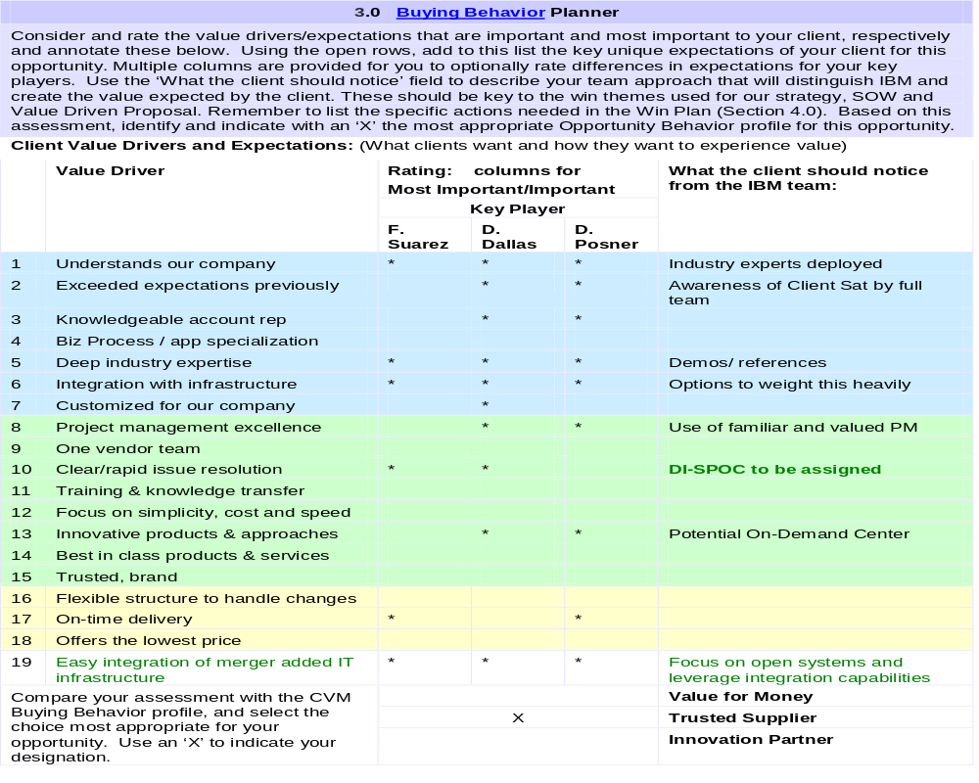
The Buying Behavior Planner in the CVM Opportunity Plan helps the team collaborate, identify and focus our strategy on the most important value drivers

Slide 11

So what’s different? What do we expect to change?
Before:
After:
Focus on winning deal & delivering on time
Focus on creating and delivering value to the client
Make clean hand off from sales to delivery
Involve delivery in early phases, sales in later phases
Base sales, delivery strategies on upselling and tradition
CVM
Base sales, delivery strategies on Opportunity Behavior and Value Drivers
Base delivery communications on project plan
Base delivery communications on Value Drivers
Confirm value received by survey, by client’s payment or not at all
Confirm value received throughout engagement, including that client received expected business impact
Operationalized by:
Deal Management System
(CVDM)
Value
Creation tools and approaches
New SSL coaching for Account Planning and behaviors
End to end involvement of delivery resources
Buying
Behaviors and BTT fields in Siebel
Strengthen
value
proposition
and delivering
of value
Work products and practices for team collaboration
Enhanced
Client Value
Assessments
Value Driven
Proposals
Delivering Client Value

Slide 12
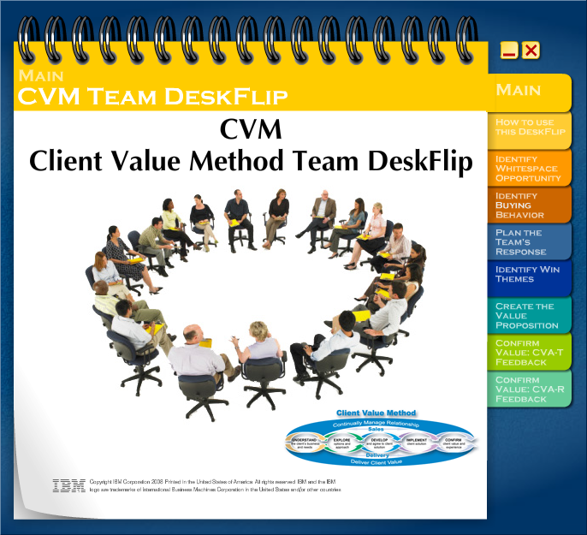
Adoption is structured to drive transformational change for all Client Facing Sales and Delivery Teams
Vehicle | Target Audience | Status
Exec Communications | All Client Facing Sales and Delivery | Completed
Executive Briefings | Senior field and corporate execs | Completed
e-Learning Website and reference guide Buying Behavior podcast Buying Behavior QuickView CVM webcast CVM QuickView Value Proposition Quickview | Client Facing Sales and Delivery Teams | Ongoing
Leader Workshops (1 day F2F or Virtual) | CFU and other key field leaders | Upon Request
Leader-led training (Virtual DeskFlip) | Client Facing Sales and Delivery Teams | Ongoing
Specific Adoption Activities | Client Facing Sales and Delivery Teams | Ongoing
Available Now: http://w3.ibm.com/hr/global/quickviews/cviqv.nsf/Content/8825741F%3A0073D835
Notes:
For Deployment, our multi-touch approach first leverages our Executive team with briefings by IOT and IMT to drive the concepts through their teams. Then we target all sales and delivery client facing personnel with short eLearning modules as an introduction to CVM and Buying Behaviors. Our focus audience, however, is our Client leadership team through workshops organized by IMT around the world. It is the expectation that after these 6 hour Virtual or F2F workshop, these leaders then bring team based learning (via the CVM deskflip) to their teams to use in actual opportunities with their existing clients. This effort will be supported by communications and brand specific activities as needed.
E-learning: 3,111 Webcast Views of 40,000 target (36% GTS/GBS; 21% STG/SWG; 43% Customer Set)
Leader workshops:
Workshops were first piloted in 4Q07 with Italy, Japan, China, India, England, and the US. 33 Workshops have been conducted as of May 30. 300 Planned Globally.
2Q: Approx 65 planned
3Q: Approx 230 planned
The On-line CVM DeskFlip is designed to help Leaders take these messages back to their teams. They become the vehicle to execute and drive adoption. The DeskFlip is arranged around key topics with directions on how to apply these concepts with their teams. For example, the Creating Value Proposition tab guides the leader to hold a meeting with their team, and using an account situation, create a proper Value Prop based on buying behaviors and industry collateral.

Slide 13
Key links and contacts
CVM Website | http://w3-03.ibm.com/transform/worksmart/ws.nsf/ContentDocsByTitle/Client+Value+Method+(CVM)
Global Director, CVM | Sandra Enoch Email: Sandra Enoch/Orlando/IBM@IBMUS
Client Value Method Lead | Sherrye Goss Email: Sherrye Goss/Chattanooga/IBM@IBMUS
Notes:
When you want to know more, please check out the CVM website. It contains links to all sorts of reference information, including the work products and the e-learning.
Sandra Enoch and Denise Freier want to help you make this transformation successful, so contact them if you need assistance.

Slide 14
APPENDIX

Slide 15
IBM INTERNAL USE ONLY
CVM
Buying Behavior: Value for Money
CLIENT VALUE DRIVERS
Lowest price On-time delivery Focus on simplicity, cost and speed in everything we do – ordering, contracting, billing | Understands our company and problem Integration with infrastructure – Products / services that work with existing systems Customized for our company – configured for my needs Trusted, known brand Flexible structure to handle changes
FOCUS FOR TEAM IBM’S RESPONSE
Client wants a specific technology or service from a trusted brand configured and delivered to their specifications on time at competitive prices, simply and efficiently.
MORE FOCUS SPECIFIC FOCUS LESS FOCUS
Help the client negotiate the “best deal.” Quickly package a deal with an attractive price and fast delivery. Make it easy for the client to do business with IBM. Determine early if IBM’s delivery timeframe will meet client needs. Engage C&N¹ early to determine the simplest and fastest contracting approach and avoid contracting issues. Respond to the client’s RFP as written. Include additional ideas only in an appendix or separate proposal. Focus the proposal on how the offering meets the client’s wants, how it will work with the client’s systems, and how it’s the best deal for the money. Involve technical experts early to respond to client questions if needed; provide clear, concise and accurate product information. If IBM is not the incumbent brand, assess whether the client is willing to invest time exploring IBM options. Disengage if odds of winning are low. | The client values speed over probing their issues. The client knows what they want to buy. Don’t spend time trying to sell something else. Do not add unneeded customization or services. Don’t spend time on a proposal before assessing the client’s preference for IBM products and brands and our odds of winning.
 | RESOURCES
 | Techline is preferred resource for solution design. Deal Hub is preferred resource for end to end bid and proposal management ibm.com and Business Partners are the preferred channels for Opportunity Owner Engage the fulfillment CSSR early to drive simplicity in ordering, contracting, billing
¹Contracts and Negotiations

Slide 16
IBM INTERNAL USE ONLY
CVM
Buying Behavior: Trusted Supplier
CLIENT VALUE DRIVERS
Understand our company and problem Previous performance – met or exceeded our expectations Integration with our existing infrastructure Project management excellence Clear, rapid issue resolution Innovative products & approaches Best in class products & services | One vendor team for entire project Knowledgeable account rep Industry experience/expertise Training & knowledge transfer to our company Trusted Brand On-time delivery Clear, rapid issue resolution
FOCUS FOR TEAM IBM’S RESPONSE
Client wants innovative, best in class technology and support services, integrated with their existing infrastructure, delivered with high-touch project management from one client-focused team from the sale through delivery fulfillment.
MORE FOCUS SPECIFIC FOCUS LESS FOCUS
Provide the client a single point of contact for the entire project Provide a team of experienced people who remain with the project from the sale through delivery fulfillment. Identify client preferences for best of class products and trusted brands; prove best in class by comparing features. Lead with and demonstrate IBM’s deep technical expertise Reinforce positive past experiences with this client and stand on our tack record. Assess the client’s capability to implement the solution and recommend how IBM can augment the client’s skills and resources. | Price needs to be reasonable but other factors are more important to the client for this opportunity. Speed alone is less important than taking time to make an informed yet timely choice While the client is willing to take time to explore options that fit their needs, they do not want to spend time unnecessarily.
 | RESOURCES
 | Engage Deal Hub for end to end bid and proposal management Assign the single focal point from the primary brand who must be willing to think outside typical responsibilities. IT architects are best to convince client of solution value Use Quality Practices (QP) resources early to ensure solution is accurate

Slide 17
IBM INTERNAL USE ONLY
CVM
Buying Behavior: Innovation Partner
CLIENT VALUE DRIVERS
Understands our company and problem Integration with our existing infrastructure Customized for our company Clear / rapid issue resolution | Industry experience/expertise Business process / business application specialization Previous performance – met or exceeded our expectations Project management excellence
FOCUS FOR TEAM IBM’S RESPONSE
Client wants a customized approach for a complex project with high strategic business impact and risk from business-oriented thought leaders and industry experts with a deep relationship-based understanding of the client.
MORE FOCUS SPECIFIC FOCUS LESS FOCUS
Thoroughly explore and confirm the client’s customization requirements and demonstrate how the customized solution will work. Bring IBM industry /business process thought leaders together with the client to collaborate on ways to meet client needs Use GBS Value Creation resources. Reference IBM’s track record leading similar projects and show the client how IBM will manage the scope and complexity of this project. Focus the proposal on how the solution supports the client’s business initiatives, including a thorough impact analysis. Apply formal project management techniques Implement a joint governance structure for project status, issue resolution and escalation. Help the client sell and manage the change to their organization. Consult with the client to measure and confirm the performance impact and business value of the solution. Report results in a format the client can share within their organization. | Price is less important than other value drivers The specific product and brand components of the solution are less important to the client than the business capability they provide. Do not focus the proposal on product/brand features and promotion. Speed is less important than other value drivers. Because the project is core to the business, the client is willing to invest time to get it right. However, we need to meet project timelines and success criteria.
 | RESOURCES
 | Engage Deal Hub for end to end bid and proposal management Strong industry presence required by Opportunity Owner – likely a GBS or GTS partner Risk Manager and Quality Practices (QP) resources involved throughout the deal Actual delivery team should be visible before the sale

Slide 18
UNDERSTAND the client’s business & needs
FOCUS FOR TEAM IBM: UNDERSTAND WHAT THE CLIENT NEEDS & VALUES
Client
What value does the client want?
Key Team Decision: What value does the client want?
Team Difference Maker: Confirm the client’s compelling reason to act
Ongoing Relationship Focus: Understand the client’s business and issues
TeamIBM
ENGAGING THE CLIENT
Relationship owners and Opportunity Identifiers lead these
CLIENT ENGAGEMENT ACTIVITIES
Build relationship and account strategy
  Team IBM Account Plan
Understand the client’s business & IT issues
  Business Position Model
Prioritize key initiatives to pursue and outline potential strategies
Identify client’s needs – desired business capabilities and impact
  Solution Framework - Client Preferences & Business Capabilities
Confirm the client’s value drivers and expectations
Clients verify value in these typical
CLIENT RESPONSES
Validate our understanding of their business issues and priorities and compelling reason to act
Share their business and/or IT strategy with us
Participate in TeamIBM Account Planning
Affirm the value of the IBM team
ENGAGING IBM
IBM INTERNAL ACTIVITIES
Use MAP¹ to understand potential and create coverage strategy that positions IBM to deliver the value the client wants.
Create the TeamIBM Account Profile and Plan
Identify the buying behavior for the opportunity.
Initiate the Opportunity Plan or disengage.
Determine Business Transaction Type (BTT)
Create Win Themes, develop proposal strategy based on Value Driven Proposals approach and begin drafting Proposal /SOW
EVIDENCE
Completed Team IBM Account Plan with relationship planning or mapping
Account Set/Met² discussion and action plan in place
Initial Opportunity Plan in place
Potential client decision leader / team is engaged
End of Phase
Progress Indicator:
Validated
CRM Siebel/Opportunity/ Pipeline
Management Sales Stages:
Noticed/Identifying
Identified/Validating
Validated/Qualifying
Qualified/Gaining Agreement
Conditionally Agreed/Closing
Won/Implementing
Won & Complete
¹ Market Alignment Program (MAP) ² Setting client expectations then ensuring they are Met (Set/Met)

Slide 19
EXPLORE options and approach
FOCUS FOR TEAM IBM: EXPLORE VALUE
Client
What options
to explore?
Select?
Key Team Decision: What options do we explore? Recommend?
Team Difference Maker: Develop the client’s perception of IBM Unique Value
Ongoing Relationship Focus: Develop key client relationships
TeamIBM
ENGAGING THE CLIENT
Opportunity Owners typically lead these
CLIENT ENGAGEMENT ACTIVITIES
Identify desired IT capabilities and impact and show how IBM options uniquely meet these needs
Confirm client’s decision and performance criteria and show how IBM options will perform.
Select/present the best option – Solution Framework—Solution Option
Develop initial benefits and business case - Value Proposition
Identify resources and investment requirements
Identify risks and potential issues
Client decision leaders / teams verify value in these typical CLIENT RESPONSES
Confirm that we understand their desired business/IT capabilities, impact and benefits
Confirm the IBM preferred approach that meets their desired needs
Acknowledge IBM Unique Value and expertise of the team
ENGAGING IBM
IBM INTERNAL ACTIVITIES
Confirm Buying Behavior and client value drivers.
Update the Opportunity Plan & confirm BTT.
Continue to draft the Proposal and SOW based on differentiated Win Themes, adding and refining insights.
Perform Business Unit Quality Practices and engage Risk Manager for complex, high Business Transaction Type (BTT) opportunities.
Verify resources to deliver options / recommended solution.
Assign and engage design team delivery owner.
Utilize the CVDM* meeting for multi-brand resource assignment.
Understand the existing t’s and c’s and contracts, and develop initial pricing and terms strategy.
EVIDENCE
Solution Framework – Solution Option
Draft Value Proposition – high level –with the client’s expected benefits
Updated Opportunity Assessment in the Opportunity Plan
IBM resources committed
End of Phase
Progress Indicator:
Qualified
CRM Siebel/Opportunity/ Pipeline
Management Sales Stages:
Noticed/Identifying
Identified/Validating
Validated/Qualifying
Qualified/Gaining Agreement
Conditionally Agreed/Closing
Won/Implementing
Won & Complete
‘* Client Value Deal Management’ (CVDM)

Slide 20
DEVELOP and agree to client solution
FOCUS FOR TEAM IBM: PROMISE VALUE
Client
What solution solves the problem?
Key Team Decision: What solution do we propose?
Team Difference Maker: Confirm the client’s expected solution benefit and value proposition
Ongoing Relationship Focus: Communicate IBM’s value proposition.
TeamIBM
ENGAGING THE CLIENT
Opportunity Owners typically lead these
CLIENT ENGAGEMENT ACTIVITIES
Design/develop solution, specify components –include Delivery Owner
Determine solution performance and impact
Refine benefits and business case – Value Proposition
Define financing, fulfillment, delivery requirements
Present our proposal
Negotiate a contract
Define project tasks, responsibilities, timeline
Client decision leaders / teams verify value in these typical CLIENT RESPONSES
Conditional Agreement
  Confirm expected solution performance, impact and benefit.
  Confirm proposed solution
Won
  Agree to price and terms and sign contract.
  Confirm Project Plan, schedule, success criteria and resources - who does what.
ENGAGING IBM
IBM INTERNAL ACTIVITIES
Confirm opportunity behavior and client value drivers
Client Relationship Team predicts the “winning price”
Confirm Pricing approvals and documentation
Engage C&N early to finalize and customize final terms and conditions
Perform Business Unit Quality Practices and engage Risk Manager
Develop high level Project Plan for implementation
Conduct Win/Loss Review if appropriate
EVIDENCE
Project Definition with project plan and schedule
Client and/or IBM delivery resources are assigned and the delivery leaders are in place
Signed contract and Statement of Work (SOW)
End of Phase
Progress Indicator:
Won
CRM Siebel/Opportunity/ Pipeline
Management Sales Stages:
Noticed/Identifying
Identified/Validating
Validated/Qualifying
Qualified/Gaining Agreement
Conditionally Agreed/Closing
Won/Implementing
Won & Complete

Slide 21
IMPLEMENT client solution
FOCUS FOR TEAM IBM: DELIVER VALUE
Client
How to implement successfully
Key Team Decision: How do we successfully implement the solution?
Team Difference Maker: Confirm that the client’s delivery expectations are being met.
Ongoing Relationship Focus: Communicate status and proactively manage issues.
TeamIBM
ENGAGING THE CLIENT
Delivery Owners typically lead these
CLIENT ENGAGEMENT ACTIVITIES
Finalize client satisfaction/success criteria and plan
Implement solution capabilities to achieve desired performance, impact and benefit.
Build the client‘s solution skills
Manage the contract/ project
  Initiate and Launch, Execute, Close
  Communicate progress and status
  Resolve issues thru Delivery Single Point of Contact (SPOC)
Client decision leaders/ teams verify value in these typical CLIENT RESPONSES
Accept deliverables
Participate in project delivery review meetings to confirm progress and value realization
Complete transaction assessment survey and confirm value
ENGAGING IBM
IBM INTERNAL ACTIVITIES
Confirm client expectations and value drivers
Assemble and submit the contract package
Develop detailed Project Plan
Mobilize resources
Perform Quality Practices activities
Deliver the products and services per the contract
Complete billing and invoicing
EVIDENCE
Project delivery feedback
Client Value Assessment (CVA) Transaction Study results
Payment received
Project resources released
Contract closed
*Note: Multi-year contracts can record this Completed after successful implementation for 1 year
End of Phase
Progress Indicator:
Completed
CRM Siebel/Opportunity/ Pipeline
Management Sales Stages:
Noticed/Identifying
Identified/Validating
Validated/Qualifying
Qualified/Gaining Agreement
Conditionally Agreed/Closing
Won/Implementing
Won & Complete

Slide 22
CONFIRM client value and experience
FOCUS FOR TEAM IBM: CONFIRM REALIZED VALUE
Client
How will
we sustain & enhance value?
Key Team Decision: How do we sustain and enhance value?
Team Difference Maker: Confirm the use of the solution as intended by the client
Ongoing Relationship Focus: Confirm the value of the relationship
TeamIBM
ENGAGING THE CLIENT
Relationship Owners typically lead these
CLIENT ENGAGEMENT ACTIVITIES
Measure performance, impact and benefit and confirm that the client’s expectations are met
Grow use of new solution capabilities; explore ways to extend value
Resolve issues thru Delivery Single Point of Contact (SPOC)
Apply what we’ve learned to discover and explore new issues and “white space” opportunities
Hold Client Value Realization Conversation for overall account relationship
Clients verify value in these typical
CLIENT RESPONSES
Confirm benefit
Engage IBM for follow on projects based on this projects success
Participate in overall account Client Value Realization Conversation
Complete relationship level Client Value Assessment (CVA) Study results and confirm value
Agree to be a reference
Agree with client on IBM engagement in future opportunities
ENGAGING IBM
IBM INTERNAL ACTIVITIES
Confirm client expectations and value drivers
Conduct Team Opportunity Learning Review and share best practices
Create a Client Reference
Create plan to improve client satisfaction
EVIDENCE
Client Value Assessment (CVA) Study results
Client Reference
Follow on opportunity / project is Identified
Minutes from the Client Value Realization Conversation distributed to participants
End of Phase
Progress Indicator:
Client Value
CRM Siebel/Opportunity/ Pipeline
Management Sales Stages:
Noticed/Identifying
Identified/Validating
Validated/Qualifying
Qualified/Gaining Agreement
Conditionally Agreed/Closing
Won/Implementing
Won & Complete

Slide 23
Each phase highlights key actions and guidance to help teams identify and deliver value to our clients
 | Account Planning alignment with client value drivers and focus on business initiatives and value creation Opportunity Behavior - align IBM resources and value proposition to client’s agenda Earlier identification of complexity (BTT) for resource assignment Integration of additional resources (Market Alignment, Client Business Value, Value Creation)
 | Improved focus on Value proposition Improved Opportunity Plan/Assessment and Solution Framework with value drivers insight Value Driven Proposals approach Streamlined resource assignment & deal prioritization for complex, multi-brand opportunities (Deal Management)
 | Solution Design Improvements: Common approach to solutioning using Unified Method Framework and End-to-end Delivery Owner role to involve delivery earlier in solution design) Quality Practices Improvement: Aligned quality checkpoints across all LOBs & End-to-end Risk Manager role to drive risk mitigation in complex, cross-LOB deals Streamlined decisions on bid release for complex, multi-brand deals (Deal Management)
 | Delivery Issue Single Point of Contact for increased focus on rapid resolution Delivery Insight Reviews sharing best practices and observations between Brands/S&D Branch Delivery Advisory Team advises IBM leadership on delivery focus Delivery Rewards and Recognition elevates importance of delivery
 | Hold specific, value-based conversation with clients to gauge delivery of value against promise Client Care and Client Value Analysis helping teams make better-informed decisions Client Value Assessments - Transaction Survey (Based on opportunity behavior) Client Value Assessments - Relationship Survey

Slide 24
The 3 Buying Behaviors provide different paths through the Client Value Method (CVM)
3 Buying Behaviors (Value for Money, Trusted Supplier, Innovation Partner)
Buying Behavior Impacts
Account Planning:
Plan based on Buying Behaviors
Use value creation tactics by Buying Behavior
Staff pursuit resources appropriate to Buying Behavior
Opportunity Planning:
Agree to Buying Behavior tagging of transaction
Select appropriate Opportunity Owner
Leverage Opportunity Behavior guidance by transaction
Proposal
Reflect differentiation and Buying Behavior
Emphasize value drivers and proposals that resonate based on Buying Behavior
Utilize appropriate QA approach based on Buying Behavior
Client Value Assessment
Assessment content will vary based on Buying Behavior value drivers

