Slide 1
Lab 1 Tutorial
ECE 454 Computer Systems Programming
Cristiana Amza
Topics:
  Profiling and Compiler Optimizations

Slide 2
Lab1 Challenge:
Measure and understand a software program
  VPR: CAD software developed at UofT
Experiment with gcc optimization levels
  -g, -O2, -O3, -Os
Use profiling tools
  /usr/bin/time
  gprof
  gcov

Slide 3
Overview of VPR

Slide 4
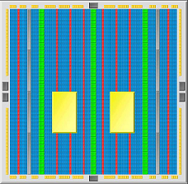
FPGA CAD Software
What is an FPGA?
  Field-Programmable Gate Array
    i.e., programmable hardware
  can implement any hardware circuit
  Altera, Xilinx, Actel, etc.
What is FPGA CAD Software?
  Computer Aided Design
  Maps user designs onto programmable fabric
  A suite of algorithms
    placement, routing, mapping, timing, optimization…
HW1 focus: VPR’s Simulated-annealing based placement
  Maps user-design components onto FPGA components

Slide 5
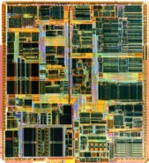
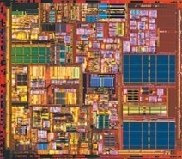
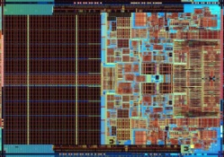
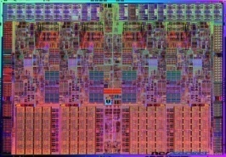
Implications of Moore’s Law
1995
2000
2005
2010
Year
FPGAs
70m
350m
1.1b
2.5b
…
CAD Complexity
Pentium II
PIV
Core 2 Duo
Core i7 Quad
CPUs
7.5m
42m
291m
731m
really need optimization/parallelization for CAD!
Notes:
1997
2000
2006
2008

Slide 6
Simulated Annealing Placement:
The Basic Idea
?
A
B
blocks
B
A
…
?
nets
C
C
D
D
Algorithm:
  1) start with random placement of blocks
  2) Randomly pick a pair of blocks to swap
  3) Keep new placement if an improvement
Notes:
net: describe the interconnect (e.g., pins)
blocks: memory blocks

Slide 7
HW1 Advice
This is a straightforward assignment
  But do start early
  There are lots of parts/questions
A shell/scripting language will make your life easier
  Eg., shell, perl, python
  Just to run lots of commands in a loop with diff parameters
Please measure on the UG machines!

Slide 8
Measurement
Machines to use for measurement:
  GB243: ug132-ug180
  SF2102: ug201-ug225
  GB251: ug226-ug249
  Develop and measure on any of these
  Try to measure on an unloaded machine!
Similar workstations:
  SF2204: ug51-ug75
  Can use for development, but don’t measure on these!

