Slide 1

TECAN ↔ ECHO Conversion using Python 3.5
Jason Lu (jasonlu6@bu.edu)
Luis Ortiz (Lortiz15@bu.edu)

Slide 2
Table of Contents
Flowchart / General Procedures
Why Python?
PyEvo Module: TECAN “Simulator”
Deliverables
Example Demonstration from JoVE
Conclusions

Slide 3
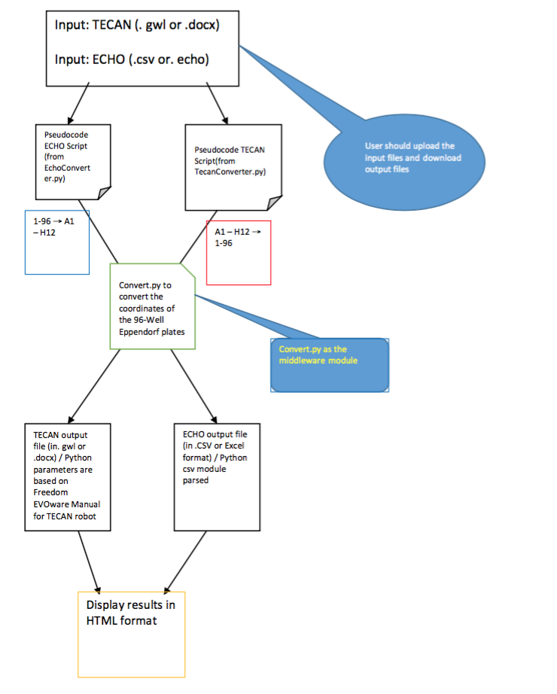
Flowchart / General Procedure
Main Steps:
Input file into psuedocode
Convert.py will make 96 Well-Eppendorf coordinates for either TECAN / ECHO
TECAN output in .docx or .gwl form
ECHO output in .csv or .echo form
Display the results / render in HTML webpage

Slide 4
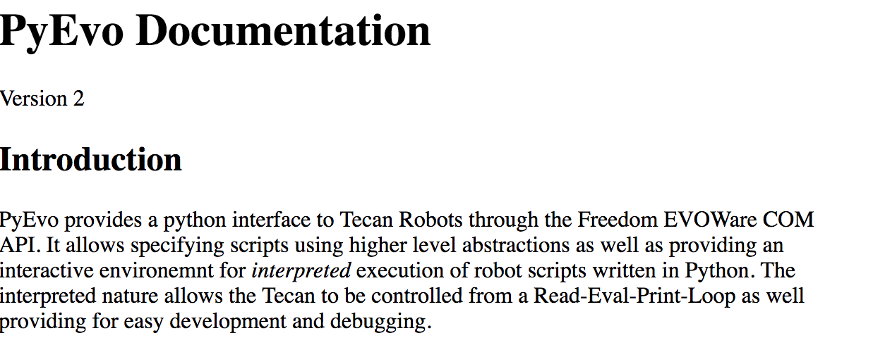
Why Python (3.5)?
I chose Python as the main programming language for the conversion of TECAN ↔ ECHO for 4 main reasons:
Already has a module called PyEvo: can simulate a TECAN robot instruction script/ Python Interface for the TECAN robot
Class abstraction: can various classes for different TECAN robot parts: liquidClass(..),plate(..),location(..)…
Main() method easy to simulate the Aspirate (A), Dispense (D), Wash (W) commands
Can use CSV, text, and other files as input / output

Slide 5
PyEvo Module: “TECAN” Simulator

Slide 6
Deliverables
Name | Format / Program Language
TecanConverter.py | Python
EchoConverter.py | Python
Convert.py | Python
Conversion.csv | CSV / Excel
Tecan Conversion To ECHO.docx | Word Document
tecanconvert.html | HTML
tecanmessenger.html | HTML
echoconvert.html | HTML

Slide 7

Example Demonstration (JoVE Article)

Slide 8
Conclusions

