Slide 1
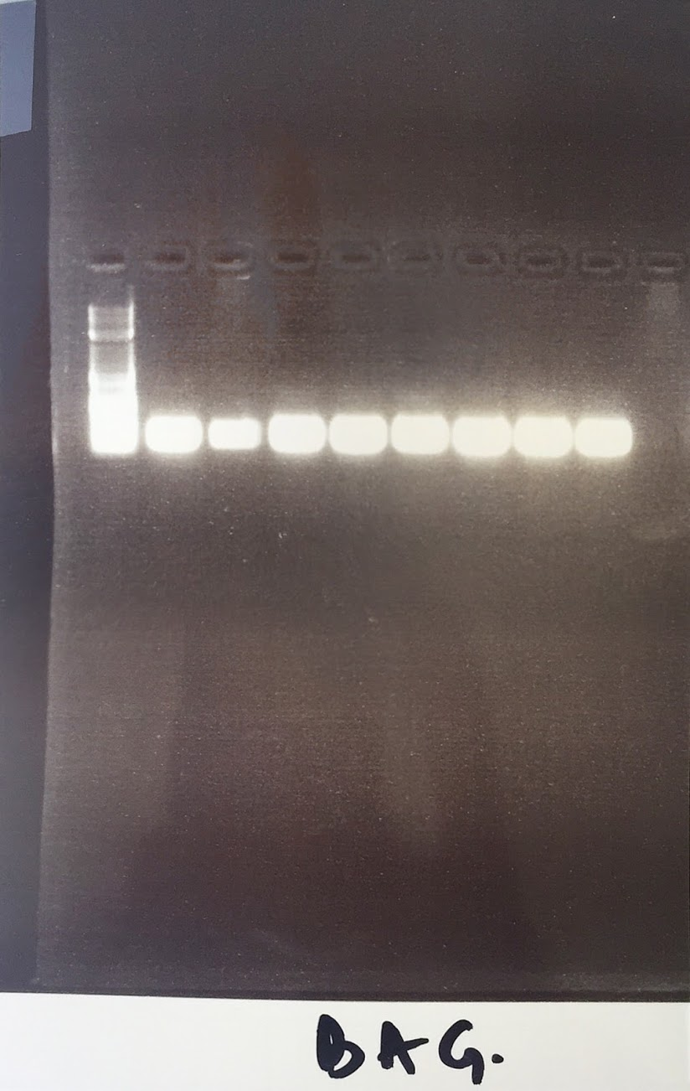
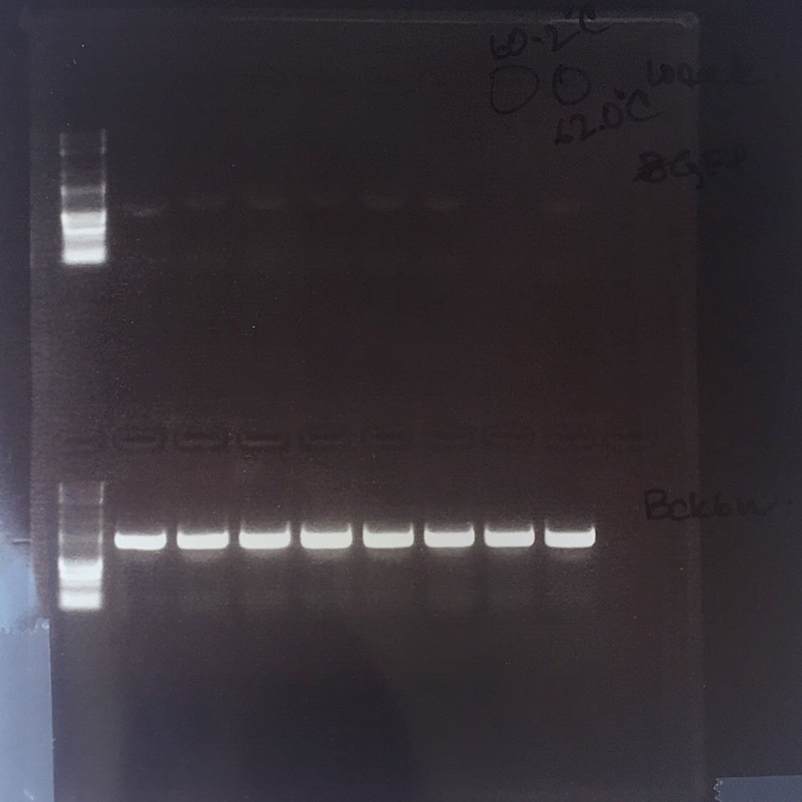
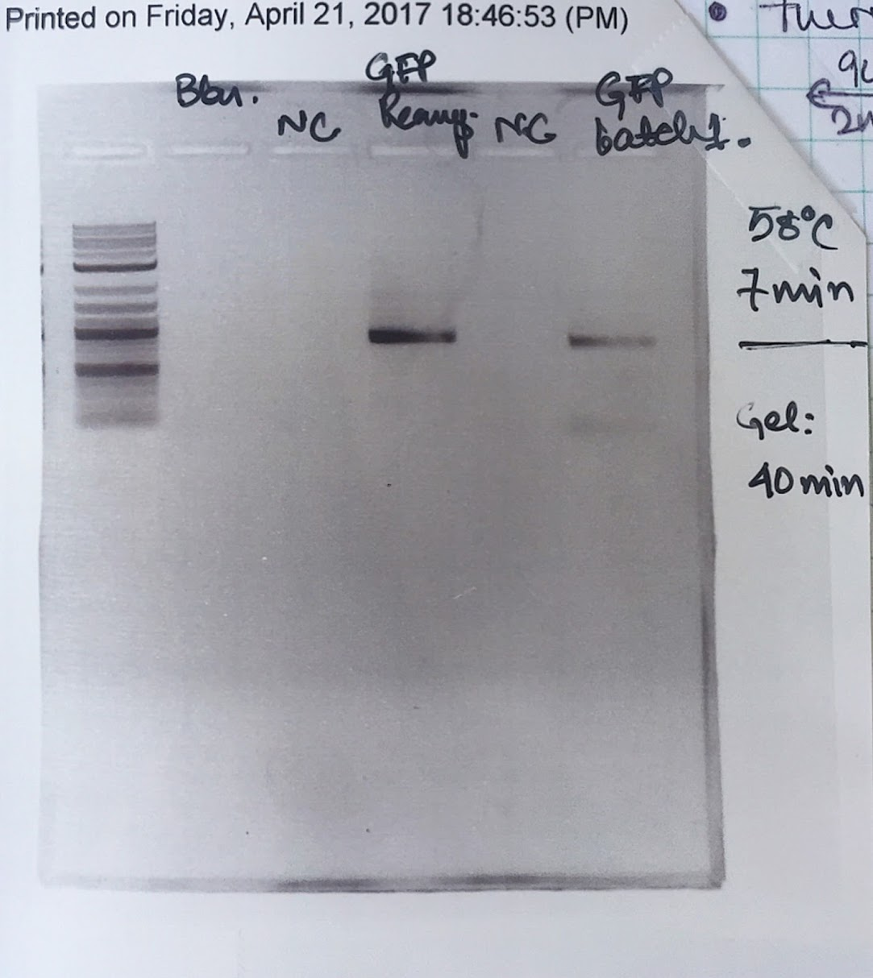


GiBSon Assembly with HTML: “Programmable” CIDAR Lab
Jason Lu (jasonlu6@bu.edu)
Rohin Banerji (rohinb96@bu.edu)
Notes:
Presentation for DAMPLAB / WETLAB Meeting 2 (July TBD 2017)
Revise the slides according to Rohin’s Request / Mary’s Suggestion (add in a flowchart)
Reduced to total of just 11 slides

Slide 2
Part I: Motivation
Needs / Reason to make the CIDAR Lab “Programmable” with HTML
Rohin’s Main Reason
Jason’s Main Reason

Slide 3
Reason 1: HTML can make data accessible to all users
HTML 5 was the choice language for making Rohin’s / CIDAR LAB data from the Excel spreadsheet more “programmable”:
1) Compact
2) Updates more quickly / easily
3) Accessible for all STEM Pathways researchers

Slide 4
Reason 2: HTML is by default “the website builder”
Majority of websites on the web were built from HTML
Boot-strapped with other languages
Easy to add dependencies
Can be run without browser
Most important of them all: easy to use

Slide 5
Reason 3: It Works with anything
HTML least likely to deal with troublesome compile errors
Eclipse makes it particularly easy to debug / fix error
Simple codes that explain what went wrong (if errors does occur):
Reference: https://en.wikipedia.org/wiki/List_of_HTTP_status_codes
Notes:
Note: best explain all of the codes in non-CS terms (though Densmore might know quite a bit of them)

Slide 6
Jason’s (My) Main Reason
ROHIN’S MAIN REASON
Incorporate the “inter-disciplinary” aspect on STEM Pathways
Combine Computer Science and Microbiology for all users
Make a website that will allow future CIDAR scientists to view data more easily (from previous lab experiments, DNA, primers…)
Fun to use (pretty UI, good aesthetics, more appealing to users) / “easy on the eyes”
Exercise in Bio-Informatics

Slide 7
Part II: Procedure
Notes:
Demo the site and the flowchart

Slide 8
Part III: Conclusion / looking ahead

Slide 9
Design is not just what it looks like and feels like. Design is how it works.
Steve Jobs (American entrepreneur and inventor [Apple])
Quote from Steve Jobs why design is important in our project
Notes:
Explain what the Steve Jobs quote means in terms of our Gibson Assembly Conversion project (especially to that of how to make Rohin’s job easier while using my computing skills to make it happen)
Also explain why this project is different than what is already available in the CIDAR LAB

Slide 10
THANK You!

