Slide 1
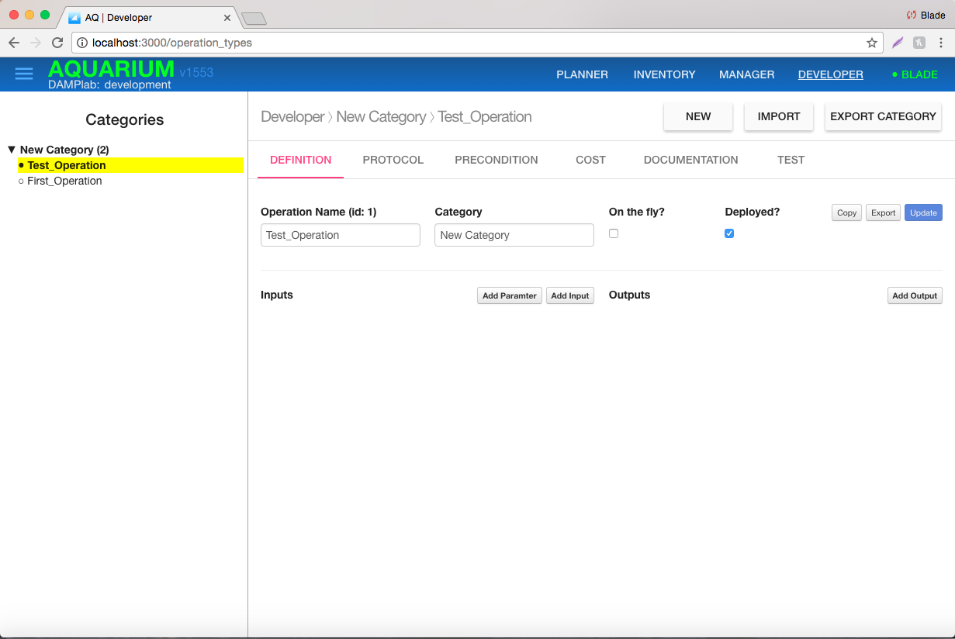
Aquarium Update
Done
Aquarium running locally on Blade’s laptop
To Do
Continue untangling UI/data needed for user workflow
Eventually deploy to Amazon instance afterward
Work on the first 2 protocols (the same that Mary sent to Biobright)
Issues
Aquarium roadmap
Long-term Support: Development Environment Setup and Code Contribution
Opportunity
Good feedback from Ron Weiss about Aquarium.
Collaboration with MIT (Ron’s group): putting efforts together to solve problems / develop capabilities (initial email sent).
No BioBright Update

