Slide 1
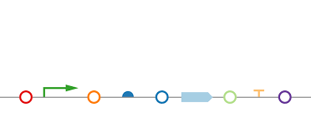




DAMP Lab
Corporate Sponsorship
Actions needed?
Hamilton visit (corporate sponsorship and software evaluation).
Communication Collaboration
Comparison pin-tool, TECAN, Spotter for the Level 1 assembly of Katherine’s parts (18 Level 1 assemblies).
Everyone should do the manual assembly for comparison, but at least the DAMP Lab North will do.
DAMP Lab North can, potentially, assemble Level 1 in Level 2 using Gibson.
Puppeteer should be adapted to attend it.
DAMP Lab Equipment / Material
Actions needed?
Opentrons.

Slide 2
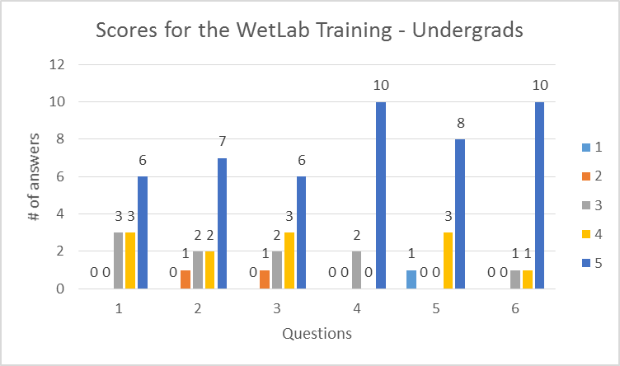
WetLab
BUILD
Publication (Outline sent).
Communication Group Collaboration
Penguin / Puppeteer (new protocols: Thermocycling and Transformation)
Outreach
Training for undergrads went well
High School:
Schedule changes
Training being developed (theoretical
and hands on)
CORI = OK for Mary
RISE orientation (Krishna is changing
mentorship with Josh)

Slide 3
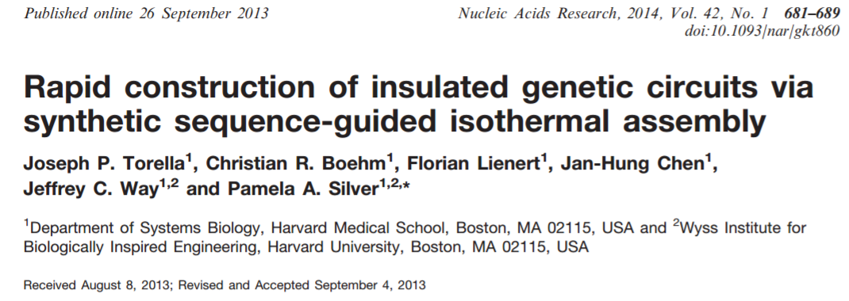
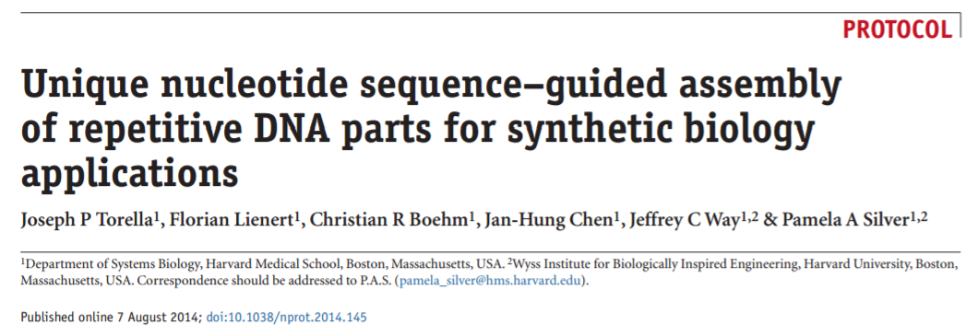
WetLab
Recombinase
Rohin focused on LCR.
Gibson assembly is not being very efficient.
Mary: developing a new strategy for Gibson assembly: to introduce 50oC, innocuous sequences at the end of each part.

Slide 4
WetLab
Cell Free
New cell extract batch (Thanks Rohin!)
Waiting until the energy solution components to arrive to finish it
Cloning and purifying GamS protein (Thanks Eric!)
ICE/SynBioHub/Benchling
Start: sent a wish list to Chris and Curtis (thanks Sarah!)
Development support
IGEM protocol development
Working with Hector to have our ICE repository public and import samples in batch (JoVe Article).

Slide 5
WetLab
Orders
PCR machines and protein supplies = PO already sent to the vendor
PCR machines service = PO already sent to the vendor
TVs = to be ordered (?)
Camera/Microscope = waiting on Melissa answer about the cost split
Safety
Inspection on last Friday – June 9th = OK.
IBC updated with new location.

