Slide 1
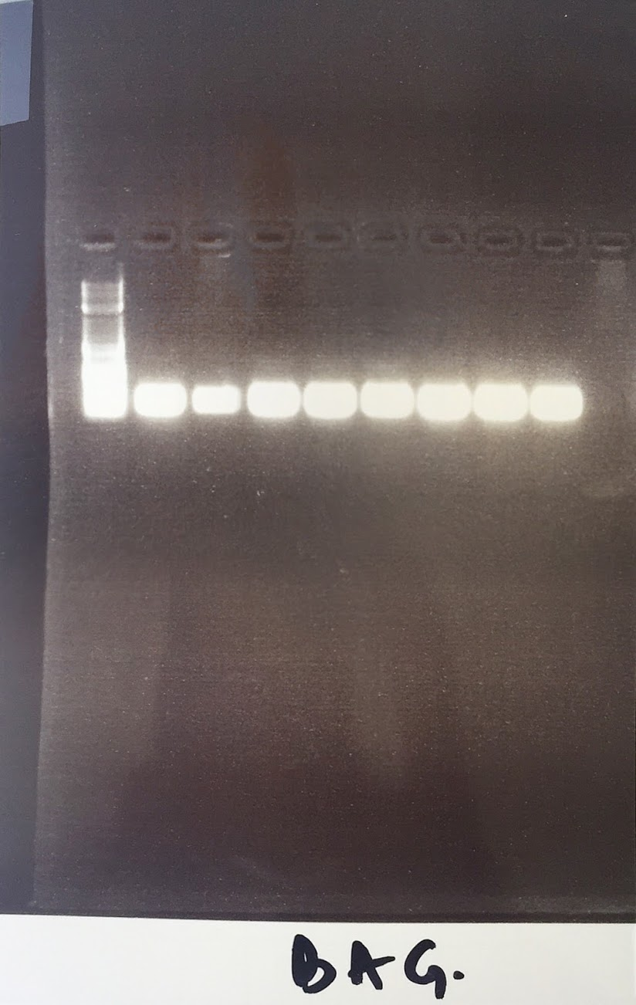
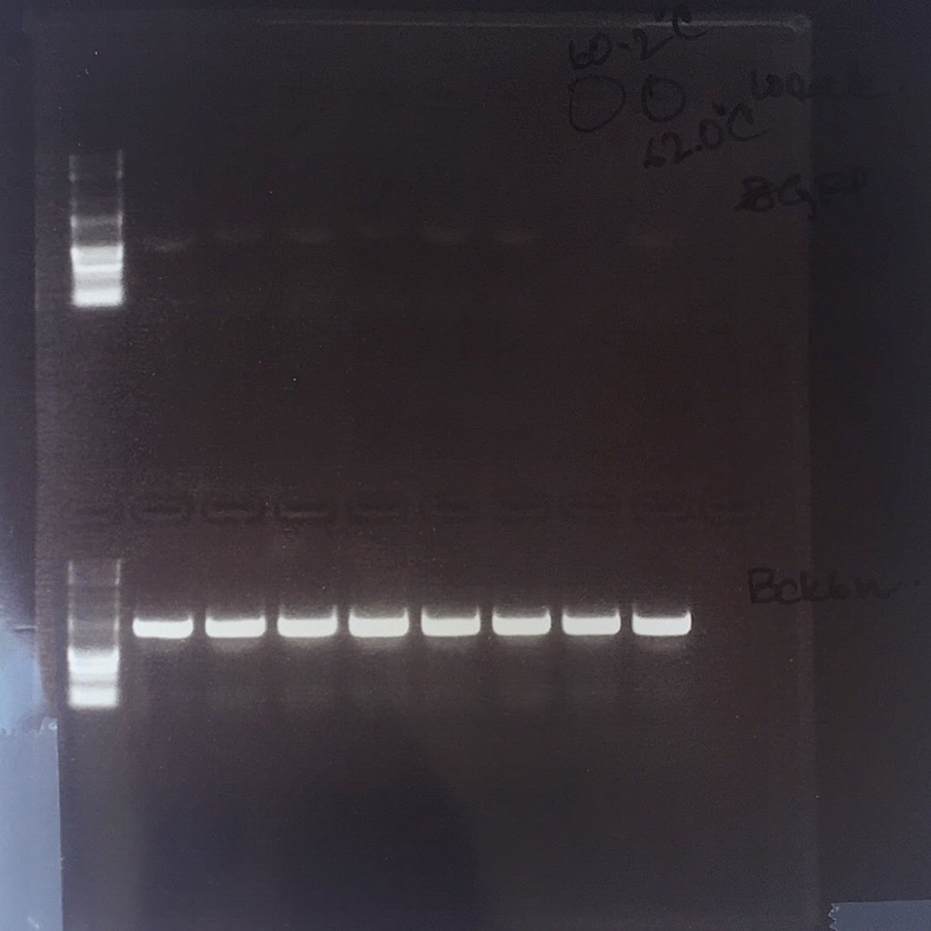
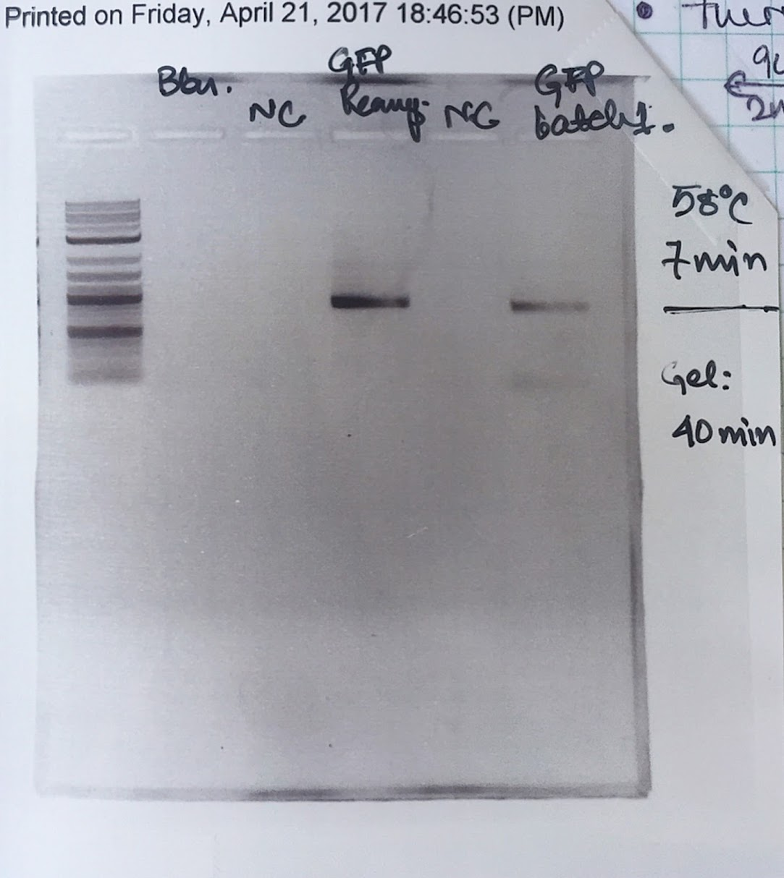


GiBSon Assembly with HTML: “Programmable” CIDAR Lab
Jason Lu (jasonlu6@bu.edu)
Rohin Banerji (rohinb96@bu.edu)
Notes:
Presentation for DAMPLAB / WETLAB Meeting 2 (July TBD 2017)

Slide 2
Table of Contents
Part I: Motivation
Part II: Procedure
Part III: Input / Output
Part IV: Conclusion / Looking Ahead

Slide 3
Part I: Motivation
Needs / Reason to make the CIDAR Lab “Programmable”
Rohin’s Main Reason
Jason’s Main Reason
Challenges / Conflicts

Slide 4
Why HTML / CSS?
Notes:
Hint: cut it to the chase!

Slide 5
Reason 1: HTML can make data accessible to all users
HTML 5 was the choice language for making Rohin’s / CIDAR LAB data from the Excel spreadsheet more “programmable”:
1) Compact, the data can be easier to read with 4 distinct tables (primers, LCR assembly, procedures, and DNA fragments) than 1 table
2) Updates more quickly / easily – instead of repeated laboratory experiments to update data, HTML allows uploads of lab data and images from the Desktop / Windows
3) Accessible for all STEM Pathways majors – code only used to show data / no CS background necessary to understand

Slide 6
Reason 2: HTML is by default “the website builder”
Majority of websites on the web were built from HTML
Can be boot-strapped (embedded) with other languages (CSS, Java, or even machine assembly languages)
Easy to add dependencies (do not have to mess with Terminal)
Can be run without browser (using a localhost port)
Useful when networks are down / internet connection bad
Most important of them all: easy to see and easy to use (no advanced CS coding background required, and code just an abstraction from the user)
Key terms: easy to use, abstraction, embedded
Notes:
Note: explain the concept of abstraction with non-CS terms
Maybe take out localhost concept (just say it can be run without a browser)
Example: the BU 802.1 network that times out almost periodicially

Slide 7
Reason 3: It Works with anything
HTML least likely to deal with troublesome compile errors
Eclipse makes it particularly easy to debug / fix error
Simple codes that explain what went wrong (if errors does occur):
More formally: HTTP (Hypertext Transfer Protocol) Status Codes
404: Website not found
200: Website found / successful
500: Internal Server Error (something is wrong with the browser / not user’s fault)
Reference: https://en.wikipedia.org/wiki/List_of_HTTP_status_codes
Notes:
Note: best explain all of the codes in non-CS terms (though Densmore might know quite a bit of them)

Slide 8
Rohin’s Main Reason
(let Rohin add this stuff)

Slide 9
Jason’s (My) Main Reason
Incorporate the “inter-disciplinary” aspect on STEM Pathways
Combine Computer Science and Microbiology for all users
Make a website that will allow future CIDAR scientists to view data more easily (from previous lab experiments, DNA, primers…)
Fun to use (pretty UI, good aesthetics, more appealing to users) / “easy on the eyes”
Exercise in Bio-Informatics

