Slide 1
Quality Assurance 508 Training
March 14, 2012

Slide 2
Section 508 Quality Assurance Training
Objectives
Review population information to support testing
Identify appropriate tools
Discuss assistive technology-independent testing methods for each standard
Q&A

Slide 3
Section 508 Quality Assurance Training
WebAIM 2010 Screen Reader Survey
  1245 respondents, 91% with a visual disability
  59.2% used JAWS as their primary reader; 11.2% used Window Eyes; 9.8% used VoiceOver
    Vast majority of respondents are on Windows OS
    47% of respondents used more than one screen reader
    80% had updated their primary screen reader w/in the last year
  Browser Use
    IE 8: 43.1%
    Firefox 3+: 23.5%
    IE 7: 12.5%
    Safari: 9.6%
  98.4% browsed the Web with JavaScript enabled
Notes:
What does this mean:
If you test for accessibility, the focus should be primarily on Windows OS
We cannot design for JAWS support alone
We should not assume that screen reader users will have the most recent versions of assistive technology, but we should not assume use of outdated versions, either
Testing must be thorough in IE, and should cover at least the two most recent versions

Slide 4
Section 508 Quality Assurance Training
Rules to Live By
Accessibility testing is not a simple pass-fail proposition
  Human judgment is required for implementation of many standards
  Accessibility is as much about design as it is coding
  Simply meeting compliance requirements will not necessarily result in an accessible product
Automated tools cannot tell the whole story
  Many tools return false positives
Testing must be incorporated into design and development
  Retrofitting accessibility is the most expensive, least efficient plan
  Testing at the end creates stress and reduces opportunities to address real design problems
Notes:
The need for interpretation is particularly important with functional performance requirements, which are extremely vague.
The goal should be to design for universal access, not to focus only on standards at the close of the development process.

Slide 5
Quality Assurance Training
Tools: Web Accessibility Toolbar for IE
Benefits:
Free
Provides page-by-page analysis of issues
Supports code validation, accessibility checking and cross-browser checking from a single toolbar
Used by FSA assistive technology group
Drawbacks:
No batch checking

Slide 6
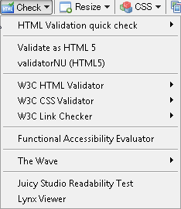
Section 508 Quality Assurance Training
Step 1: Validating Code
W3C Validator can provide information on:
  Missing text equivalents
  Mismatched “for”/”id” values (in forms)
  Nesting errors in data tables
  Mismatched “id”/”headers” values in complex data tables
Conformance with HTML standards will improve cross-browser compatibility and reduce accessibility issues

Slide 7
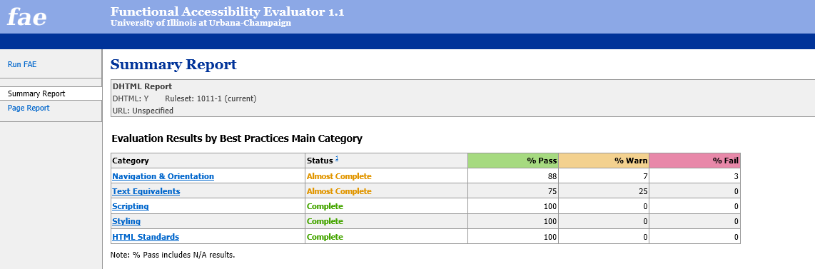
Quality Assurance Training
Step 2: Automated Testing
Benefits:
Provides a linked summary view
Supports drilling down to specific issues within a page
Page view provides detailed issues to review for each summary category
Drawbacks:
Results are not specific to 508, which can lead to confusion about what is required for compliance

Slide 8
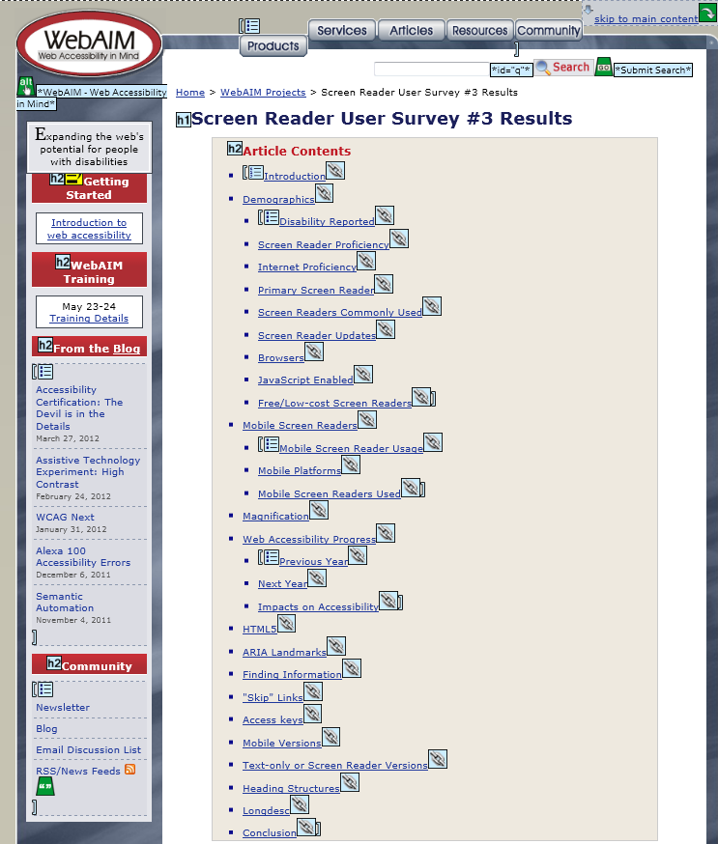
Section 508 Quality Assurance Training
Step 2: Automated Testing
The Wave
Benefits:
Provides a visual representation of where issues may exist within a specific page – no need to chase down code
Drawbacks:
Icons can be a little opaque

Slide 9
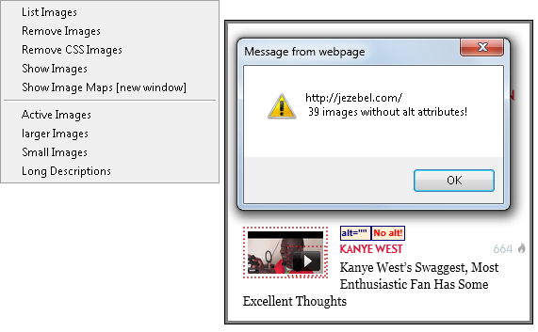
Section 508 Quality Assurance Training
Step 3: Testing for Specific Issues
Images
Use “Show Images” to:
  Locate images without text equivalents, including spacer GIFs
  Review existing text equivalents for appropriateness in context
  Get a tally of images that do not include “alt” values

Slide 10
Section 508 Quality Assurance Training
Step 3: Testing for Specific Issues
Multimedia
Ask yourself:
  Does the video include captions?
  Are they synchronized with the presentation?
  If the video does not include audio, does it include an audio description track?
  If an audio file is included, is a transcript provided in an accessible format (e.g., HTML)?
  If a player is embedded, do buttons include text equivalents/are they readable as text?
  Are buttons keyboard operable?
    Can you tab from button to button?
    Do you experience any unexpected changes in focus?
  If a video file download is offered, does the page offer a link to download an accessible player?

Slide 11
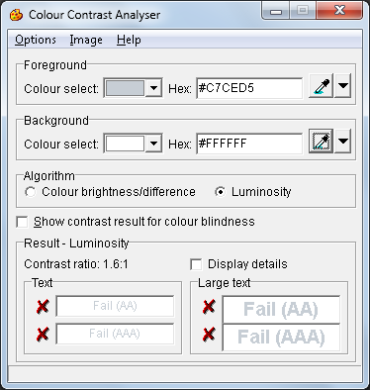
Section 508 Quality Assurance Training
Step 3: Testing for Specific Issues
Color
Ask yourself:
  Does the page include features or elements that depend upon color alone?
  Is contrast between text and background sufficient?
Color Contrast Analyzer
Enables simple color contrast analysis, based on WCAG 2.0 success criteria
Specific success criteria are not defined in current Section 508 standards
Notes:
As noted in the basic training, WCAG 2.0 is likely to be adopted as standards for Web application development in the Refresh.

Slide 12
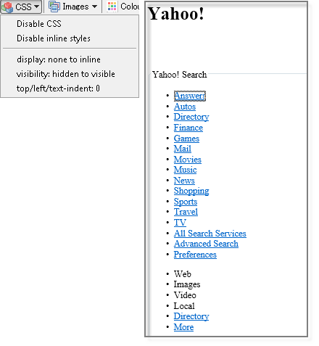
Section 508 Quality Assurance Training
Step 3: Testing for Specific Issues
Style Sheets
Disable CSS
Ask yourself:
  Is reading order affected?
  Is everything legible?
  Does content make sense?
  Are functionality and content still presented in context?
Notes:
Problem: Developers sometimes use CSS to radically change order of content w/in the page. Disable CSS to test for this issue. The page must make sense if CSS is disabled.
* Disabling CSS may also enable location of form labels if CSS is used to hide labels in forms.

Slide 13
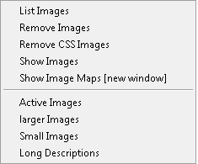
Section 508 Quality Assurance Training
Step 3: Testing for Specific Issues
Image Maps
In a client-side image map:
  Each hot spot should include a text equivalent (alt=“Georgia”)
  The map image must include a text equivalent (alt=“United States”)
To test:
  Use the IE Toolbar
    Show Image Maps
    Show Images

Slide 14
Section 508 Quality Assurance Training
Step 3: Testing for Specific Issues
Layout Tables
Ask yourself:
  Is the table laid out in a grid?
  Are row and column headers clearly defined?
  If not, does the table interfere with the linear reading order of the page?
To test:
  Tab order will often mirror reading order (tab through the page to determine linear reading order)
  Go to Tables/Linearize to remove page content from tabular presentation

Slide 15
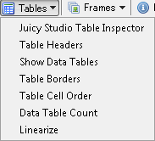
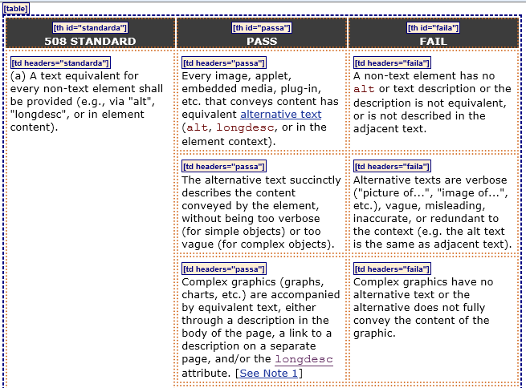
Section 508 Quality Assurance Training
Step 3: Testing for Specific Issues
Data Tables
Show Data Tables
Notes:
Show Data Tables will display table beginning/end
It will show where row and column headers have been defined
It will show the header/data association strategy being used (e.g., “headers” versus “scope”)
It cannot tell you which method is most appropriate; human judgment is required for this determination

Slide 16
Section 508 Quality Assurance Training
Step 3: Testing for Specific Issues
Complex Data Tables
All row and column headers must be marked up as TH
  If the table title is included in the body of the table, it should be marked up as TH
  If not, use CAPTION
If two or more levels of headers are present, associative markup should be used (“scope” or “id”/”headers”)
If the table structure is complex, “id”/”headers” is the best method
Complex data tables require a final check with a screen reader
Notes:
Ideally, table titles should be marked up with CAPTION, but this is not required by current Section 508 standards
Very complex table =
headers do not begin in first row/column
Multiple levels of row or column headers (spanning or merged cells)
Table contains nested tables w/in specific cells
Table contains elements that are not part of the data table (e.g., buttons for navigating through a grid)
Avoid nesting w/in data tables wherever possible

Slide 17
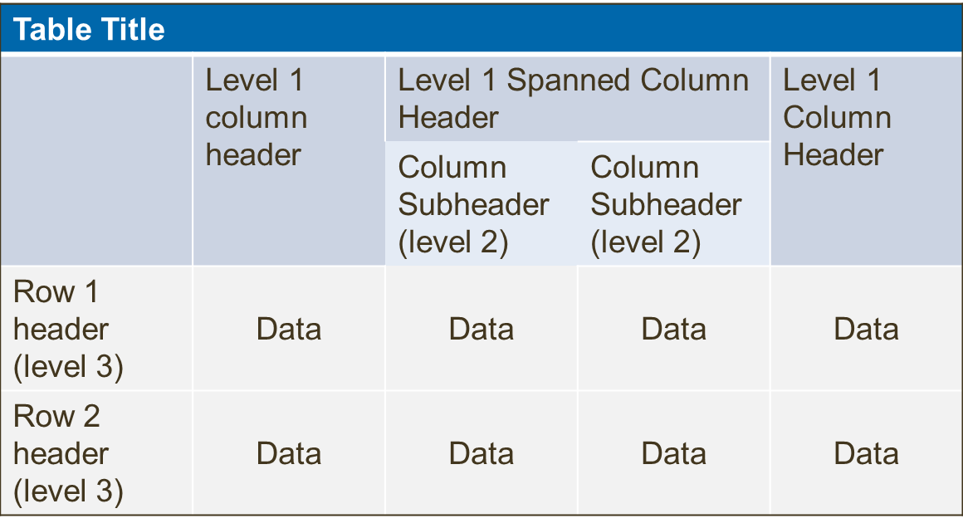
Section 508 Quality Assurance Training
Step 3: Testing for Specific Issues
Data Tables
Recognizing Levels
Notes:
TH alone
Works fine if the table has only one level of headers (e.g., column headers), and headers begin in the first row/column
“Scope” works well for tables that are simple
Two levels of headers
No spanning
No inserted presentation effects (e.g., using the first row for a title, adding blank rows or columns to create spacing)
“Headers”/”id”
Has widest support from assistive technology
Should be used for complex tables, due to lack of adequate support for “scope” in Window Eyes
Remember that a screen reader will read the associated headers in order of placement w/in the “headers” attribute, so it’s ideal to provide new information first (in most cases, this will be the “id” value for the column header), to enable users to quickly distinguish between content as they navigate through a table

Slide 18
Section 508 Quality Assurance Training
Step 3: Testing for Specific Issues
Frames
Applies to both FRAME and iframe implementation
All frames must include “title” attribute
“Title” must convey purpose of frame within page context
  Frame titles should not indicate location (“left” “right” “top” “bottom”)
iframes and panes should be keyboard navigable
Testing options:
  View Source and search within the document for the frame or iframe elements
  Use the Accessibility Toolbar to view a list of frames (see Frames menu)
  Use an Accessibility Favelet to assess frames within the page
  Use a screen reader to check frame titles for context
Notes:
Keyboard navigable in this context means the user should be able to use the tab key to navigate between framed or paned content
The Accessibility Toolbar sometimes has difficulty recognizing iframe content. The Favelets information will be posted to the Accessibility Wiki after this training.

Slide 19
Section 508 Quality Assurance Training
Step 3: Testing for Specific Issues
Scripting
Scripting may include widgets, form validation methods, error message distribution, and a number of other features
Ask yourself:
  Can I operate buttons, menus and links by keyboard?
  Do I notice unexpected changes in focus when navigating by keyboard?
  Is the information that is available to me when I navigate by mouse also available by keyboard?
  If I make a selection in a form, does the page refresh automatically? Does my location change?
  Are widget behaviors consistent with standards?
To test:
  Unplug your mouse. Attempt to tab or otherwise access all screen features using the keyboard alone.
Notes:
Consistent behaviors:
Dialogs can be resized and moved, per common Windows behaviors
Trees can be navigated by arrow keys; users can tab into the first node in the tree
User can navigate into menus and toolbars using either the Tab key or system-defined shortcuts
Accessibility accommodations that are not evident (e.g., shortcuts) are documented in system Help

Slide 20
Section 508 Quality Assurance Training
Step 3: Testing for Specific Issues
Downloadable Documents
If a page offers a document for download in a non-HTML format (e.g., PDF), a link must be provided to download an accessble plugin or applet
To test:
  Look for a link to download an appropriate Reader or Viewer application
  If no such link is provided on the page where the document is provided, look for the plugin download in another logical location in the page template – e.g., Help documentation or an Accessibility link
  Is the document itself tagged or structured for accessibility?
    In PDF documents, check Properties
  If not, is an alternate version of that content provided?
    An accessible alternate version may be offered in a number of formats, including HTML
Notes:
An alternate version of a downloadable document may be the Web application itself, depending on the document contents (i.e., the document may provide a downloadable version of the user’s data entry into the system).
If the downloadable document is meant to provide an alternate method of data entry (e.g., the FAFSA PDF forms), then the Web system cannot be viewed as an alternate version and the downloadable document must meet accessibility requirements.

Slide 21
Section 508 Quality Assurance Training
Step 3: Testing for Specific Issues
Forms
Form controls should be explicitly associated with labels in markup
To test:
  Click the label; focus should move into the control (“click test”)
  Validate the HTML
    Validation will identify invalid or repeated “id” values
  If no text label is visible, try turning off CSS
    This can be accomplished from the IE Toolbar
    Sometimes labels are hidden
  If the form is marked up as a data table, hover over form controls to verify that “title” has been included
    Labels will display as tooltips
Notes:
Consistent behaviors:
Dialogs can be resized and moved, per common Windows behaviors
Trees can be navigated by arrow keys; users can tab into the first node in the tree
User can navigate into menus and toolbars using either the Tab key or system-defined shortcuts
Accessibility accommodations that are not evident (e.g., shortcuts) are documented in system Help

Slide 22
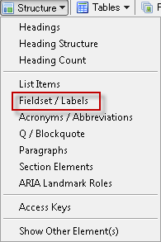
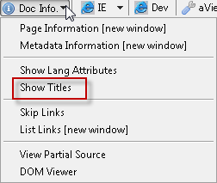


Section 508 Quality Assurance Training
Step 3: Testing for Specific Issues
Forms
Additional Method: IE Toolbar
  The toolbar can show you where labels are located, results are not always easy to read; use the click test if uncertain.

Slide 23
Section 508 Quality Assurance Training
Step 3: Testing for Specific Issues
Skip Navigation
If the system includes repetitive navigation links, a method must be provided of skipping those links
Skip links must be tested in IE and Firefox
To test:
  Tab to the skip link
  Press Enter to activate the link
  Focus should move to the anchor
  Press tab again
    Focus should move to the first link or tab-able object (e.g., a button) after the anchor
  Check to be certain link text is present and descriptive (i.e., “Skip to main content”)

Slide 24
Section 508 Quality Assurance Training
Step 3: Testing for Specific Issues
System Time Out
If a user session will time out within a set period of time, then:
  Users should be notified that timeout is about to occur
  Users should be given an opportunity to request additional time
To test:
  Wait it out. Are you prompted to request additional time?
  If you are, what happens when you indicate that more time is required?
  If a countdown is in place, is it necessary for use?
  If the user requests additional time, is it granted?
  If the timeout occurs, is the user returned to his or her last location/activity?
  Does the system indicate the timeout period anywhere (login screen, Help documentation)?
Notes:
Can the user ascertain how long they have if they cannot read the changing times on the countdown?

Slide 25
Q & A

