Slide 1
Section 508:
Web Standards Training
April 12, 2012

Slide 2
Section 508 Web Training
Section 508: Definition and Impact
Requires all Federal agencies to make their electronic and information technology (E&IT) equally accessible to people with disabilities
  Enacted by Congress in 1998
  Amendment to the Rehabilitation Act
  In effect since 2001
Ensures Federal employees with disabilities access to and use of E&IT comparable to that of other Federal employees
Ensures all individuals in the general public have equal access to all Government information
Applies to all Federal agencies
  when they develop, procure, maintain, or use electronic and information technology
Applies to all Federally funded programs
  including those supported by grant funding and cooperative agreements
Notes:
Exceptions:
National security systems
Incidental to a contract
located in spaces frequented only by service personnel for maintenance, repair, or occasional monitoring of equipment
would impose an undue burden on the agency
Undue burden:
Must be documented within the agency
Defined as: significant burden or expense
Decision on undue burden cases must be made by the agency, not vendors
If no available product meets requirements, we must choose the product that comes closest!
* Discuss/Mention VPAT/Buy Accessible
Explain functional requirements here –
* Functional requirements apply where specific standards are not applicable
* Functional requirements for 508 current are very general, and simply state that a “mode of operation” must be available to users of various disability types (proposed Refresh language is much more specific)

Slide 3
Section 508 Web Training
Section 508: Important Concepts
If adopting an application, applet or plugin:
If no accessible product is available, we must select the product that comes closest to meeting standards
Functional Performance Requirements:
Functional requirements apply where specific standards are not applicable
Functional requirements for 508 current simply state that a “mode of operation” must be available to users of various disability types
Each Federal or state agency has different interpretations regarding Section 508
Thus, they have different requirements
Notes:
One of the primary complaints about functional performance requirements is that they are not testable; this may be changed when the Refresh standards are finalized.
* Because functional performance requirements are not easily testable, the onus is on the evaluator to apply the standards, leaving room for interpretation.

Slide 4
Section 508 Web Training
Section 508: Technologies Covered
Information technology and any equipment or interconnected system or subsystem equipment used in the creation, conversion, or duplication of data or information
This includes:
  Web sites
  Software
  Electronic documents (e.g., PDFs)
  Multimedia, including videotapes and online videos
  Telecommunications products, including telephones
  Information kiosks
  Transaction machines (ATMs)
  Office equipment, such as copiers and fax machines

Slide 5
Section 508 Web Training
Section 508: Disabilities Covered
Blindness, low vision, color blindness
  Screen readers, screen magnifiers
  Text equivalents, audio description, keyboard support
Hearing Disabilities
  TTY services
  Captioning, transcripts
Motor Disabilities
  Alternate input devices
  Support for keyboard navigation, OS keyboard supports
Cognitive Disabilities
  Speech recognition software
  Use of adequate white space, plain language
Notes:
Remember that this is a short list: Disabilities are individual and individuals may have more than one disability. It’s not all about JAWS.
Individuals may have more than one disability.
Disabilities may be temporary (e.g., repetitive stress injuries), caused by illness, or related to ageing (sight, motor or hearing losses).
Assistive technology may describe any number of accommodations, including track-ball mouse

Slide 6
Section 508 Web Training
Section 508: The Refresh
Section 508 Refresh
  First update since 2001
  First report issued in 2008
  Most recent comment period closed March 3
  Adopting Web Content Accessibility Guidelines, Levels A and AA
Objectives
  Testability
  Harmonization of standards
  Interoperability with assistive technology
Notes:
Explain effective date
Recommend that they begin using WCAG as a technical resource
Indicate that Web applications need to meet both Web and software requirements, as well as functional performance and documentation

Slide 7
Web Standards

Slide 8
Section 508 Web Training
Images
A text equivalent for every non-text element shall be provided (e.g., via "alt", "longdesc", or in element content).
Examples of non-text elements:
  Images, including graphs and charts
  Image Maps
  PDFs
  Audio clips
  Video or other multimedia

Slide 9
Section 508 Web Training
Writing Text Equivalents
Be succinct
Use null “alt” text with spacer GIFs (alt=“”)
Describe the purpose of the image
Provide meaningful “alt” text with linked images
Provide transcripts with audio files
Provide synchronized captions with video
Provide “tagged” PDF files or HTML versions

Slide 10
Section 508 Web Training
What is meaningful ALT text?
Meaningful “alt” text:
Focuses on the purpose or intent of the image rather than its appearance
  Good “alt” text for an error icon: “Please revise your entry.”
  Bad “alt” text for an error icon: “Red stop sign”
Indicates the target of a linked image:
  Good “alt” text for a logo image that is linked to a Web site home page: “NSF Home”
  Bad “alt” text for same: “Logo”
It is not necessary to specify the image type (e.g., “photo of,” “image of,” “icon”) in the text equivalent, unless this information conveys additional information about page context

Slide 11
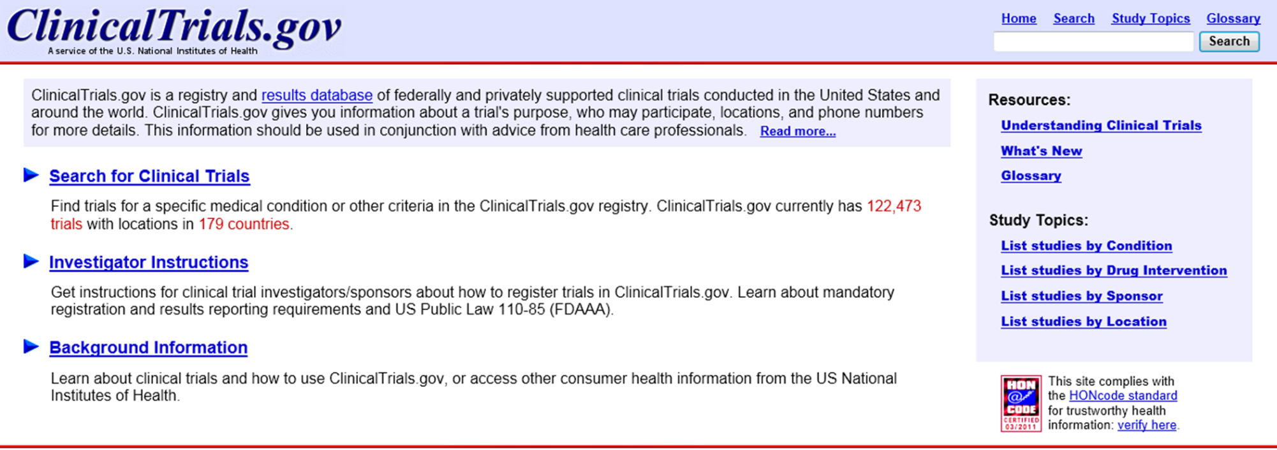
Section 508 Web Training
Exercise: Writing Text Equivalents
Notes:
Identify images visually
Suggest text equivalents

Slide 12
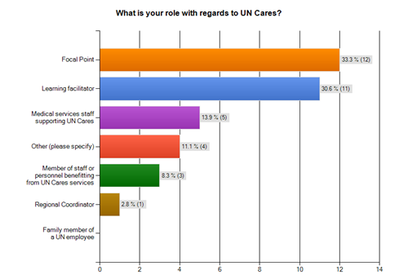
Section 508 Web Training
Exercise: Writing Text Equivalents
Notes:
Methods of adding text equivalents (types of links, types of equivalents)
Issues with d-links
Best representation of data in text version?

Slide 13
Section 508 Web Training
Multimedia
Equivalent alternatives for any multimedia presentation shall be synchronized with the presentation.
Key Concepts:
  If a pre-recorded video file is provided, it must be captioned or include audio description
  Pre-recorded audio must include transcripts
  Real-time audio must include synchronized captions
  If embedded, the media player must meet software requirements
Notes:
Benefits of Transcripts:
Searchable
Provide an alternate version of the video or audio content
Quick to download if the user is in an environment where playing multimedia is inconvenient/inappropriate
Key issues for media players:
If the player is embedded,
All keys must be operable w/o a mouse
There must be a visual indication of focus
When the user makes a selection (e.g., mute), focus must remain w/in the player
Any buttons that are images must include appropriate text equivalents

Slide 14
Section 508 Web Training
Color
Web pages shall be designed so that all information conveyed with color is also available without color, for example from context or markup.
Key Concepts:
  Users may have difficulty distinguishing between colors (10% of American men are color blind)
  Contrast between background and foreground is key to readability
  In the Refresh, contrast requirements are more specific
Notes:
Examples:
Error indicators may be provided in red, but must also be available in text.
Contrast requirement in the Refresh: “The visual presentation of text and images of text has a contrast ratio of at least 4.5:1.”

Slide 15
Section 508 Web Training
Style Sheets
Documents shall be organized so they are readable without requiring an associated style sheet.
Key Concepts:
  Do not interfere with user-defined style sheets
  When CSS is disabled, page content should be readable and in logical order

Slide 16
Section 508 Web Training
Image Maps
Redundant text links shall be provided for each active region of a server-side image map.
Client-side image maps shall be provided instead of server-side image maps except where the regions cannot be defined with an available geometric shape.
Key Concepts:
  Where possible, use client-side image maps
  Each clickable area/hot spot must include a text equivalent via the “alt” attribute
  The map image must also include an equivalent

Slide 17
Section 508 Web Training
Tables
Row and column headers shall be identified for data tables.
Markup shall be used to associate data cells and header cells for data tables that have two or more logical levels of row or column headers.
Key Concepts:
  Layout vs. data tables
  Number of levels/structure
  “Scope” versus “Headers”
Notes:
Labeling a data table’s row and column headers can also be done using the accessibility tags of a .pdf.
If the first row or column of a table does not include headers, then it is likely the “headers” attribute will be required.
The “scope” attribute works well with simple tables with a single level of column and single level of row headers; “scope” is not well supported by Window Eyes in more complex data tables.

Slide 18
Section 508 Web Training
Create Accessible Data Tables
Use data table markup in data tables only
Use TH to mark up headers, not to create formatting effects
Where the table structure is complex, use TH with “id” and “headers” attributes
Simplify, simplify, simplify
Avoid nesting tables within a data table
Avoid inserting other page elements within the body of the data table
Notes:
* Provide an example for discussion, particularly explaining simplification options
* Explain use of CAPTION and “summary”

Slide 19
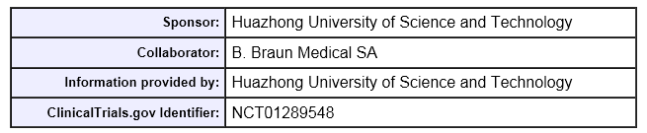
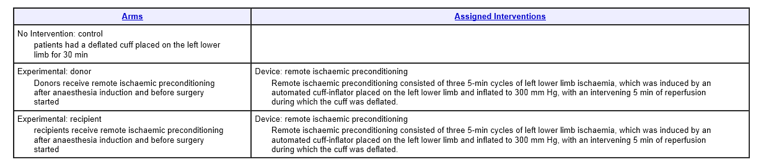
Section 508 Web Training
Exercise: Layout vs. Data
Table 1
Table 2
Notes:
Is the first table a layout table or a data table?
In the second, what is the best strategy to use to mark up the table?

Slide 20
Section 508 Web Training
Exercise: Complex Data
Where are you currently located?
Answer Options |  | Response Percent | Response Count
West and Central Africa |  | 17.1% | 13
Eastern and Southern Africa |  | 13.2% | 10
Asia and the Pacific |  | 11.8% | 9
Middle East and North Africa |  | 10.5% | 8
The Caribbean |  | 10.5% | 8
European HQ (Geneva, Rome, Paris, Vienna, Bonn, Madrid, etc.) |  | 10.5% | 8
Latin America |  | 9.2% | 7
Eastern Europe and Central Asia |  | 7.9% | 6
North America (New York and Washington, DC) |  | 7.9% | 6
Other (please specify) |  | 1.3% | 1
answered question |  |  | 76
skipped question |  |  | 1
Notes:
What is the best strategy for marking up this table?
“scope” vs. “headers”?
Spanned, nested headers
Use of caption vs TH

Slide 21
Section 508 Web Training
Frames
Frames shall be titled with text that facilitates frame identification and navigation.
Rules
Use “title” with FRAME or iframe to identify each frame in a page
Titles should be succinct and descriptive
  Title should indicate role in page content (i.e., “menu”) rather than location (e.g., “left”)

Slide 22
Section 508 Web Training
Flickering and Blinking
Pages shall be designed to avoid causing the screen to flicker with a frequency greater than 2 Hz and lower than 55 Hz.
Rules
Do not cause the page to flicker or blink

Slide 23
Section 508 Web Training
Text-Only Versions
A text-only page, with equivalent information or functionality, shall be provided to make a web site comply with the provisions of these standards, when compliance cannot be accomplished in any other way. The content of the text-only page shall be updated whenever the primary page changes.
Concerns
Text-only pages are updated less often
Text-only does not help users with hearing or motor disabilities
In most cases, Web pages do not require separate text versions

Slide 24
Section 508 Web Training
Scripting
When pages utilize scripting languages to display content, or to create interface elements, the information provided by the script shall be identified with functional text that can be read by assistive technology.
Key Concepts:
Use device-independent handlers
Ensure that content is readable with assistive technology
Avoid causing the page to automatically refresh
Ensure that scripted content is keyboard navigable
Do not cause unexpected changes in focus

Slide 25
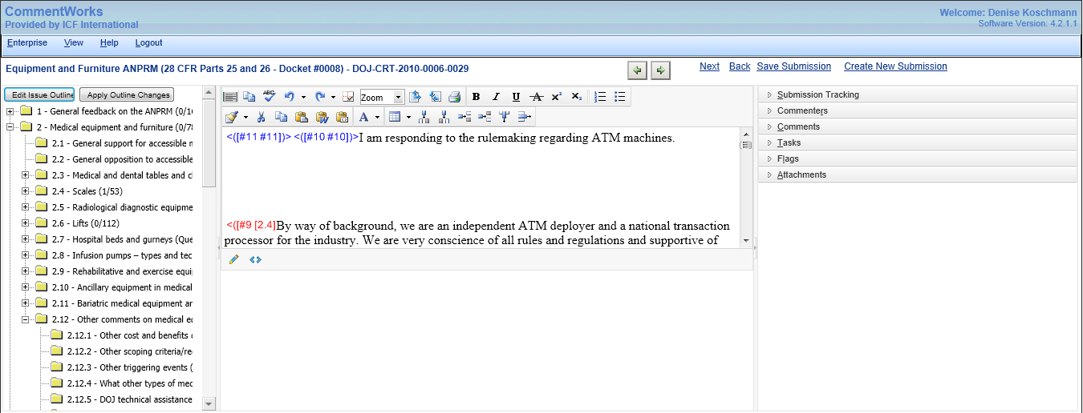
Section 508 Web Training
Exercise: Testing Web Applications
Notes:
What issues would you expect to encounter?
Where would keyboard support need to be built in? What types of accommodations would you include?
What other concerns might you have?

Slide 26
Section 508 Web Training
Applets and Plugins
When a web page requires that an applet, plug-in or other application be present on the client system to interpret page content, the page must provide a link to a plug-in or applet that complies with §1194.21(a) through (l).
Rules:
If a file is provided in a downloadable format, provide a link to download the appropriate Reader or Viewer application
Software requirements (1194.21) will apply to the plug-in
Notes:
Our responsibility: to select the most accessible possible plugin or applet.

Slide 27
Section 508 Web Training
Forms
When electronic forms are designed to be completed on-line, the form shall allow people using assistive technology to access the information, field elements, and functionality required for completion and submission of the form, including all directions and cues.
Key Concepts:
Use LABEL to explicitly associate form controls with labels
  Assistive technology support for implicit association is unpredictable
If LABEL cannot be used, use “title”
Notes:
Explain valid use of LABEL (“id”/”for” association, valid “id” use, click testing)
Explain “title” (contents pop up, contents are read in sentence format)

Slide 28
Section 508 Web Training
Forms
Implicit Association:
  <label>First Name:
  <input type="text" name="fn" size="20" />
  </label>
Explicit Association:
  <label for="fn">First Name:</label>
  <input type="text" name="fn" id="fn" size="20" />
Title Attribute:
    <input title=“First Name” type="text" name="fn" size="20" />
Notes:
Explain valid use of LABEL (“id”/”for” association, valid “id” use, click testing)
Explain when to use “title” (e.g., when LABEL cannot be used)

Slide 29
Section 508 Web Training
Skip Navigation Links
A method shall be provided that permits users to skip repetitive navigation links.
The three methods:
Invisible linked spacer image
Invisible or visible linked text
Invisible linked text that becomes visible when keyboard focus is placed on the link
Notes:
Discuss IE bug
Walk through skip link test
Discuss semantic markup and its role as a navigation accelerator

Slide 30
Section 508 Web Training
Timed Responses
When a timed response is required, the user shall be alerted and given sufficient time to indicate more time is required.
Key Concepts:
  Notify users that the system will time out after a certain period of time
  Provide an opportunity for users to request additional time before timeout occurs
  Make sure that if a timeout does occur, the user’s data will not be lost

Slide 31
Incorporating Accessibility

Slide 32
Section 508 Web Training
How it works best
Incorporate accessibility from the beginning
Think about accessibility during design
Test early and often
Before incorporating a new widget or application, have it tested

Slide 33
Q & A

