Slide 1

Reactive Web

Slide 2
Topics
The Spring Framework
Spring 5
Reactive Programming
Reactive Web Frameworks (for Java)
Spring Reactive Web (WebFlux, Project Reactor)
Coding Session

Slide 3
The Spring Framework
The Spring Framework is an application framework and inversion of control container for the Java platform. The framework's core features can be used by any Java application, but there are extensions for building web applications on top of the Java EE (Enterprise Edition) platform. Although the framework does not impose any specific programming model, it has become popular in the Java community as an addition to, or even replacement for the Enterprise JavaBeans (EJB) model. The Spring Framework is open source. (Wikipedia)
It‘s one of the most commonly used Java frameworks. It provides tons of features, documentation and tutorials.

Slide 4
The Spring Framework (2)
Based on the ideas of Rod Johnson (Expert One-on-One J2EE Design and Development, 2002)
Mainly developed and maintained by Pivotal Software. (Software consulting, services and tutorials)
Based on different modules, which can be imported as dependencies into your own project.
Current version: 5.1 (released 21-09-2018)
Many different projects:
https://spring.io/projects

Slide 5
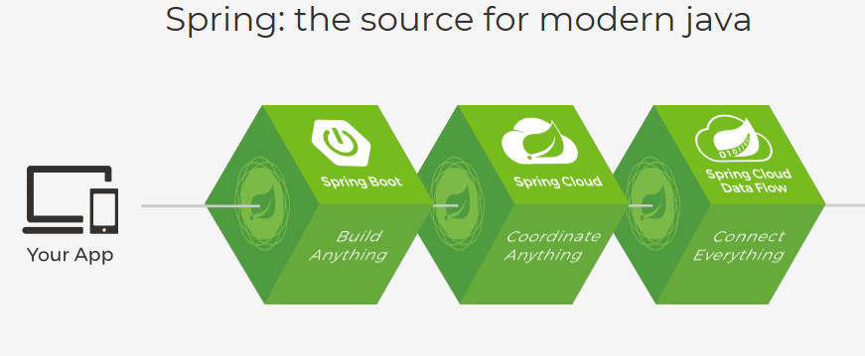
The Spring Framework (3)
From http://spring.io

Slide 6
Spring 5
Current Version: 5.1 (September 2018) (5.0 is from 2017)
Improved Spring Boot Module.
Improved Spring Security.
Integrated Microsoft Azure functions for Java.
Integrated Project Reactor -> Reactive (non-blocking) versions of many known Spring modules (Web MVC, MongoDB, Security, etc.)
…

Slide 7
Reactive Programming
The Reactive Manifesto:
https://www.reactivemanifesto.org/

Slide 8
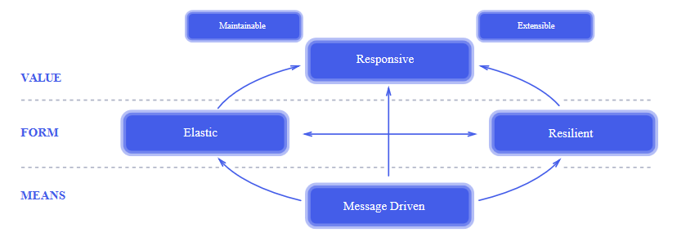
Reactive Programming (2)
Principles of reactive programming. From https://www.reactivemanifesto.org/

Slide 9
Reactive Programming (3)
Responsive: Quickness and a positive user experience under various conditions, such as failure of an external system or a spike of traffic, depends on the two traits of a Reactive application: resilience (against errors) and scalability.
Resilient: Resilience is achieved by replication, containment, isolation and delegation. Failures are contained within each component, isolating components from each other and thereby ensuring that parts of the system can fail and recover without compromising the system as a whole. Recovery of each component is delegated to another (external) component and high-availability is ensured by replication where necessary.
The application is always accessible, no matter what conditions there are.
Errors are dealt with internally, without compromising the application
From: https://blog.redelastic.com/what-is-reactive-programming-bc9fa7f4a7fc and https://www.reactivemanifesto.org/

Slide 10
Reactive Programming (4)
Elastic: react to changes in the input rate by increasing or decreasing the resources allocated to service these inputs. This implies designs that have no contention points or central bottlenecks, resulting in the ability to shard or replicate components and distribute inputs among them.
Message-driven: Reactive Systems rely on asynchronous message-passing to establish a boundary between components that ensures loose coupling, isolation and location transparency. Employing explicit message-passing enables load management, elasticity, and flow control by shaping and monitoring the message queues in the system and applying back-pressure. Non-blocking communication allows recipients to only consume resources while active, leading to less system overhead.
The application can handle any traffic without wasting resources.
Components are separated and communicate through asynchronous messaging.
From: https://blog.redelastic.com/what-is-reactive-programming-bc9fa7f4a7fc and https://www.reactivemanifesto.org/

Slide 11
Reactive Programming (5)
Three main aspects / arguments for reactive programming:
Error = message
An error is a single message in the message stream
The receiver decides on how to handle the error (or not)
Backpressure (Controlled by demand)
Number of messages, that are passed through, depends on the capacity of the receiver
If the receiver doesn’t request new messages, the service can deal with other tasks.
Non-blocking architecture
No waiting threads -> less threads required -> less switches between threads -> better performance
From: https://dzone.com/articles/what-are-reactive-streams-in-java

Slide 12
Reactive Programming (6)
Reactive Streams API (included in Java 9 API)
Publisher: published a possibly unlimited number of elements.
Subscriber: requests and receives a possibly unlimited number of elements.
Subscription: represents a one-to-one lifecycle of a Subscriber subscribing to a Publisher.
Processor: represents a processing stage — which is both a Subscriber and a Publisher and obeys the contracts of both. (e.g. a mapping mechanism) -> bridge

Slide 13
Reactive Programming (7)
Reactive Streams API (included in Java 9 API)
Subscription
Publisher
Subscriber
Processor
Available Data

Slide 14
Reactive (Web) Frameworks for Java
Java 8 (CompletableFuture<T>)
Java 9 (Reactive Streams API)
Ratpack (Basic Implementation)
ReactiveX -> RXJava (based on Observable Pattern and not on Reactive Streams)
Project Reactor (includes Reactive Streams and RXJava functions) -> Reactive Spring
Others (Akka Streams, Vert.x, …)
From: https://dzone.com/articles/what-are-reactive-streams-in-java

Slide 15
Spring Reactive Web (WebFlux / Project Reactor)
Reactive Spring represents a platform wide initiative to deliver reactive support at every level of the development stack—web, security, data, messaging, etc. Spring Framework 5 delivers on this vision by providing a new reactive web stack called, Spring WebFlux, which is offered side-by-side with the traditional Spring MVC web stack. The choice is yours! (from spring.io)

Slide 16
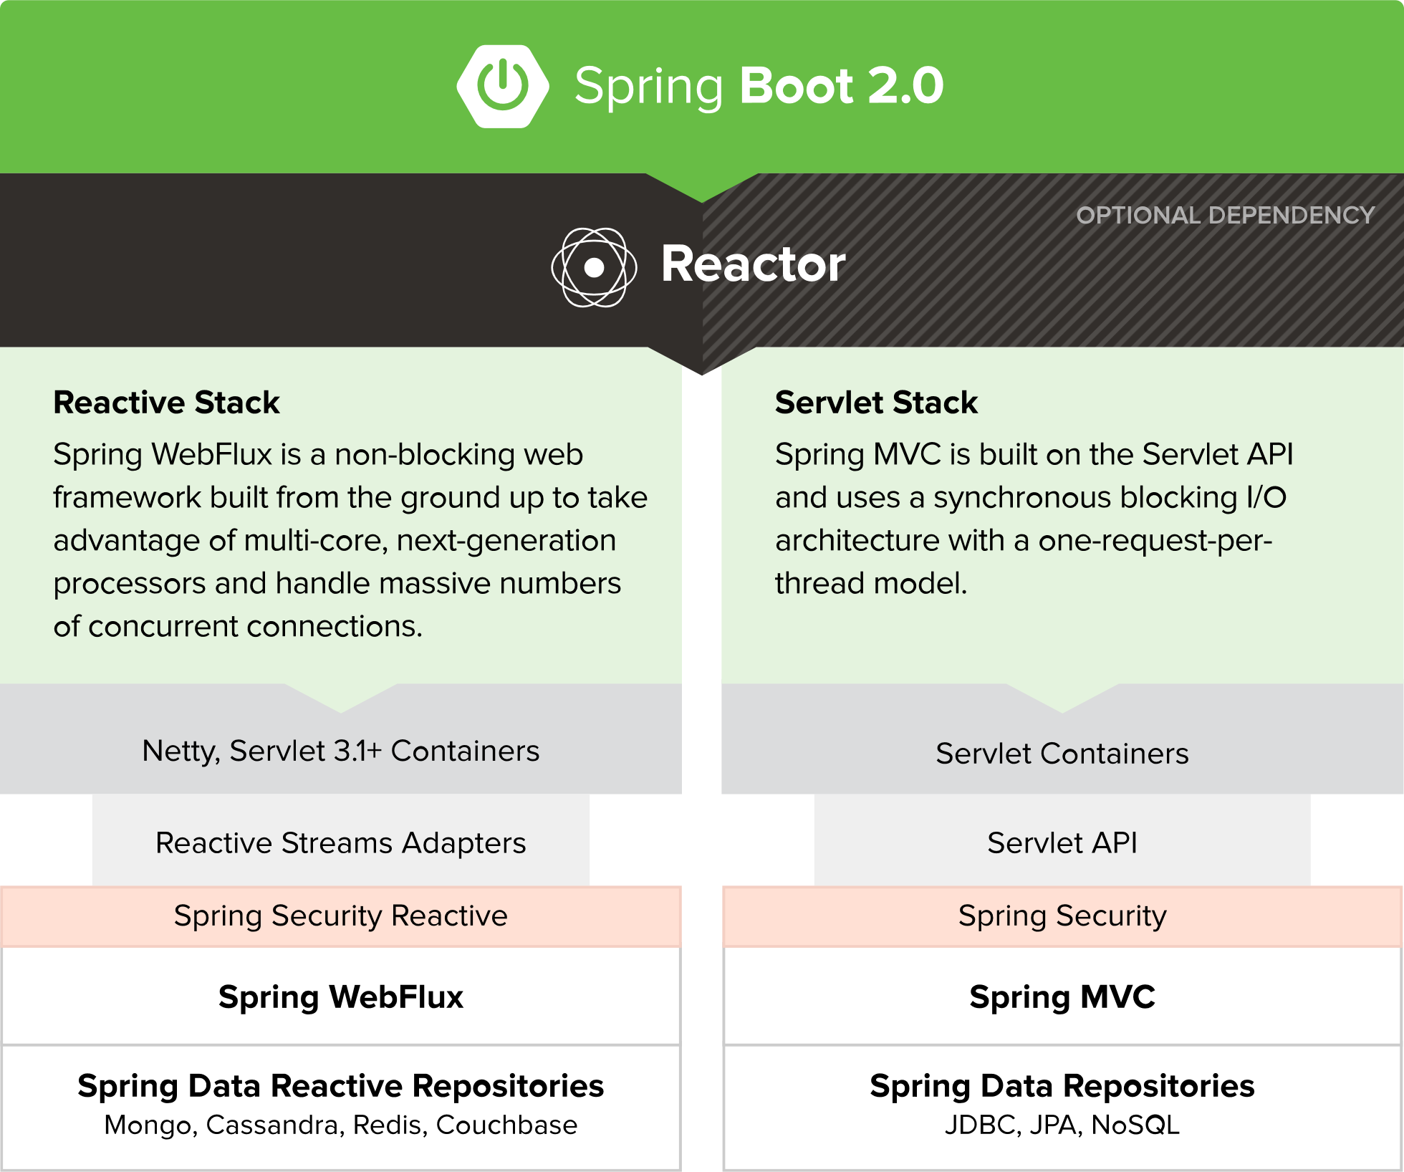
Spring Reactive Web

Slide 17
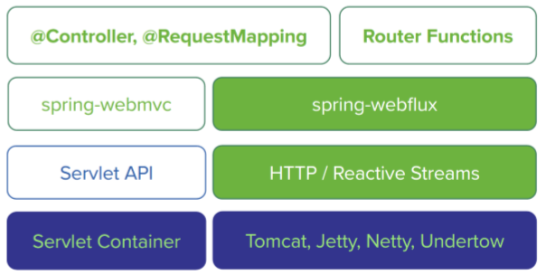
Spring Reactive Web – Server side stack
Web MVC
Reactive Web

Slide 18
Spring Reactive Web - Classes
Mono<T>
Provides one or no single Object of class T to the subscriber.
Flux<T>
Provides 0 to infinity Objects of class T to the subscriber.
Subscriber (no class)
Any class that uses the subscribe() function of any Mono or Flux Implementation.

Slide 19
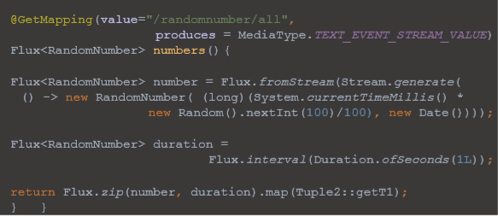
Spring Reactive Web –Code sample
Publisher (REST Controller)

Slide 20
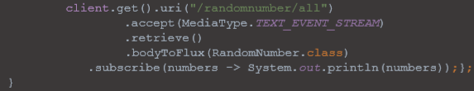
Spring Reactive Web –Code sample
Subscriber (Client)

Slide 21
Coding session
Get My Grades

Slide 22
Coding Session
Idea: Get My Grades – as we are students, we want to retrieve our grades from a repository. Since we do not know, which profs did finish their grading yet, we do not know how many grades are available.
Repository: Reactive MongoDB
UI: Simple text stream, since our time is limited.
Tools: IntelliJ / Eclipse, MongoDB, Spring starter (http://start.spring.io), Lombok (Compile Time Annotation Processor)

Slide 23
Thank you for your attention!
Do you have any questions?
Would you like to share your opinion on Spring Reactive Web with us?

Slide 24
For further reading /watching
http://spring.io
https://www.youtube.com/watch?v=zVNIZXf4BG8&t=711s
https://www.youtube.com/watch?v=l7VBdWhtl7A
https://www.youtube.com/watch?v=GbVpKF7tVeI
https://www.youtube.com/watch?v=fiR7MWoTYjs&t=219s (Fully reactive Application with React and Spring Reactive Web)
https://www.youtube.com/watch?v=27Lg96EwPEg

