Slide 1

Internet of Things
with Arduino

Slide 2
Very Basic Circuit Primer
circuits
  involves a power source with negative and positive poles
  electricity flows through and performs work
types of electricity:
  alternating current (AC)
    wall outlets
    better at transmitting power over long distances
    Tesla
direct current (DC)
    electronics
    Edison

Slide 3
Very Basic Electronics Primer
Voltage (volt) – potential difference between two poles of a power source
Ampere (amp) – measurement of the number of electrons flowing through a circuit
Wattage (watt) – measure of how much power is consumed, calculated by multiplying volts and amps
Resistance (ohms) – slows down electricity

Slide 4
Analog and Digital
analog
  works with the full range of available voltage
digital – on or off
  what exactly is on or off?
  voltage
  circuits not exact
  some point divides on and off, about 3V for 5V Arduino boards

Slide 5
DC Components
all circuits consist of discrete components
Light Emitting Diodes (LEDs)
Resistors
Transistors
Capacitors
Potentiometers
Buttons
Motors

Slide 6
Arduino Boards
microcontroller/single board computer vs microprocessor
not system on a chip (SoC)
open source hardware
  plans available online
  anyone can build
very basic, low level
can do analog and digital I/O
extensible through shields
many different models both 5 volt and 3.3 volt
Arduino Boards

Slide 7
Arduino History
started in 2005 at Interaction Design Institute Ivrea in Ivrea, Italy
began in response to students only having BASIC stamp microcontrollers
  expensive, around $100
  program in BASIC
designed to be simple and inexpensive

Slide 8
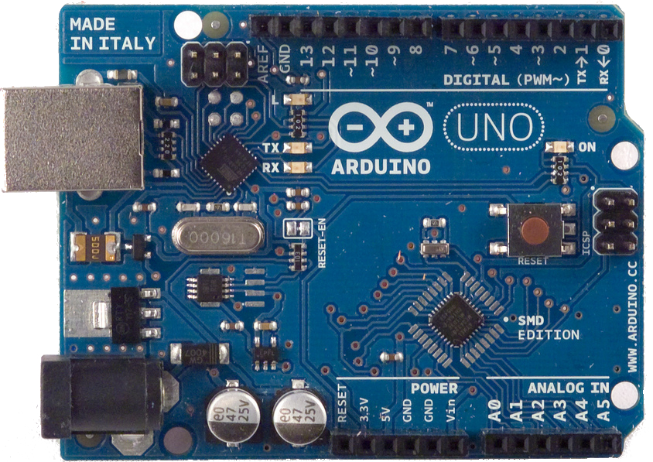
Arduino Uno
(Reference Implementation)

Slide 9
Input/Output
Digital Input – high or low
  high is reading of >= 3 volts (on 5 volt boards)
Digital Output – high or low
  depends on board voltage
Analog Input
  0 to 1024
  max 10,000 reads per second
Analog Output
  0 to 255
  via Pulse Width Modulation (PWM)

Slide 10
Arduino Models
Name | Volts | CPU (Mhz) | Program Space (KB) | SRAM (KB) | EE PROM (KB) | Ethernet | Analog In Ports | Digital Ports (IO/PWM)
Uno | 5 | 16 | 32 | 2 | 1 | shield | 6 | 14/6
Ethernet | 5 | 16 | 32 | 2 | 1 | on board | 6 | 14/6
Mega | 5 | 16 | 256 | 8 | 4 | on board | 16 | 54/15
Due | 3.3 | 84 | 512 | 96 | 0 | shield | 12 | 54/12
LilyPad USB | 3.3 | 8 | 32 | 2.5 | 1 | n/a | 4 | 9/4
Intel Galileo | 5 | 400 | 8MB | 256MB | 11 | on board | 6 | 14/6

Slide 11
Getting Started
Electronics Books (library)
Arduino Starter Kits
  sparkfun
  amazon.com
digital multimeter
  autoranging if in the budget
solderless breadboard
  often comes with started kit
  will want bigger

Slide 12
Other Single Board Computers
Raspberry Pi
  designed as an inexpensive Linux computer
  not great for hardware hacking
  $40, 512MB RAM, 700MHz
Beaglebone Black
  Linux/javascript
  $55, 512MB RAM, 1GHz ARM processor
Tessel
  javascript/WiFi built-in
  not intended for hardware hacking
  $100 (includes expansion module)
  32MB RAM, 180MHz ARM processor

