Slide 1
dtbus SYSTEM
姬明江 2017/10/30

Slide 2
Dtbus 系统组件
Binary log & Alibaba Canal
Apache Flume
Akka Http & Akka Actor
Apache Kafka
HDFS & HBase
Spark Stream
有象视频实时推荐系统
需要改进的地方
Q & a

Slide 3
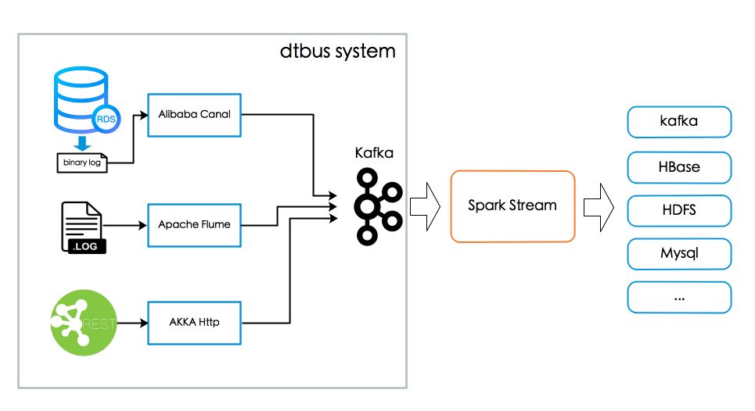

Slide 4
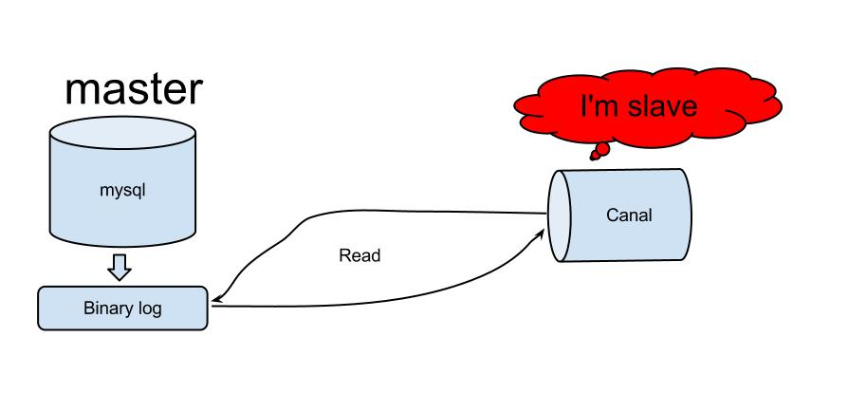
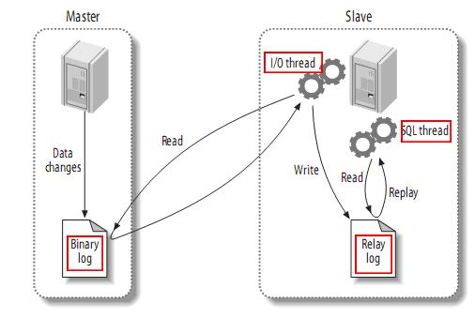
Binlog & Canal
用于查看数据库变更历史
主从数据库复制
canal模拟mysql slave的交互协议，伪装自己为mysql slave，向mysql master发送dump协议
mysql master收到dump请求，开始推送binary log给slave(也就是canal)
canal解析binary log对象(原始为byte流)

Slide 5
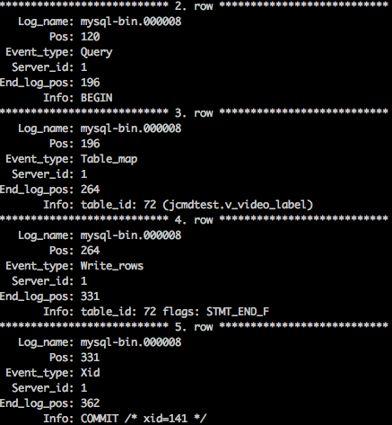
show binlog events in 'mysql-bin.000008'\G
Canal解析binlog格式，并构造JSON格式发送
{ "sourceType":"MYSQL", "port":"3306", "dbName":"daxiang-general", "ip":"10.0.31.180", "afterRow":{ "id":"1", "video_base_id":"v2170228015154176", "name":"会计刺客15" }, "eventType":"UPDATE", "isDdl":"false", "tableName":"v_video_base", "executeTime":"1509343116000", "beforeRow":{ "id":"1", "video_base_id":"v2170228015154176", "name":"会计刺客14" } }

Slide 6
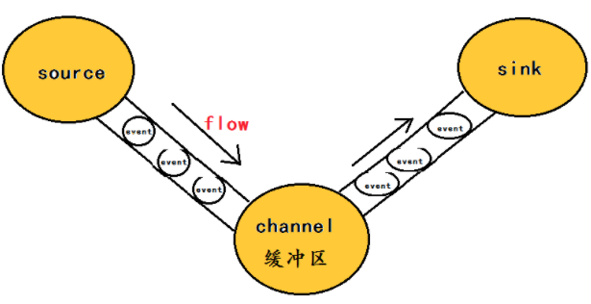
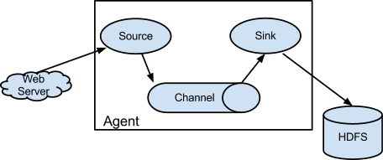
Apache Flume
# 配置一个agent，名称为a1，Source、Channel、Sink分别只有1个
a1.sources = r1
a1.sinks = k1
a1.channels = c1
# 配置Source，类型为netcat，监听本机的44444端口
a1.sources.r1.type = netcat
a1.sources.r1.bind = localhost
a1.sources.r1.port = 44444
# sink1 配置
a3.sinks.kafka1.type = org.apache.flume.sink.kafka.KafkaSink
a3.sinks.kafka1.brokerList=localhost:9092
a3.sinks.kafka1.topic=flumetest
a3.sinks.kafka1.serializer.class=kafka.serializer.StringEncoder
#a3.sinks.kafka1.requiredAcks=1
a3.sinks.kafka1.batchSize = 20
# 配置Channel，类型为memory
a1.channels.c1.type = memory
a1.channels.c1.capacity = 1000
a1.channels.c1.transactionCapacity = 100
# 绑定Source、Sink和Channel的对应关系
a1.sources.r1.channels = c1
a1.sinks.k1.channel = c1
Source
kafka, taildir, spooling directory …
Channel
Memory , kafka, file …
Sink
HDFS, Logger, kafka, Elastic search…

Slide 7
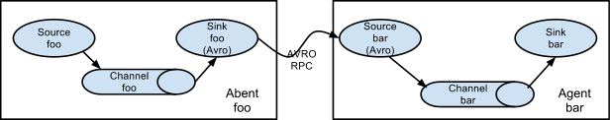
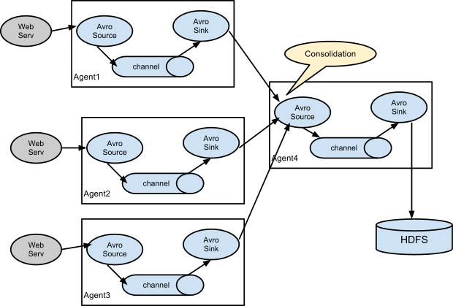
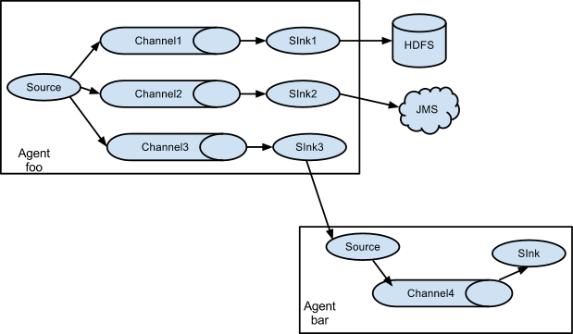

Slide 8
Akka Http
轻量级的库
多种层次的api, High Level, Low Level.
与actor模型交互
Route DSL
val route: Route = path("hello") { get { complete(Httpentity(Contenttypes.`text/html(utf-8)`, "<h1>say hello</h1>")) } } ~ path("data") { post {
entity(as[kafkamessage]) { msg => complete(msg.topic)
} } ~ get { complete(map("test" -> "112")) } }
Val bindingfuture = Http().bindAndHandle(route, "0.0.0.0", 8081)

Slide 9
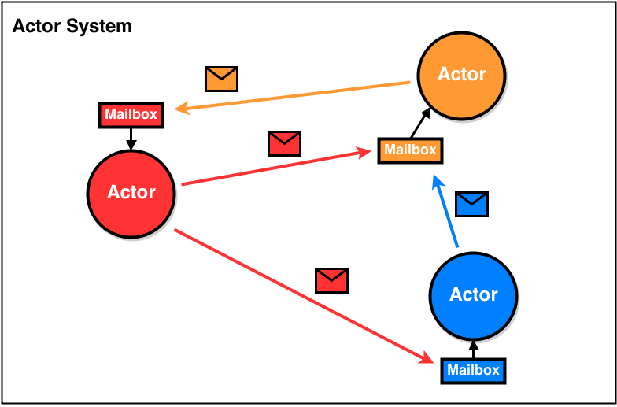
Akka Actor
并发模型
比Thread 更轻量级
异步消息发送
横向扩展
容错策略

Slide 10
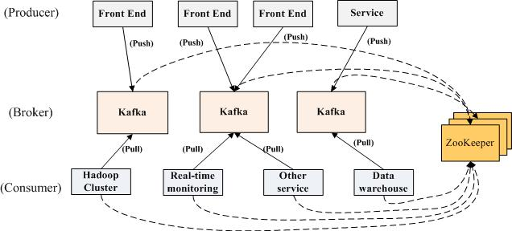
Kafka
解耦合
缓冲
顺序保证
组件隔离
数据恢复
扩展性
异步通信

Slide 11
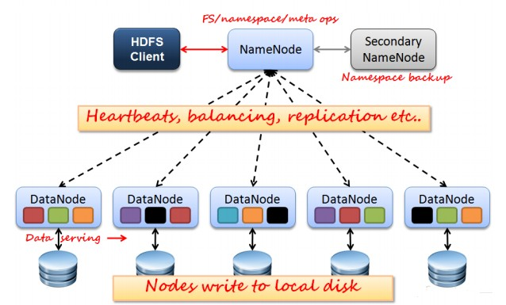
hdfs
NameNode
fsimage
edits
Secondary NameNode
DataNode

Slide 12
HBase
无固定Schema，无类型
分布式、面向列的数据库
数据量大（亿级）
Hbase 自动切分数据，使得数据存储自动具有水平扩展
列的可以动态增加，并且列为空就不存储数据，节省存储空间
与 Hadoop Mapreduce 相结合有利于数据分析
不支持事务
不支持条件查询
不支持关联操作

Slide 13
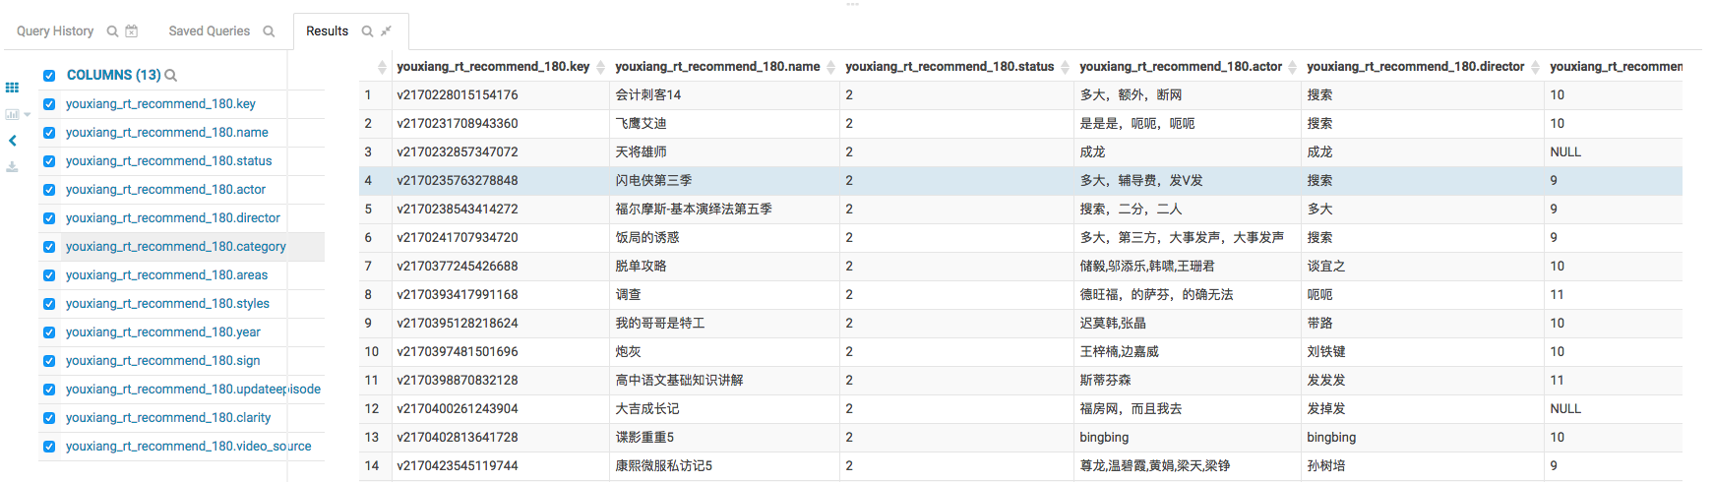
"v_video_base" -> List("video_base_id", "name", "status”) "v_video_label" -> List("video_base_id", "label_id”) "v_video_append" -> List("video_base_id", "actor", "director”) "v_video_ext" -> List("video_base_id", "property", "value”) "v_video_source" -> List("video_base_id", "video_source")

Slide 14
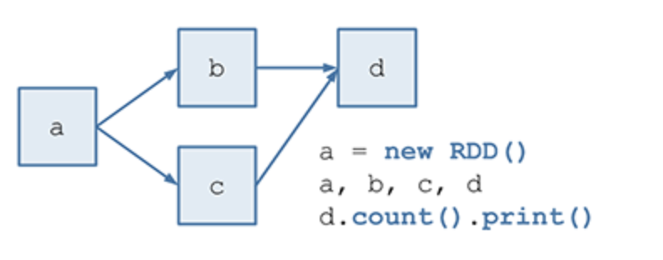
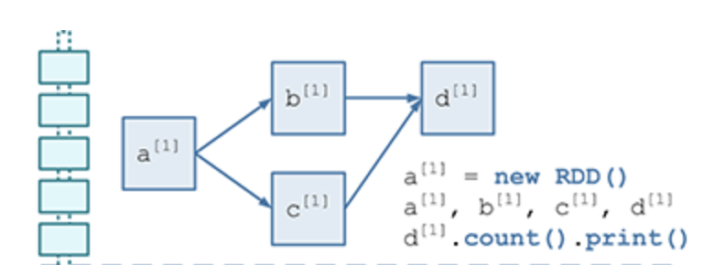
Spark Stream
RDD & Partition
DAG
DStream & DStreamGraph
val lines = ssc.socketTextStream("localhost", 9999) val words = lines.flatMap(_.split(" ")) val pairs = words.map(word => (word, 1)) val wordCounts = pairs.reduceByKey(_ + _) wordCounts.print()
ssc.start()

Slide 15
canal {
# 应用名称 appname: “youxiang_real_recommend_180” # broker 集群地址 brokers: “dx01-bigdata-test:9092,dx03-bigdata-test:9092,dx04-bigdata-test:9092” consumergroup: “youxiang_real_recommend_180” topics: “10.0.31.180_3306_daxiang-general_v_video_source,10.0.31.180_3306_daxiang-general_v_video_ext,10.0.31.180_3306_daxiang-general_v_video_label,10.0.31.180_3306_daxiang-general_v_video_append,10.0.31.180_3306_daxiang-general_v_video_base” numthreads: 2 second: 30 frombeginning: false print: true checkpoint: “checkpoint”
# 保存到hdfs
hdfspath: "hdfs://172.18.6.4:8020/user/test/spark/"
# 保存到hbase hbaseconf { zooquorum: “dx01-bigdata-test:2181,dx03-bigdata-test:2181,dx04-bigdata-test:2181” table: “youxiang_rt_recommend_180” columnfamily: “result” }
# 失败处理 exceptionhandler { kafka { bootstrapservers: "dx01-bigdata-test:9092,dx03-bigdata-test:9092,dx04-bigdata-test:9092" topic: "spark-error” } } }

Slide 16

有象视频实时推荐系统
基于物品基本属性的推荐算法
实时推荐延迟 （Dtbus + Kafka Batch Submit + Spark Stream Window + Compute）
$\frac{a∗标记得分+b∗类型分+c∗导演分+d∗主演分+e∗地区分+f∗年代分}{\sqrt{a^{2}+b^{2}+c^{2}+d^{2}+e^{2}+f^{2}}}$
序号 | 视频维度 | 电视剧 | 电影 | 综艺 | 娱乐 | 音乐 | 资讯 | 少儿 | 新城镇
a | 标记 | 2 | 2 | 3 | 2 | 2 | 3 | 3 | 3
b | 类型 | 4 | 4 | 4 | 4 | 3 | 4 | 4 | 4
c | 导演 | 1 | 1 | — | — | 1 | — | — | —
d | 主演 | 2 | 2 | 1 | 2 | 2 | — | 1 | —
e | 地区 | 1 | 1 | 1 | 1 | 1 | 1 | 1 | 1
f | 年代 | — | — | 1 | 1 | 1 | 2 | 1 | 2

Slide 17
What’s next…
Kafka Broker 权限管理
Kafka 集群、Topic 管理
Dtbus 系统升级维护
实时推荐算法升级
离线数据分析
…

Slide 18

Q & a

