Slide 1
Securing Web Services
Global Summit 2013
Jason Mimick

Slide 2
Goal
High-level review of web-service security standards supported in Caché today
Live demo setting up Username/Password security over SSL for a web-service

Slide 3
Expectations
Not deep dive into details of each standard
Lots of existing documentation in docbook
Many resources available – see me
End-to-end “eyes-on” demo of a very common scenario

Slide 4
Standards Supported
SOAP 1.1 & 1.2
Core messaging protocol
Defines XML “envelopes” for your service requests and responses

Slide 5
Standards Supported
WS-Security
Standards for supporting security mechanisms for web services
Encryption/Decryption of messages
Token support for
Username - authentication
Timestamps - prevent replay attacks
Binary blobs - references to signatures and encrypted keys

Slide 6
WS-Security Overview
XML Document
<SOAP Message>
<Header>
WS-Security Header Element
Timestamp (Can be signed)
Username Token
Other Optional Header Elements…
<Body>
SOAP Message Body can be optionally Encrypted/Decrypted…

Slide 7
Standards Supported
WS-Policy
Additional standard for defining the security behavior of your services
Simpler that using direct APIs
Declarative XML format which describes the WS-Security configuration
Supported with Studio Web Service/Client Configuration Wizard
Think “cross-cut” from aspect oriented programming (or don’t)

Slide 8
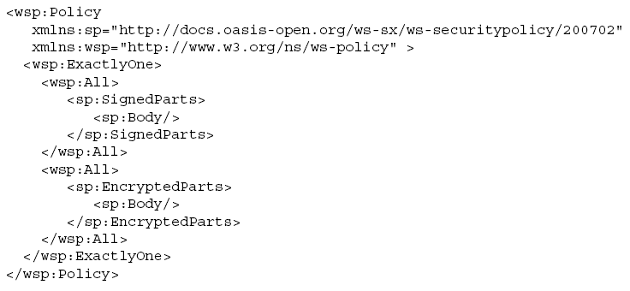
Web Services Policy Example
BAD Bunch of XML
GOOD Caché can generate it for you!

Slide 9
Demo - Scenario
You have an existing web-service but now are asked to implement additional security for this service since your application is getting migrated to the cloud.
It has been determined that you will require all access to the service to happen over SSL and that Username and Timestamp tokens will be required.

Slide 10
Demo – Step 0
SSL is already setup for Apache and my Caché instances
But will walk through the configuration
Notes:
Login to phase-dance
/etc/apache2/httpd.conf has csp setup
Ssl setup is in
/etc/apache2/sites-available/default-ssl
ubuntu@domU-12-31-39-0F-BA-7D:~$ grep myCA /etc/apache2/sites-available/default-ssl
SSLCertificateFile /home/ubuntu/myCA/server_crt.pem
SSLCertificateKeyFile /home/ubuntu/myCA/server_key.pem
ubuntu@domU-12-31-39-0F-BA-7D:~$ ls /etc/apache2/sites-enabled/
000-default default-ssl
ubuntu@domU-12-31-39-0F-BA-7D:~$ ls-l /etc/apache2/sites-enabled/
ls-l: command not found
ubuntu@domU-12-31-39-0F-BA-7D:~$ ls -l /etc/apache2/sites-enabled/
total 0
lrwxrwxrwx 1 root root 26 Mar 12 17:01 000-default -> ../sites-available/default
lrwxrwxrwx 1 root root 30 Mar 12 17:06 default-ssl -> ../sites-available/default-ssl
ubuntu@domU-12-31-39-0F-BA-7D:~$

Slide 11
Demo - Flow
Create simple web-service without any security and test
Generate client from WSDL, test
Show SSL config
Show Apache cert reference and how it maps the CSP folder
Show server Caché cert config
Show client Caché cert config
Pull up existing non-secure service through Apache SSL port, show it works
Notes:
Create process stat service
Test it
Download wsdl
Open session on RED, open %ZEN.Template….
Generate client

Slide 12
Demo – Flow 2
Create secure version of service
Create secure version of client
Write simple client test method, adding security properties
Test with terminal - show good user/pass succeed and also bad user/pass fail - demonstrate error handling

Slide 13

Thanks!
Thanks for your time – enjoy the Summit
See me if you would like a copy of the sample code

