Slide 1
Task Management Process Improvement

Slide 2
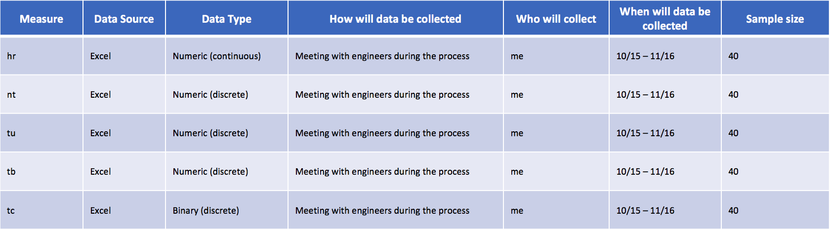
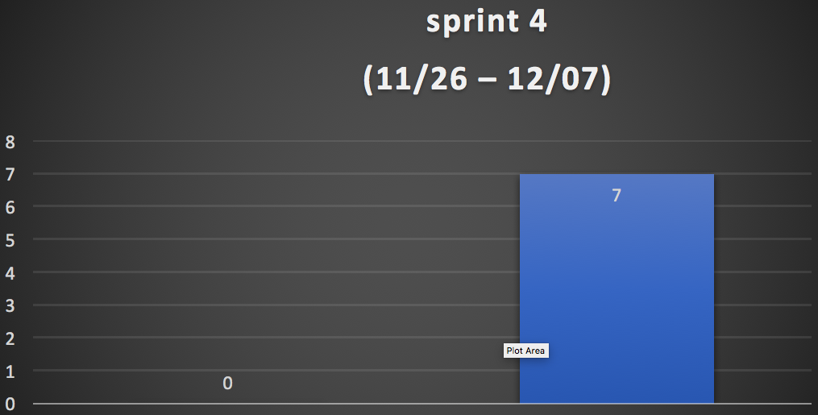
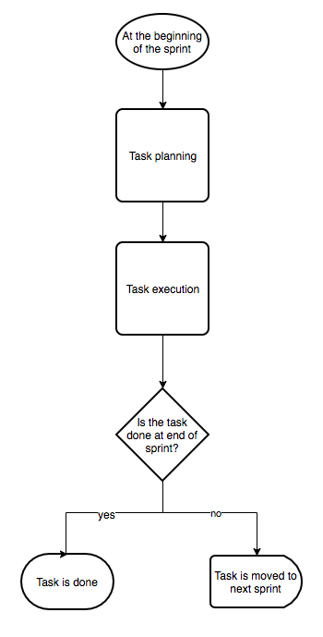
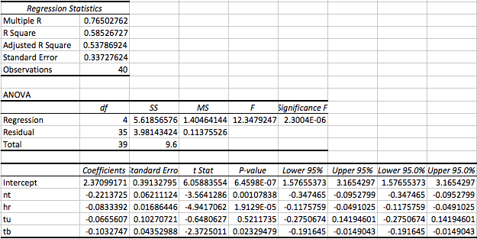
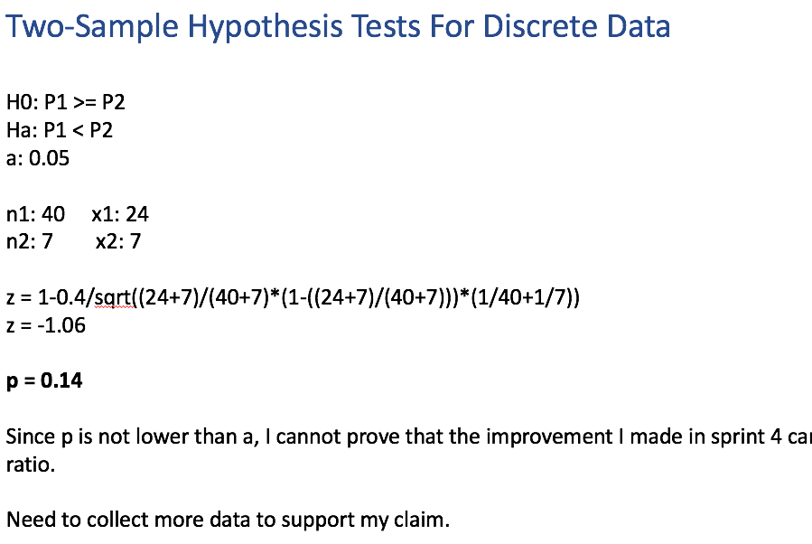
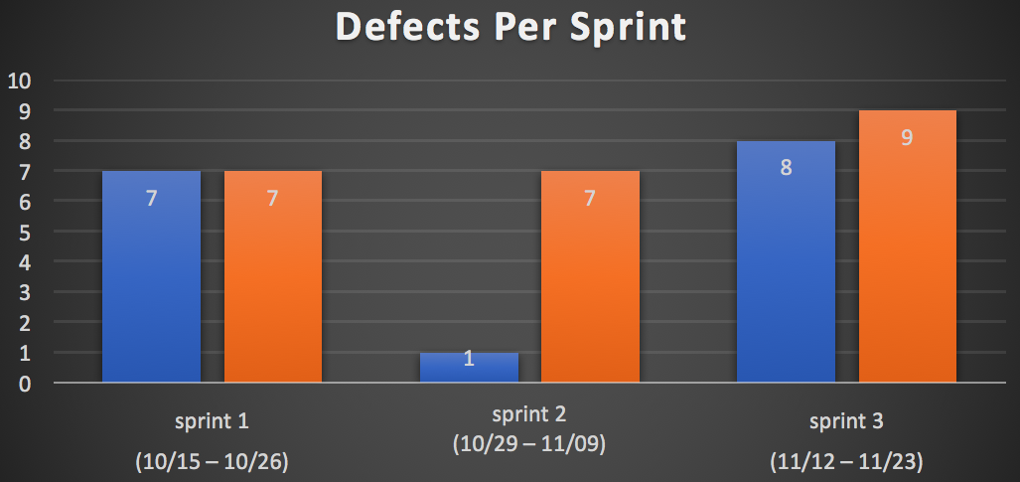
Story Board
October 10
January 15
Define
10/07
Measure
10/15 – 11/30
Analyze
11/17
Improve
11/18
Control
12/01
DEFINE
MEASURE
ANALYZE
IMPROVE
Identify what kind of data to collect
Use linear regression to identify key factors that are affecting output
Make adjustments to key factors and then collect data again
Problem:
The current task management process is not getting things done and I don’t know why
Identify key factors that have significant affect on output
10/15–11/16:
Collect data from 3 sprints
11/19 – 11/30:
Collect data from 1 sprints
CONTROL
SQL = ~1.75

Slide 3
Problem Definition
Problem Statement
I work as a project manager for a very a small software development startup, where we have 3 engineers work part-time remotely. I had proposed a task management process to allow the team to work on their own. The process spans a sprint (2 weeks) and repeat itself after each sprint. Couple months into this process, I have found that this process has not yield high productivity. I am exploring ways to improve this task management process.
Business Impact
This process need to be modified because we need to improve our productivity and to meet client’s deadline.
Goal
My goal is to identify key metrics that have an effect on process efficiency, and to made adjustment on those metrics.
Project Scope
The main product from the task management process is the completion of the task. My focus is on the metrics related to the task.

Slide 4
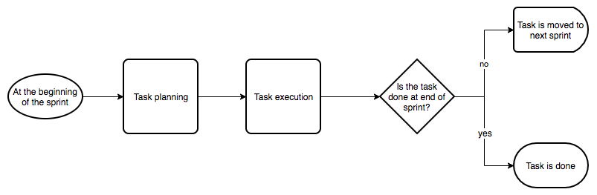
Process Map
Process overview
Engineers and myself are the main actors in this sub-process
Output of the process is task
Myself is the main actor in this sub-process
Remember:
1 sprint equals
2 weeks

Slide 5
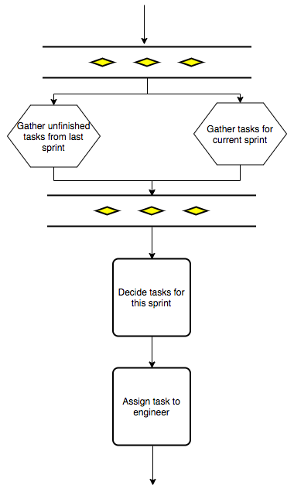
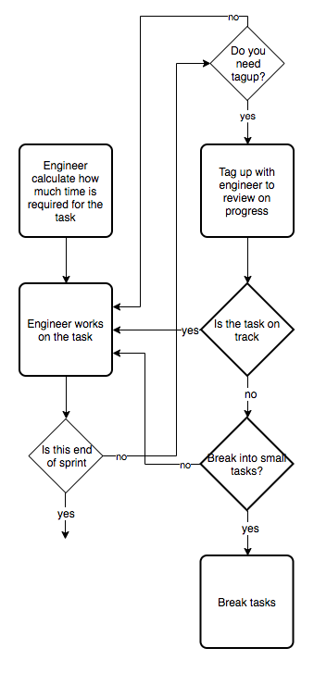
Process Map
Task planning
Task Execution
Preparing task
Working on task

Slide 6
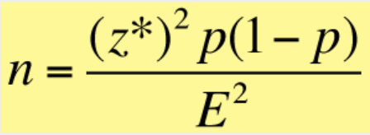
Sample Size
Sample Collection Plan
Since the main product is task, data related to the task itself will be collected. I will collect those data myself through my interaction with engineers in the sprint. The data will be recorded in an excel file.
The following data are identified for collection:
estimated hours for the task
number of tasks assigned to the engineer at the same sprint
number of tagup session I have with the engineer
number of time the task is broken down into smaller tasks
finally, whether the task is complete
Sample Size Desired
Assume:
95% confidence
Margin of error = 0.1 or 10%
Proportion = 0.50
n = (1.96^2)(0.50)(0.50)/0.1^2
n = 961
The desired sample size is 961 if I want to have 95% confidence interval with 0.1 margin of error. Given the length of this course, the actual sample size that I can collect will be much smaller.

Slide 7
Sample Collection Plan
Both Continuous and discrete data was collected from 10/18/18 – 11/16/18 (6 weeks or 3 sprints)
Measure | Data Source | Data Type | How will data be collected | Who will collect | When will data be collected | Sample size
hr | Excel | Numeric (continuous) | Meeting with engineers during the process | me | 10/15 – 11/16 | 40
nt | Excel | Numeric (discrete) | Meeting with engineers during the process | me | 10/15 – 11/16 | 40
tu | Excel | Numeric (discrete) | Meeting with engineers during the process | me | 10/15 – 11/16 | 40
tb | Excel | Numeric (discrete) | Meeting with engineers during the process | me | 10/15 – 11/16 | 40
tc | Excel | Binary (discrete) | Meeting with engineers during the process | me | 10/15 – 11/16 | 40
Reference
hr – estimated hours on the task
nt – number of task the engineer is assigned for that sprint
tu – number of tagups with the engineer for that sprint
tb – number of time the task is being broken into smaller tasks
tc – whether the task is completed at the end of sprint

Slide 8
Sample Collection Summary
Summary of the data collected
 | hr | nt | tu | tb | tc
mean | 7.1 | 4.9 | 0.8 | 0.4 | 0.6
median | 8 | 5 | 1 | 0 | 1
mode | 4 | 6 | 0 | 0 | 1
range | 12 | 4 | 2 | 8 | 1
sd | 3.33 | 1.28 | 0.79 | 1.30 | 0.50
variance | 11.07 | 1.63 | 0.63 | 1.68 | 0.25
Reference
hr – estimated hours on the task
nt – number of task the engineer is assigned for that sprint
tu – number of tagups with the engineer for that sprint
tb – number of time the task is being broken into smaller tasks
tc – whether the task is completed at the end of sprint

Slide 9
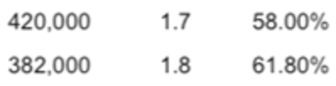
SQL Calculation
Defect Definition
A defect is defined as a task does not get finished at end of sprint. That is, a task will only have 1 defect opportunity.
SQL Calculation
Defect opportunities = 1
Total units = 40
DU = 40
Actual defects = 16
A/DU = 0.4
Defects per million outputs: ~400,000
Base on SQL table:
SQL = ~1.75

Slide 10
Sample Analysis Using Regression
Linear Regression Summary
Interpretation
R is 0.77. It is a good indicator that there is correlation among the data collected. Of all the data, hr has the lowest P-value, and nt has the second lowest. It indicate that they are more significant than the other.
In the future, I will only collect and modify nt and hr.
Reference
hr – estimated hours on the task
nt – number of task the engineer is assigned for that sprint
tu – number of tagups with the engineer for that sprint
tb – number of time the task is being broken into smaller tasks
tc – whether the task is completed at the end of sprint

Slide 11
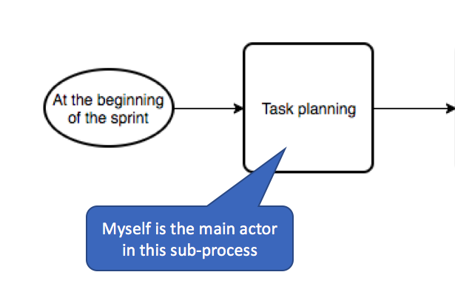
Improvement
Improvement Plan
From the result of regression test, it is clear that lowering number of tasks per engineer and the hours on each task will have yield better task completion rate. That is an easy fix for me since both attributes are controled at the task planning phase.
My plan is to purposely lower these 2 attributes in the next sprint (sprint 4), and to compare the data collected from sprint 4 to previous sprints.
Where to modify

Slide 12
Improvement Result
Sprint 4 Summary
The data came back from sprint 4 shows that all tasks were complete.
 | defects | success
sprint 4 (11/26 – 12/07) | 0 | 7

Slide 13
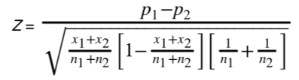
Improvement Result Analysis
Two-Sample Hypothesis Tests For Discrete Data
H0: P1 >= P2
Ha: P1 < P2
a: 0.05
n1: 40 x1: 24
n2: 7 x2: 7
z = 1-0.4/sqrt((24+7)/(40+7)*(1-((24+7)/(40+7)))*(1/40+1/7))
z = -1.06
p = 0.14
Since p is not lower than a, I cannot prove that the improvement I made in sprint 4 can indeed increase task completion ratio.
Need to collect more data to support my claim.

Slide 14

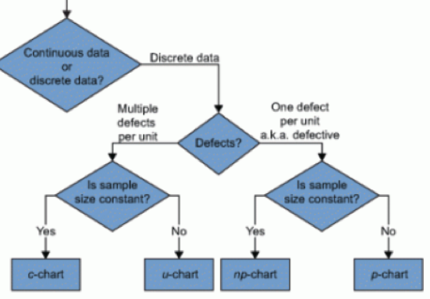
Control
P-Chart
I only have to worry about LCL. That is when task completion ratio drops lower than usual.

Slide 15
Conclusion
Accomplishment from this project
Two key factors that can improve task complection ratio were identified through analysis
Through modifying these two factors, better results were observed
More data need to be collected to prove that the solution is indeed effective
A control step is also implemented to make sure the process is healthy

