Slide 1
IST 707
Team 3 :
Jason Kang – Team Lead
Aaron Talley – Primary R Coder
Michael Esparza – Artifact Support and RESEARCH

Slide 2
Project Presentation Agenda
Introduction
5 Key Analyses
Conclusions

Slide 3
Introduction
References: “ABOUT THE PROJECT AND FINAL PRESENTATION”
Dr. Ami M. Gates
Data Set: The Raw Data Frame was downloaded from the NOAA Data Base
https://d396qusza40orc.cloudfront.net/repdata%2Fdata%2FStormData.csv.bz2
Area of Research: Severe Weather Events Types
Goals: Provide leadership at the various levels of government and private industry with specific data on the most severe weather events for leadership to develop Risk Management Frameworks(RMF), Mitigation Plans , and Pre-Planned Responses (PPR) to reduce loss of life and economic impact of severe weather events
1. In the U.S. which severe weather event types are most harmful to population health?
2. In the U.S. which severe weather event types have the greatest economic consequences?

Slide 4

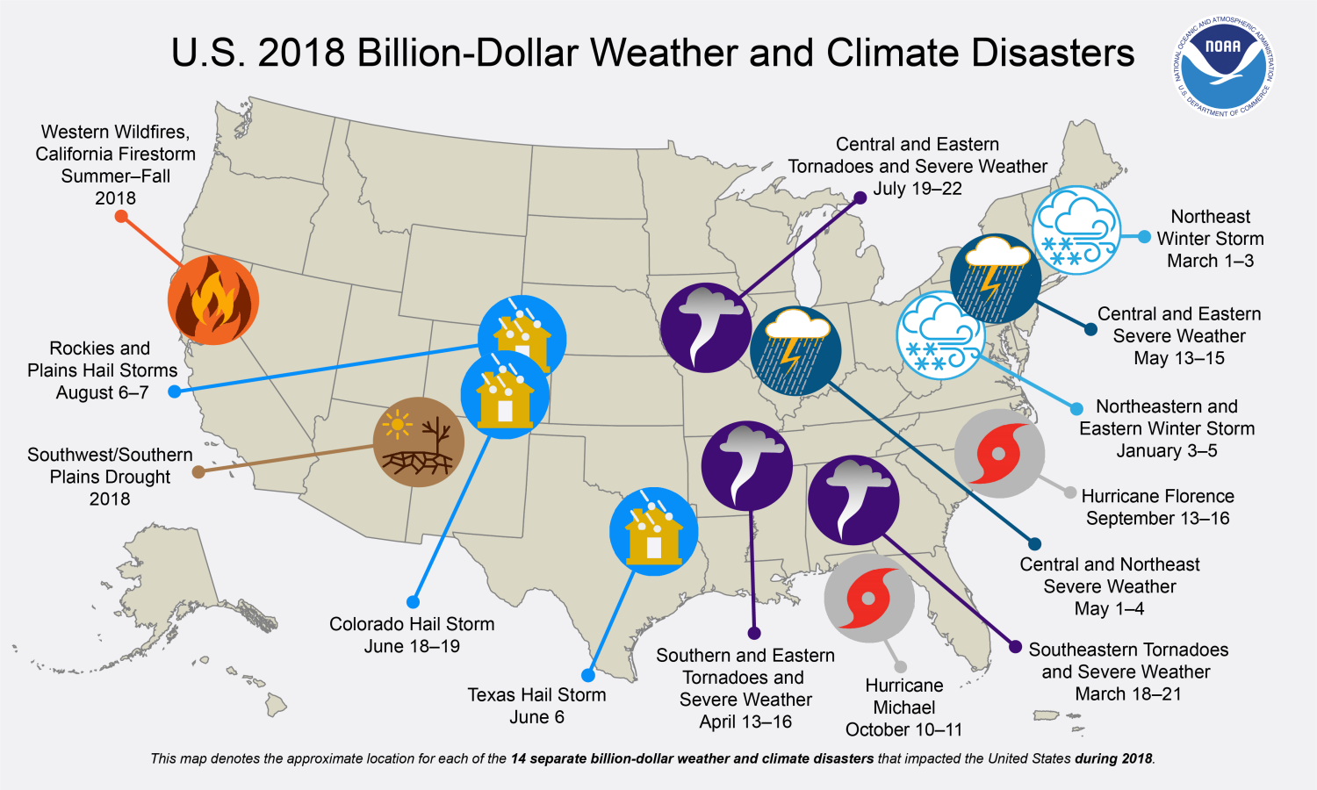



Overview

Slide 5

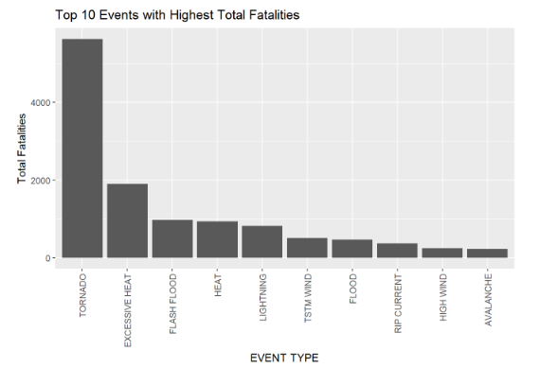
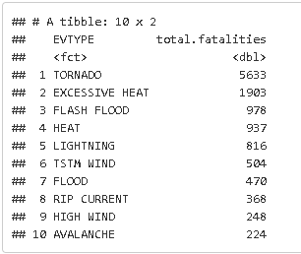
Analysis 1 - Most Fatalities

Slide 6
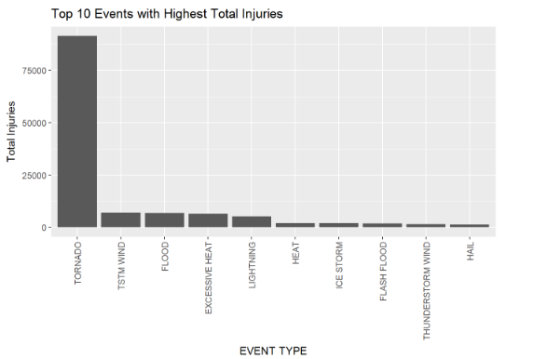
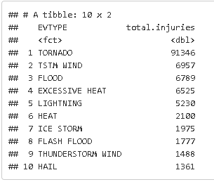
Analysis 2 – Total Injuries

Slide 7
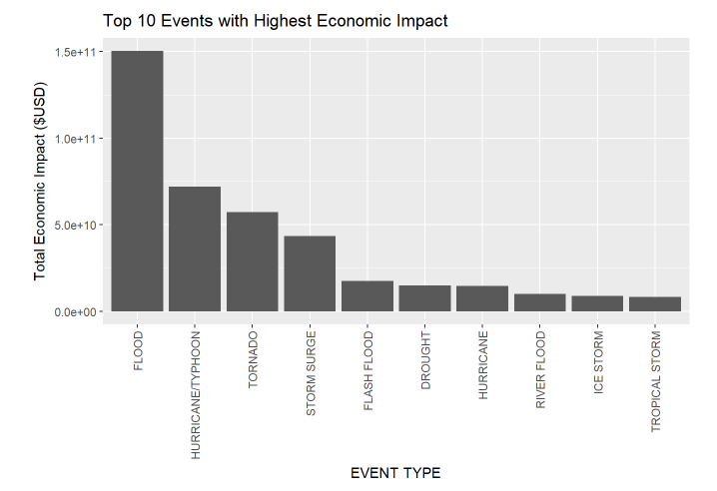
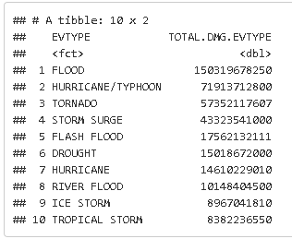
Analysis 3 – Highest Economic Impact

Slide 8
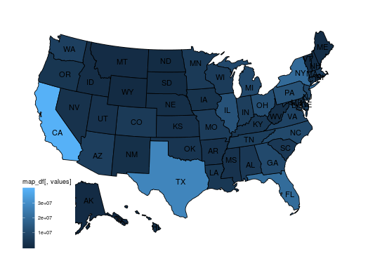
Analysis 4 – Counties with the Most Severe Weather Event Type - Tornados
County | State | Event Type
Washita | OK | Tornado
Comanche | TX | Tornado
Lehigh | PA | Tornado
Hughes | OK | Tornado
Nuckolls | NE | Tornado

Slide 9
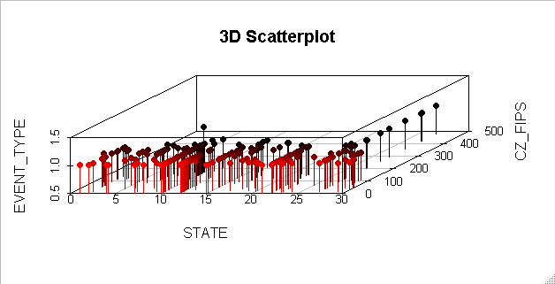
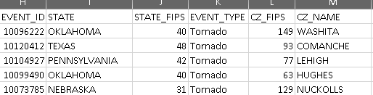
Analysis 5 – 3D Scatter Plot by State and County

Slide 10
Conclusions
Severe Weather Event Type (EVTYPE) Flood (Flooding) is the cause of the greatest economic (monetary) loss and thus the greatest impact on the U.S. Economy.
Severe Weather Event Type (EVTYPE) TORNADO causes the greatest Health Impact to the U.S. Population, in both Fatalities and Injuries.
“Tornado Alley” is a visible storm event corridor as displayed on the counties impacted by this specific event.
Tornados, NOT Hurricanes, account for the greatest number of fatalities in the U.S.

