Slide 1
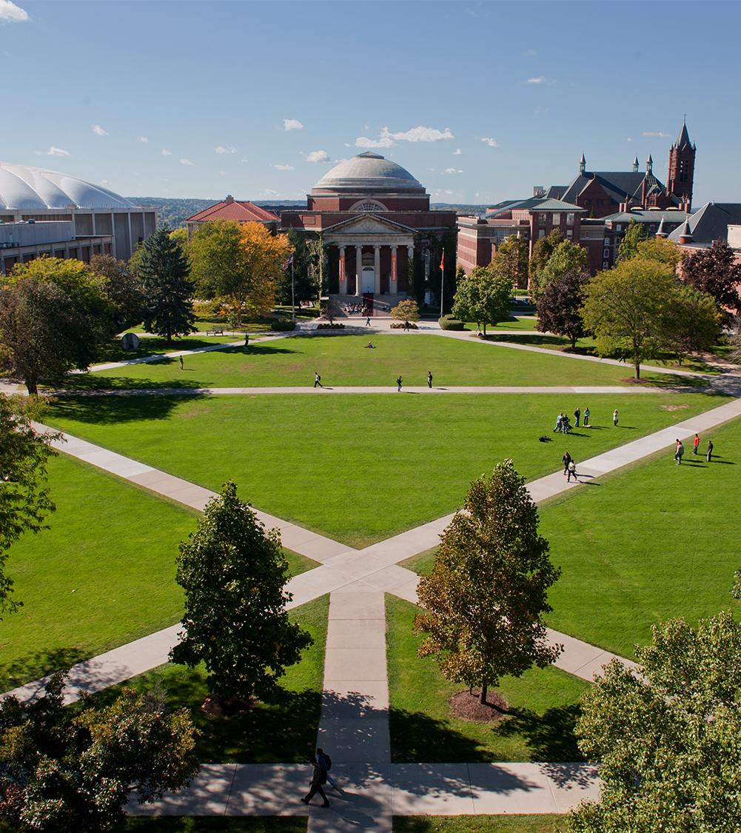
Portfolio Milestone
Jason Min-Liang Kang
SUID 894583556
Notes:
My name is Jason Kang
I am currently at the last semester of the master in applied data science program
This is a presentation of my portfolio milestone project

Slide 2
Agenda
About myself
My journey to data science
Data Science Process
Problem formulation
Acquisition
Exploration
Analytics and Modeling
Interpretation
Moving forward
Notes:
For the agenda of this presentation
I will first give a small introduction about myself
and my journey to data science
I will talk about the data science process in sequence and also the projects that i have done through out the program that best illustrate that particular process
Finally, I will talk about my plan moving forward from here

Slide 3

About myself
From Los Angeles California
Software Engineer at JPL
BS and MS in Computer Science
Started Applied Data Science 2018
Notes:
I am from Los Angeles California
In my family picture you can see my wonderful wife, my dog, and myself
I am a software engineer at JPL
I have been working over 10 years there
I came from computer science background
My bachelor and master are both from computer science
I started the applied data science program at syracuse university at 2018

Slide 4
Journey to Data Science
The term data science
was first coined in 2008
became an entry in Wikipedia in 2012
I became aware of the term around 2015
Notes:
my journey to data science is rather long and unusual
even though statistic and data have been studied for a very long time
the term data science was first coined in 2008 by engineers in linkedin and facebook
that is when they started to have data science as a job title
at the same time data become more abundantly available
hence the beginning of the big data movement
It became an entry in Wikipedia since 2012
and as for myself, I first became aware of the term around 2015

Slide 5
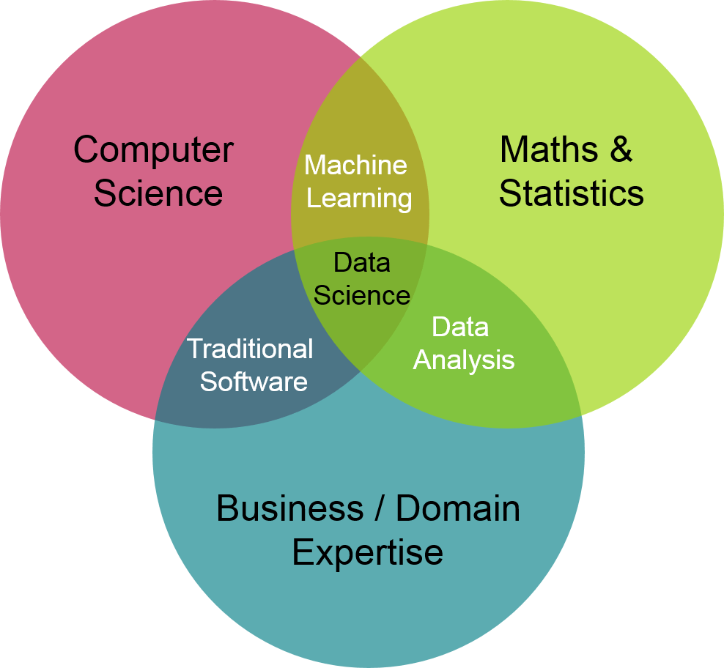
Journey to Data Science
Notes:
when people talk about data science they would immediately bring up this data science venn diagram
when I first looked at it, I thought, okay, I have computer science background and I’m already doing traditional software development
what I want to learn is machine learning
although I didn’t have any idea at that time, I kinda know that it is a new way to programe a computer to do stuffs
As oppose to writing all the instruction, machine learning use data to drive computers
I thought that was cool
so based on the diagram, it seems that I need to learn statistics in order to get to machine learning
so I enrolled in a couple of online statistic courses, while the courses were interesting, I felt very remote from machine learning by the end of the courses
Now I understand that this diagram means I only need a small subset of statistic in order to understand machine learning and data science.
Unfortunately, the diagram does not tell you which subset.

Slide 6

Journey to Data Science
2017
Notes:
2 years later, in 2017, I went to a data science conference local in LA
while I could sort of understand the technology jargons, I cannot really relate to them, and I didn’t get much knowledge out of it
that is when I decided to seriously engage in data science
so I started to apply for data science schools
and I started school at syracuse university at 2018

Slide 7
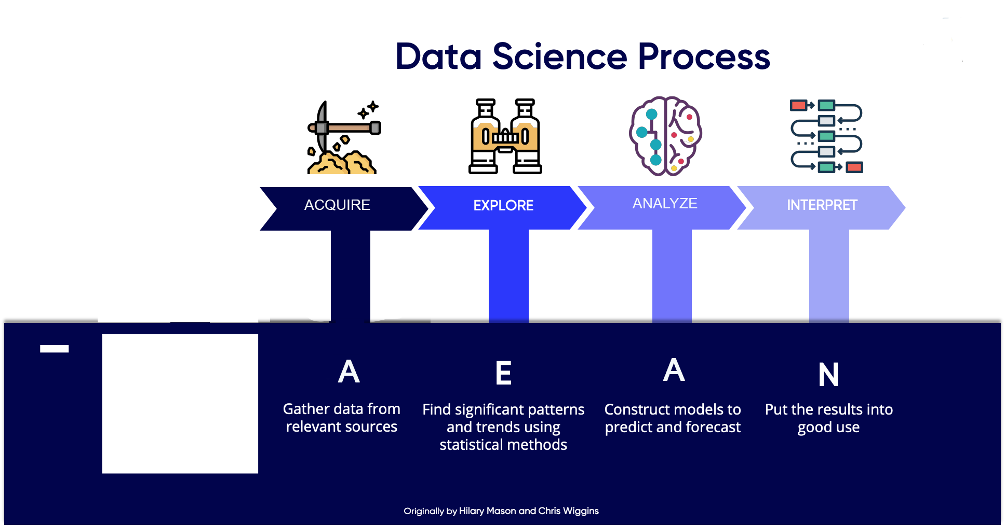
Data Science Process
Notes:
One takeaway from this program that really helps me to connect all the dots of data science is the data science process
The process consists of
data acquistion – gather data from relevent sources
data exploration – include data cleaning and finding significant patterns and trends using statistical methods
analytic -– construst model to predict and forecast
interpret – report results with evidence, put the results into good use
In the following, I will talk about each of these process, and also talk about which project that i have done in the program that best illustrate that process

Slide 8
Problem Formulation
Data Science process is problem solving process
Need well defined problem
Notes:
data science process is a problem solving process
before we enter the process, we need a well defined problem
Sometimes the problem is given and trivial. Other times, the problem may be buried deep in the business requirements and processes. When it comes to problem formulation, one course called IST 659 Data Admin Concepts really standout because it incorporates the formulation of real live problem.

Slide 9
CodeXchange
IST 659 Data Admin Concept
What
Under guidance of Professor Chad Harper
Web-based platform for software developers to ask for and to share solutions to coding errors
Tech
R
SQL Server
SQL Access
Draw.io
Notes:
IST 659 Data Admin Concepts was taught by Professor Chad Harper. It was the first course I took in the program. At the time I was studying this course, I was also working on a side project idea. As a software engineer, I noticed how often I encountered obscure coding errors (i.e. error messages outputted by compiler to signal possible errors in the codes) during my daily coding works. The idea was to create a web-based platform for frustrated software engineer, like myself, to ask for and to share solutions to coding errors. When Professor Harper suggested to develop a real-life idea in the final project, I decided to give my little side project idea a try.
The tech stack used for this project is R, SQL Server, SQL Access, and Draw.io

Slide 10
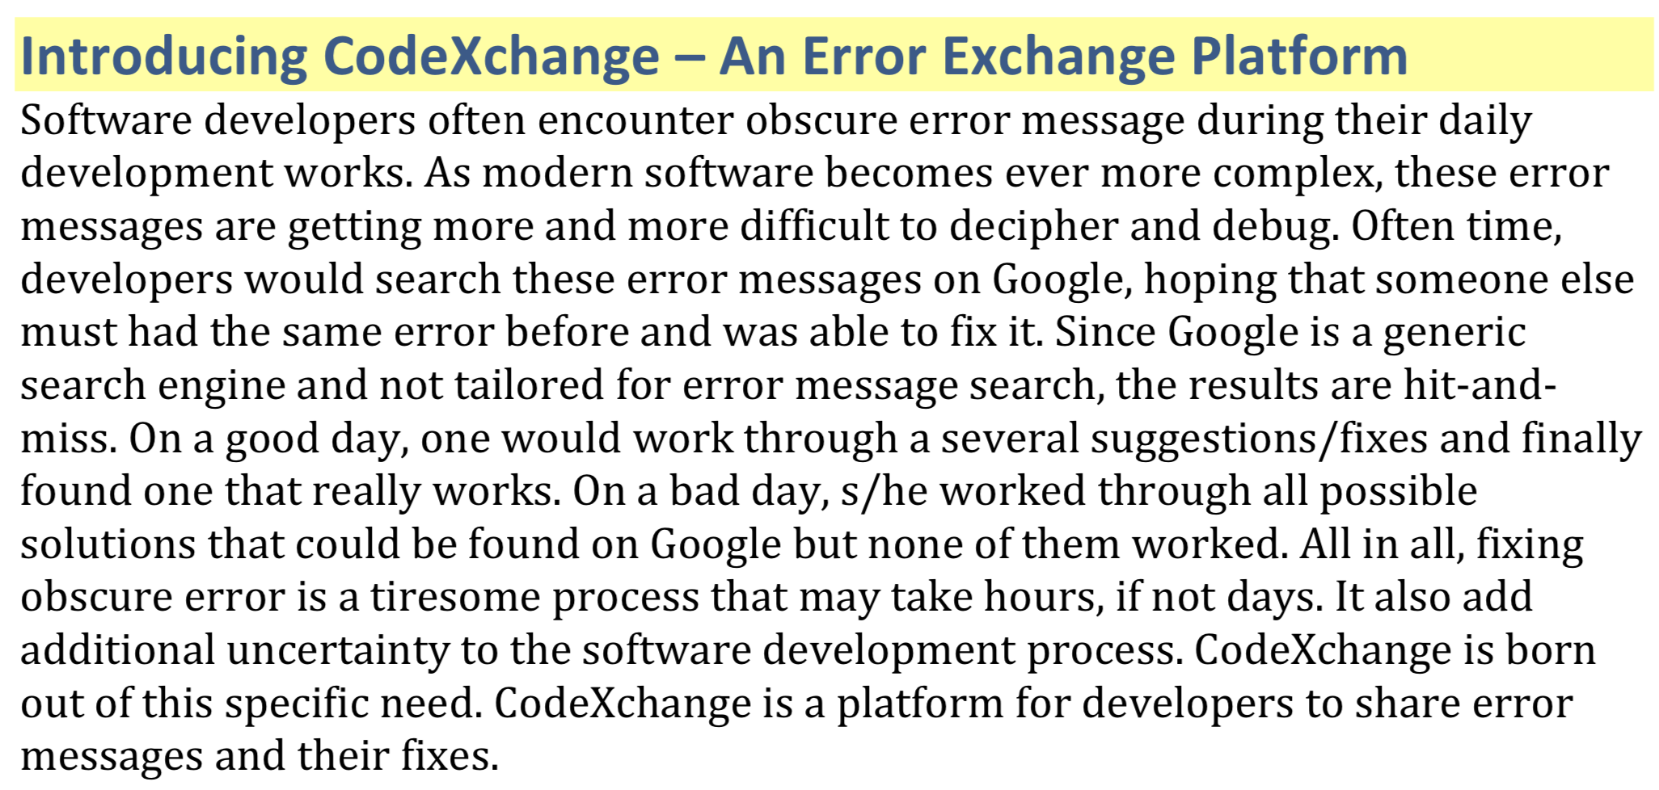
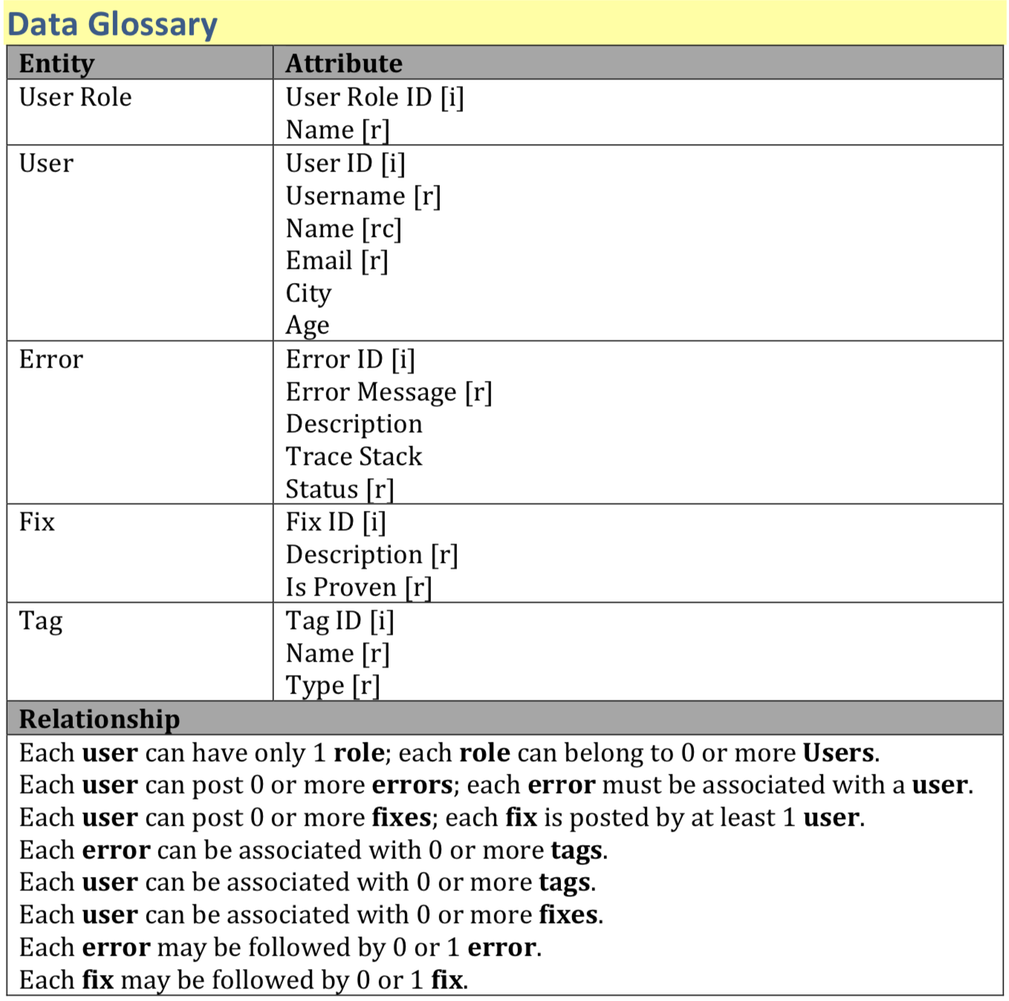
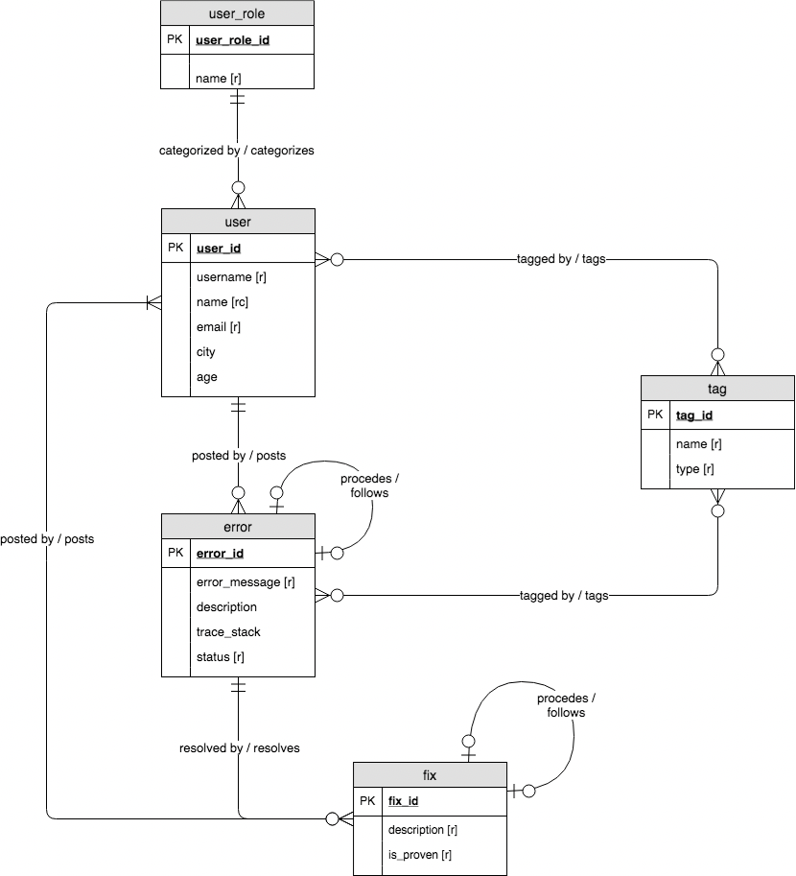
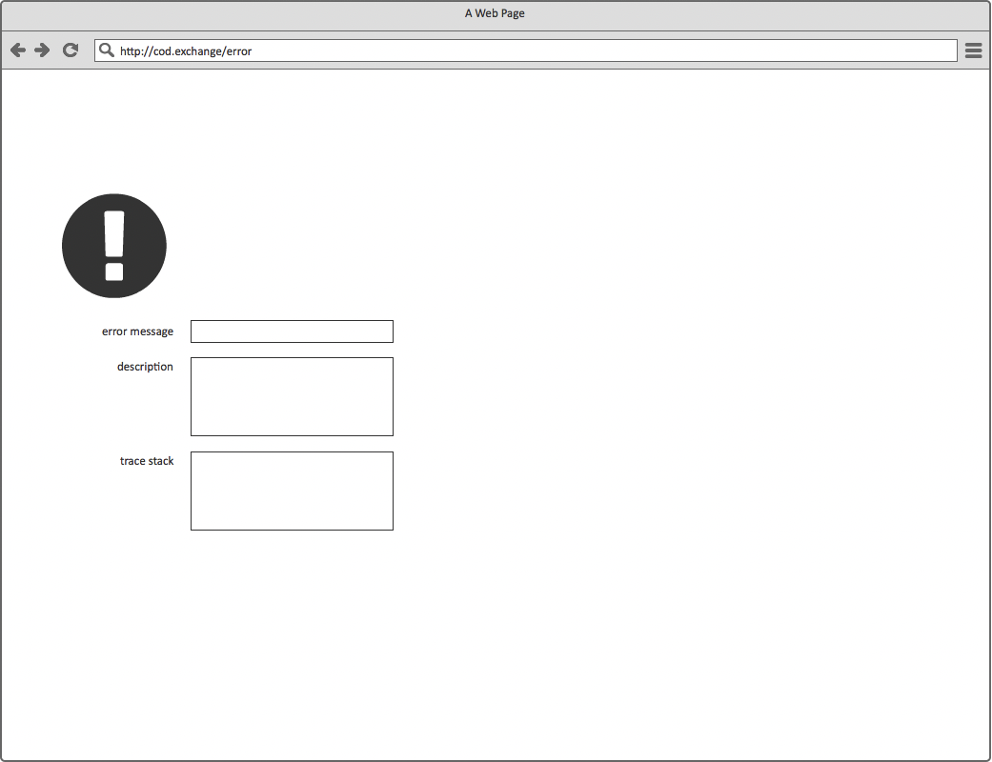
IST 659 Data Admin Concept
Notes:
Under the direction of Professor Harper, I quickly developed a narrative. I named the platform CodeXchange. I designed three types of users – site curator, author, and wander; I developed detailed functions for each user. Based on the narrative, I extracted necessary business rules needed to develop logical models. Finally, with the insight derived from the logical models, I created the basic UI prototype designed to catch inputs from users.
The most important skill that I learnt from this course is to write a narrative of the problem that I am about to solve. Writing it down forces me to think through exactly what I am trying to solve and what data I need to collect. This, in essence, is problem formulation. One takeaway from the course is that spending some extract time in problem formulation will pay off down the road.

Slide 11
Acquisition
First step in data science process
“Garbage in garbage out”
Notes:
Data acquisition (i.e. collecting data) is the first step of the data science process. Data scientists use data to solve problems. Without good data, the rest of the data science process is fruitless. In software engineering, there is a concept called “garbage in garbage out”. This is saying that during an algorithm computation, flawed input produces nonsense output. This same concept applies to data science as well. In most courses that I took, data was either provided or was readily available for download online. The most brutal data acquisition experience that I had was during the course IST 687 Introduction to Data Science.

Slide 12
NBA Data Analytic
IST 687 Introduction to Data Science
What
Under guidance of Professor Mohammed Syed
Find correlation between NBA team stats and winnings
Tech
R
Regression
Notes:
IST 687 Introduction to Data Science was taught by Professor Mohammed Syed. Since it was one of the earlier courses I took in the program, my data science skills were still very raw at that time. The final project was a group project. The goal was to find out whether there exists a correlation between the stats of NBA teams and their winnings. Intuitively, there must exists a correlation. The question, therefore, is to find out the data fields that do correlate.
The tech stack used for this project is R and regression modeling

Slide 13
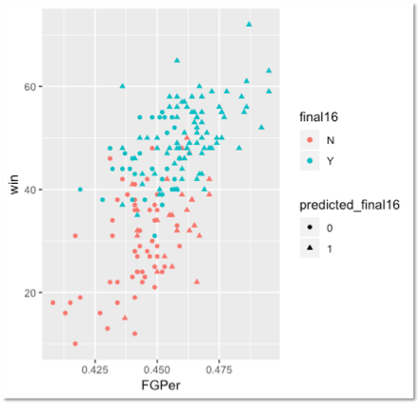
IST 687 Introduction to Data Science
Notes:
Unfortunately, we could not find any prefabricated dataset that would fit our purpose. Our last resort was to scrape the data directly off official web sites. From Basketball Reference, we scraped team stats, and team standings; From Wikipedia, we scraped playoffs data. The web scarping took most than a week to finish. The figure shows what the data looked like in their original web site. Once completed, we then stitched the data together to form the final dataset with 31 data fields. After that, we ran correlation tests on the dataset and were able to identify the fields that should be include in the final linear regression model.
One takeaway from this course is that useful data does not always come cheap. This course prepared me to take on extreme measures to acquire useful data. In hindsight, instead of scraping the data manual, I should had invested the time to automate the web scraping process by using tools like Scrapy and BeautifulSoup.

Slide 14
Exploration
Data cleaning
feature identification
Notes:
Once the dataset is acquired, a series of data exploration techniques are applied/performed on the dataset. There are two part of data exploration. The first is data cleaning. In this part, data records that contain missing or invalid data should be removed; those that contain incorrectly formatted data should be converted to the correct format. Some data types are prone to formatting issues such as dates, address, and phone number. The second part of data exploration is feature identification. In this part, useful or meaningful data fields are identified using correlation techniques and are selected to move on to data analytic phrase. Almost all projects I have done so far require some sort of data exploration. The final project in IST 718 Big Data Analytics course is the most challenging among them.

Slide 15
In-Game Assessment Scoring Engine
IST 687 Big Data Analytics
What
Under guidance of Professor Jillian Lando
Kaggle 2019 Data Science competition problem
Gain insights into how gaming can help children learn
Tech
Python
Jupyter Notebook
Exploration: histogram, boxplot, heat map
Modeling: CatBoost, XGBoost Classifier, Decision Tree
Notes:
This course was taught by Professor Jillian Lando. It is an advanced course in data analytics that covers a wide range of data analytic techniques. The final project for this course was a group project. Since Kaggle just released its 2019 data science competition problem around that time, we tried to be fancy and decided to use the competition problem for the final project. The goal of the competition problem was to gain insights into how gaming can help children learn important skills for success in school and life. Dataset was raw data collected by an app called PBS KIDS Measure UP. It was an app that helped children ages 3 to 5 to learn early math concepts through completing levels and assessments in a game setting. Learning materials are presented to children as games. At the end of each game level, children had to pass an assessment test in order to gain access to next level. The success of learning is therefore measured by how many attempts children had to take to complete the assessment.
The tech stack for this project is python, jupyter notebook. For data exploration, we used histogram, boxplot, heat map. For modeling, we used CatBoost and XGBoost Classifier, and Decision Tree

Slide 16
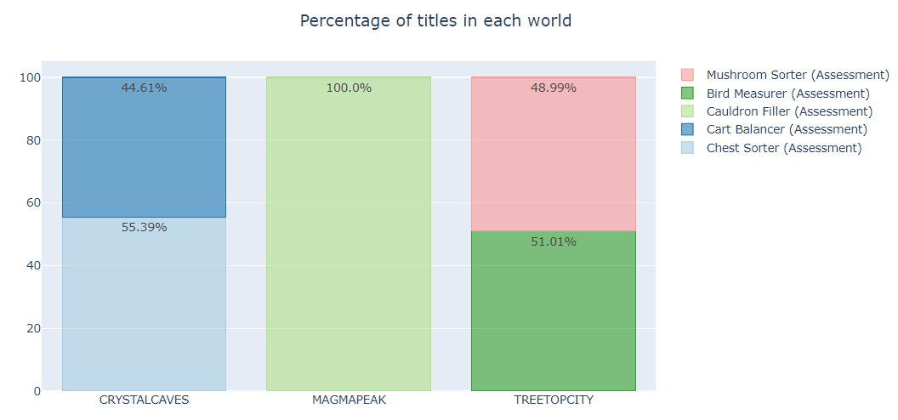
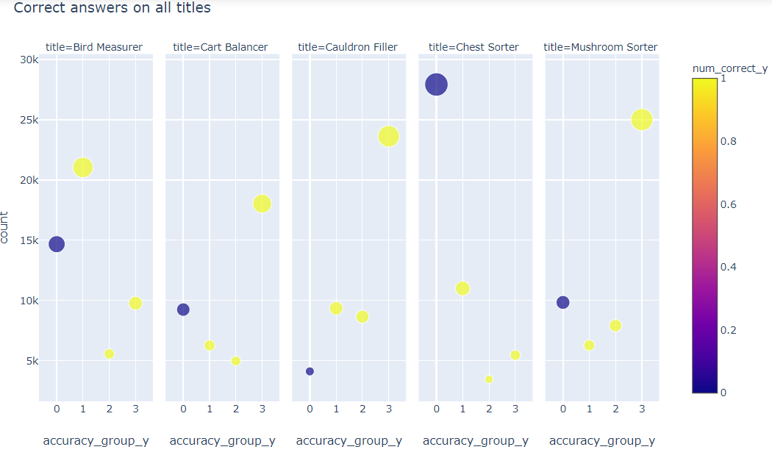
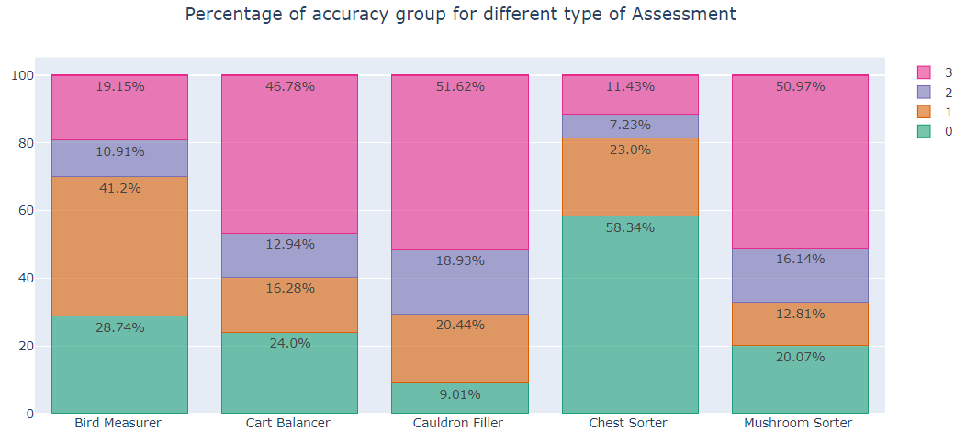
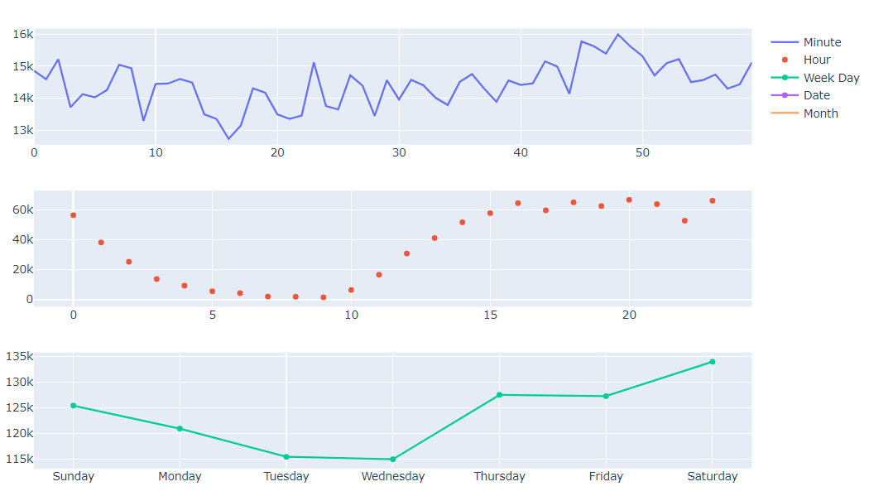
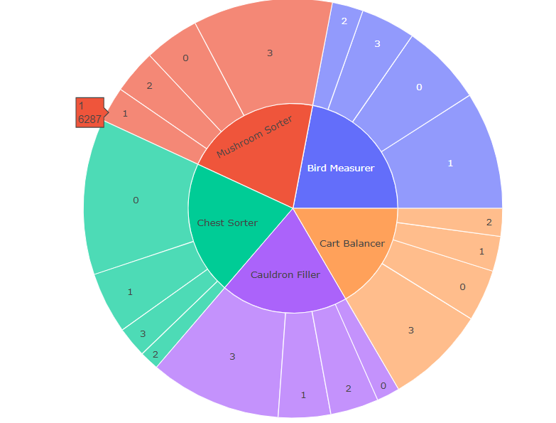
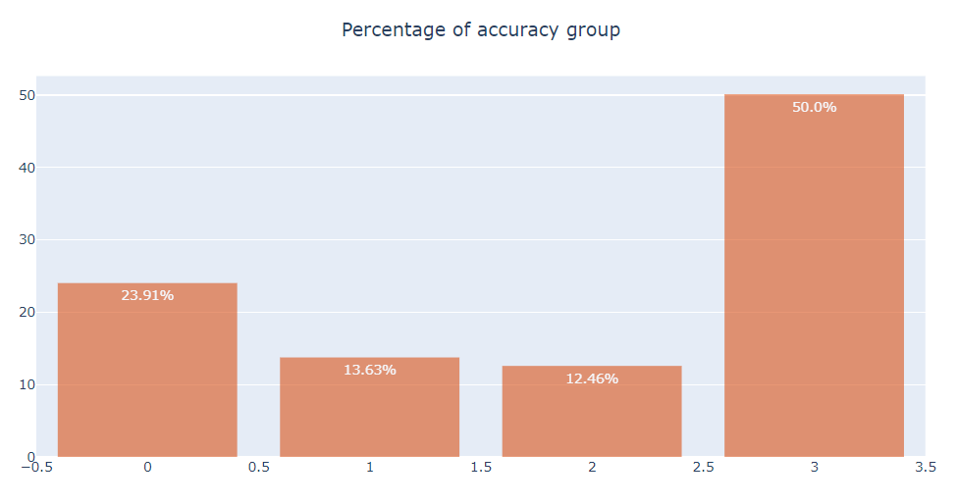
IST 718 Big Data Analytics
Notes:
the first thing we did was to derived the number of attempts by aggregating data records by game session ID and assessment ID. We also removed invalid data during the process. Once we had the dataset cleaned up, we then proceeded to visualize the dataset for any correlation and pattern by plotting it out. We ran it through a couple of common plots, such as histogram, boxplot, heat-map, as depicted in the figure. For modeling, we chose CatBoost, XGBoost Classifier and Decision Tree. The Decision Tree model yields the most accurate result.
In retrospect, the raw dataset was almost 4 GB in size. This makes it really slow to perform data exploration routines from a laptop computer. It would even crash our computers from time to time. In hindsight, we should had stored the dataset in a cloud database and perform data exploration routines directly from the cloud for better performance and response time.

Slide 17
Analytics and Modeling
Descriptive, predictive, prescriptive
Predictive – regression, classification, clustering, neural network
Notes:
I used to think that data analytic is the longest and most complicated part of data science. In practice, it is actually easier and shorter comparing to data acquisition and exploration because all commonly used analytic algorithms are well studied and implemented. The hardest part is to use the right analytic algorithm and to understand the results. Data analytic is divided into three types: descriptive, predictive, and prescriptive.

Slide 18
Severe Weather Events
IST 707 Data Analytics
What
Under guidance of Professor Amy Gates
Predict which events are most harmful to population health, and have greatest economic consequences
Tools
R, rdoc
Modeling: Decision Tree, Random Forest, SVM, Naive Bayes, K Means, Association Rule Mining
Notes:
Here I will use a predictive project from IST 707 Data Analytics as an example.
The course was taught by Professor Amy Gates. It was a comprehensive study of different predictive analytic models. For the final group project, Professor Gates wanted us to use different analytic models to analyze the same dataset, and compare the results and tradeoffs. We decided to use severe weather events data from National Oceanographic and Atmospheric Administration (NOAA). The goal is to predict which events are most harmful to population health, and have the greatest economic consequences.
The tech stack for this project is R, we use rdoc
for modeling, we used Decision Tree, Random Forest, SVM, Naive Bayes, K Means, Association Rule Mining

Slide 19
IST 707 Data Analytics
Notes:
Since this is a classification problem, we experimented with a couple of classification models, such as Decision Tree, Random Forest, Support Vector Machine, Naïve Bayes, K Means, and Association Rule Mining. The results from some of the models are shown in the figure. We had to make slight adjustments to the dataset to fit each model of course. Our findings shown that Tornados as the leading cause of injuries, and that flooding had the greatest impact on U.S. economy
One takeaway from the course is the realization that a dataset can be rearranged to fit almost any analytic models. A good practice is to run the dataset through different models then compare the results. However, to know which model works best with a dataset and why take practice and experience.

Slide 20
Interpretation and Reporting
finding solution
present solution with evidence
Notes:
As mentioned before, data science process is also a problem-solving process. The previous steps focus on finding and analyzing evidences/data. The final step, interpretation, focuses on finding a solution and presenting the solution with evidence. Every data science course I took involves interpretation in one form or another. Data science is a discipline of making recommendation, after all. Of all the presentations I have done in the program, the one from MBC 638 Data Analysis and Decision Making is most memorable.

Slide 21
Improvement on Software Development Process
MBC 638 Data Analysis and Decision Making
What
Under guidance of Professor Marc Miller
Identify issue in process
Collect measurements
Analyze measurements
Improve measurements
Tools
R
Powerpoint
Notes:
The course was taught by Professor Marc Miller. It focused on implementation of process improvement using data science techniques. The final project was an opportunity to identify issues in a real-world process, and to improve the process. As a software developer, I naturally decided to use software development process as an experiment.
Software development process works in sprints of two weeks. For each sprint, each software developer is given a set of tasks to complete in that sprint. The goal is to improve the task completion rate.

Slide 22
MBC 638 Data Analysis and Decision Making
Notes:
After collecting relevant data/measurements and done analytics on them, I found out that total estimated hours and number of tasks have negative impact on task completion rate. The whole story is captured and summarized in one slide.
This course taught me that story board is an effective way to communicate data science process and findings. I regret not able to use it often enough in my other projects due to time constraints, but it will remain a useful tool in my data science arsenal.

Slide 23
Moving Forward
Information security
Data analytic algorithms
Apply what I have learnt in work
volunteering in community projects such as the ones from datakind.org
Notes:
Last three years have been a wonderful journey into data science. As the program comes to an end, however, my journey does not end here. After the program, I plan to take a deep dive into data analytic algorithms. In addition to how to use them, I want to learn the ins and outs of how they work. I also want to gain more knowledge in data/information security as this will become a big challenge for the coming decades. More importantly, I want to apply what I have learnt in my workplace as well as the community.

