Slide 1

KeyDate
Owning a home isn’t impossible.
It has a date.
JCI Edmonton · Creative Young Entrepreneur
keydate.ca
Notes:
OPEN COLD. Do not read the slide. "Ask someone in their twenties when they'll own a home. They won't give you a year. They'll give you a feeling — probably never." Pause. Then move to slide 2.

Slide 2
WHY I BUILT THIS
I bought my first place.
I was guessing the whole way.
Spreadsheets
Contradictory advice
A goal that kept moving
Notes:
THIS IS THE SLIDE THAT NEEDS YOUR REAL DETAIL. Pick ONE and tell it properly: · the month you nearly gave up · the person who gave you advice that turned out to be wrong · the number you were short by Talking points: rebuilt the spreadsheet every month · every source said something different · the target moved every time you looked at it. One concrete detail beats three general ones.

Slide 3
Nobody could tell me when.
How much do I actually need?
Am I even close?
Is this the year, or five years away?
Notes:
Say these like you are still annoyed about it. They were YOUR questions. Talking point to land after: "Every tool I found answered a different question than the one I was actually asking."

Slide 4
AND I HAD IT EASIER THAN THE PEOPLE BEHIND ME
One generation apart
2006
TODAY
$276,974
$696,078
2.5×
average Canadian home
average Canadian home
Source: CREA (2006 average MLS price) · national average, June 2026
Notes:
Do not linger — this is evidence for a feeling, not the argument. Talking points: "If it was that hard for me, what is it for someone starting now?" · "Most of you in this room bought somewhere inside that gap too." If challenged: 2006 is CREA's own figure for a record year. No income number is quoted on purpose — the series isn't cleanly comparable that far back.

Slide 5
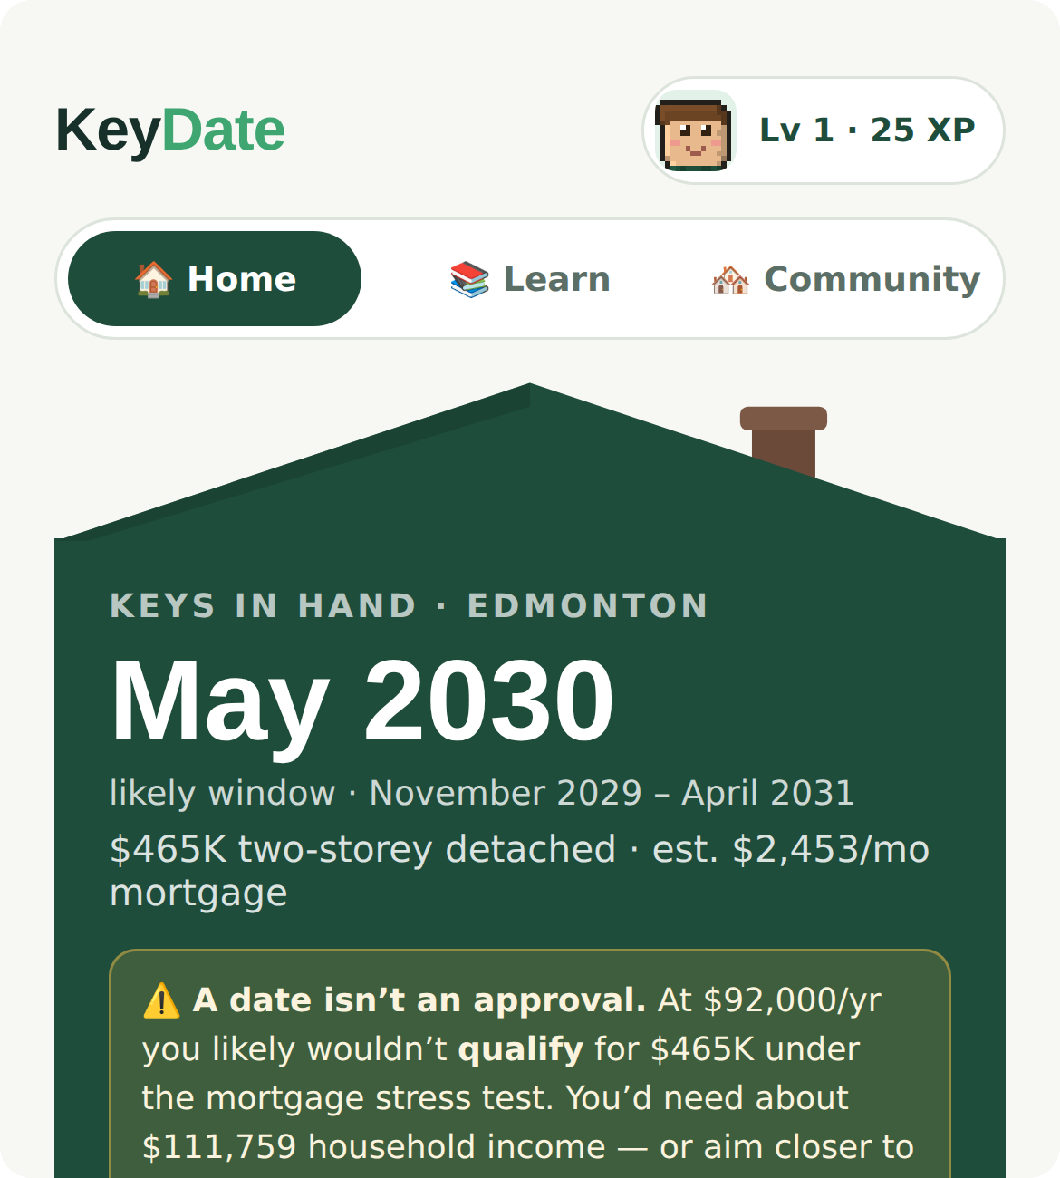
SO I BUILT THE THING I NEEDED
Sixty seconds in. A real date out.
1
Three questions
2
A real month
3
Watch it get closer
Real screen, real plan
Notes:
HOLD UP THE PHONE HERE. Have your own plan already on screen — never type live, never rely on venue wifi. Talking points: income, savings, monthly · built on the real Canadian rules — FHSA, Home Buyers' Plan, the stress test · every dollar saved builds the house on screen.

Slide 6
INNOVATION
We changed the question
EVERY OTHER TOOL
KEYDATE
“Afford it today?”
“When?”
No.
June 2029.
Notes:
KEY LINE — do not cut for time: "I can't make the house cheaper. I can give people the answer I never got." It pre-empts the sharpest question in the room and buys credibility for everything after it. Talking point: today the answer is no, so people close the tab and stop saving entirely.

Slide 7
IT WAS NEVER JUST MY STORY
The engine doesn’t change at the border
Canada
Australia
UK
Ireland
New Zealand
The engine stays. The rulebook swaps.
Notes:
BIGGEST SCORING SLIDE — impact is 35 of 115 points, and "international" is written into it. Talking points: when people can't see a path they stop building wealth at all — renters instead of owners, wealth that never compounds · every one of these countries has the same two problems: a generation priced out, and government programs nobody understands · KeyDate is a rules engine with a Canadian rulebook loaded. Slow down on "The rulebook swaps."

Slide 8
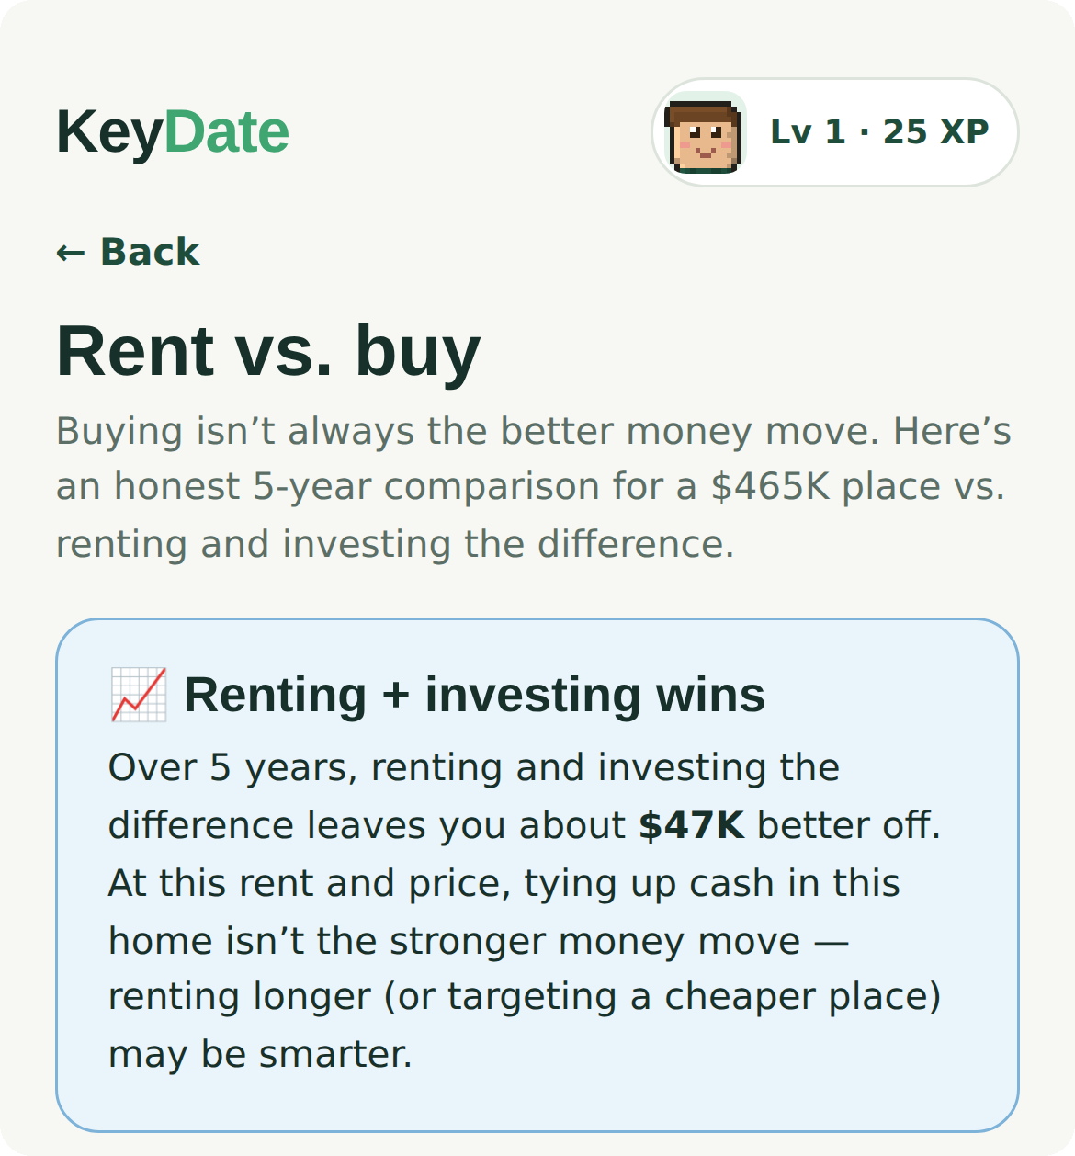
COMMUNITY IMPACT & SUSTAINABILITY
The money we refuse to take
We never sell you
to brokers.
We built the tool
that says don’t buy.
A company on referral fees can never say that.
Notes:
SECOND BIGGEST SCORING SLIDE — community + sustainability is 20 points. Talking points: the obvious way to monetise this is selling users to mortgage brokers — people who just told you their income, their savings, and exactly when they'll need a mortgage · most valuable lead list in the country · our privacy policy says we never will, in writing, live today · the moment I'm paid to push you toward a house I stop being able to tell you the truth. Land the last line slowly.

Slide 9
SCALABILITY & LEADERSHIP
Built, shipped, live
467
~$0
1
municipalities
cost per user
founder
A new country is a rulebook, not a rebuild.
Notes:
Leadership is 15 points and you are solo — lead with evidence, not adjectives. Talking points: live at keydate.ca right now · incorporated · privacy policy, terms and content moderation done before the first user — because I'd rather be trusted than fast · I built and shipped it myself.

Slide 10
It just doesn’t have
a date yet.
We’re giving it one.
keydate.ca
Edmonton beta opens this week
Notes:
MEMORISE THIS. Never read the close. "Owning a home isn't impossible. It just doesn't have a date yet. We're giving it one." Then stop talking.

