Slide 1







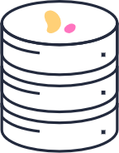
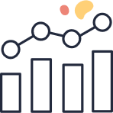
Model orchestration and tracking
Deploy ++
Ingest
Prepare
Train
Validate
ETL, Streaming, Logs, Scrapers, ..
Join, Aggregate, Split, ..
With hyper-params,
multiple algorithms
Selected model with test data
Test, deploy, monitor model & API servers
Automated ML & Analytics Serverless Functions
base features
train + test datasets
model
report
Real Time features
metrics
Securely Shared and Versioned Data

