Slide 1
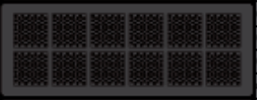

Scale-Up System
Scale-Out System
CPU/Drive ratio
Performance
Capacity
Smart Rebuild
CPU/Drive ratio
Performance
Capacity
Smart Rebuild

