Slide 1
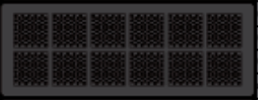

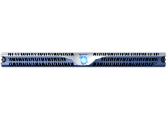
Scale-Up System
Scale-Out System
Iguazio Unified Data Platform Scale-Out ²
CPU/Drive ratio
Performance
Capacity
Smart Rebuild
CPU/Drive ratio
Performance
Capacity
Smart Rebuild
CPU/Drive ratio
Performance
Capacity
Smart Rebuild

