Slide 1



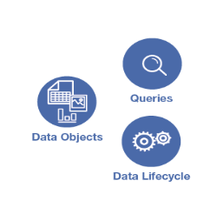




Data Eligible?
Data-Access Policies
POSIX ACL
HCFS / FUSE / SPARK / PRESTO / NGINX

