Slide 1
0,101010,0011010110101,111010101
1,101111,0011010111101,101110101
2,100000,0011010110111,111010101
3,101110,0011011110101,10100000
4,111010,0011110110101,101111111
5,101111,0011011111101,111010111
6,100011,0011000000101,100010101
Policy
Transform and optimize
Compile
Execute per request

Slide 2
0,101010,0011010110101,111010101
1,101111,0011010111101,101110101
2,100000,0011010110111,111010101
3,101110,0011011110101,10100000
4,111010,0011110110101,101111111
5,101111,0011011111101,111010111
6,100011,0011000000101,100010101
Policy
Line rate (100GbE) processing
Transform and optimize
Compile

Slide 3
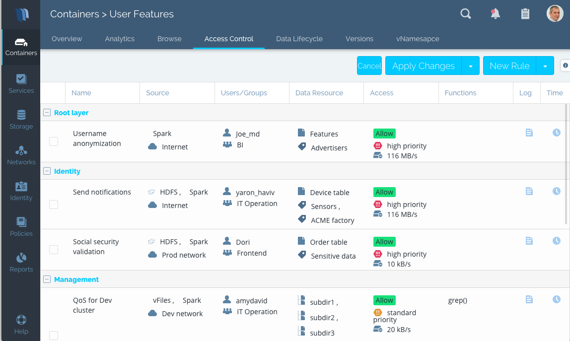
0,101010,0011010110101,111010101
1,101111,0011010111101,101110101
2,100000,0011010110111,111010101
3,101110,0011011110101,10100000
4,111010,0011110110101,101111111
5,101111,0011011111101,111010111
6,100011,0011000000101,100010101
Transform and optimize
Compile
Execute per request

Slide 4
0,101010,0011010110101,111010101
1,101111,0011010111101,101110101
2,100000,0011010110111,111010101
3,101110,0011011110101,10100000
4,111010,0011110110101,101111111
5,101111,0011011111101,111010111
6,100011,0011000000101,100010101
Transform and optimize
Compile
Execute per request

Slide 5
0,101010,0011010110101,111010101
1,101111,0011010111101,101110101
2,100000,0011010110111,111010101
3,101110,0011011110101,10100000
4,111010,0011110110101,101111111
5,101111,0011011111101,111010111
6,100011,0011000000101,100010101
Policy
Transform and optimize
Compile
Execute per request

