Slide 1

Generic ED Data analysis
EY Data challenge

Slide 2
Agenda
BACKGROUND AND RESEARCH
PREPARATION AND ANALYSIS
NEXT STEPS
￼
ASSUMPTIONS AND BUSINESS PROBLEM
FINDINGS AND RECOMMENDATIONS

Slide 3
Background and research
Emergency Departments are often overcrowded, which impacts medical service delivery and patient experience
Australian triage process follows ATS standards, whereby a 1 indicates highest severity and a 5 indicates lowest severity
The triage priority rating also provides a guideline as to the timeframe within which a patient should receive medical attention after arrival to ED
Within Australia, 70%* of patients receive treatment within an appropriate time relative to their triage category
Time based Emergency Department performance metrics† include:
Length of time taken to receive medical attention from a doctor
Length of time between initial medical attention and ED departure
Overall length of stay in ED
￼
* AIHW, Australian hospital statistics 2010-2011: emergency department care and elective surgery waiting times
† Applying advanced analytics to guide emergency department operational decisions: A proof-of-concept study examining the effects of boarding

Slide 4
Dataset Assumptions
Triage process follows the Australian standards, whereby a 1 indicates highest severity and a 5 indicates lowest severity
ED data of children hospital
All data is exported directly from ED’s database. None are calculated outside of database
The time of being seen to by a doctor reflects the first instance a patient is seen to upon admission into ED
This is used as a proxy for treatment time
￼

Slide 5
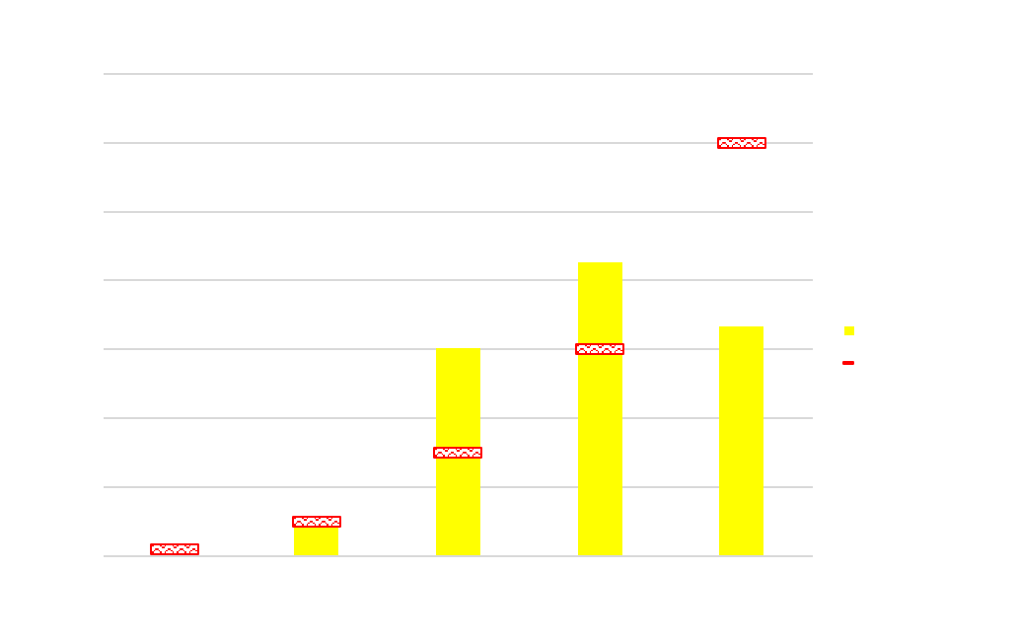
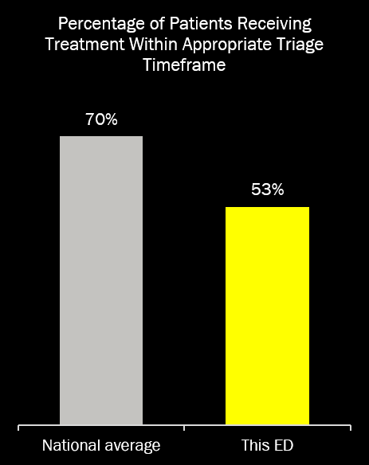
Initial investigation OF AVERAGE Wait time
Wait time defined as the difference (in minutes) between arrival time and doctor seen time

Slide 6
Analysis preparation
Data cleaning
Identified data quality issues in calculated columns – recalculated using raw data
TimeDiff TreatDrNr-Act. Depart (mins) had 6,727 incorrectly calculated rows
Cleansing of free text values in Diagnosis Desc. for standardisation
Filter out patients with Departure Status Desc. as “PATIENT FOR DELETION BY CAMPUS ADMINISTRATOR” or “DEAD ON ARRIVAL (NO TREATMENT PROVIDED IN ED)”
Generated ED wait room timeline for analysis
Timeline shows all patients presenting in ED who have not been seen to by a doctor
Grain is each patient presenting in ED at any given arrival time
Created fields for analysis
Arrival – Doctor seen time in minutes
Number of patients presenting in ED at arrival time of new patient
Whether a patient is seen to later than their priority ranking

Slide 7
ED WAIT ROOM timeline
Triage
Doctor seen
Arrival to ED
Departure
Triage
Doctor seen
Arrival to ED
Departure
Triage
Doctor seen
Arrival to ED
Departure
At this time, the ED wait room timeline only considers patients 2 and 3 as they have not been seen to by a doctor

Slide 8
EXPECTED VS. ACTUAL ORDER OF MEDICAL TREATMENT
Triage
E1
Arrival to ED
A2
Departure
Triage
E2
Departure
Arrival to ED
A3
Triage
A1
Departure
Arrival to ED
E3
E: Expected order – calculated using the patient’s arrival time and expected treatment wait time based on triage priority
A: Actual order

Slide 9
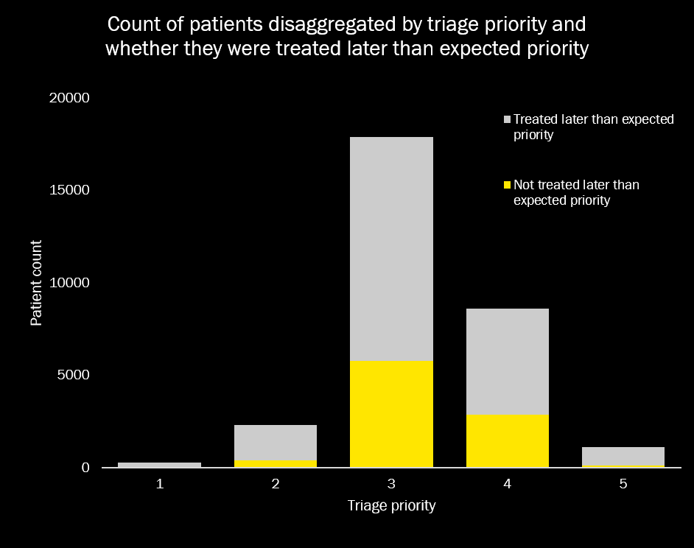
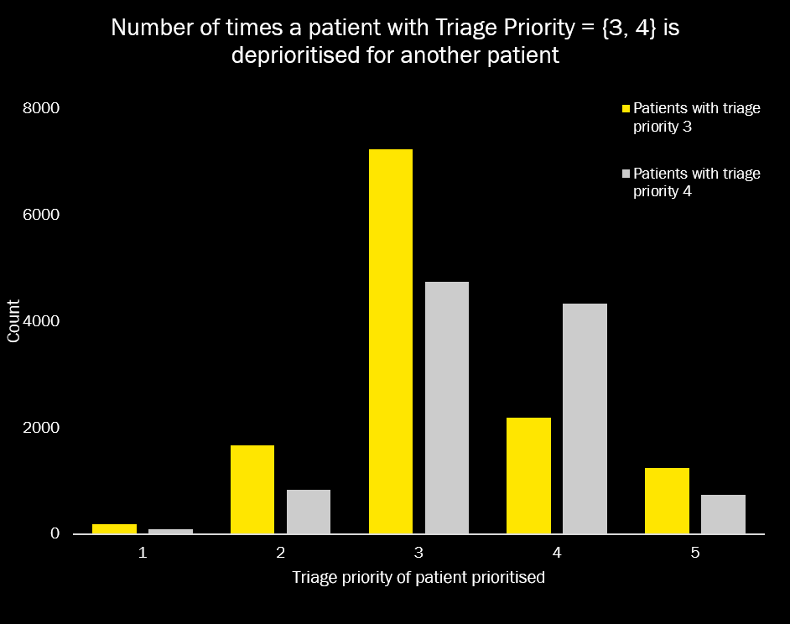
Priority adherence in ed wait room

Slide 10
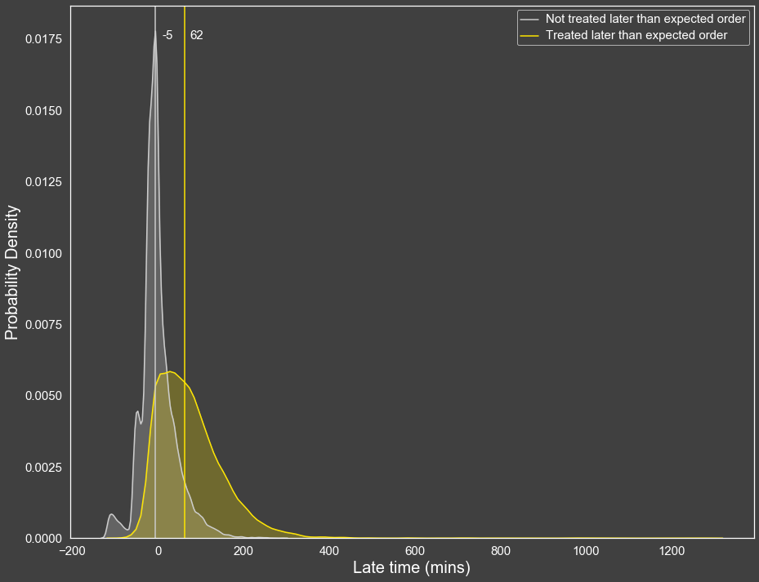
priority adherence impacts ability to meet ats standards
Testing
Mann-Whitney U
P-value = 0.0
￼
 | Mean rank | Median
Not treated later than expected priority | 11928.17059 | -5
Treated later than expected priority | 21945.97418 | 62
 | Late | Count
Not treated later than expected priority | 0 | 12,764
 | 1 | 8,037
Treated later than expected priority | 0 | 1,386
 | 1 | 7,811
Patients who are treated later than their expected priority have a significantly longer wait period beyond the ATS recommended timeframe.

Slide 11
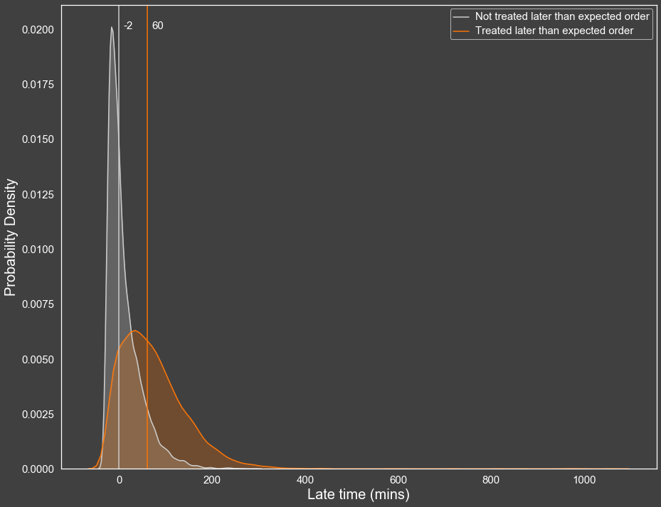
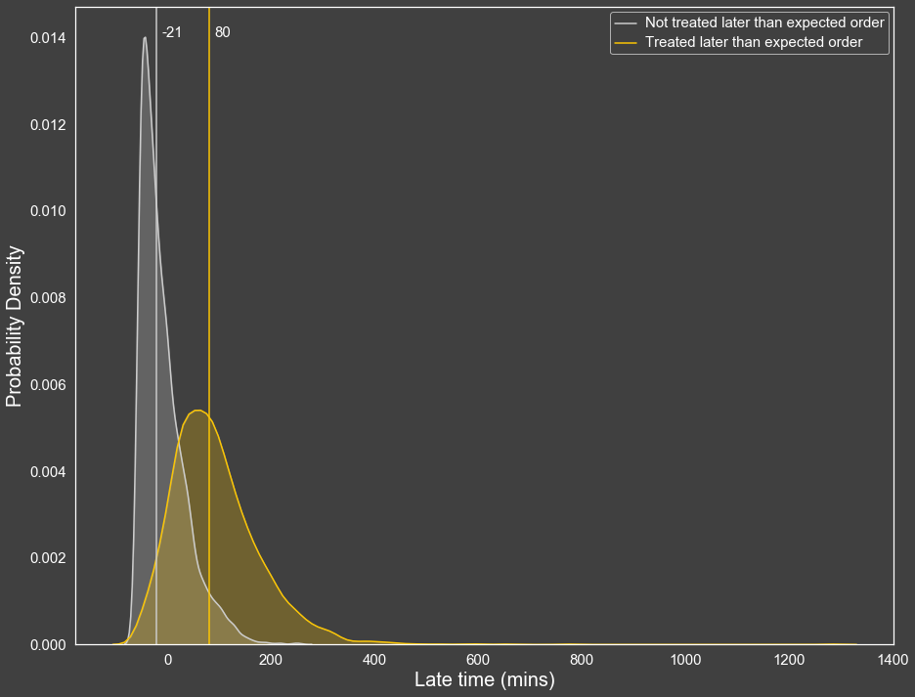
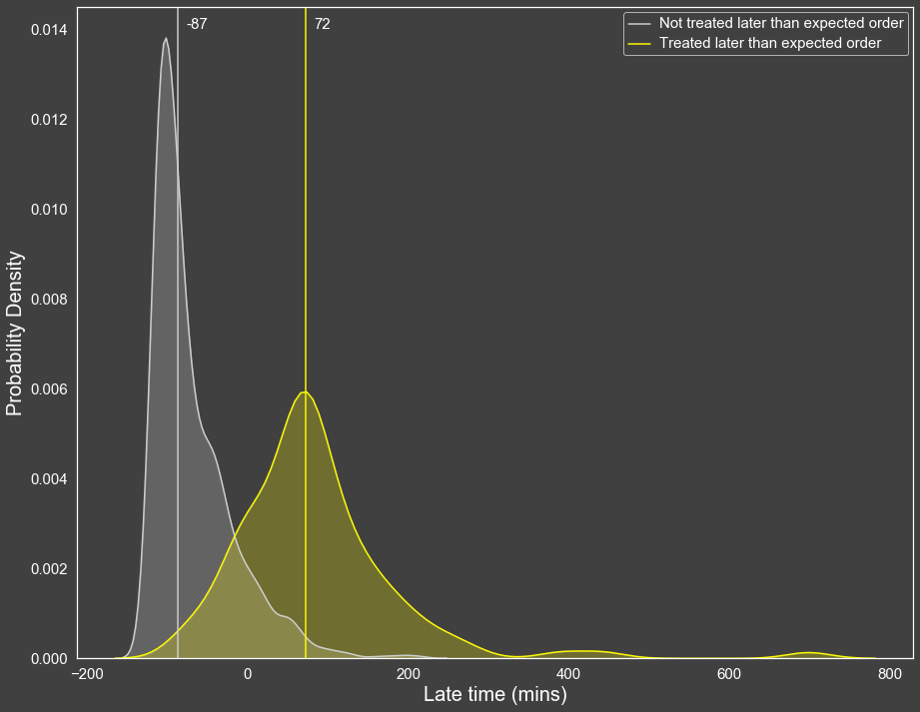
Triage Priority 3
Triage Priority 4
Triage Priority 5

Slide 12
Recommendation
It is recommended that an automated patient ranking system is implemented to support the prioritisation of patient visits, providing ED staff with clear visibility over which patient should be seen to next
The system should calculate the relative priority of all patients presenting in ED, and automatically readjust once a new patient is triaged
Medical staffs should adhere strictly to this ranking system
This recommendation is based on the assumption that the triage process produces accurate triage priority for each patient
The system should send alerts to staffs using a traffic light system to denote the amount of time left until the expected treatment time for a patient
The alert should stay on until the patient has a doctor seen date time entered
Red: 5 minutes
Orange: 10 minutes
Yellow: 20 minutes

Slide 13
Automated Patient priority ranking system
0:22
0:32
Arrival Time | Triage Priority | Expected Treatment Time
0:17 | 3 | 0:47
0:01 | 4 | 1:01
0:22 | 4 | 1:22
0:37
Arrival Time | Triage Priority | Expected Treatment Time
0:37 | 2 | 0:47
0:17 | 3 | 0:47
0:01 | 4 | 1:01
0:22 | 4 | 1:22
Arrival Time | Triage Priority | Expected Treatment Time
0:17 | 3 | 0:47
0:01 | 4 | 1:01
0:22 | 4 | 1:22
1
2
3
1
2
3
4
1
2
3
Tie breaking
Wait for triage

Slide 14
Automated Patient priority ranking system ALERT
0:37
Expected Treatment Time | Doctor Seen Time
0:47
0:47
1:01
1:22
0:42
Expected Treatment Time | Doctor Seen Time
0:47
0:47
1:01
1:22
0:48
Expected Treatment Time | Doctor Seen Time
0:47 | 0:45
0:47
1:01
1:22
1
2
3
4
1
2
3
4
1
2
3

Slide 15
Conclusion and next steps
In summary, adherence to patient priority ranking plays a significant role in explaining wait time relative to triage priority
A recommendation for an automated patient priority ranking system can be made along with proper training to ensure all healthcare staffs adhere strictly to the ranking system
Seasonal differs in wait time relative to triage priority should be investigated further
While number of patients in ED is positively correlated with wait time, it has insufficient explaining power
Next steps: Analysis of a patient’s treatment time (time taken between first instance of doctor seen and departure from ED) to provide insights on potential bottlenecks and improvement opportunities
It is reasonable to assume that longer treatment time would be correlated with wait time for other patients
￼

Slide 16
Finding 2: PERFORMANCE metrics differ seasonally
Seasonal and weekday attributes were found to significantly impact a patient’s time taken to receive medical treatment relative to their triage category
On Mondays, patients’ average wait time relative to their triage category is significantly higher than other days of the week
ED patient volumes were not found to be a possible explanation for this finding, as Monday volumes were reflective of the average ED volume throughout the week
Within the month of July, patients’ average wait time relative to their triage category is significantly higher than other months
ED patient volumes were also found to not be a possible explanation for this finding
For May, patients’ average wait time relative to their triage category is significantly lower than other months, despite having comparable patient volumes to July
Overall, the better months (where patients receive earlier treatment relative to their triage category) are April, May, June, October, November, and December
This potentially coincides with medicine/nursing students’ placements
￼

Slide 17
Finding 2: Recommendation
Seasonal difference in treatment wait time should be investigated further to understand the underlying cause
There is potential understaffing on Mondays
This aspect should be investigated further

Slide 18
Finding 3: NUMBER OF PATIENTS IN ED does not SUFFICIENTLY explain wait time
The national median wait time to receive medical attention in ED is 23 minutes
The dataset’s median wait time to receive medical attention in ED is 42 minutes
There is a positive and significant correlation between number of patients presenting in ED and wait time
For each additional patient in ED, the wait time increases by 4 minutes
However, this factor can only explain 6% of the variance in wait time
￼

