Slide 1

Generic ED Data analysis
EY Data challenge

Slide 2
Agenda
BACKGROUND AND RESEARCH
PREPARATION AND ANALYSIS
NEXT STEPS
￼
ASSUMPTIONS AND BUSINESS PROBLEM
FINDINGS AND RECOMMENDATIONS

Slide 3
Background and research
Emergency Departments are often overcrowded, which impacts medical service delivery and patient experience
Australian triage process follows ATS standards, whereby a 1 indicates highest severity and a 5 indicates lowest severity
The triage priority rating also provides a guideline as to the timeframe within which a patient should receive medical attention after arrival to ED
Time based Emergency Department performance metrics† include:
Proportion of patients seen to within an appropriate triage timeframe
Length of time taken to receive medical attention from a doctor
Length of time between initial medical attention and ED departure
Overall length of stay in ED
Within Australia, 70%* of patients receive treatment within an appropriate time relative to their triage category
￼
* AIHW, Australian hospital statistics 2010-2011: emergency department care and elective surgery waiting times
† Applying advanced analytics to guide emergency department operational decisions: A proof-of-concept study examining the effects of boarding

Slide 4
Dataset Assumptions
ED data of children hospital
Triage process follows the Australian standards, whereby a 1 indicates highest severity and a 5 indicates lowest severity
The time of being seen to by a doctor reflects the first instance a patient is seen to upon admission into ED
This is used as a proxy for treatment time
￼

Slide 5

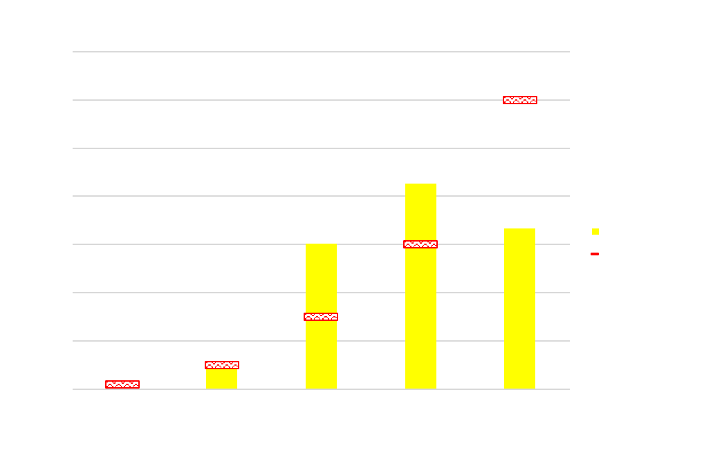
Initial investigation OF AVERAGE Wait time
Wait time defined as the difference (in minutes) between arrival time and doctor seen time

Slide 6
Analysis preparation
Data cleaning
Identified data quality issues in calculated columns – recalculated using raw data
TimeDiff TreatDrNr-Act. Depart (mins) had 6,727 incorrectly calculated rows
Filter out entries with Departure Status Desc. as “PATIENT FOR DELETION BY CAMPUS ADMINISTRATOR” or “DEAD ON ARRIVAL (NO TREATMENT PROVIDED IN ED)”
Generated ED wait room timeline for analysis
Timeline shows all patients presenting in ED yet to be seen to by a doctor
Grain is each patient presenting in ED at any given arrival time
Created fields for analysis
Arrival to Doctor seen time in minutes
Whether a patient is seen to later than their priority ranking

Slide 7
ED WAIT ROOM timeline
Triage
Doctor seen
Arrival to ED
Departure
Triage
Doctor seen
Arrival to ED
Departure
Triage
Doctor seen
Arrival to ED
Departure
At this time, the ED wait room timeline only considers patients 2 and 3 as they have not been seen to by a doctor

Slide 8
EXPECTED VS. ACTUAL ORDER OF MEDICAL TREATMENT
Triage
E1
Arrival to ED
A2
Departure
Triage
E2
Departure
Arrival to ED
A3
Triage
A1
Departure
Arrival to ED
E3
E: Expected order – calculated using the patient’s arrival time and expected treatment wait time based on triage priority
A: Actual order

Slide 9


Priority adherence in ed wait room

Slide 10
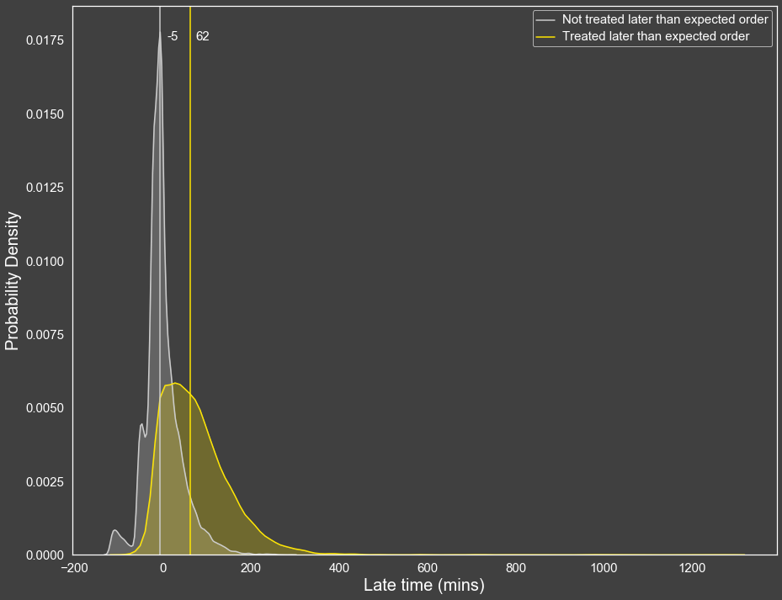
priority adherence impacts ability to meet ats standards
Testing
Mann-Whitney U
P-value < 0.001
￼
 | Mean rank | Median
Not treated later than expected priority | 11,928.17 | -5
Treated later than expected priority | 21,945.97 | 62
 | Late | Count
Not treated later than expected priority | 0 | 12,764
 | 1 | 8,037
Treated later than expected priority | 0 | 1,386
 | 1 | 7,811
Treating patients earlier than their expected priority negatively impacts other patients’ wait time relative to their triage priority

Slide 11
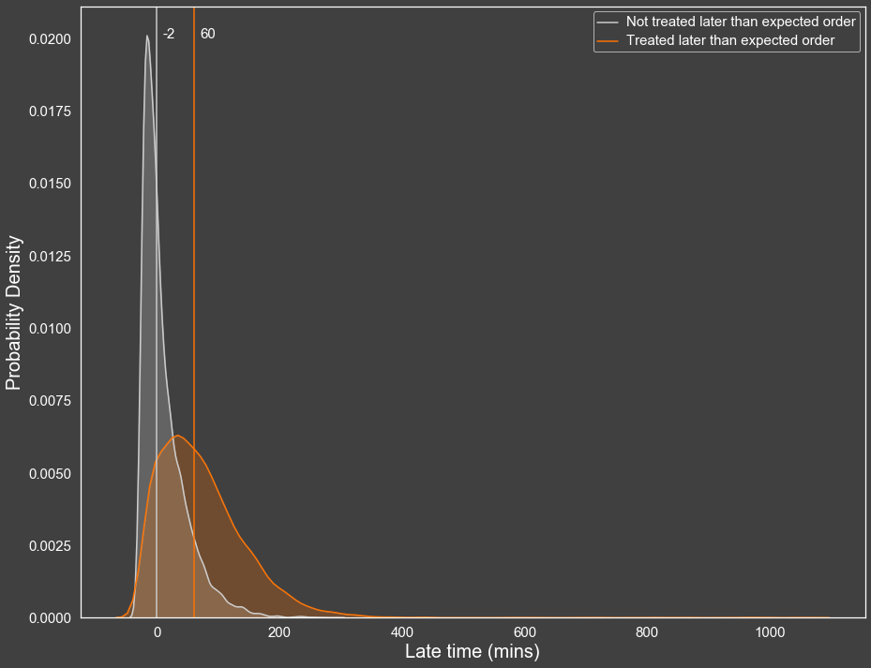
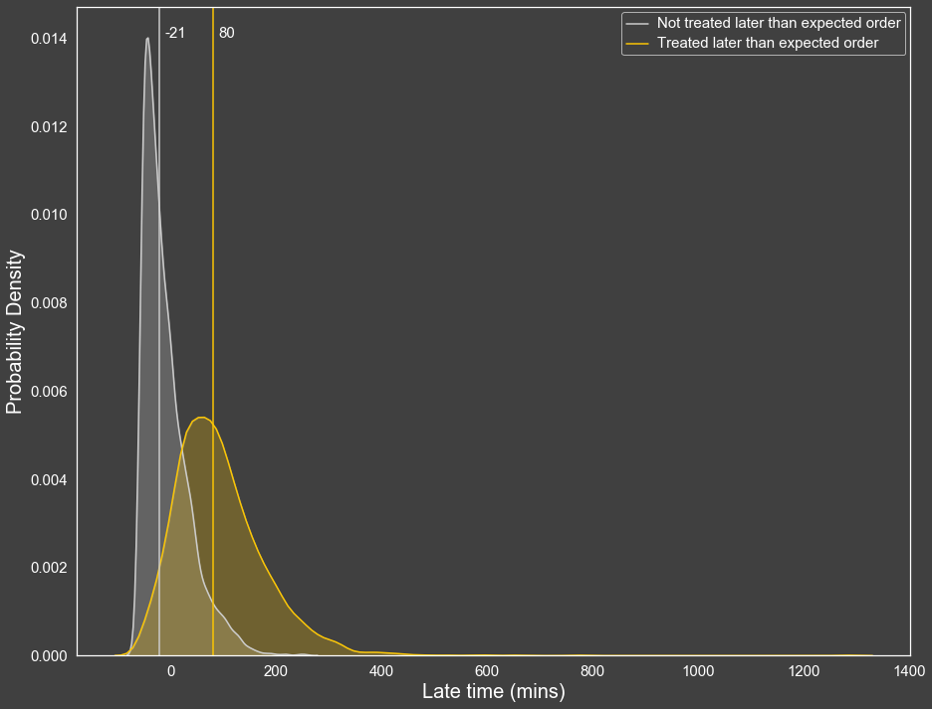
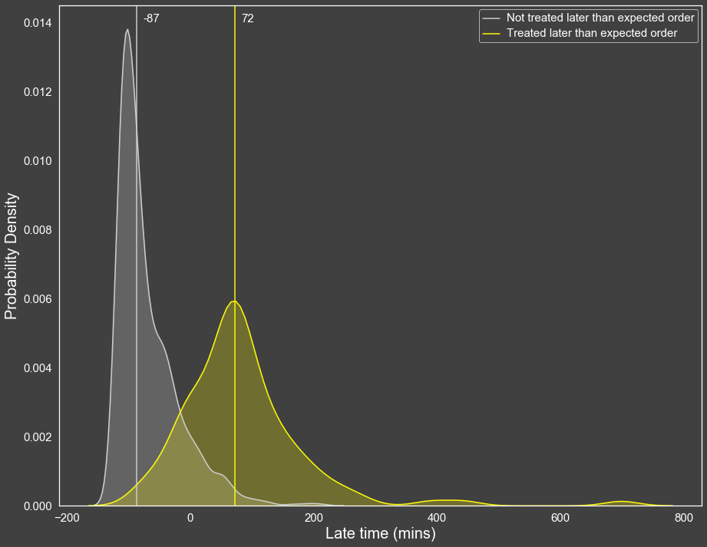
Triage Priority 3
Triage Priority 4
Triage Priority 5
Non-adherence to expected priority significantly extends wait time across triage priorities {3, 4, 5}

Slide 12
Recommendation
An automated patient ranking system should be implemented to support patient prioritisation
The system would provide ED staff with clear visibility over which patient should be seen to next
The system would calculate the relative priority of all patients presenting in ED, and automatically readjust once a new patient is triaged
This recommendation is based on the assumption that the triage process produces accurate triage priority for each patient
The system will provide the ability to re-prioritise patients should their condition severity change
The system should send alerts to staff using a traffic light system to denote the amount of time left until the expected treatment time for a patient
The alert should stay on until the patient has a doctor seen date time entered
5 minutes
10 minutes
20 minutes

Slide 13
Automated Patient priority ranking system
0:22
0:32
0:37
Arrival Time | Triage Priority | Expected Treatment Time
0:17 | 3 | 0:47
0:01 | 4 | 1:01
0:22 | 4 | 1:22
Arrival Time | Triage Priority | Expected Treatment Time
0:17 | 3 | 0:47
0:01 | 4 | 1:01
0:22 | 4 | 1:22
Arrival Time | Triage Priority | Expected Treatment Time
0:37 | 2 | 0:47
0:17 | 3 | 0:47
0:01 | 4 | 1:01
0:22 | 4 | 1:22
1
2
3
1
2
3
1
2
3
4
Tie breaking
Yet to be triaged

Slide 14
Patient reprioritisation
0:37
0:40
0:40
Arrival Time | Triage Priority | Expected Treatment Time
0:37 | 2 | 0:47
0:17 | 3 | 0:47
0:01 | 4 | 1:01
0:22 | 4 | 1:22
Arrival Time | Triage Priority | Expected Treatment Time
0:37 | 2 | 0:47
0:17 | 4 | 1:17
0:01 | 4 | 1:01
0:22 | 4 | 1:22
Arrival Time | Triage Priority | Expected Treatment Time
0:37 | 2 | 0:47
0:01 | 4 | 1:01
0:17 | 4 | 1:17
0:22 | 4 | 1:22
1
2
3
4
1
2
3
4
1
2
3
4

Slide 15
Patient Alert
0:37
0:42
0:48
Expected Treatment Time | Doctor Seen Time
0:47
0:47
1:01
1:22
Expected Treatment Time | Doctor Seen Time
0:47
0:47
1:01
1:22
Expected Treatment Time | Doctor Seen Time
0:47 | 0:45
0:47
1:01
1:22
1
2
3
4
1
2
3
4
1
2
3

Slide 16
Conclusion and next steps
In summary, adherence to patient priority ranking plays a significant role in explaining wait time relative to triage priority
A recommendation for an automated patient priority ranking system can be made along with proper training to ensure all healthcare staffs adhere strictly to the ranking system
Next steps: Gain insights into ED triage process to verify the assumption that the triage process is consistent and reflective of patient acuity
￼

