Slide 1

Optimal Control
Recall:
$$u_{opt}\left(t\right)=\underset{K_{opt}\left(t\right)}{\underbrace{−R^{−1}B^{T}P\left(t\right)}}x\left(t\right) \\ λ\left(t\right)=P\left(t\right)x\left(t\right)$$
$$P\left(t\right)={\left(Φ_{22}−SΦ_{12}\right)}^{−1}\left(SΦ_{11}−Φ_{21}\right)$$
Where $\left[Φ\right]$ is the transition matrix of the Hamiltonian system.

Slide 2

Example
$$\dot{x}\left(t\right)=2x\left(t\right)+u\left(t\right)$$
$$J=\frac{1}{2}\left(3x^{2}\left(5\right)\right)+\frac{1}{2}\int_{0}^{5}{5x^{2}+u^{2} dt}$$
$$t_{0}=0, t_{f}=5, S=3, Q=5, R=1$$
Form Hamiltonian System:
$$\left\{\begin{matrix}\dot{x}\left(t\right) \\ \dot{λ}\left(t\right)\end{matrix}\right\}=\underset{ℋ}{\underbrace{\left[\begin{matrix}A & −BR^{−1}B^{T} \\ −Q & −A^{T}\end{matrix}\right]}}\left\{\begin{matrix}x\left(t\right) \\ λ\left(t\right)\end{matrix}\right\}$$

Slide 3

Example
$$[Φ\left(t\right)=e^{ℋt}=ℒ^{−1}\left\{{\left(sI−ℋ\right)}^{−1}\right\}$$
$$\begin{matrix} & {\left(sI−ℋ\right)}^{−1}= & {\left[\begin{matrix}s−2 & 1 \\ 5 & s+2\end{matrix}\right]}^{−1} \\ & & ⇓ \\ ℋ=\left[\begin{matrix}2 & −1 \\ −5 & −2\end{matrix}\right] & & =\frac{1}{s^{2}−9}\left[\begin{matrix}s+2 & −1 \\ −2 & s−2\end{matrix}\right]\end{matrix}$$

Slide 4

Example
$$e^{ℋ}=ℒ^{−1}[\begin{matrix}\frac{s+2}{\left(s+3\right)\left(s−3\right)} & \frac{−1}{\left(s+3\right)\left(s−3\right)} \\ \frac{−2}{\left(s+3\right)\left(s−3\right)} & \frac{s−2}{\left(s+3\right)\left(s−3\right)}\end{matrix} \\ =\left[\begin{matrix}\frac{1}{6}e^{−3t}+\frac{5}{6}e^{3t} & \frac{1}{6}e^{−3t}−\frac{1}{6}e^{3t} \\ \frac{1}{3}e^{−3t}−\frac{1}{3}e^{3t} & −\frac{5}{6}e^{−3t}+\frac{1}{6}e^{3t}\end{matrix}\right]$$

Slide 5
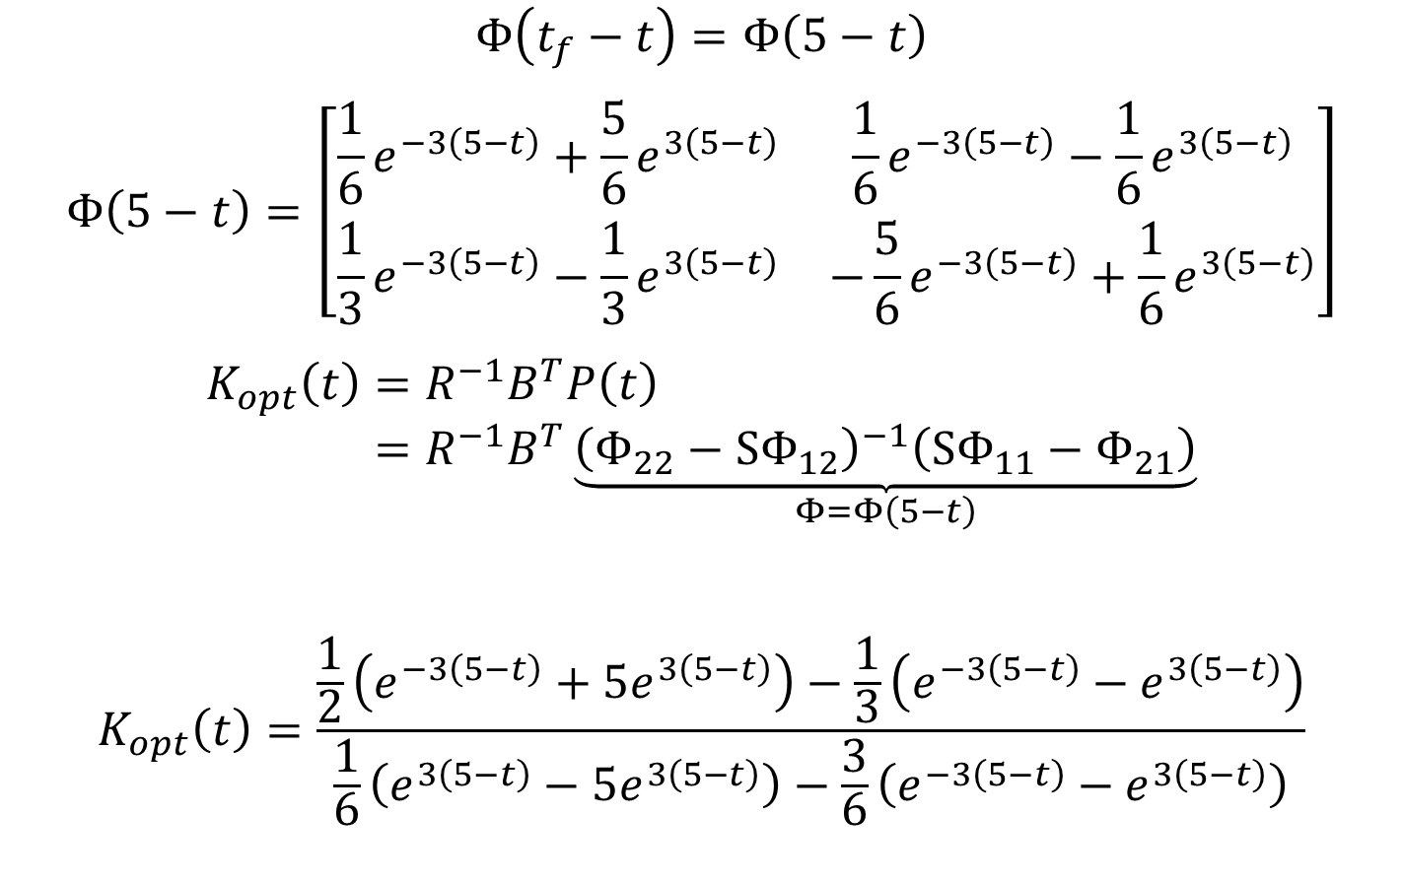
Example
$$Φ\left(t_{f}−t\right)=Φ\left(5−t\right)$$
$$Φ\left(5−t\right)=\left[\begin{matrix}\frac{1}{6}e^{−3\left(5−t\right)}+\frac{5}{6}e^{3\left(5−t\right)} & \frac{1}{6}e^{−3\left(5−t\right)}−\frac{1}{6}e^{3\left(5−t\right)} \\ \frac{1}{3}e^{−3\left(5−t\right)}−\frac{1}{3}e^{3\left(5−t\right)} & −\frac{5}{6}e^{−3\left(5−t\right)}+\frac{1}{6}e^{3\left(5−t\right)}\end{matrix}\right]$$
$$K_{opt}\left(t\right)=R^{−1}B^{T}P\left(t\right) \\ =R^{−1}B^{T}\underset{Φ=Φ\left(5−t\right)}{\underbrace{{\left(Φ_{22}−SΦ_{12}\right)}^{−1}\left(SΦ_{11}−Φ_{21}\right)}}$$
$$K_{opt}\left(t\right)=\frac{\frac{1}{2}\left(e^{−3\left(5−t\right)}+5e^{3\left(5−t\right)}\right)−\frac{1}{3}\left(e^{−3\left(5−t\right)}−e^{3\left(5−t\right)}\right)}{\frac{1}{6}\left(e^{3\left(5−t\right)}−5e^{3\left(5−t\right)}\right)−\frac{3}{6}\left(e^{−3\left(5−t\right)}−e^{3\left(5−t\right)}\right)}$$

Slide 6
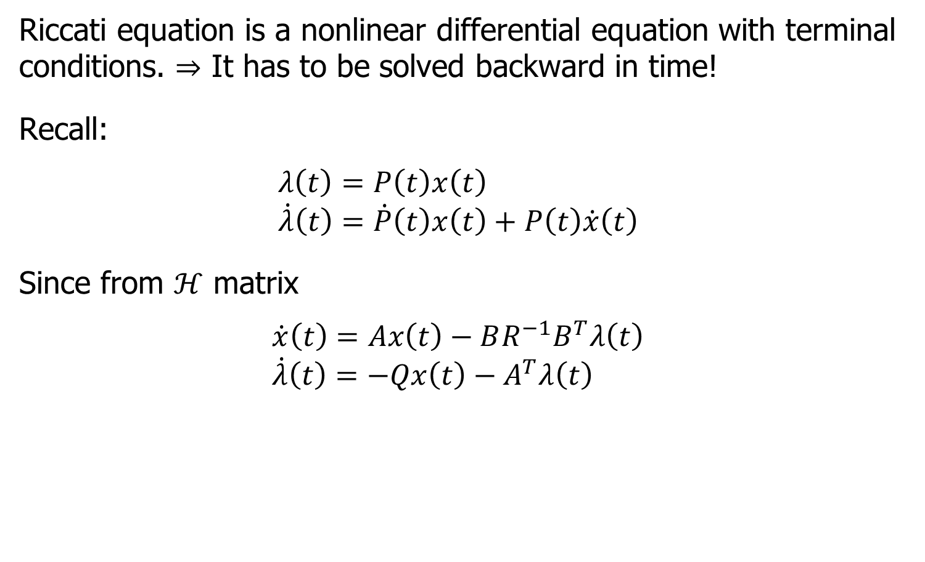
Alternative Way to Find $P(t)$ Riccati Equation
Riccati equation is a nonlinear differential equation with terminal conditions. $⇒$ It has to be solved backward in time!
Recall:
$$λ\left(t\right)=P\left(t\right)x\left(t\right) \\ \dot{λ}\left(t\right)=\dot{P}\left(t\right)x\left(t\right)+P\left(t\right)\dot{x}\left(t\right)$$
Since from $ℋ$ matrix
$$\dot{x}\left(t\right)=Ax\left(t\right)−BR^{−1}B^{T}λ\left(t\right) \\ \dot{λ}\left(t\right)=−Qx\left(t\right)−A^{T}λ\left(t\right)$$

Slide 7
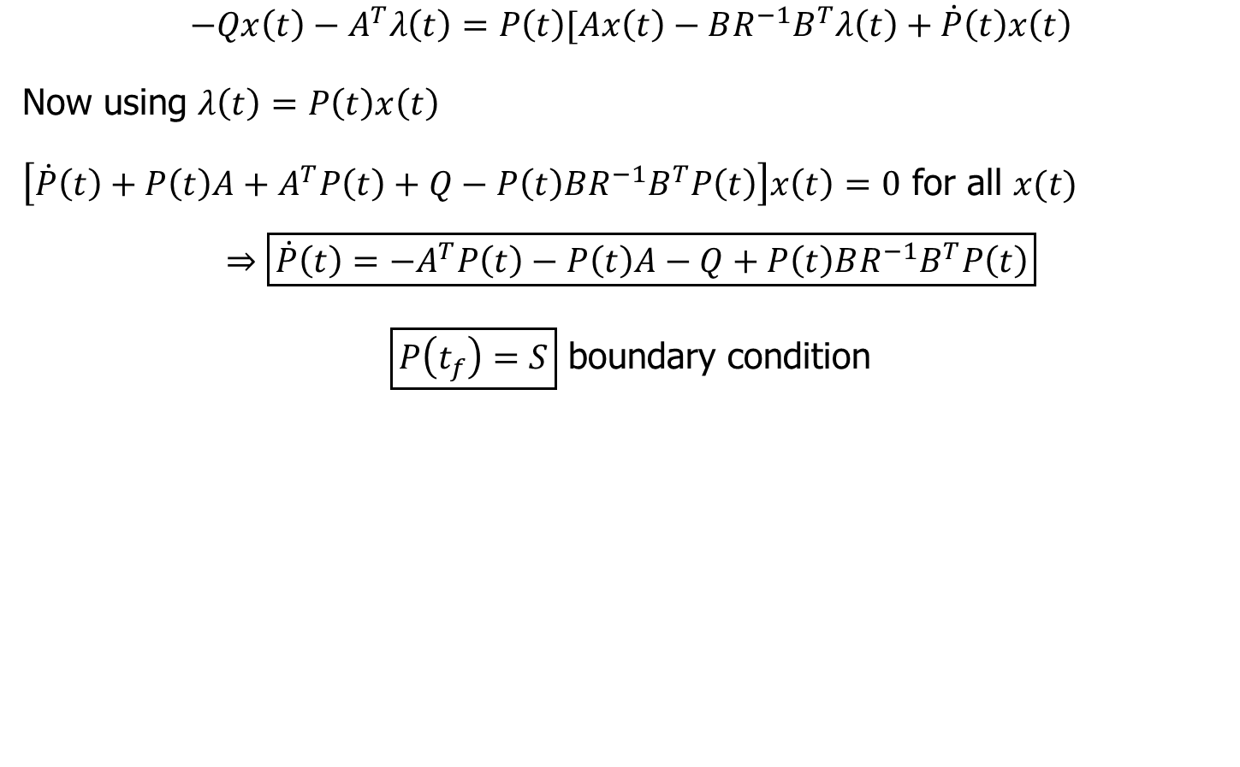
Riccati Solution
$$−Qx\left(t\right)−A^{T}λ\left(t\right)=P\left(t\right)[Ax\left(t\right)−BR^{−1}B^{T}λ\left(t\right)+\dot{P}\left(t\right)x\left(t\right)$$
Now using $λ\left(t\right)=P\left(t\right)x\left(t\right)$
$\left[\dot{P}\left(t\right)+P\left(t\right)A+A^{T}P\left(t\right)+Q−P\left(t\right)BR^{−1}B^{T}P\left(t\right)\right]x\left(t\right)=0$ for all $x(t)$
$$⇒\boxed{\dot{P}\left(t\right)=−A^{T}P\left(t\right)−P\left(t\right)A−Q+P\left(t\right)BR^{−1}B^{T}P\left(t\right)}$$
$\boxed{P\left(t_{f}\right)=S}$ boundary condition

Slide 8

Riccati Equation Properties
Riccati solution is symmetric. i.e. $P=P^{T}$
Riccati solution alos gives optimal cost

Slide 9
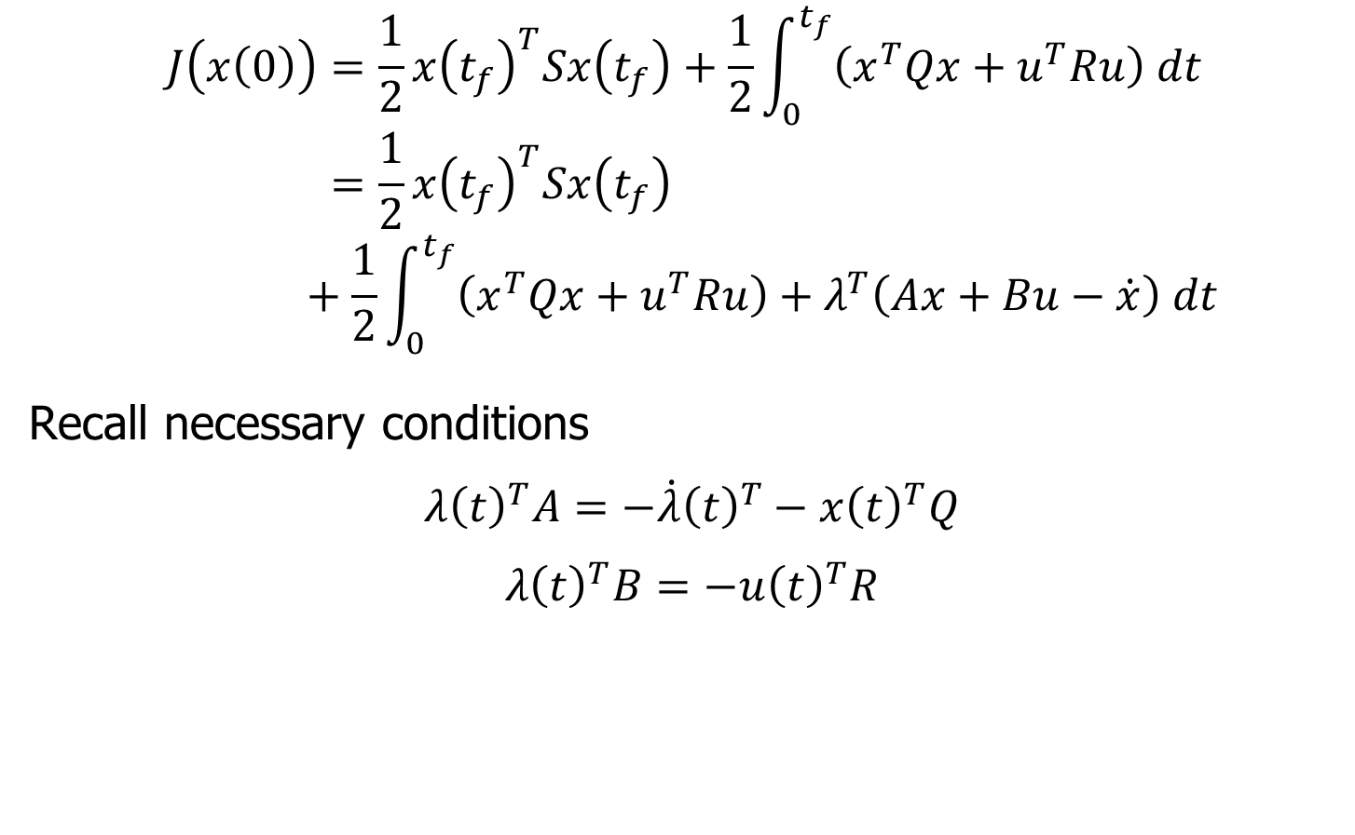
Solving for an Optimal Cost
$$J\left(x\left(0\right)\right)=\frac{1}{2}x{\left(t_{f}\right)}^{T}Sx\left(t_{f}\right)+\frac{1}{2}\int_{0}^{t_{f}}{\left(x^{T}Qx+u^{T}Ru\right) dt} \\ =\frac{1}{2}x{\left(t_{f}\right)}^{T}Sx\left(t_{f}\right)+\frac{1}{2}\int_{0}^{t_{f}}{\left(x^{T}Qx+u^{T}Ru\right)+λ^{T}\left(Ax+Bu−\dot{x}\right) dt}$$
Recall necessary conditions
$$λ{\left(t\right)}^{T}A=−\dot{λ}{\left(t\right)}^{T}−x{\left(t\right)}^{T}Q$$
$$λ{\left(t\right)}^{T}B=−u{\left(t\right)}^{T}R$$

Slide 10

Optimal Cost
$$J\left(x\left(0\right)\right)=\frac{1}{2}x{\left(t_{f}\right)}^{T}Sx\left(t_{f}\right)+\frac{1}{2}\int_{0}^{t_{f}}{\frac{d}{dt}\left(λ{\left(t\right)}^{T}x\left(t\right)\right) dt} \\ =\frac{1}{2}x{\left(t_{f}\right)}^{T}Sx\left(t_{f}\right)+\frac{1}{2}λ{\left(t\right)}^{T}x\left(t\right)+\frac{1}{2}λ{\left(0\right)}^{T}x\left(0\right)$$

Slide 11

Optimal Cost
Since
$P\left(t\right)=P{\left(t\right)}^{T}$ and $P\left(t_{f}\right)=S$ and $λ\left(t_{f}\right)=P\left(t_{f}\right)x\left(t_{f}\right)$
$$J\left(x\left(0\right)\right)=\frac{1}{2}x{\left(t_{f}\right)}^{T}Sx\left(t_{f}\right)−\frac{1}{2}x{\left(t_{f}\right)}^{T}Sx\left(t_{f}\right)+\frac{1}{2}x{\left(0\right)}^{T}P\left(0\right)x\left(0\right)$$
$$\boxed{J\left(x\left(0\right)\right)=\frac{1}{2}x{\left(0\right)}^{T}P\left(0\right)x\left(0\right)}$$

