Slide 1
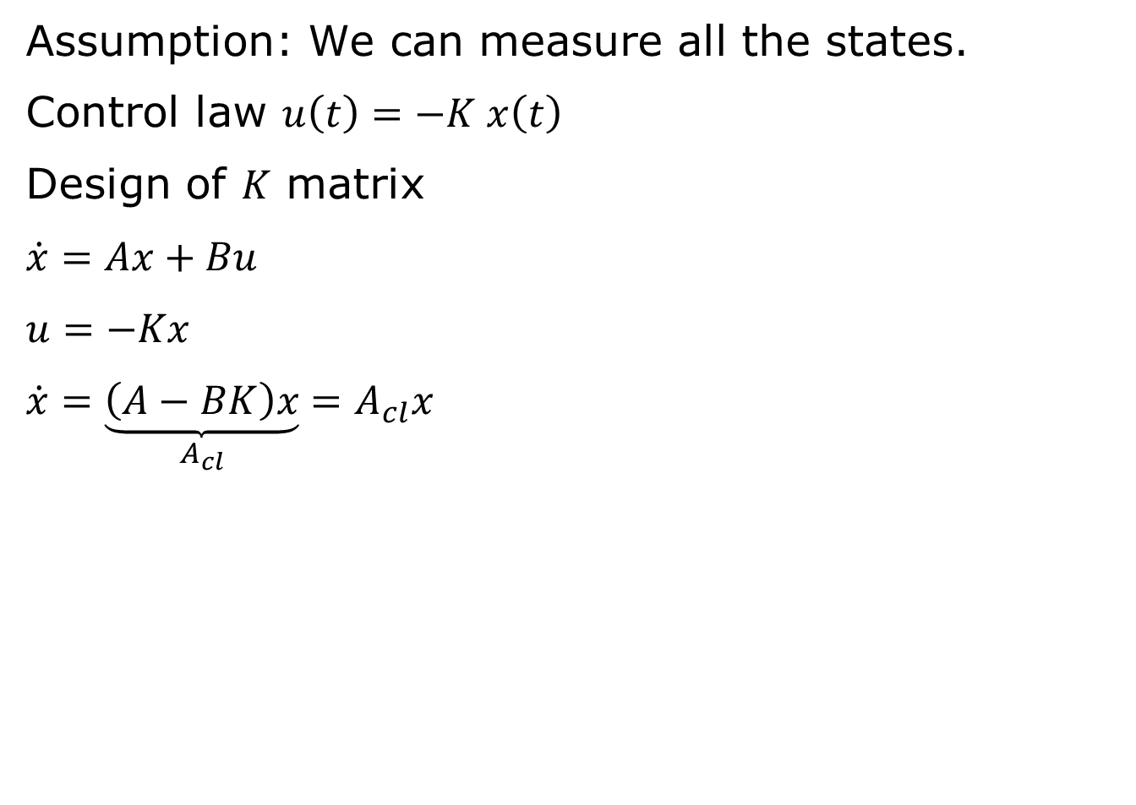
State Feedback Control
Assumption: We can measure all the states.
Control law $u\left(t\right)=−K x\left(t\right)$
Design of $K$ matrix
$$\dot{x}=Ax+Bu$$
$$u=−Kx$$
$$\dot{x}=\underset{A_{cl}}{\underbrace{\left(A−BK\right)x}}=A_{cl}x$$

Slide 2
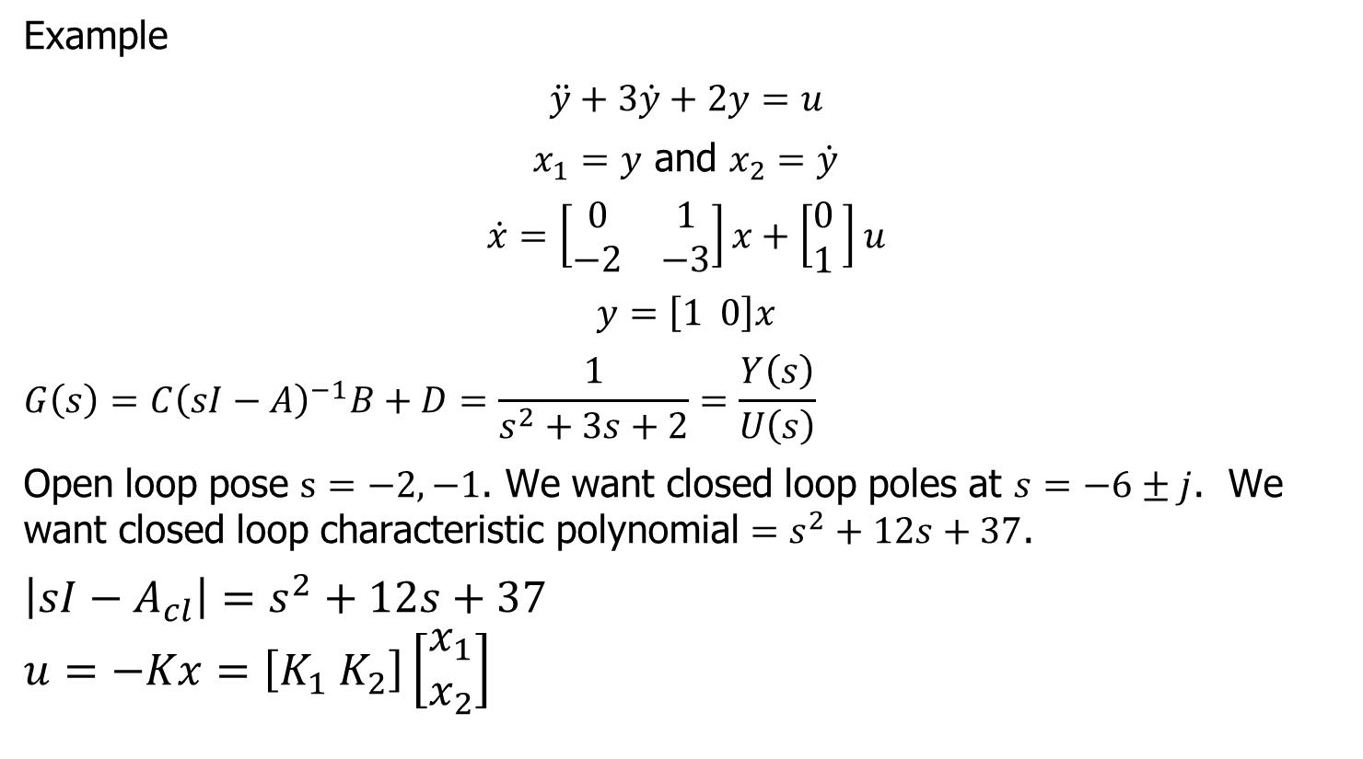
Pole Placement
Example
$$\ddot{y}+3\dot{y}+2y=u$$
$x_{1}=y$ and $x_{2}=\dot{y}$
$$\dot{x}=\left[\begin{matrix}0 & 1 \\ −2 & −3\end{matrix}\right]x+\left[\begin{matrix}0 \\ 1\end{matrix} \right]u$$
$$y=\left[1 0\right]x$$
$$G\left(s\right)=C{\left(sI−A\right)}^{−1}B+D=\frac{1}{s^{2}+3s+2}=\frac{Y\left(s\right)}{U\left(s\right)}$$
Open loop pose $s=−2,−1$. We want closed loop poles at $s=−6±j$. We want closed loop characteristic polynomial $=s^{2}+12s+37$.
$$\left|sI−A_{cl}\right|=s^{2}+12s+37$$
$$u=−Kx=\left[K_{1} K_{2}\right]\left[\begin{matrix}x_{1} \\ x_{2}\end{matrix}\right]$$

Slide 3
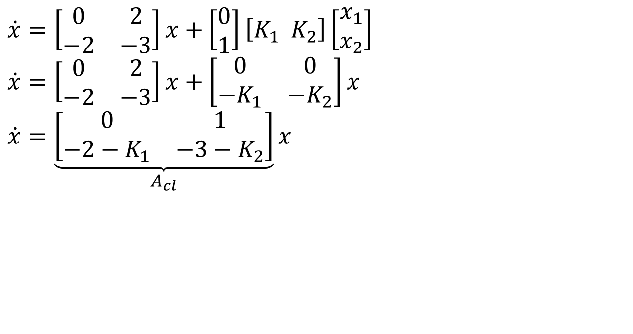
State Feedback Control Law
$$\dot{x}=\left[\begin{matrix}0 & 2 \\ −2 & −3\end{matrix}\right]x+\left[\begin{matrix}0 \\ 1\end{matrix}\right]\left[K_{1} K_{2}\right]\left[\begin{matrix}x_{1} \\ x_{2}\end{matrix}\right]$$
$$\dot{x}=\left[\begin{matrix}0 & 2 \\ −2 & −3\end{matrix}\right]x+\left[\begin{matrix}0 & 0 \\ −K_{1} & −K_{2}\end{matrix}\right]x$$
$$\dot{x}=\underset{A_{cl}}{\underbrace{\left[\begin{matrix}0 & 1 \\ −2−K_{1} & −3−K_{2}\end{matrix}\right]}}x$$

Slide 4
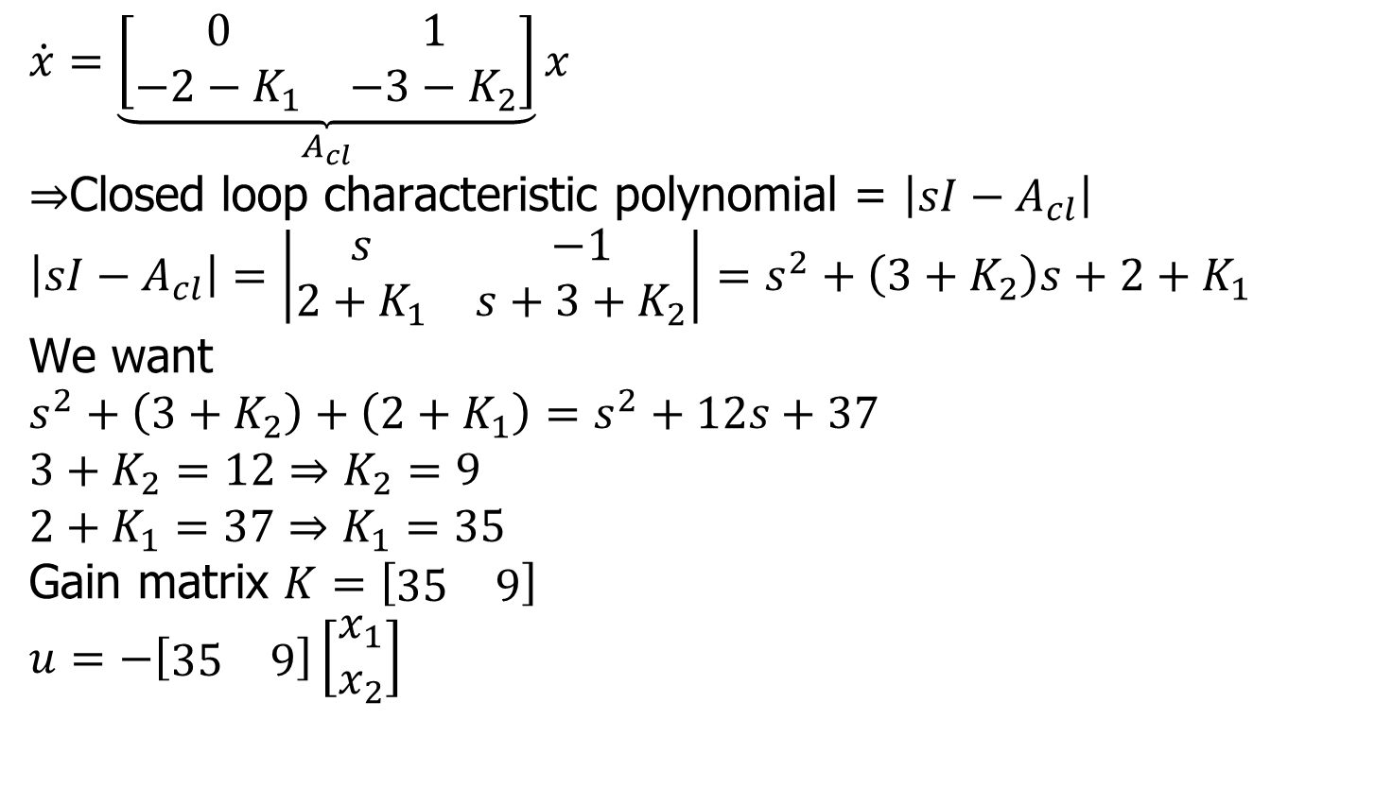
State Feedback Control Law
$$\dot{x}=\underset{A_{cl}}{\underbrace{\left[\begin{matrix}0 & 1 \\ −2−K_{1} & −3−K_{2}\end{matrix}\right]}}x$$
$⇒$Closed loop characteristic polynomial = $\left|sI−A_{cl}\right|$
$$\left|sI−A_{cl}\right|=\left|\begin{matrix}s & −1 \\ 2+K_{1} & s+3+K_{2}\end{matrix}\right|=s^{2}+\left(3+K_{2}\right)s+2+K_{1}$$
We want
$$s^{2}+\left(3+K_{2}\right)+\left(2+K_{1}\right)=s^{2}+12s+37$$
$$3+K_{2}=12⇒K_{2}=9$$
$$2+K_{1}=37⇒K_{1}=35$$
Gain matrix $K=\left[\begin{matrix}35 & 9\end{matrix}\right]$
$$u=−\left[\begin{matrix}35 & 9\end{matrix}\right]\left[\begin{matrix}x_{1} \\ x_{2}\end{matrix}\right]$$

Slide 5
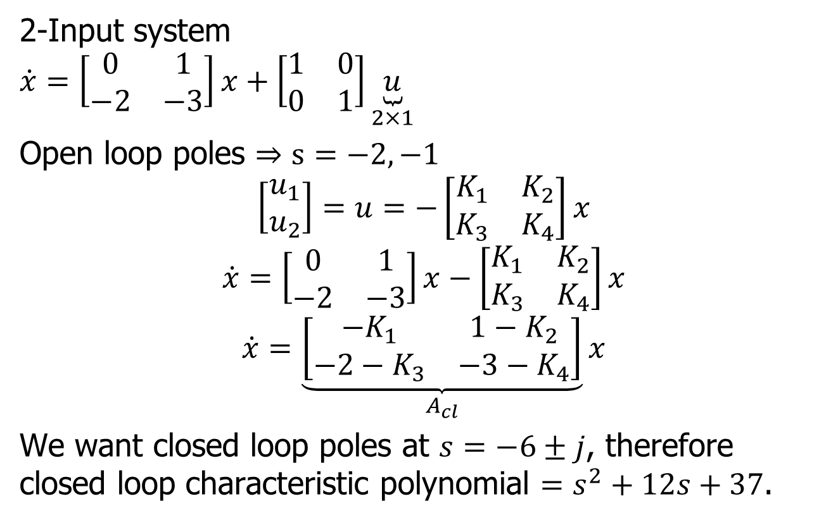
MIMO Case
2-Input system
$$\dot{x}=\left[\begin{matrix}0 & 1 \\ −2 & −3\end{matrix}\right]x+\left[\begin{matrix}1 & 0 \\ 0 & 1\end{matrix}\right]\underset{2×1}{\underbrace{u}}$$
Open loop poles $⇒s=−2, −1$
$$\left[\begin{matrix}u_{1} \\ u_{2}\end{matrix}\right]=u=−\left[\begin{matrix}K_{1} & K_{2} \\ K_{3} & K_{4}\end{matrix}\right]x$$
$$\dot{x}=\left[\begin{matrix}0 & 1 \\ −2 & −3\end{matrix}\right]x−\left[\begin{matrix}K_{1} & K_{2} \\ K_{3} & K_{4}\end{matrix}\right]x$$
$$\dot{x}=\underset{A_{cl}}{\underbrace{\left[\begin{matrix}−K_{1} & 1−K_{2} \\ −2−K_{3} & −3−K_{4}\end{matrix}\right]}}x$$
We want closed loop poles at $s=−6±j$, therefore closed loop characteristic polynomial $=s^{2}+12s+37$.

Slide 6
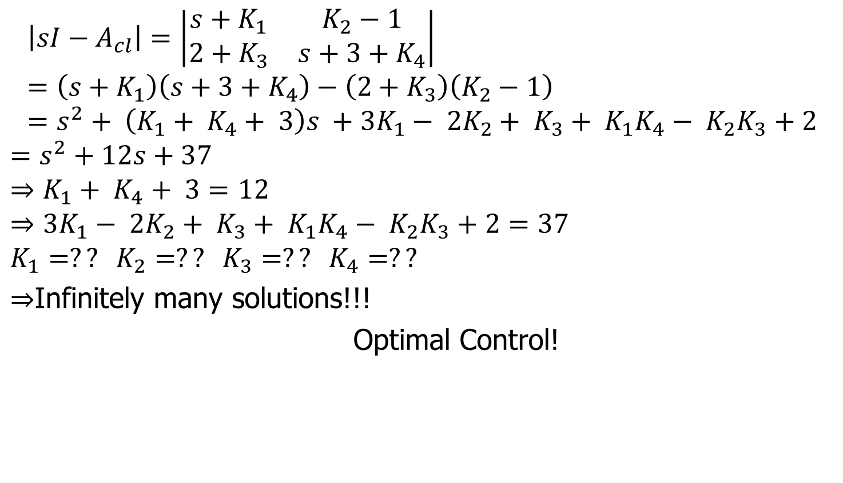
MIMO Case (cont.)
$$\left|sI−A_{cl}\right|=\left|\begin{matrix}s+K_{1} & K_{2}−1 \\ 2+K_{3} & s+3+K_{4}\end{matrix}\right| \\ =\left(s+K_{1}\right)\left(s+3+K_{4}\right)−\left(2+K_{3}\right)\left(K_{2}−1\right) \\ =s^{2}+ \left(K_{1}+ K_{4}+ 3\right)s +3K_{1}− 2K_{2}+ K_{3}+ K_{1}K_{4}− K_{2}K_{3}+2$$
$$=s^{2}+12s+37$$
$$⇒K_{1}+ K_{4}+ 3=12$$
$$⇒3K_{1}− 2K_{2}+ K_{3}+ K_{1}K_{4}− K_{2}K_{3}+2=37$$
$$K_{1}=?? K_{2}=?? K_{3}=?? K_{4}=??$$
$⇒$Infinitely many solutions!!!
Optimal Control!

Slide 7
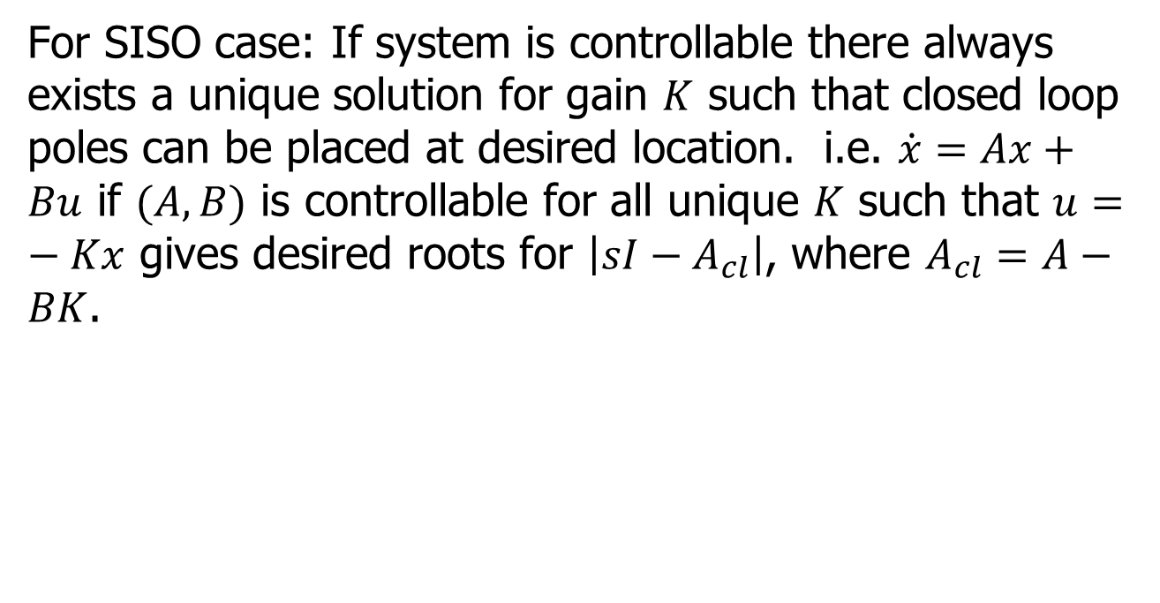
Summary
For SISO case: If system is controllable there always exists a unique solution for gain $K$ such that closed loop poles can be placed at desired location. i.e. $\dot{x}=Ax+Bu$ if $(A,B)$ is controllable for all unique $K$ such that $u=−Kx$ gives desired roots for $\left|sI−A_{cl}\right|$, where $A_{cl}=A−BK$.

Slide 8
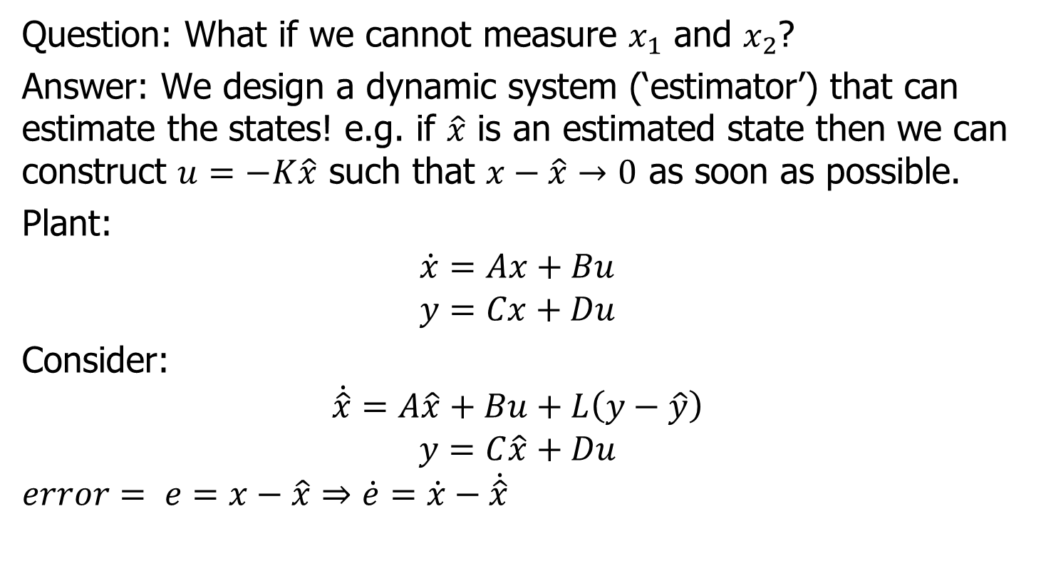
Observer-based feedback
Question: What if we cannot measure $x_{1}$ and $x_{2}$?
Answer: We design a dynamic system (‘estimator’) that can estimate the states! e.g. if $\hat{x}$ is an estimated state then we can construct $u=−K\hat{x}$ such that $x−\hat{x}→0$ as soon as possible.
Plant:
$$\dot{x}=Ax+Bu$$
$$y=Cx+Du$$
Consider:
$$\dot{\hat{x}}=A\hat{x}+Bu+L\left(y−\hat{y}\right)$$
$$y=C\hat{x}+Du$$
$$error= e=x−\hat{x}⇒\dot{e}=\dot{x}−\dot{\hat{x}}$$

Slide 9
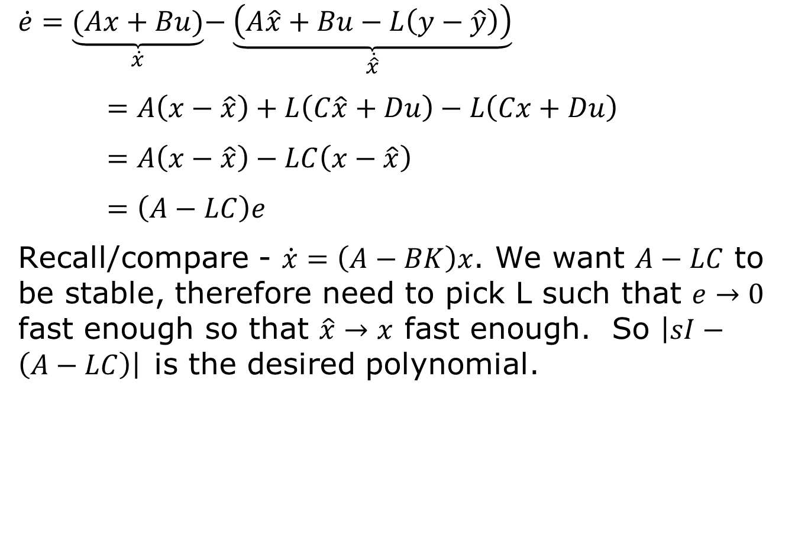
Observer-based Feedback
$$\dot{e}=\underset{\dot{x}}{\underbrace{(Ax+Bu)}}−\underset{\dot{\hat{x}}}{\underbrace{\left(A\hat{x}+Bu−L\left(y−\hat{y}\right)\right)}}$$
$=A\left(x−\hat{x}\right)+L\left(C\hat{x}+Du\right)−L\left(Cx+Du\right)$
$=A\left(x−\hat{x}\right)−LC\left(x−\hat{x}\right)$
$=\left(A−LC\right)e$
Recall/compare - $\dot{x}=\left(A−BK\right)x$. We want $A−LC$ to be stable, therefore need to pick L such that $e→0$ fast enough so that $\hat{x}→x$ fast enough. So $\left|sI−\left(A−LC\right)\right|$is the desired polynomial.

Slide 10
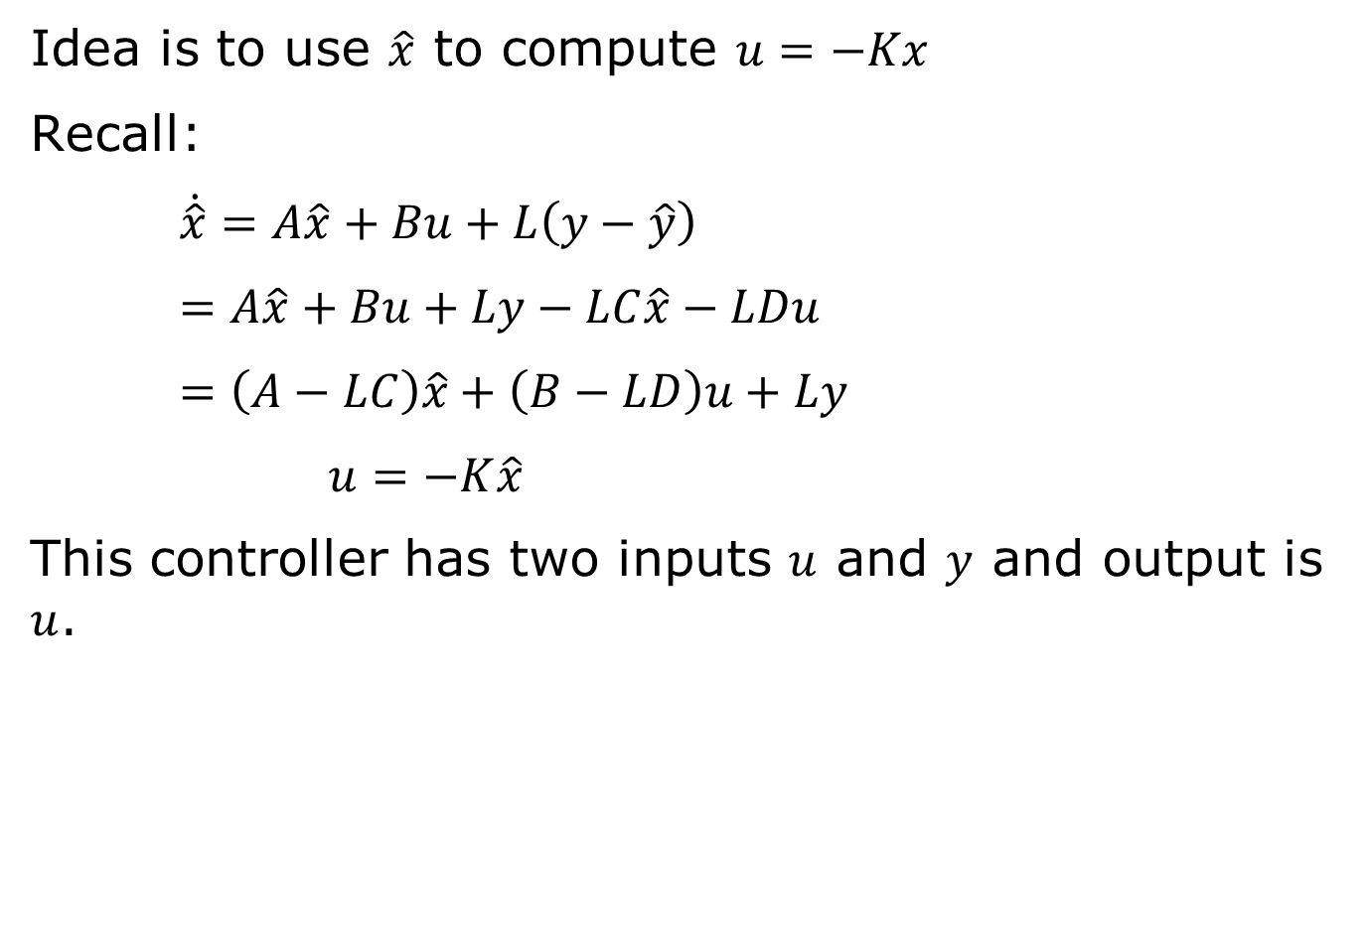
Observer-base Controller
Idea is to use $\hat{x}$ to compute $u=−Kx$
Recall:
$\dot{\hat{x}}=A\hat{x}+Bu+L\left(y−\hat{y}\right)$
$=A\hat{x}+Bu+Ly−LC\hat{x}−LDu$
$=\left(A−LC\right)\hat{x}+\left(B−LD\right)u+Ly$
$u=−K\hat{x}$
This controller has two inputs $u$ and $y$ and output is $u$.

Slide 11


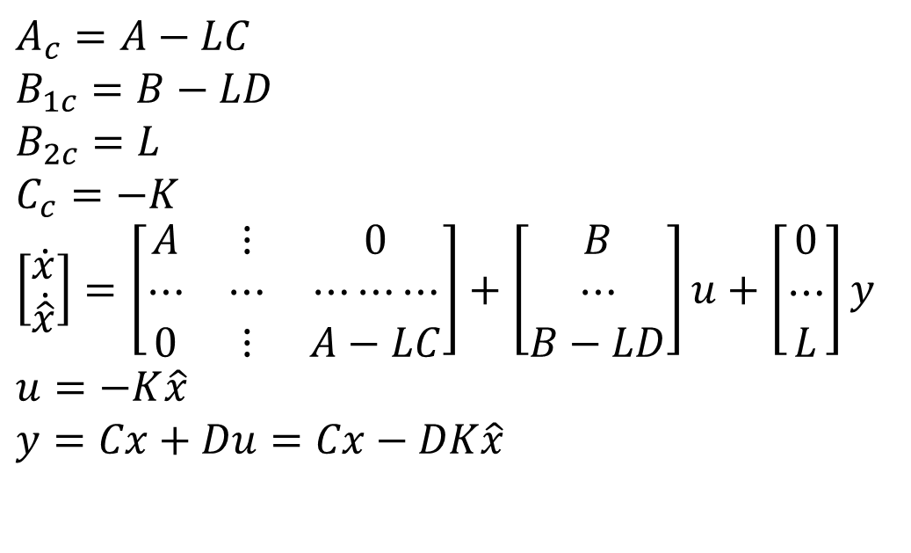



Observer-based Controller
$$u$$
$$y$$
$$Plant$$
$$A_{c}=A−LC \\ B_{1c}=B−LD \\ B_{2c}=L \\ C_{c}=−K$$
$$\left[\begin{matrix}\dot{x} \\ \dot{\hat{x}}\end{matrix}\right]=\left[\begin{matrix}A & ⋮ & 0 \\ ⋯ & ⋯ & ⋯⋯⋯ \\ 0 & ⋮ & A−LC\end{matrix}\right]+\left[\begin{matrix}B \\ ⋯ \\ B−LD\end{matrix}\right]u+\left[\begin{matrix}0 \\ ⋯ \\ L\end{matrix}\right]y$$
$$u=−K\hat{x}$$
$$y=Cx+Du=Cx−DK\hat{x}$$
$$−K$$
$$estimator$$

Slide 12
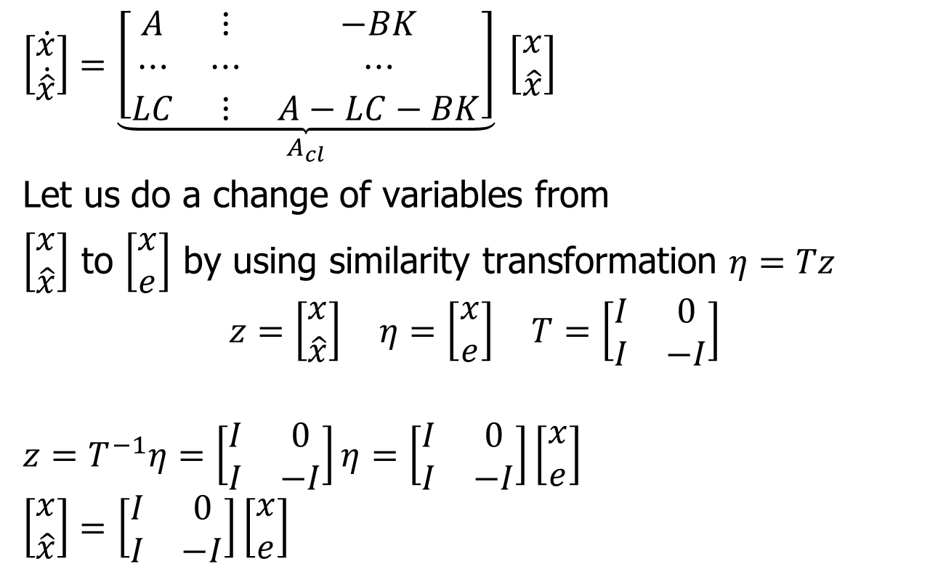
Observer-based Controller
$$\left[\begin{matrix}\dot{x} \\ \dot{\hat{x}}\end{matrix}\right]=\underset{A_{cl}}{\underbrace{\left[\begin{matrix}A & ⋮ & −BK \\ ⋯ & ⋯ & ⋯ \\ LC & ⋮ & A−LC−BK\end{matrix}\right]}} \left[\begin{matrix}x \\ \hat{x}\end{matrix}\right]$$
Let us do a change of variables from
$\left[\begin{matrix}x \\ \hat{x}\end{matrix}\right]$ to $\left[\begin{matrix}x \\ e\end{matrix}\right]$ by using similarity transformation $η=Tz$
$$z=\left[\begin{matrix}x \\ \hat{x}\end{matrix}\right] η=\left[\begin{matrix}x \\ e\end{matrix}\right] T=\left[\begin{matrix}I & 0 \\ I & −I\end{matrix}\right]$$
$$z=T^{−1}η=\left[\begin{matrix}I & 0 \\ I & −I\end{matrix}\right]η=\left[\begin{matrix}I & 0 \\ I & −I\end{matrix}\right]\left[\begin{matrix}x \\ e\end{matrix}\right]$$
$$\left[\begin{matrix}x \\ \hat{x}\end{matrix}\right]=\left[\begin{matrix}I & 0 \\ I & −I\end{matrix}\right]\left[\begin{matrix}x \\ e\end{matrix}\right]$$

Slide 13
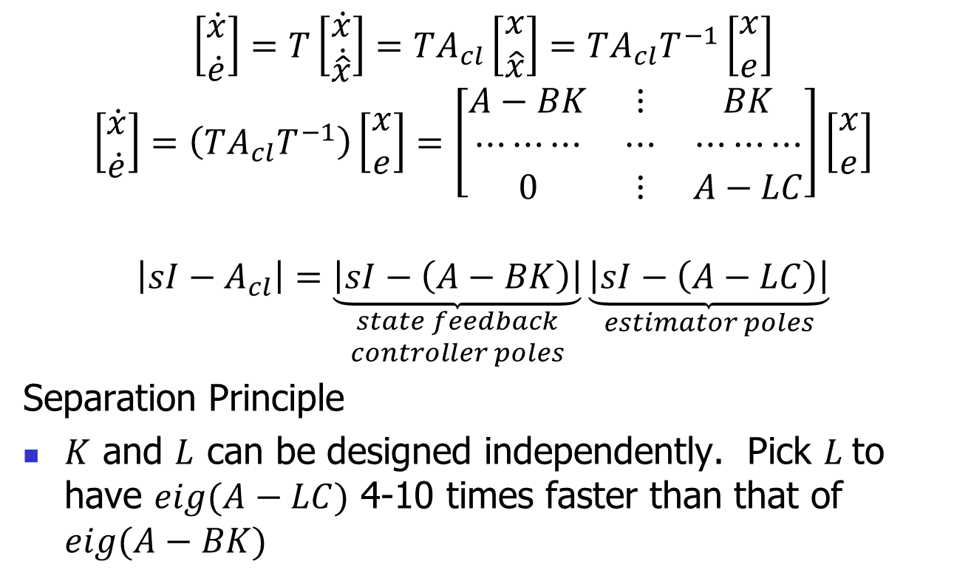
Observer-based Controller
$$\left[\begin{matrix}\dot{x} \\ \dot{e}\end{matrix}\right]=T\left[\begin{matrix}\dot{x} \\ \dot{\hat{x}}\end{matrix}\right]=TA_{cl}\left[\begin{matrix}x \\ \hat{x}\end{matrix}\right]=TA_{cl}T^{−1}\left[\begin{matrix}x \\ e\end{matrix}\right]$$
$$\left[\begin{matrix}\dot{x} \\ \dot{e}\end{matrix}\right]=\left(TA_{cl}T^{−1}\right)\left[\begin{matrix}x \\ e\end{matrix}\right]=\left[\begin{matrix}A−BK & ⋮ & BK \\ ⋯⋯⋯ & ⋯ & ⋯⋯⋯ \\ 0 & ⋮ & A−LC\end{matrix}\right]\left[\begin{matrix}x \\ e\end{matrix}\right]$$
$$\left|sI−A_{cl}\right|=\underset{\begin{aligned}state feedback \\ controller poles\end{aligned}}{\underbrace{\left|sI−\left(A−BK\right)\right|}}\underset{estimator poles}{\underbrace{\left|sI−\left(A−LC\right)\right|}}$$
Separation Principle
$K$ and $L$ can be designed independently. Pick $L$to have $eig(A−LC)$ 4-10 times faster than that of $eig(A−BK)$

Slide 14
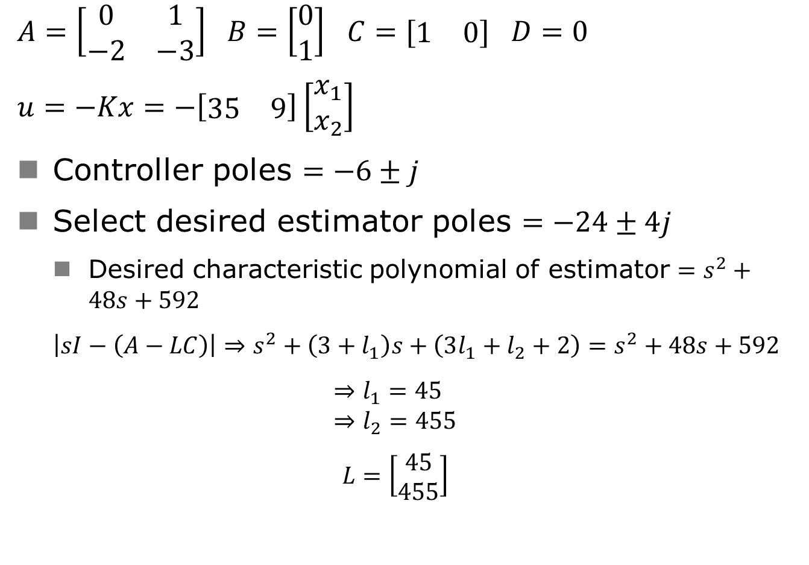
Observer-based Controller
$A=\left[\begin{matrix}0 & 1 \\ −2 & −3\end{matrix}\right]$ $B=\left[\begin{matrix}0 \\ 1\end{matrix}\right]$ $C=[\begin{matrix}1 & 0\end{matrix}]$ $D=0$
$$u=−Kx=−\left[\begin{matrix}35 & 9\end{matrix}\right]\left[\begin{matrix}x_{1} \\ x_{2}\end{matrix}\right]$$
Controller poles $=−6±j$
Select desired estimator poles $=−24±4j$
  Desired characteristic polynomial of estimator $=s^{2}+48s+592$
  $$\left|sI−\left(A−LC\right)\right|⇒s^{2}+\left(3+l_{1}\right)s+\left(3l_{1}+l_{2}+2\right)=s^{2}+48s+592$$
  $$⇒l_{1}=45 \\ ⇒l_{2}=455$$
  $$L=\left[\begin{matrix}45 \\ 455\end{matrix}\right]$$

