Slide 1
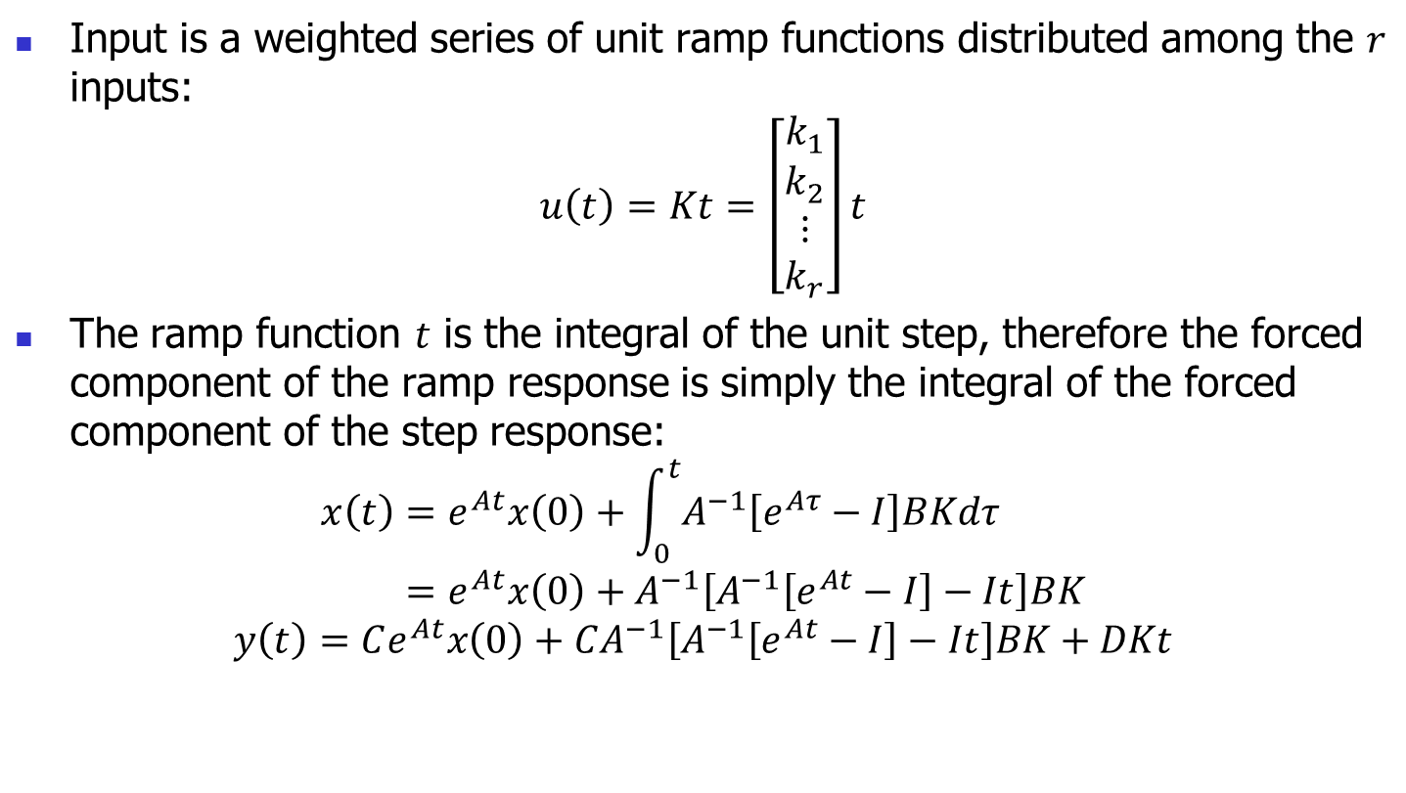
Ramp Response
Input is a weighted series of unit ramp functions distributed among the $r$ inputs:
$$u\left(t\right)=Kt=\left[\begin{matrix}k_{1} \\ k_{2} \\ \begin{aligned}⋮ \\ k_{r}\end{aligned}\end{matrix}\right]t$$
The ramp function $t$ is the integral of the unit step, therefore the forced component of the ramp response is simply the integral of the forced component of the step response:
$$x\left(t\right)=e^{At}x\left(0\right)+\int_{0}^{t}{A^{−1}\left[e^{Aτ}−I\right]BKdτ} \\ =e^{At}x\left(0\right)+A^{−1}\left[A^{−1}\left[e^{At}−I\right]−It\right]BK$$
$$y\left(t\right)=Ce^{At}x\left(0\right)+CA^{−1}\left[A^{−1}\left[e^{At}−I\right]−It\right]BK+DKt$$

Slide 2
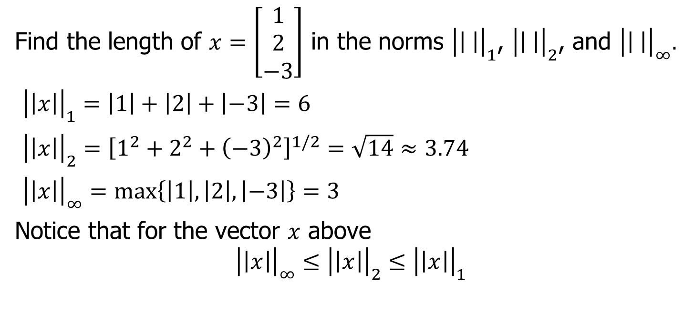
Example
Find the length of $x=\left[\begin{matrix}1 \\ 2 \\ −3\end{matrix}\right]$ in the norms ${\left|\left| \right|\right|}_{1}$, ${\left|\left| \right|\right|}_{2}$, and ${\left|\left| \right|\right|}_{∞}.$
${\left|\left|x\right|\right|}_{1}=\left|1\right|+\left|2\right|+\left|−3\right|=6$
${\left|\left|x\right|\right|}_{2}={\left[1^{2}+2^{2}+{\left(−3\right)}^{2}\right]}^{1/2}=\sqrt{14}≈3.74$
${\left|\left|x\right|\right|}_{∞}=\max\left\{\left|1\right|,\left|2\right|,\left|−3\right|\right\}=3$
Notice that for the vector $x$ above
$${\left|\left|x\right|\right|}_{∞}≤{\left|\left|x\right|\right|}_{2}≤{\left|\left|x\right|\right|}_{1}$$

Slide 3

In Class Practice Problem
For following vector find the 1-norm, 2-norm, 3-norm, 4-norm, and infinity norm
$$x=\left[\begin{matrix}1 \\ 2 \\ 3\end{matrix}\right]$$

Slide 4
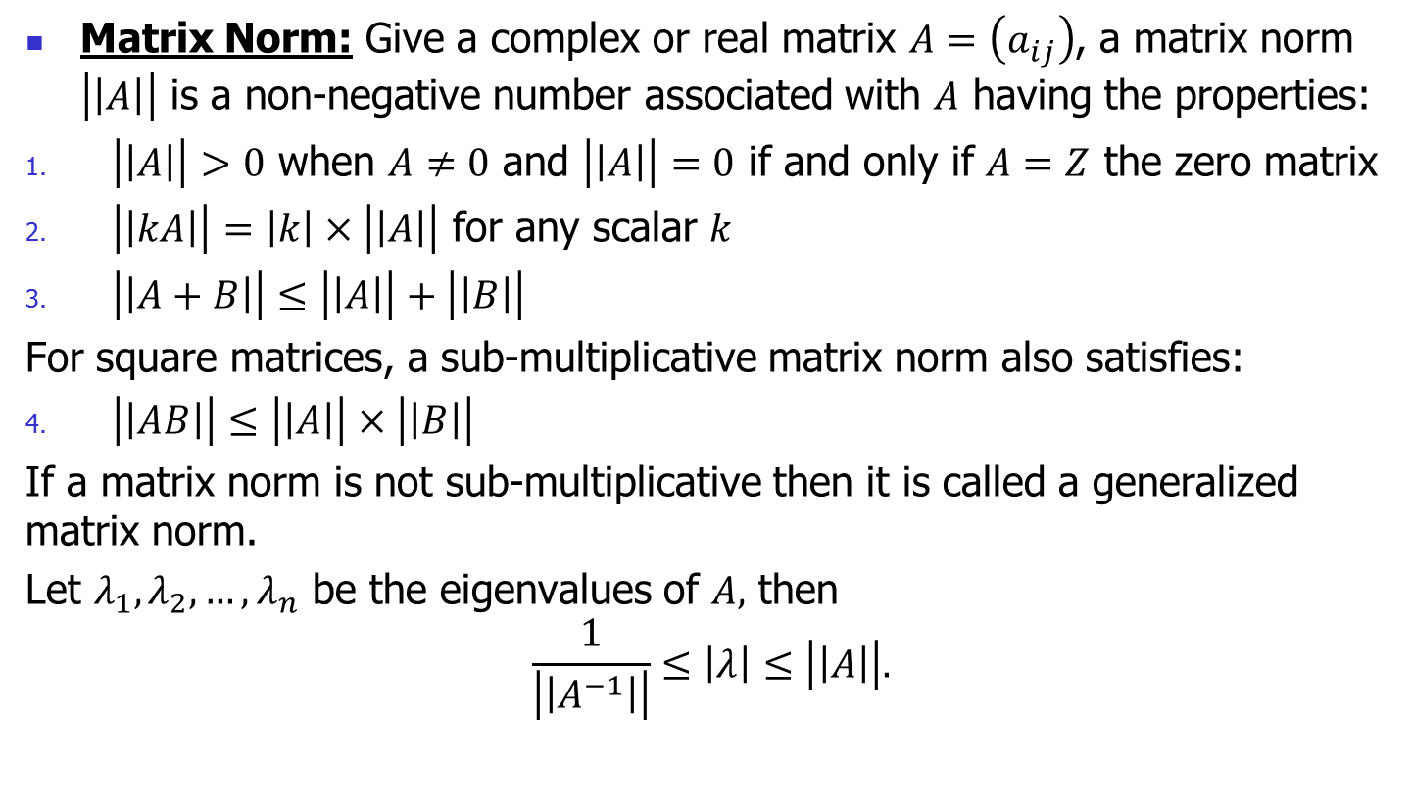
Matrix Norms
Matrix Norm: Give a complex or real matrix $A=\left(a_{ij}\right)$, a matrix norm $\left|\left|A\right|\right|$ is a non-negative number associated with $A$ having the properties:
$\left|\left|A\right|\right|>0$ when $A≠0$ and $\left|\left|A\right|\right|=0$ if and only if $A=Z$ the zero matrix
$\left|\left|kA\right|\right|=\left|k\right|×\left|\left|A\right|\right|$ for any scalar $k$
$\left|\left|A+B\right|\right|≤\left|\left|A\right|\right|+\left|\left|B\right|\right|$
For square matrices, a sub-multiplicative matrix norm also satisfies:
$\left|\left|AB\right|\right|≤\left|\left|A\right|\right|×\left|\left|B\right|\right|$
If a matrix norm is not sub-multiplicative then it is called a generalized matrix norm.
Let $λ_{1},λ_{2}, …,λ_{n}$ be the eigenvalues of $A,$ then
$$\frac{1}{\left|\left|A^{−1}\right|\right|}≤\left|λ\right|≤\left|\left|A\right|\right|.$$

Slide 5
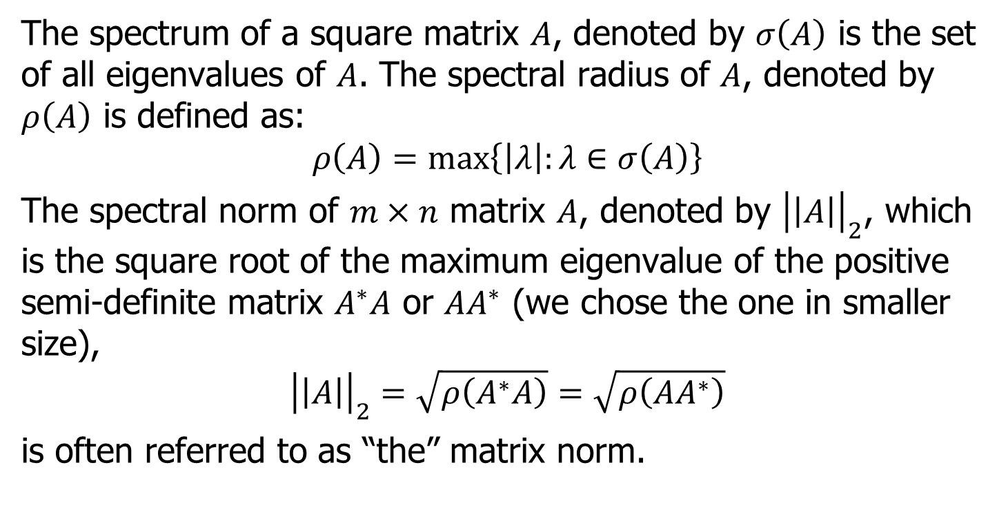
Matrix 2-norm
The spectrum of a square matrix $A$, denoted by $σ\left(A\right)$ is the set of all eigenvalues of $A$. The spectral radius of $A$, denoted by $ρ\left(A\right)$ is defined as:
$$ρ\left(A\right)=\max\left\{\left|λ\right|:λ∈σ\left(A\right)\right\}$$
The spectral norm of $m×n$ matrix $A$, denoted by ${\left|\left|A\right|\right|}_{2}$, which is the square root of the maximum eigenvalue of the positive semi-definite matrix $A^{∗}A$ or $AA^{∗}$ (we chose the one in smaller size),
$${\left|\left|A\right|\right|}_{2}=\sqrt{ρ\left(A^{∗}A\right)}=\sqrt{ρ\left(AA^{∗}\right)}$$
is often referred to as “the” matrix norm.

Slide 6
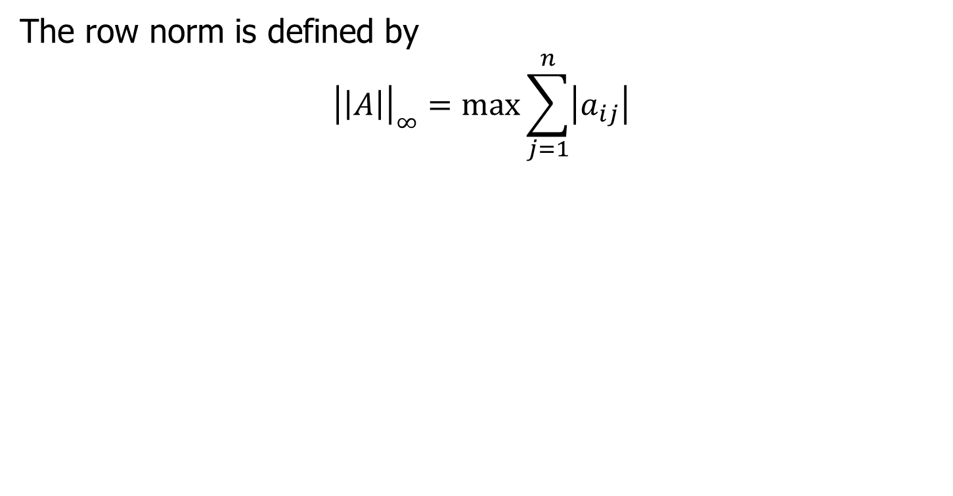

Matrix $∞$-norm (Row-Norm)
The row norm is defined by
$${\left|\left|A\right|\right|}_{∞}=\max{\sum_{j=1}^{n}{\left|a_{ij}\right|}}$$

Slide 7
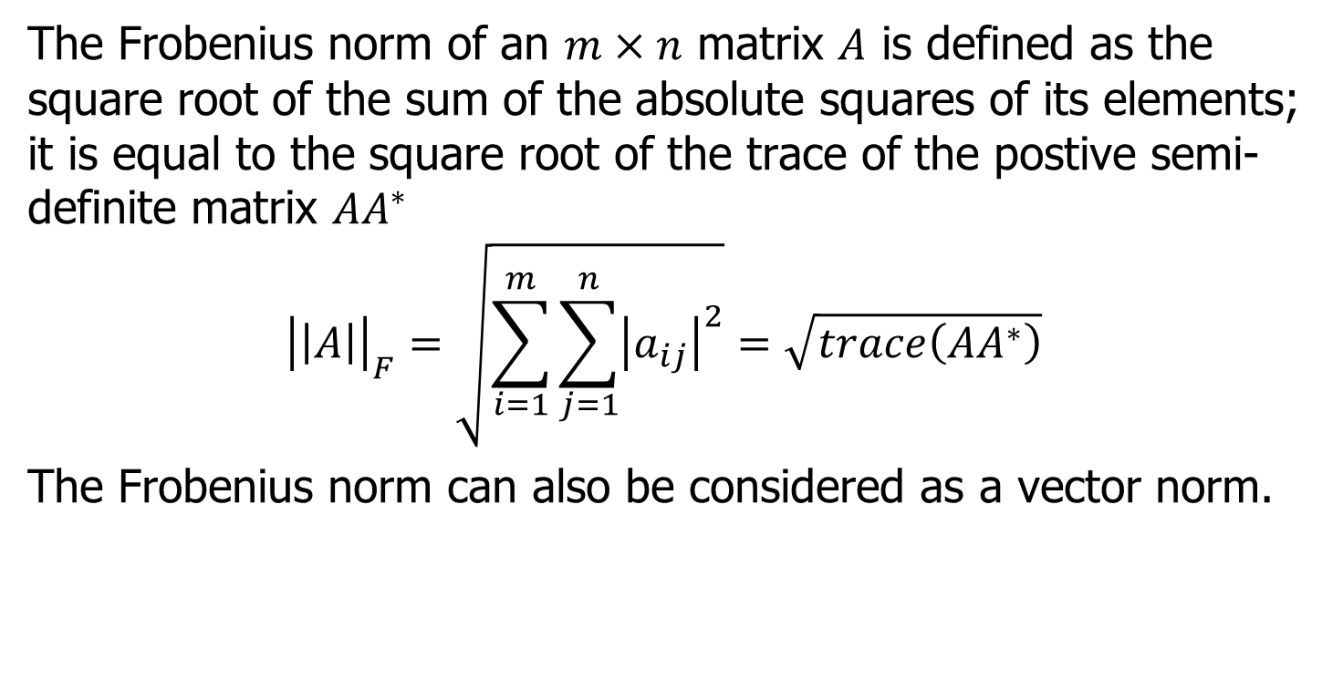
Matrix Frobenius Norm
The Frobenius norm of an $m×n$ matrix $A$ is defined as the square root of the sum of the absolute squares of its elements; it is equal to the square root of the trace of the postive semi-definite matrix $AA^{∗}$
$${\left|\left|A\right|\right|}_{F}=\sqrt{\sum_{i=1}^{m}{\sum_{j=1}^{n}{{\left|a_{ij}\right|}^{2}}}}=\sqrt{trace\left(AA^{∗}\right)}$$
The Frobenius norm can also be considered as a vector norm.

Slide 8
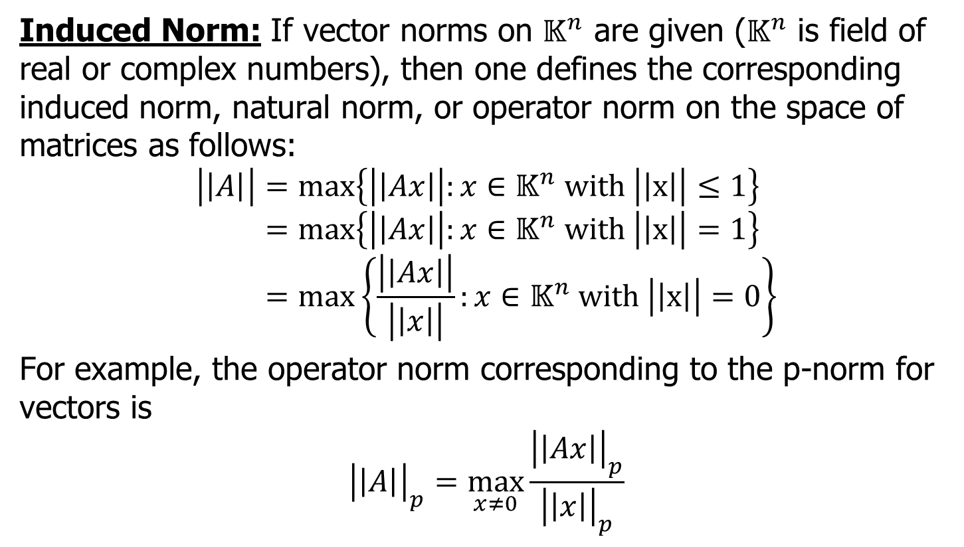
Matrix Induced Norm
Induced Norm: If vector norms on $𝕂^{n}$ are given ($𝕂^{n}$ is field of real or complex numbers), then one defines the corresponding induced norm, natural norm, or operator norm on the space of matrices as follows:
$$\left|\left|A\right|\right|=\max\left\{\left|\left|Ax\right|\right|:x∈𝕂^{n} with \left|\left|x\right|\right|≤1\right\} \\ =\max\left\{\left|\left|Ax\right|\right|:x∈𝕂^{n} with \left|\left|x\right|\right|=1\right\} \\ =\max\left\{\frac{\left|\left|Ax\right|\right|}{\left|\left|x\right|\right|}:x∈𝕂^{n} with \left|\left|x\right|\right|=0\right\}$$
For example, the operator norm corresponding to the p-norm for vectors is
$${\left|\left|A\right|\right|}_{p}=\max_{x≠0}{\frac{{\left|\left|Ax\right|\right|}_{p}}{{\left|\left|x\right|\right|}_{p}}}$$

Slide 9
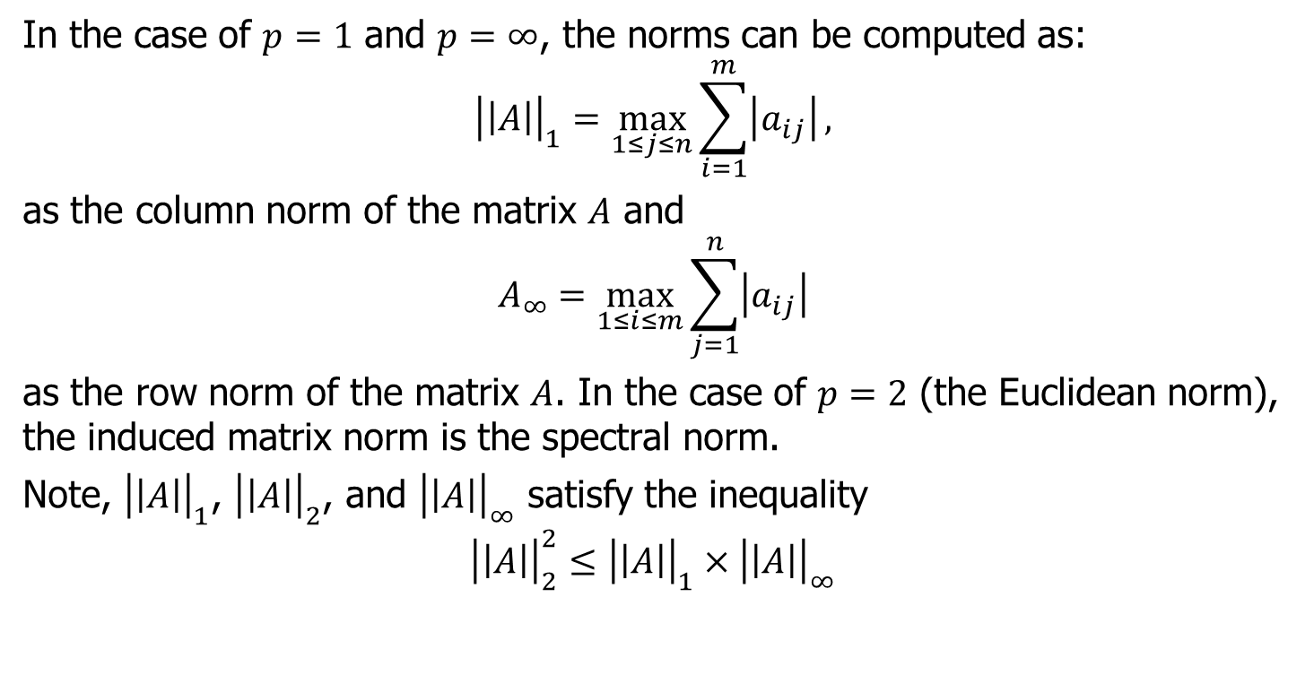
Matrix Induced Norm (continued)
In the case of $p=1$ and $p=∞$, the norms can be computed as:
$${\left|\left|A\right|\right|}_{1}=\max_{1≤j≤n}{\sum_{i=1}^{m}{\left|a_{ij}\right|}},$$
as the column norm of the matrix $A$ and
$$A_{∞}=\max_{1≤i≤m}{\sum_{j=1}^{n}{\left|a_{ij}\right|}}$$
as the row norm of the matrix $A$. In the case of $p=2$ (the Euclidean norm), the induced matrix norm is the spectral norm.
Note, ${\left|\left|A\right|\right|}_{1}$, ${\left|\left|A\right|\right|}_{2}$, and ${\left|\left|A\right|\right|}_{∞}$ satisfy the inequality
$${\left|\left|A\right|\right|}_{2}^{2}≤{\left|\left|A\right|\right|}_{1}×{\left|\left|A\right|\right|}_{∞}$$

Slide 10
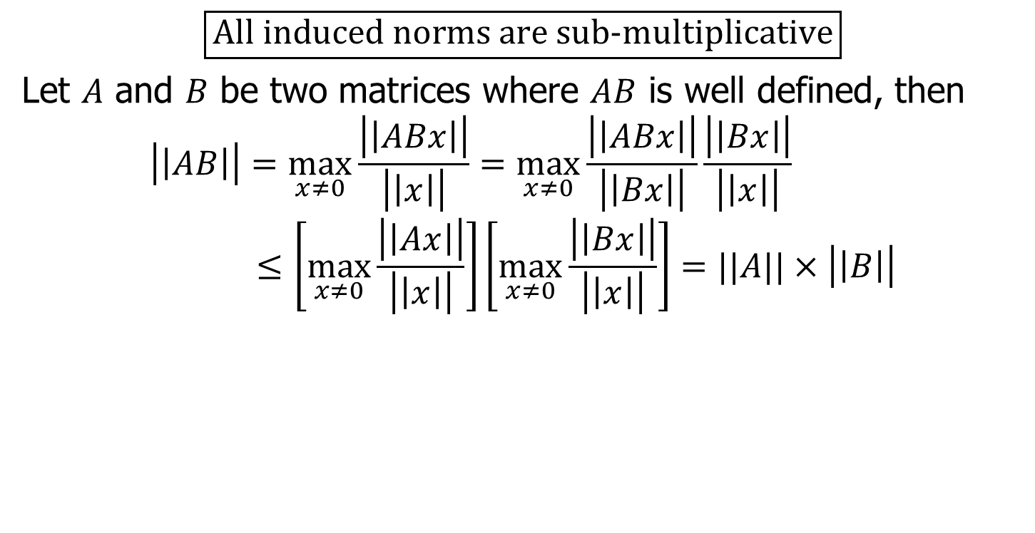
Matrix Induced Norm (continued)
$$\boxed{\text{All} \text{induced} \text{norms} \text{are} \text{sub}\text{−}\text{multiplicative}}$$
Let $A$ and $B$ be two matrices where $AB$ is well defined, then
$$\left|\left|AB\right|\right|=\max_{x≠0}{\frac{\left|\left|ABx\right|\right|}{\left|\left|x\right|\right|}}=\max_{x≠0}{\frac{\left|\left|ABx\right|\right|}{\left|\left|Bx\right|\right|}\frac{\left|\left|Bx\right|\right|}{\left|\left|x\right|\right|}}≤\left[\max_{x≠0}{\frac{\left|\left|Ax\right|\right|}{\left|\left|x\right|\right|}}\right]\left[\max_{x≠0}{\frac{\left|\left|Bx\right|\right|}{\left|\left|x\right|\right|}}\right]=||A||×\left|\left|B\right|\right|$$

Slide 11
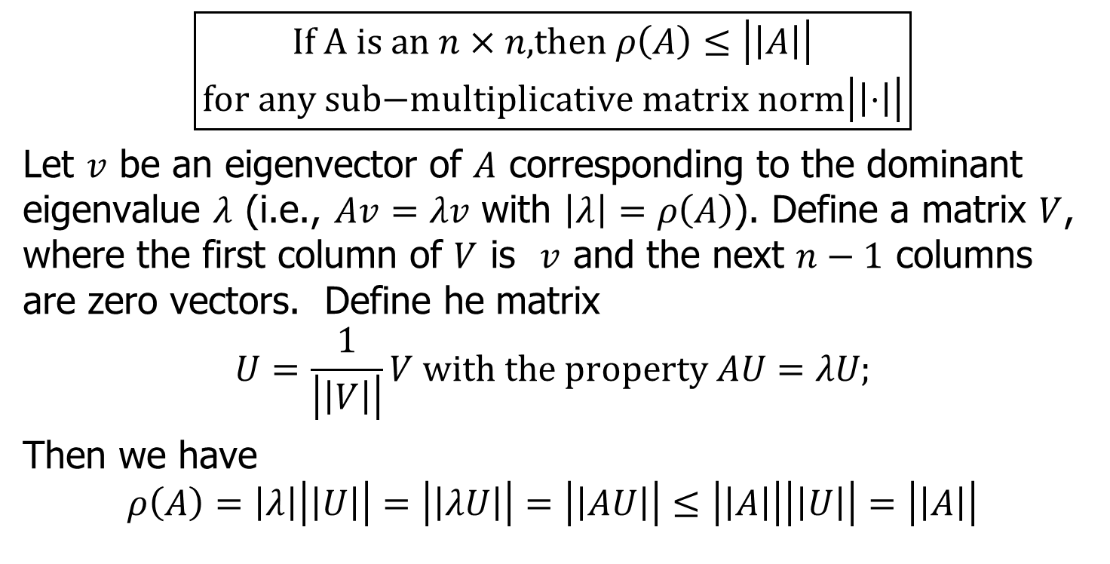
Matrix Induced Norm (continued)
$$\boxed{\begin{aligned}\text{If} \text{A} \text{is} \text{an} n×n\text{,}\text{then} ρ\left(A\right)≤\left|\left|A\right|\right| \\ \text{for} \text{any} \text{sub}\text{−}\text{multiplicative} \text{matrix} \text{norm}\left|\left|⋅\right|\right|\end{aligned}}$$
Let $v$ be an eigenvector of $A$ corresponding to the dominant eigenvalue $λ$ (i.e., $Av=λv$ with $\left|λ\right|=ρ\left(A\right)$). Define a matrix $V$, where the first column of $V$ is $v$ and the next $n−1$ columns are zero vectors. Define he matrix
$$U=\frac{1}{\left|\left|V\right|\right|}V \text{with} \text{the} \text{property} AU=λU\text{;}$$
Then we have
$$ρ\left(A\right)=\left|λ\right|\left|\left|U\right|\right|=\left|\left|λU\right|\right|=\left|\left|AU\right|\right|≤\left|\left|A\right|\right|\left|\left|U\right|\right|=\left|\left|A\right|\right|$$

Slide 12
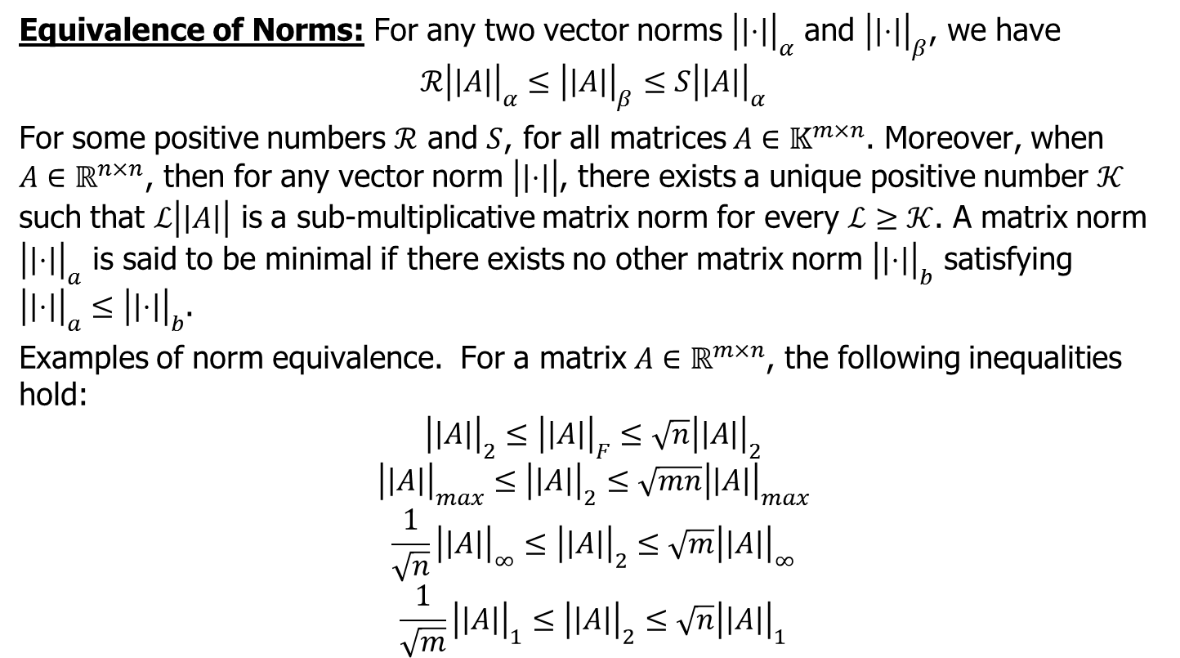
Norm Equivalence
Equivalence of Norms: For any two vector norms ${\left|\left|⋅\right|\right|}_{α}$ and ${\left|\left|⋅\right|\right|}_{β}$, we have
$$ℛ{\left|\left|A\right|\right|}_{α}≤{\left|\left|A\right|\right|}_{β}≤S{\left|\left|A\right|\right|}_{α}$$
For some positive numbers $ℛ$ and $S$, for all matrices $A∈𝕂^{m×n}$. Moreover, when $A∈ℝ^{n×n}$, then for any vector norm $\left|\left|⋅\right|\right|$, there exists a unique positive number $𝒦$ such that $ℒ\left|\left|A\right|\right|$ is a sub-multiplicative matrix norm for every $ℒ≥𝒦$. A matrix norm ${\left|\left|⋅\right|\right|}_{a}$ is said to be minimal if there exists no other matrix norm ${\left|\left|⋅\right|\right|}_{b}$ satisfying ${\left|\left|⋅\right|\right|}_{a}≤{\left|\left|⋅\right|\right|}_{b}$.
Examples of norm equivalence. For a matrix $A∈ℝ^{m×n}$, the following inequalities hold:
$${\left|\left|A\right|\right|}_{2}≤{\left|\left|A\right|\right|}_{F}≤\sqrt{n}{\left|\left|A\right|\right|}_{2}$$
$${\left|\left|A\right|\right|}_{max}≤{\left|\left|A\right|\right|}_{2}≤\sqrt{mn}{\left|\left|A\right|\right|}_{max}$$
$$\frac{1}{\sqrt{n}}{\left|\left|A\right|\right|}_{∞}≤{\left|\left|A\right|\right|}_{2}≤\sqrt{m}{\left|\left|A\right|\right|}_{∞}$$
$$\frac{1}{\sqrt{m}}{\left|\left|A\right|\right|}_{1}≤{\left|\left|A\right|\right|}_{2}≤\sqrt{n}{\left|\left|A\right|\right|}_{1}$$

Slide 13
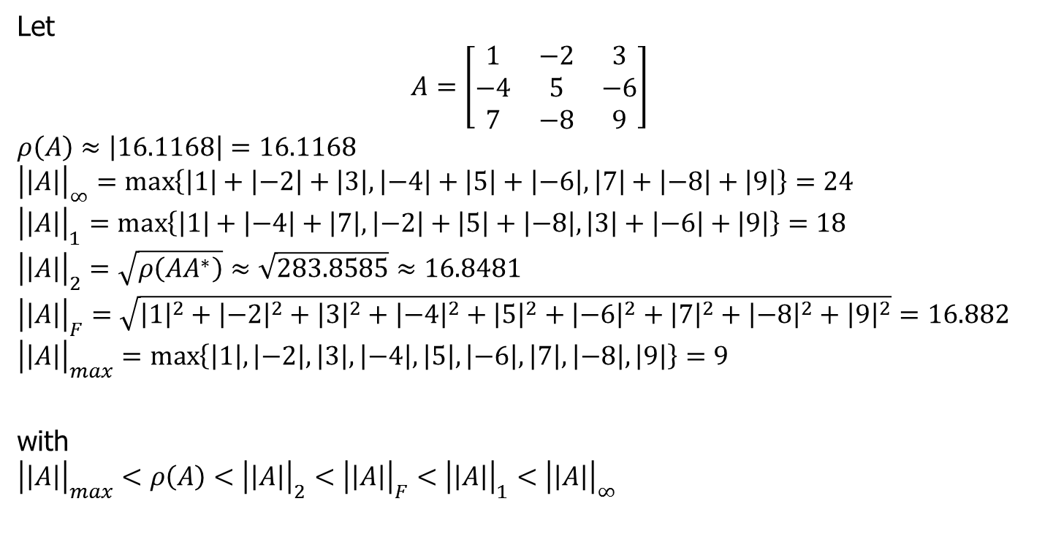
Example
Let
$$A=\left[\begin{matrix}1 & −2 & 3 \\ −4 & 5 & −6 \\ 7 & −8 & 9\end{matrix}\right]$$
$$ρ\left(A\right)≈\left|16.1168\right|=16.1168$$
$${\left|\left|A\right|\right|}_{∞}=\max\left\{\left|1\right|+\left|−2\right|+\left|3\right|,\left|−4\right|+\left|5\right|+\left|−6\right|,\left|7\right|+\left|−8\right|+\left|9\right|\right\}=24$$
$${\left|\left|A\right|\right|}_{1}=\max\left\{\left|1\right|+\left|−4\right|+\left|7\right|,\left|−2\right|+\left|5\right|+\left|−8\right|,\left|3\right|+\left|−6\right|+\left|9\right|\right\}=18$$
$${\left|\left|A\right|\right|}_{2}=\sqrt{ρ\left(AA^{∗}\right)}≈\sqrt{283.8585}≈16.8481$$
$${\left|\left|A\right|\right|}_{F}=\sqrt{{\left|1\right|}^{2}+{\left|−2\right|}^{2}+{\left|3\right|}^{2}+{\left|−4\right|}^{2}+{\left|5\right|}^{2}+{\left|−6\right|}^{2}+{\left|7\right|}^{2}+{\left|−8\right|}^{2}+{\left|9\right|}^{2}}=16.882$$
$${\left|\left|A\right|\right|}_{max}=\max\left\{\left|1\right|,\left|−2\right|,\left|3\right|,\left|−4\right|,\left|5\right|, \left|−6\right|,\left|7\right|,\left|−8\right|,\left|9\right|\right\}=9$$
with
$${\left|\left|A\right|\right|}_{max}<ρ\left(A\right)<{\left|\left|A\right|\right|}_{2}<{\left|\left|A\right|\right|}_{F}<{\left|\left|A\right|\right|}_{1}<{\left|\left|A\right|\right|}_{∞}$$

Slide 14
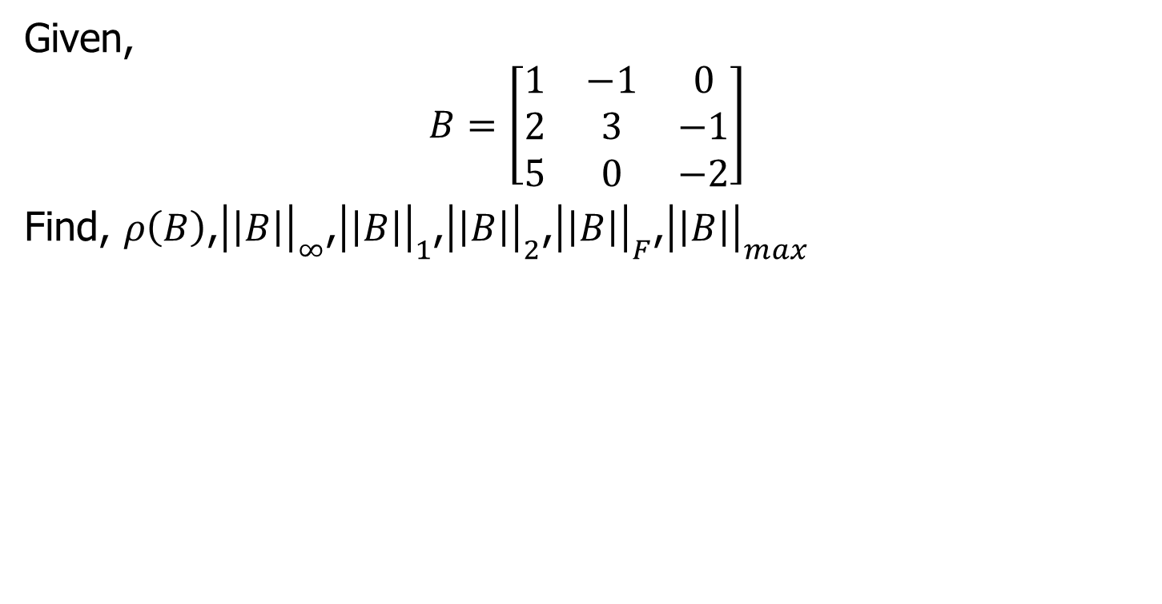
In-class Exercise
Given,
$$B=\left[\begin{matrix}1 & −1 & 0 \\ 2 & 3 & −1 \\ 5 & 0 & −2\end{matrix}\right]$$
Find, $ρ\left(B\right)$,${\left|\left|B\right|\right|}_{∞}$,${\left|\left|B\right|\right|}_{1}$,${\left|\left|B\right|\right|}_{2}$,${\left|\left|B\right|\right|}_{F}$,${\left|\left|B\right|\right|}_{max}$

