Slide 1
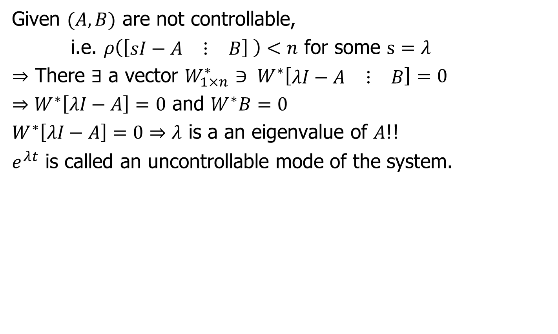
Uncontrollable Modes
Given $(A,B)$ are not controllable,
i.e. $ρ\left(\left[\begin{matrix}sI−A & ⋮ & B\end{matrix}\right] \right)<n$ for some $s=λ$
$⇒$ There $∃$ a vector $W_{1×n}^{∗}$ $∋ W^{∗}\left[\begin{matrix}λI−A & ⋮ & B\end{matrix}\right]=0$
$⇒W^{∗}\left[λI−A\right]=0$ and $W^{∗}B=0$
$W^{∗}\left[λI−A\right]=0⇒λ$ is a an eigenvalue of $A$!!
$e^{λt}$ is called an uncontrollable mode of the system.

Slide 2
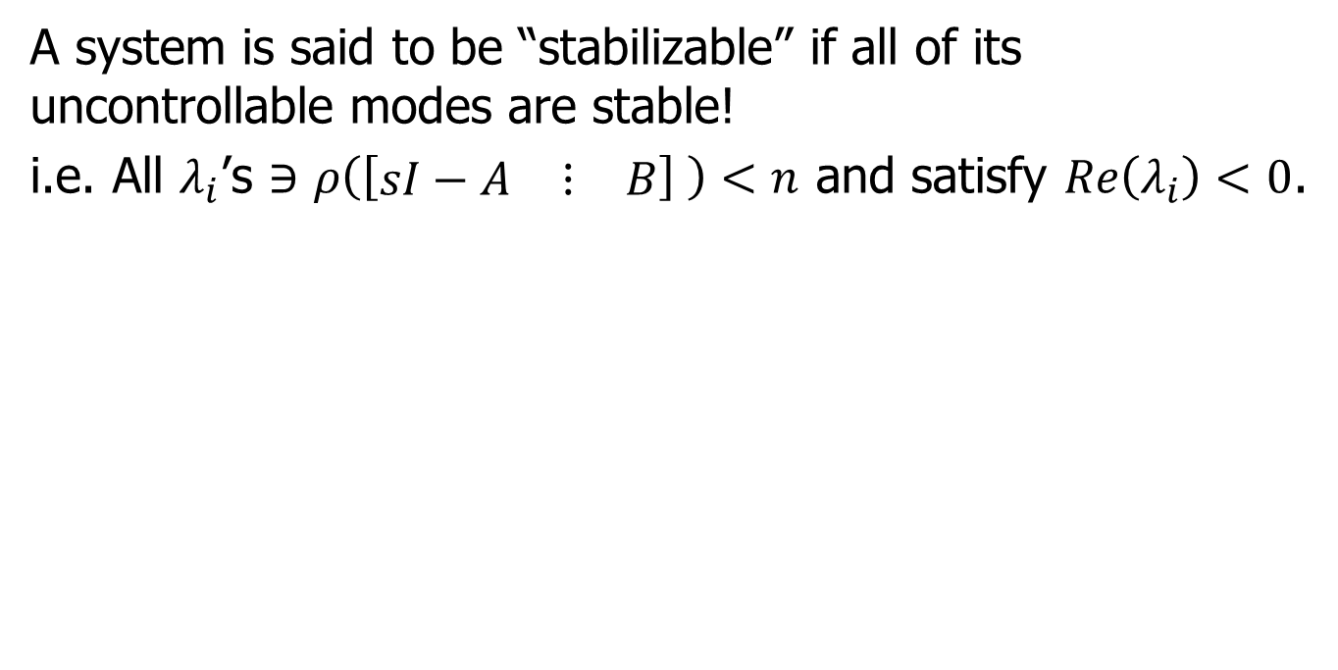
Stabilizability
A system is said to be “stabilizable” if all of its uncontrollable modes are stable!
i.e. All $λ_{i}$’s $∋$ $ρ\left(\left[\begin{matrix}sI−A & ⋮ & B\end{matrix}\right] \right)<n$ and satisfy $Re\left(λ_{i}\right)<0$.

Slide 3
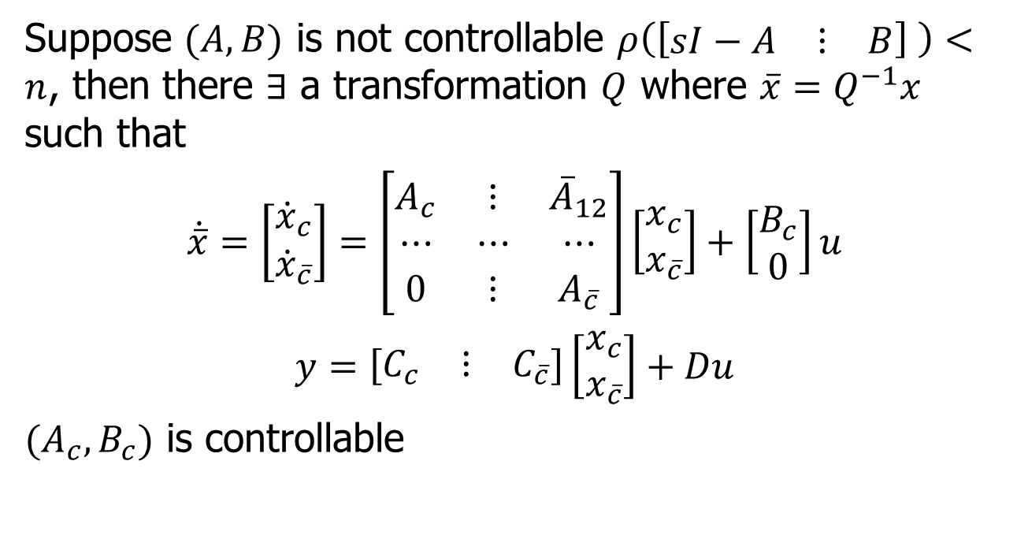
Controllable Canonical Decomposition
Suppose $(A,B)$ is not controllable $ρ\left(\left[\begin{matrix}sI−A & ⋮ & B\end{matrix}\right] \right)<n$, then there $∃$ a transformation $Q$ where $\overline{x}=Q^{−1}x$ such that
$$\dot{\overline{x}}=\left[\begin{matrix}{\dot{x}}_{c} \\ {\dot{x}}_{\overline{c}}\end{matrix}\right]=\left[\begin{matrix}A_{c} & ⋮ & {\overline{A}}_{12} \\ ⋯ & ⋯ & ⋯ \\ 0 & ⋮ & A_{\overline{c}}\end{matrix}\right]\left[\begin{matrix}x_{c} \\ x_{\overline{c}}\end{matrix}\right]+\left[\begin{matrix}B_{c} \\ 0\end{matrix}\right]u$$
$$y=\left[\begin{matrix}C_{c} & ⋮ & C_{\overline{c}}\end{matrix}\right]\left[\begin{matrix}x_{c} \\ x_{\overline{c}}\end{matrix}\right]+Du$$
$(A_{c}, B_{c})$ is controllable

Slide 4
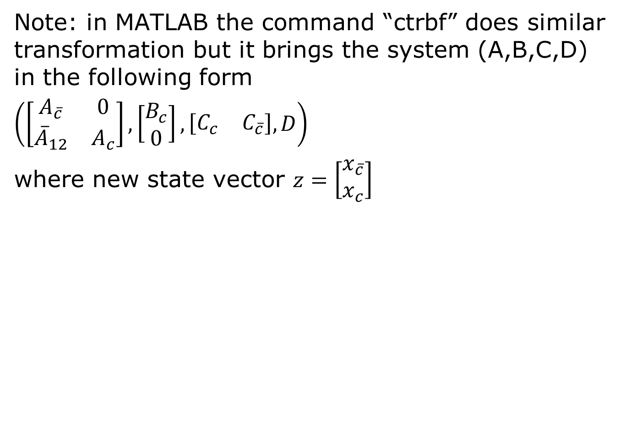
Controllable Canonical Decomposition in MATLAB
Note: in MATLAB the command “ctrbf” does similar transformation but it brings the system (A,B,C,D) in the following form
$\left(\left[\begin{matrix}A_{\overline{c}} & 0 \\ {\overline{A}}_{12} & A_{c}\end{matrix}\right],\left[\begin{matrix}B_{c} \\ 0\end{matrix}\right],\left[\begin{matrix}C_{c} & C_{\overline{c}}\end{matrix}\right], D\right)$
where new state vector $z=\left[\begin{matrix}x_{\overline{c}} \\ x_{c}\end{matrix}\right]$

Slide 5
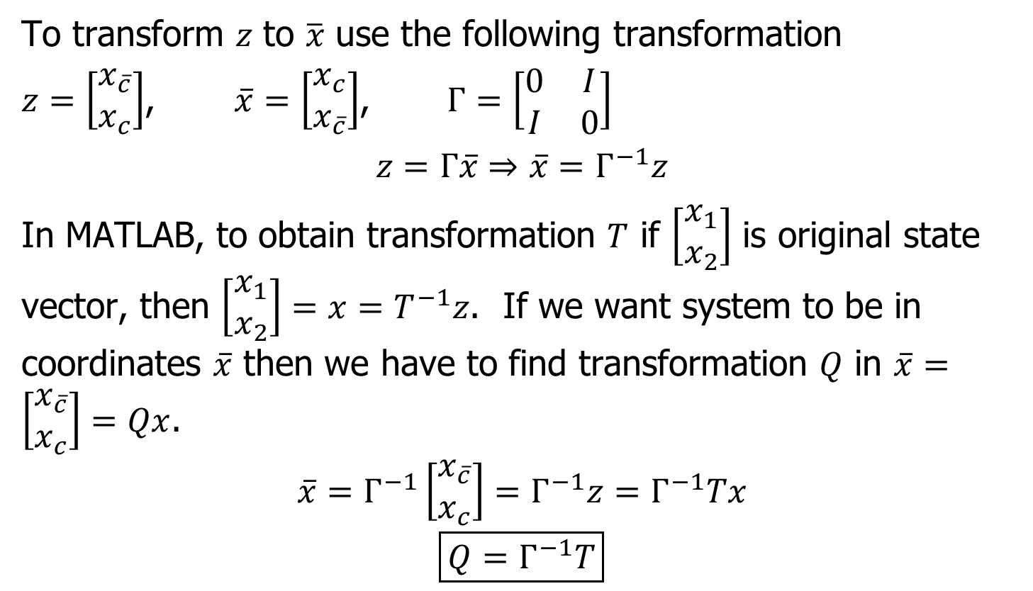
Controllable Canonical Decomposition in MATLAB
To transform $z$ to $\overline{x}$ use the following transformation
$z=\left[\begin{matrix}x_{\overline{c}} \\ x_{c}\end{matrix}\right]$, $\overline{x}=\left[\begin{matrix}x_{c} \\ x_{\overline{c}}\end{matrix}\right]$, $Γ=\left[\begin{matrix}0 & I \\ I & 0\end{matrix}\right]$
$$z=Γ\overline{x}⇒\overline{x}=Γ^{−1}z$$
In MATLAB, to obtain transformation $T$ if $\left[\begin{matrix}x_{1} \\ x_{2}\end{matrix}\right]$ is original state vector, then $\left[\begin{matrix}x_{1} \\ x_{2}\end{matrix}\right]=x=T^{−1}z$. If we want system to be in coordinates $\overline{x}$ then we have to find transformation $Q$ in $\overline{x}=\left[\begin{matrix}x_{\overline{c}} \\ x_{c}\end{matrix}\right]=Qx$.
$$\overline{x}=Γ^{−1}\left[\begin{matrix}x_{\overline{c}} \\ x_{c}\end{matrix}\right]=Γ^{−1}z=Γ^{−1}Tx$$
$$\boxed{Q=Γ^{−1}T}$$

Slide 6
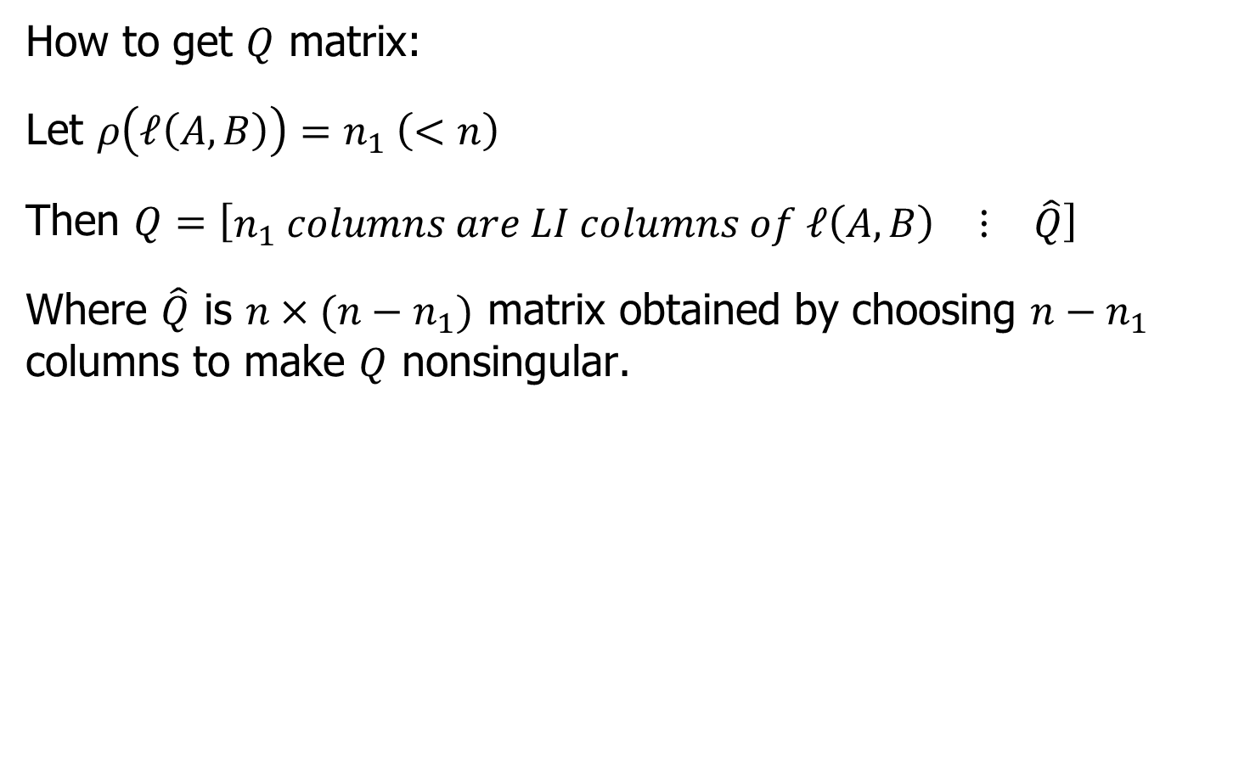
Controllable Canonical Decomposition
How to get $Q$ matrix:
Let $ρ\left(ℓ\left(A,B\right)\right)=n_{1} \left(<n\right)$
Then $Q=\left[\begin{matrix}n_{1} columns are LI columns of ℓ\left(A,B\right) & ⋮ & \hat{Q}\end{matrix}\right]$
Where $\hat{Q}$ is $n×(n−n_{1})$ matrix obtained by choosing $n−n_{1}$ columns to make $Q$ nonsingular.

Slide 7
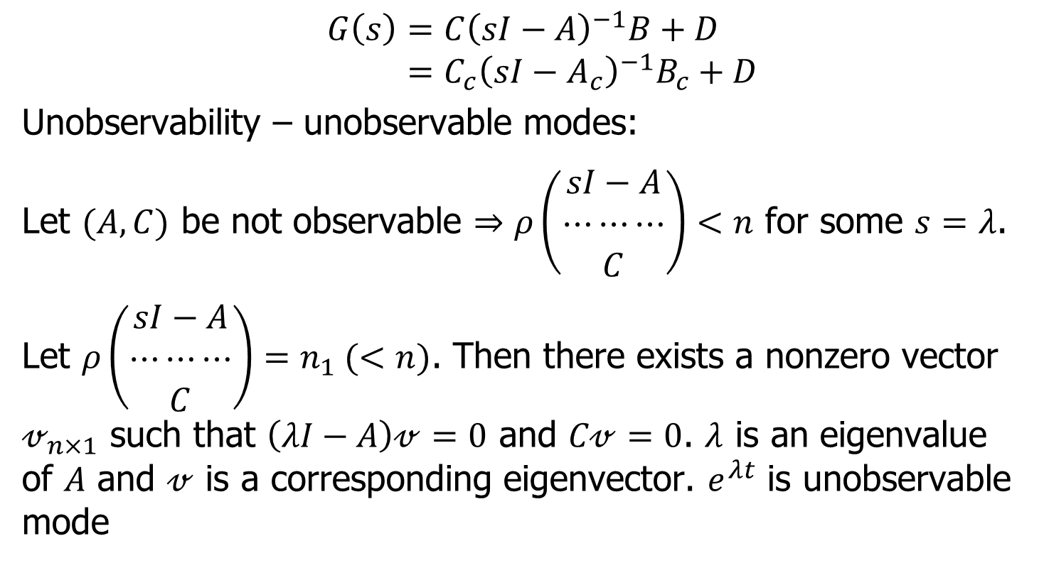
Observable Canonical Decomposition
$$G\left(s\right)=C{\left(sI−A\right)}^{−1}B+D \\ =C_{c}{\left(sI−A_{c}\right)}^{−1}B_{c}+D$$
Unobservability – unobservable modes:
Let $(A,C)$ be not observable $⇒ρ\left(\begin{matrix}sI−A \\ ⋯⋯⋯ \\ C\end{matrix}\right)<n$ for some $s=λ$.
Let $ρ\left(\begin{matrix}sI−A \\ ⋯⋯⋯ \\ C\end{matrix}\right)=n_{1} (<n)$. Then there exists a nonzero vector $𝓋_{n×1}$ such that $\left(λI−A\right)𝓋=0$ and $C𝓋=0$. $λ$ is an eigenvalue of $A$ and $𝓋$ is a corresponding eigenvector. $e^{λt}$ is unobservable mode

Slide 8
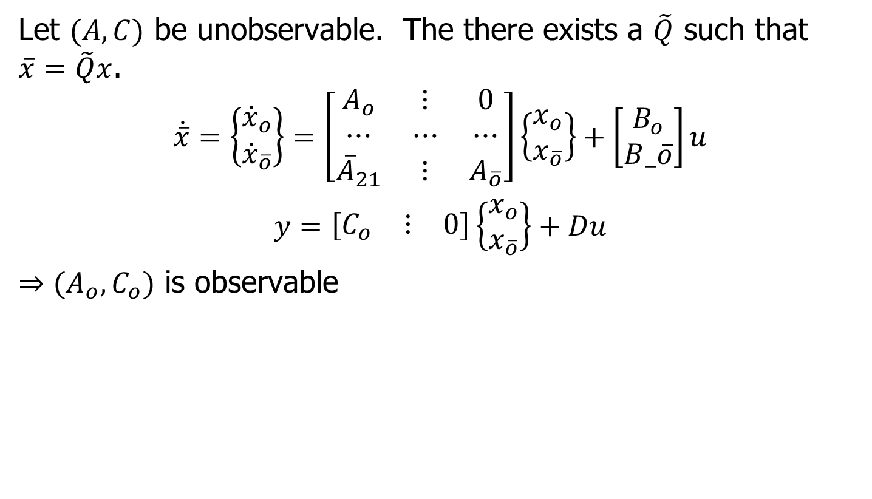
Observability Canonical Decomposition
Let $(A,C)$ be unobservable. The there exists a $\tilde{Q}$ such that $\overline{x}=\tilde{Q}x$.
$$\dot{\overline{x}}=\left\{\begin{matrix}{\dot{x}}_{o} \\ {\dot{x}}_{\overline{o}}\end{matrix}\right\}=\left[\begin{matrix}A_{o} & ⋮ & 0 \\ ⋯ & ⋯ & ⋯ \\ {\overline{A}}_{21} & ⋮ & A_{\overline{o}}\end{matrix}\right]\left\{\begin{matrix}x_{o} \\ x_{\overline{o}}\end{matrix}\right\}+\left[\begin{matrix}B_{o} \\ B_\overline{o}\end{matrix}\right]u$$
$$y=\left[\begin{matrix}C_{o} & ⋮ & 0\end{matrix}\right]\left\{\begin{matrix}x_{o} \\ x_{\overline{o}}\end{matrix}\right\}+Du$$
$⇒(A_{o},C_{o})$ is observable

Slide 9
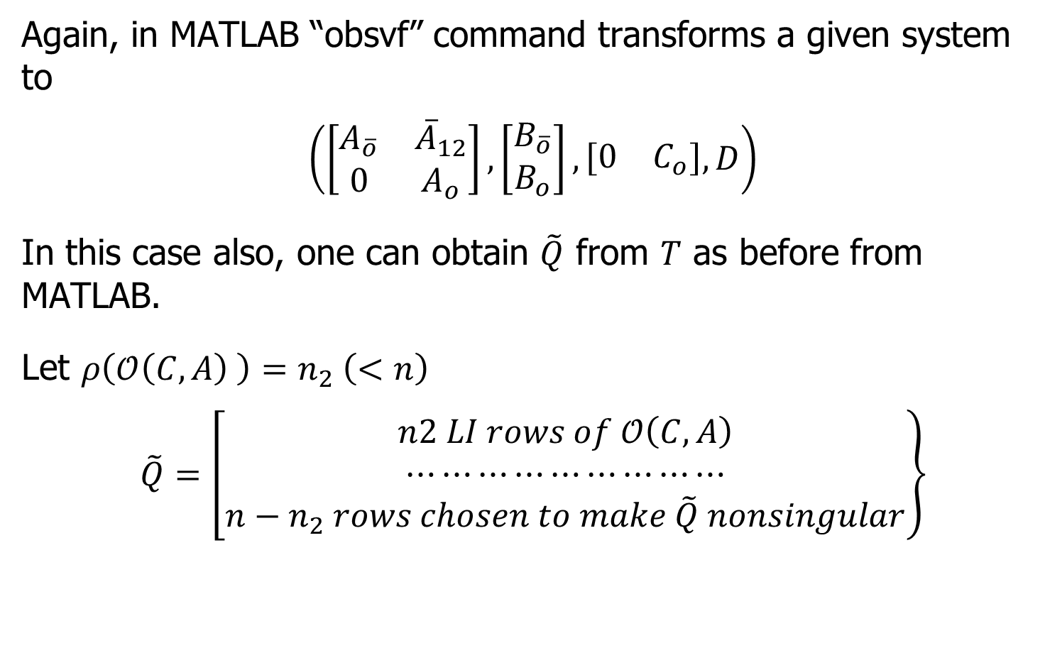
Observability Canonical Decomposition in MATLAB
Again, in MATLAB “obsvf” command transforms a given system to
$$\left(\left[\begin{matrix}A_{\overline{o}} & {\overline{A}}_{12} \\ 0 & A_{o}\end{matrix}\right],\left[\begin{matrix}B_{\overline{o}} \\ B_{o}\end{matrix}\right],\left[\begin{matrix}0 & C_{o}\end{matrix}\right], D\right)$$
In this case also, one can obtain $\tilde{Q}$ from $T$ as before from MATLAB.
Let $ρ\left(𝒪\left(C,A\right) \right)=n_{2} \left(<n\right)$
$$\tilde{Q}=\left[\begin{matrix}n2 LI rows of 𝒪\left(C,A\right) \\ ⋯⋯⋯⋯⋯⋯⋯⋯⋯ \\ n−n_{2} rows chosen to make \tilde{Q} nonsingular\end{matrix}\right\}$$

Slide 10
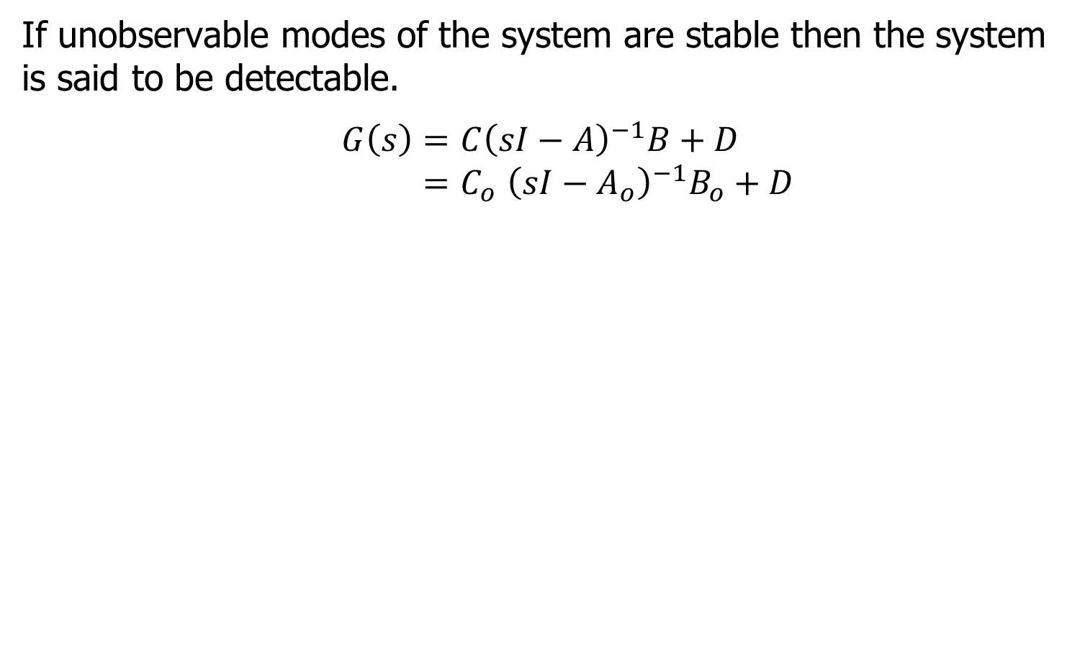
Detectability
If unobservable modes of the system are stable then the system is said to be detectable.
$$G\left(s\right)=C{\left(sI−A\right)}^{−1}B+D \\ {=C}_{o}{\left(sI−A_{o}\right)}^{−1}B_{o}+D$$

Slide 11
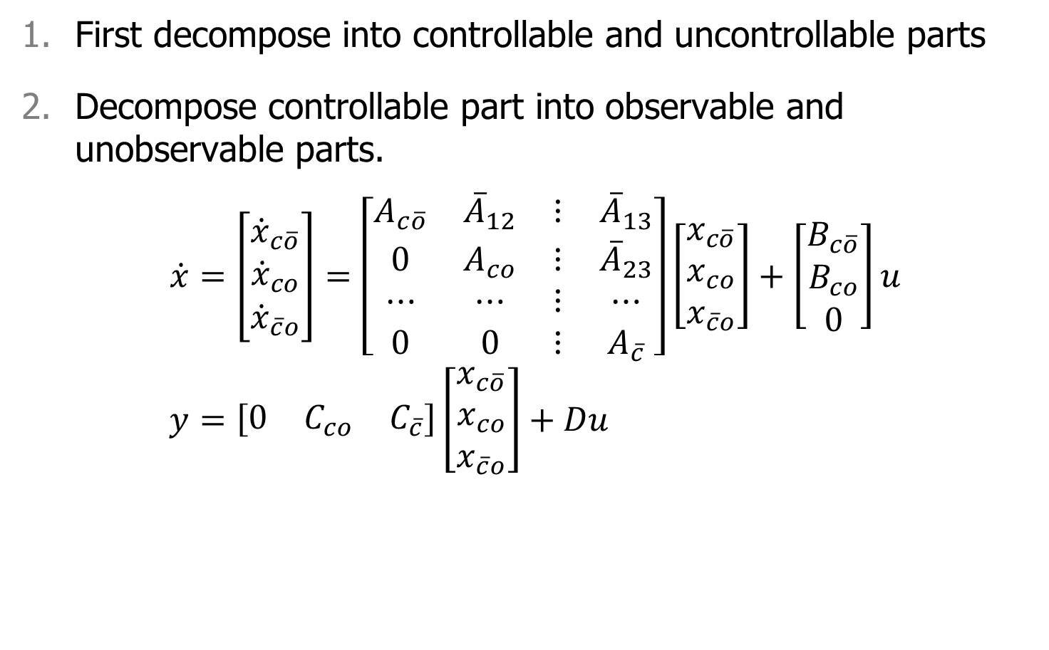
Controllable-observable Decomposition
First decompose into controllable and uncontrollable parts
Decompose controllable part into observable and unobservable parts.
$$\dot{x}=\left[\begin{matrix}{\dot{x}}_{c\overline{o}} \\ {\dot{x}}_{co} \\ {\dot{x}}_{\overline{c}o}\end{matrix}\right]=\left[\begin{matrix}A_{c\overline{o}} & {\overline{A}}_{12} & ⋮ & {\overline{A}}_{13} \\ 0 & A_{co} & ⋮ & {\overline{A}}_{23} \\ ⋯ & ⋯ & ⋮ & ⋯ \\ 0 & 0 & ⋮ & A_{\overline{c}}\end{matrix}\right]\left[\begin{matrix}x_{c\overline{o}} \\ x_{co} \\ x_{\overline{c}o}\end{matrix}\right]+\left[\begin{matrix}B_{c\overline{o}} \\ B_{co} \\ 0\end{matrix}\right]u \\ y=\left[\begin{matrix}0 & C_{co} & C_{\overline{c}}\end{matrix}\right]\left[\begin{matrix}x_{c\overline{o}} \\ x_{co} \\ x_{\overline{c}o}\end{matrix}\right]+Du$$

Slide 12
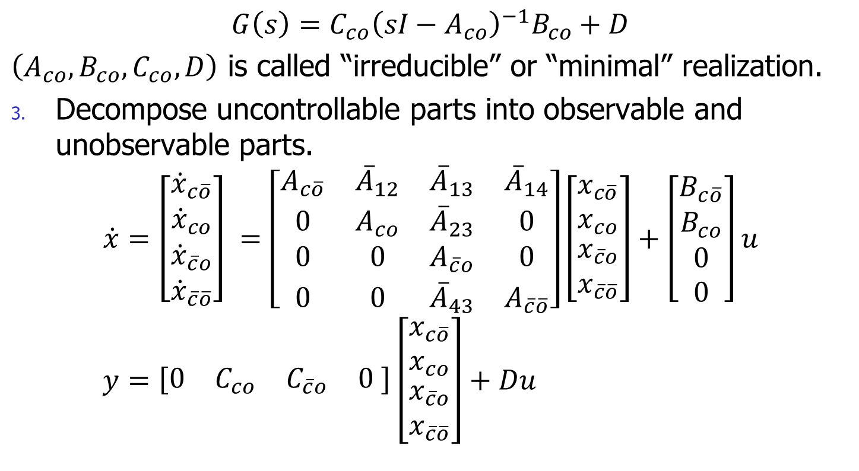
Controllable-observable Decomposition
$$G\left(s\right)=C_{co}{\left(sI−A_{co}\right)}^{−1}B_{co}+D$$
$\left(A_{co},B_{co},C_{co},D\right)$ is called “irreducible” or “minimal” realization.
Decompose uncontrollable parts into observable and unobservable parts.
$$\dot{x}=\left[\begin{matrix}{\dot{x}}_{c\overline{o}} \\ {\dot{x}}_{co} \\ \begin{aligned}{\dot{x}}_{\overline{c}o} \\ {\dot{x}}_{\overline{c}\overline{o}}\end{aligned}\end{matrix}\right] =\left[\begin{matrix}A_{c\overline{o}} & {\overline{A}}_{12} & {\overline{A}}_{13} & {\overline{A}}_{14} \\ 0 & A_{co} & {\overline{A}}_{23} & 0 \\ 0 & 0 & A_{\overline{c}o} & 0 \\ 0 & 0 & {\overline{A}}_{43} & A_{\overline{c}\overline{o}}\end{matrix}\right]\left[\begin{matrix}x_{c\overline{o}} \\ x_{co} \\ \begin{aligned}x_{\overline{c}o} \\ x_{\overline{c}\overline{o}}\end{aligned}\end{matrix}\right]+\left[\begin{matrix}B_{c\overline{o}} \\ B_{co} \\ \begin{aligned}0 \\ 0\end{aligned}\end{matrix}\right]u \\ y=\left[\begin{matrix}0 & C_{co} & C_{\overline{c}o} & 0 \end{matrix}\right]\left[\begin{matrix}x_{c\overline{o}} \\ x_{co} \\ \begin{aligned}x_{\overline{c}o} \\ x_{\overline{c}\overline{o}}\end{aligned}\end{matrix}\right]+Du$$

Slide 13






Controllable-observable Decomposition
Block diagram of Controllable-observable Decomposition
$$C\overline{O}$$
$$u$$
$$y$$
$$CO$$
$$\overline{C}O$$
$$\overline{C}\overline{O}$$

Slide 14
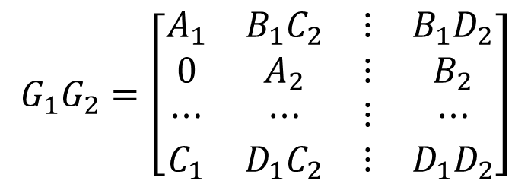





Composite Systems
Notation: $G\left(s\right)∼\left[\begin{matrix}A & ⋮ & B \\ ⋯ & ⋯ & ⋯ \\ C & ⋮ & D\end{matrix}\right]$
Series connection:
$$u$$
$$y$$
$$G_{2}$$
$$G_{1}$$
$$G_{1}G_{2}=\left[\begin{matrix}A_{1} & B_{1}C_{2} & ⋮ & B_{1}D_{2} \\ 0 & A_{2} & ⋮ & B_{2} \\ ⋯ & ⋯ & ⋮ & ⋯ \\ C_{1} & D_{1}C_{2} & ⋮ & D_{1}D_{2}\end{matrix}\right]$$

Slide 15







Parallel Connection
$$G_{1}$$
$$u$$
$$y$$
$$+$$
$$+$$
$$G_{2}$$
$$=\left[\begin{matrix}A_{1} & 0 & ⋮ & B_{1} \\ 0 & A_{2} & ⋮ & B_{2} \\ ⋯ & ⋯ & ⋮ & ⋯ \\ C_{1} & C_{2} & ⋮ & D_{1}+D_{2}\end{matrix}\right]$$

Slide 16



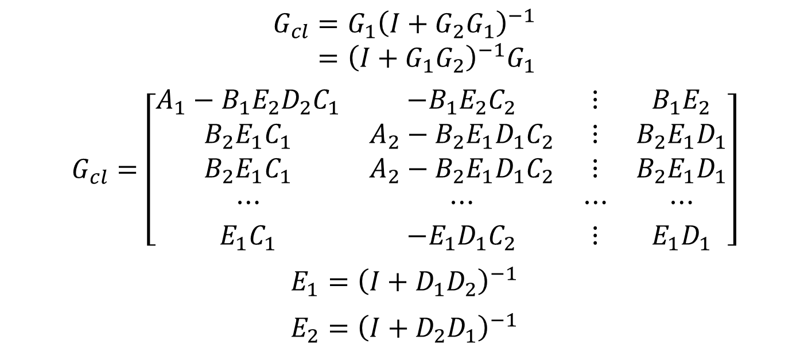



Feedback Connection
$$u$$
$$y$$
$$+$$
$$G_{1}$$
$$+$$
$$G_{2}$$
$$G_{cl}=G_{1}{\left(I+G_{2}G_{1}\right)}^{−1} \\ ={\left(I+G_{1}G_{2}\right)}^{−1}G_{1}$$
$$G_{cl}=\left[\begin{matrix}A_{1}−B_{1}E_{2}D_{2}C_{1} & −B_{1}E_{2}C_{2} & ⋮ & B_{1}E_{2} \\ B_{2}E_{1}C_{1} & A_{2}−B_{2}E_{1}D_{1}C_{2} & ⋮ & B_{2}E_{1}D_{1} \\ B_{2}E_{1}C_{1} & A_{2}−B_{2}E_{1}D_{1}C_{2} & ⋮ & B_{2}E_{1}D_{1} \\ ⋯ & ⋯ & ⋯ & ⋯ \\ E_{1}C_{1} & −E_{1}D_{1}C_{2} & ⋮ & E_{1}D_{1}\end{matrix}\right]$$
$$E_{1}={\left(I+D_{1}D_{2}\right)}^{−1}$$
$$E_{2}={\left(I+D_{2}D_{1}\right)}^{−1}$$

Slide 17



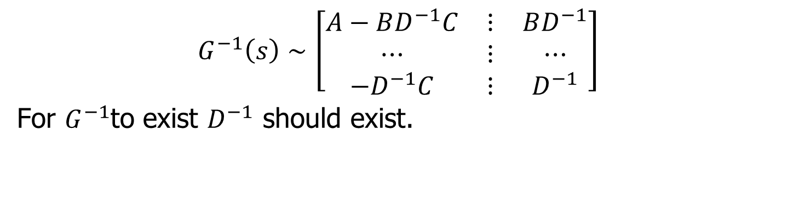



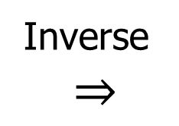
Inverse System
Inverse
$$⇒$$
$$u$$
$$u$$
$$y$$
$$y$$
$$G(s)$$
$$G^{−1}(s)$$
$$G^{−1}\left(s\right)∼\left[\begin{matrix}A−BD^{−1}C & ⋮ & BD^{−1} \\ ⋯ & ⋮ & ⋯ \\ −D^{−1}C & ⋮ & D^{−1}\end{matrix}\right]$$
For $G^{−1}$to exist $D^{−1}$ should exist.

